Slide 1
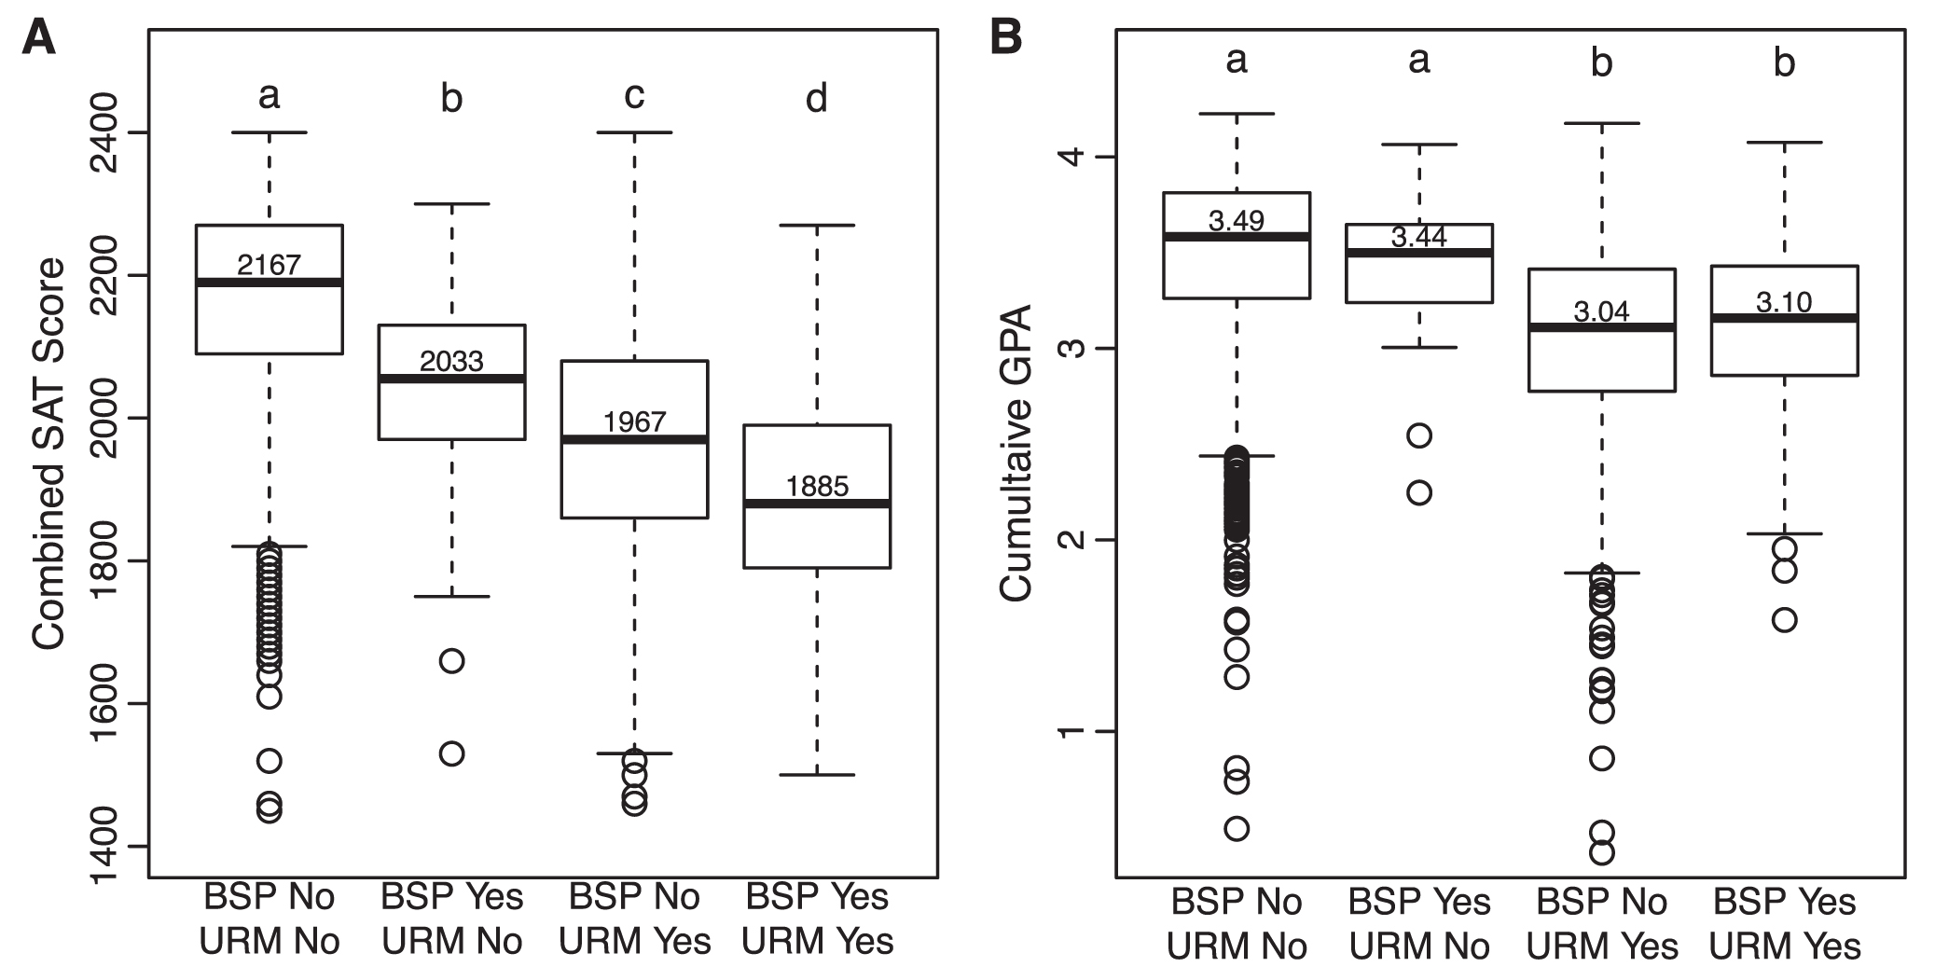
Figure 1. Differences in preparedness as estimated with the (a) combined SAT scores and (b) cumulative GPAs among ...
Notes:
Figure 1. Differences in preparedness as estimated with the (a) combined SAT scores and (b) cumulative GPAs among students who varied in minority status and participation in the Biology Scholars Program (BSP). The mean values are shown for each group above the median bar in the bar plot. The outliers are shown as circles. The significant differences in pairwise comparisons of least-squares means estimates are shown above each box plot. Abbreviation: URM, underrepresented racial minority.
Unless provided in the caption above, the following copyright applies to the content of this slide: © The Author(s) 2017. Published by Oxford University Press on behalf of the American Institute of Biological Sciences. All rights reserved. For permissions, please e-mail: journals.permissions@oup.com

Slide 2
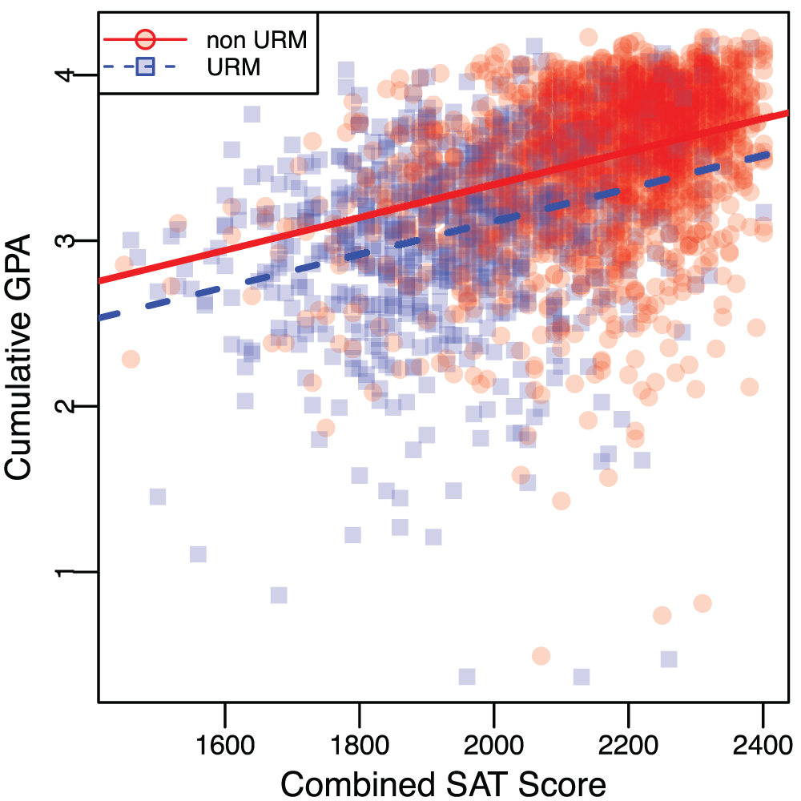
Figure 2. A scatterplot of combined SAT score and cumulative GPA, which shows a positive correlation between these two ...
Notes:
Figure 2. A scatterplot of combined SAT score and cumulative GPA, which shows a positive correlation between these two metrics. The red circles and the red dotted line represent non-URM students, whereas the blue squares and the blue dotted line represent URM students.
Unless provided in the caption above, the following copyright applies to the content of this slide: © The Author(s) 2017. Published by Oxford University Press on behalf of the American Institute of Biological Sciences. All rights reserved. For permissions, please e-mail: journals.permissions@oup.com

