Slide 1
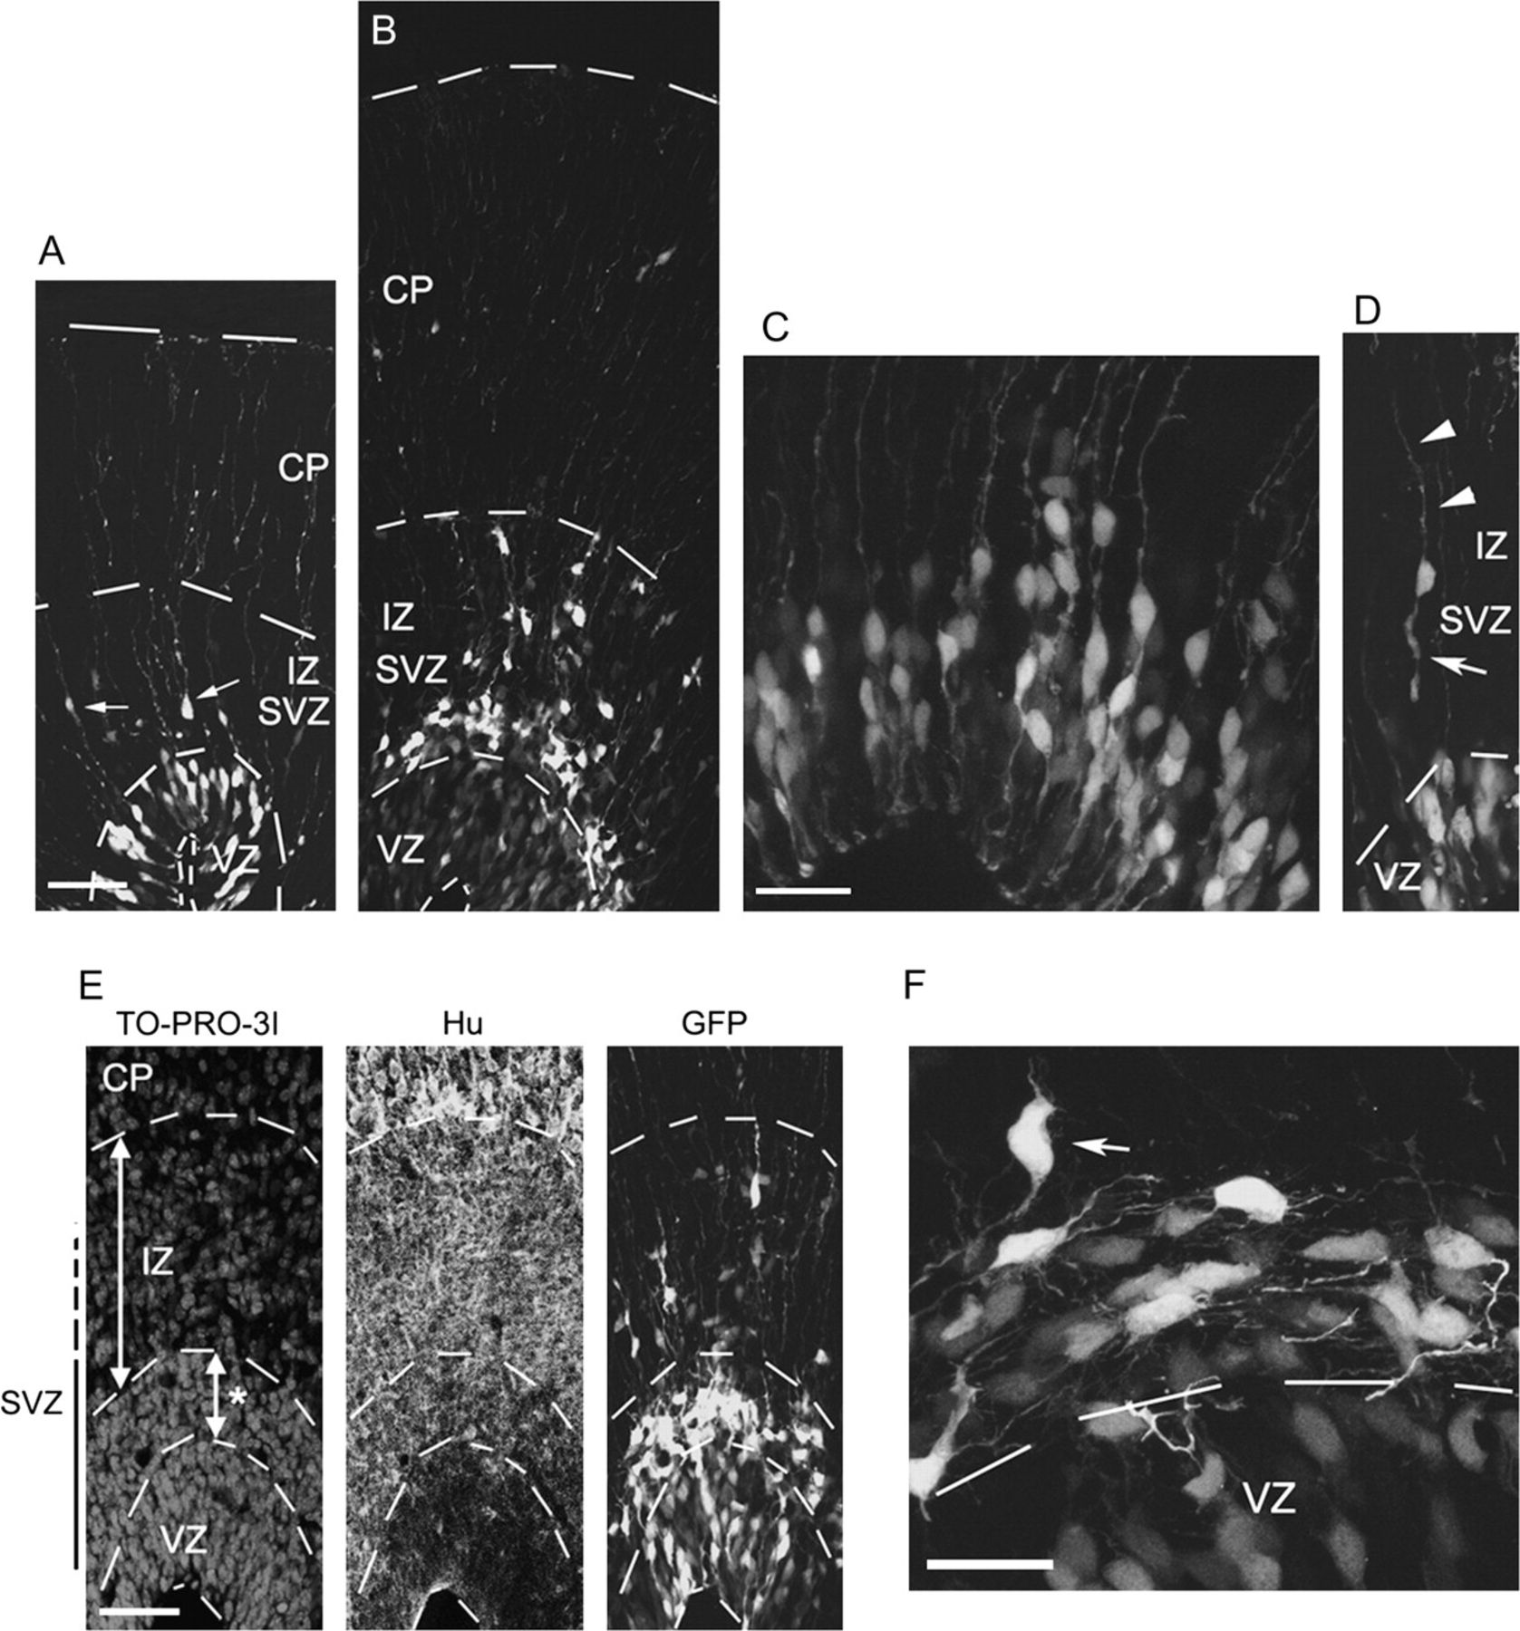
Figure 1. Morphological and positional differences of cells from the cortical VZ 12 or 36 h after labeling. (A-E) VZ ...
Notes:
Figure 1. Morphological and positional differences of cells from the cortical VZ 12 or 36 h after labeling. (A-E) VZ cells of the cerebral wall of the mouse embryos were transfected with GFP-expression vector at E16 and observed the GFP expression 12 h (A, C, D) and 36 h (B, E) later. At the 12-h time point, GFP expressing cells were mainly found in the VZ (A) but some were found in the IZ (arrows in A). High magnification view revealed that they took radial glial or pin-like morphology in the VZ (C), and STL morphology having an ascending process (arrowheads in D) and a retraction bulb (arrow in D) in the SVZ or IZ. At the 36-h time point, GFP-positive cells accumulated just above the VZ (B), where the cell density is high (showing nuclear staining using TO-PRO-3I) and HuC/D, a neuronal marker, is positive (“*” in the left E). (F) The high magnification image of GFP-positive cells in this region in the brains electroporated at E14.5 and fixed at E16 showed that they were multipolar cells extending the multiple processes tangentially. The arrow indicates the radially oriented cell having tangentially extended axon. The broken lines in (A), (B), (E) indicate the margin of tissues or borders between the VZ and SVZ, or between the IZ and CP. Because the upper border of the SVZ is not clear, it is shown with a broken vertical line. Scale bars: 50 μm in (A), (B), (D), (E) and 20 μm in (C), (F).
Unless provided in the caption above, the following copyright applies to the content of this slide: © The Author 2009. Published by Oxford University Press. All rights reserved. For permissions, please e-mail: journals.permissions@oxfordjournals.org

Slide 2
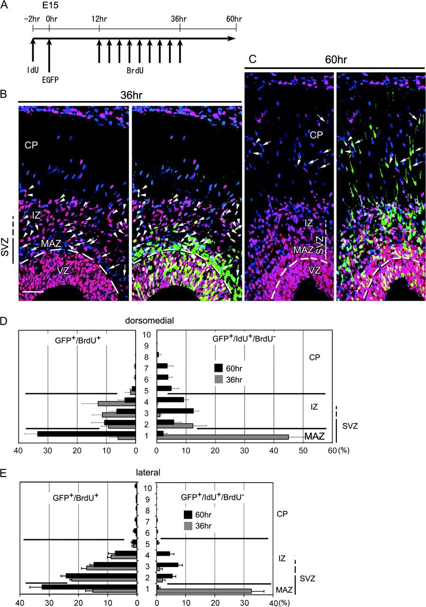
Figure 2. Postmitotic cells generated from VZ cells accumulated just above the VZ (=MAZ) as multipolar cells. (A) ...
Notes:
Figure 2. Postmitotic cells generated from VZ cells accumulated just above the VZ (=MAZ) as multipolar cells. (A) Experimental procedure to identify postmitotic cells generated from VZ cells in the specific period. (B, C) The brains after the experiment described in A were fixed at 36-h (B) and 60-h (C) time point, and then BrdU (magenta) and IdU (blue) were detected. Arrows and arrowheads indicate IdU+/GFP+/BrdU− cells (=the direct progeny of the VZ cells) and GFP+/BrdU+ cells, respectively. (D, E) The histograms of the distributions in dorsomedial (D) and lateral cerebral walls (E). SVZ/IZ, SVZ or IZ. Because the upper border of the SVZ is not clear, it is shown with a broken vertical line. Scale bar; (B) and (C), 50 μm.
Unless provided in the caption above, the following copyright applies to the content of this slide: © The Author 2009. Published by Oxford University Press. All rights reserved. For permissions, please e-mail: journals.permissions@oxfordjournals.org

Slide 3
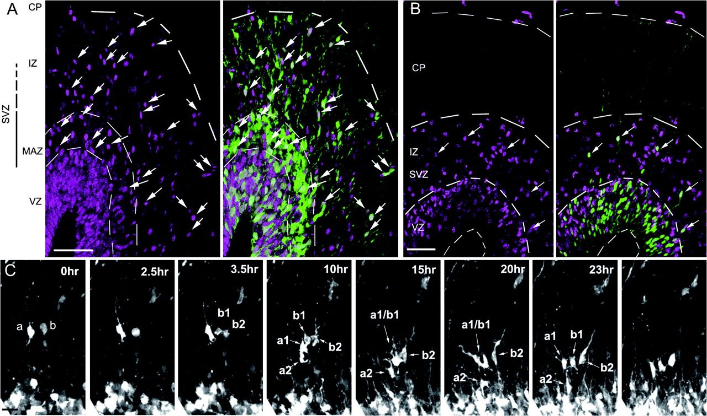
Figure 3. The REP has proliferative activity. (A) The immunostaining of PCNA (magenta) in the brains that were ...
Notes:
Figure 3. The REP has proliferative activity. (A) The immunostaining of PCNA (magenta) in the brains that were electroporated at E16 and fixed 36 h later. The left panel shows PCNA staining, and the right panel shows the merged image with GFP. The arrows indicate the GFP+/PCNA+ cells. The GFP-positive cells above the MAZ were frequently PCNA positive. (B) BrdU incorporation of GFP+ cells migrated out of the VZ by 12 h after electroporation. Embryos were electroporated at E16 and fixed 12 h later. BrdU was injected 30 min before fixation. The arrows indicate GFP+/BrdU+ cells in the SVZ/IZ. (C) The time-lapse observation of the SVZ/IZ cells on the brain electroporated at E14.5 and sliced 12 h after the electroporation. Cell “a” having STL morphology divided into cell “a1” and “a2,” and lost its ascending fiber. Cell “b” having no ascending process also divided into cell “b1” and “b2”. Scale bars; (A), (B); 50 μm, (C); 20 μm.
Unless provided in the caption above, the following copyright applies to the content of this slide: © The Author 2009. Published by Oxford University Press. All rights reserved. For permissions, please e-mail: journals.permissions@oxfordjournals.org

Slide 4
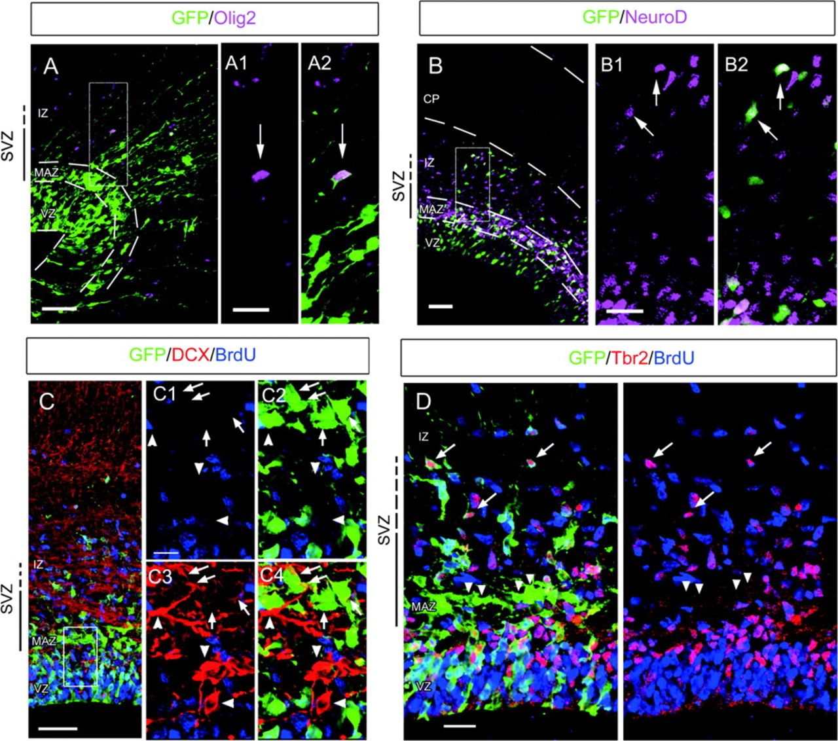
Figure 4. Characterization of the REP and SEP. (A, B) The brains electroporated at E15 and fixed 36 h later were ...
Notes:
Figure 4. Characterization of the REP and SEP. (A, B) The brains electroporated at E15 and fixed 36 h later were stained with anti-Olig2 (A, A1, 2, magenta) and anti-NeuroD1 (B, B1, 2, magenta), respectively. The boxed regions of (A) and (B) are shown in A2 and B2. A1 and B1 show the images without GFP signals. A few GFP-positive cells in the IZ were positive for Olig2 (arrows in A1, 2), but the major population was positive for NeuroD (arrows in B1, 2). (C, D) The brains fixed at the 36-h time point after the experiment described in Figure 2A were subjected to immunostaining for doublecortin (DCX, C, red) or Tbr2 (D, red) together with GFP (green) and BrdU (blue). The boxed region of C is shown in C1–4 in different channel combinations. The expression of DCX in the GFP-positive/BrdU-negative cells (= SEP) was detected (arrows). The morphological features of cells that were strongly positive for DCX but negative for GFP in the VZ or MAZ suggest that they are tangentially migrating interneurons (arrowheads). (D) The merged image is shown in the left panel and the image without GFP signals in the same field is shown in the right panel. The GFP+/BrdU- cells (=SEP, arrowheads) were negative or, if any, only faintly positive for Tbr2, whereas a subset of GFP+/BrdU+ cells in the IZ (=REP, arrows) was strongly positive. Because the upper border of the SVZ is not clear, it is shown with a broken vertical line. Scale bars; A, B, C; 50 μm, C1–4; 10 μm, A1, A2, B1, B2, D; 20 μm.
Unless provided in the caption above, the following copyright applies to the content of this slide: © The Author 2009. Published by Oxford University Press. All rights reserved. For permissions, please e-mail: journals.permissions@oxfordjournals.org

Slide 5
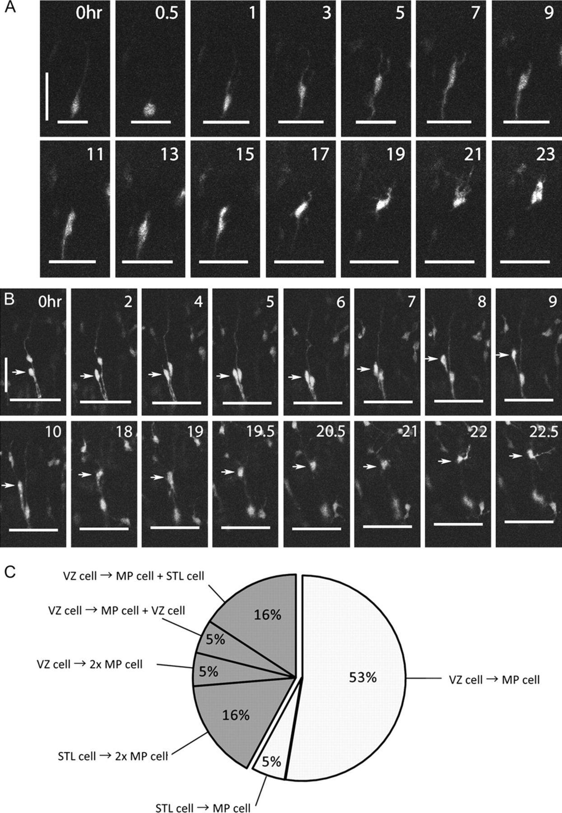
Figure 5. Transformation of the postmitotic cells in the VZ, which is identified as the SEP, into the multipolar cells. ...
Notes:
Figure 5. Transformation of the postmitotic cells in the VZ, which is identified as the SEP, into the multipolar cells. (A, B) Time-lapse analyses showing the generation of multipolar cells from the radial VZ cells without further mitosis. GFP-retrovirus was injected at E15.5 and slices were prepared 18 h later. A pin-like cell is pointed by arrows (B). The short horizontal lines represent the luminal surface of the VZ. (C) Classification of the multipolar cell formation. MP, multipolar. Scale bars; 50 μm.
Unless provided in the caption above, the following copyright applies to the content of this slide: © The Author 2009. Published by Oxford University Press. All rights reserved. For permissions, please e-mail: journals.permissions@oxfordjournals.org

Slide 6
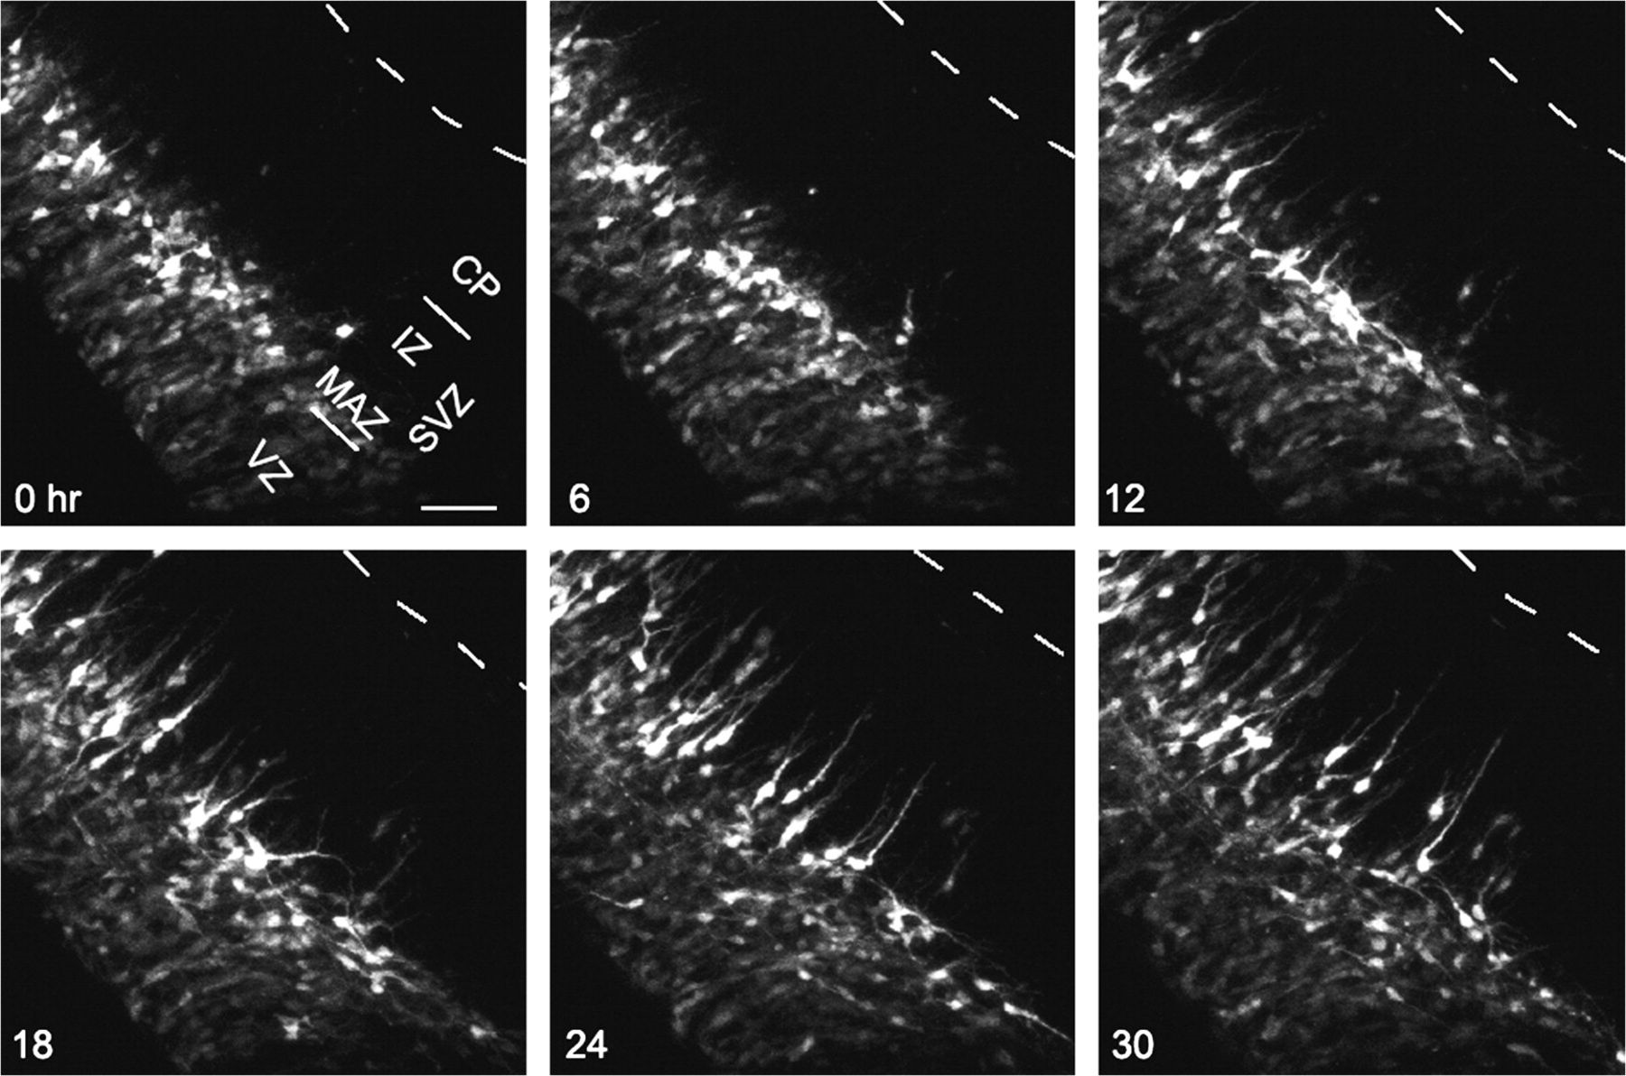
Figure 6. Transformation of multipolar cells in the MAZ into locomotion cells. The brains electroporated at E14.5 was ...
Notes:
Figure 6. Transformation of multipolar cells in the MAZ into locomotion cells. The brains electroporated at E14.5 was sliced at E15.5 and observed using a confocal microscope. The broken lines indicate the margin of the tissue. Scale bar; 50 μm.
Unless provided in the caption above, the following copyright applies to the content of this slide: © The Author 2009. Published by Oxford University Press. All rights reserved. For permissions, please e-mail: journals.permissions@oxfordjournals.org

Slide 7
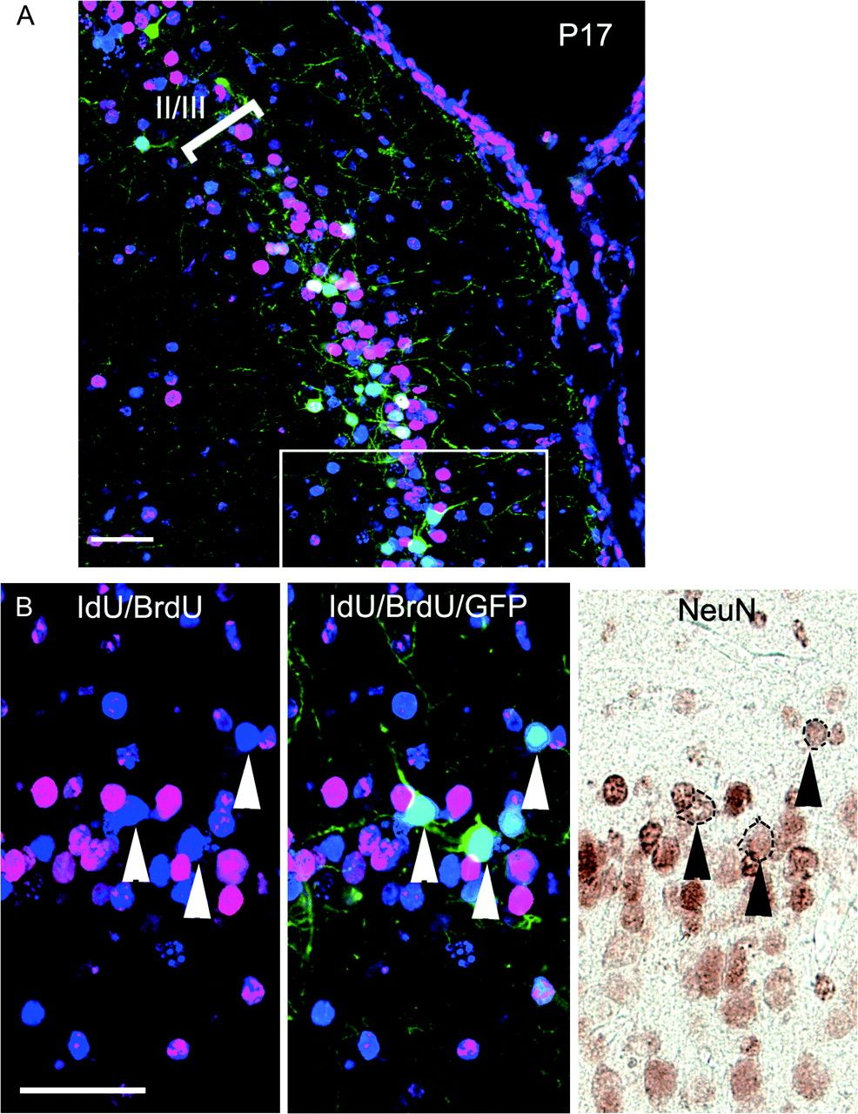
Figure 7. Final fate of postmitotic cells generated within the VZ (SEP). (A) SEP-derived cells identified as ...
Notes:
Figure 7. Final fate of postmitotic cells generated within the VZ (SEP). (A) SEP-derived cells identified as GFP+/IdU+/BrdU− using the method described in Figure 2A were mainly found in layers II/III. (B) NeuN expression in SEP-derived cells. The boxed region in (A) is shown in the left and middle (B). Arrowheads indicate SEP-derived cells. After took fluorescent images of GFP, IdU, and BrdU, the sections were further stained with anti-NeuN, a marker for mature neurons, using peroxidase and diaminobentidine, and the same visual field was observed (right panel). Scale bars: 50 μm.
Unless provided in the caption above, the following copyright applies to the content of this slide: © The Author 2009. Published by Oxford University Press. All rights reserved. For permissions, please e-mail: journals.permissions@oxfordjournals.org

Slide 8
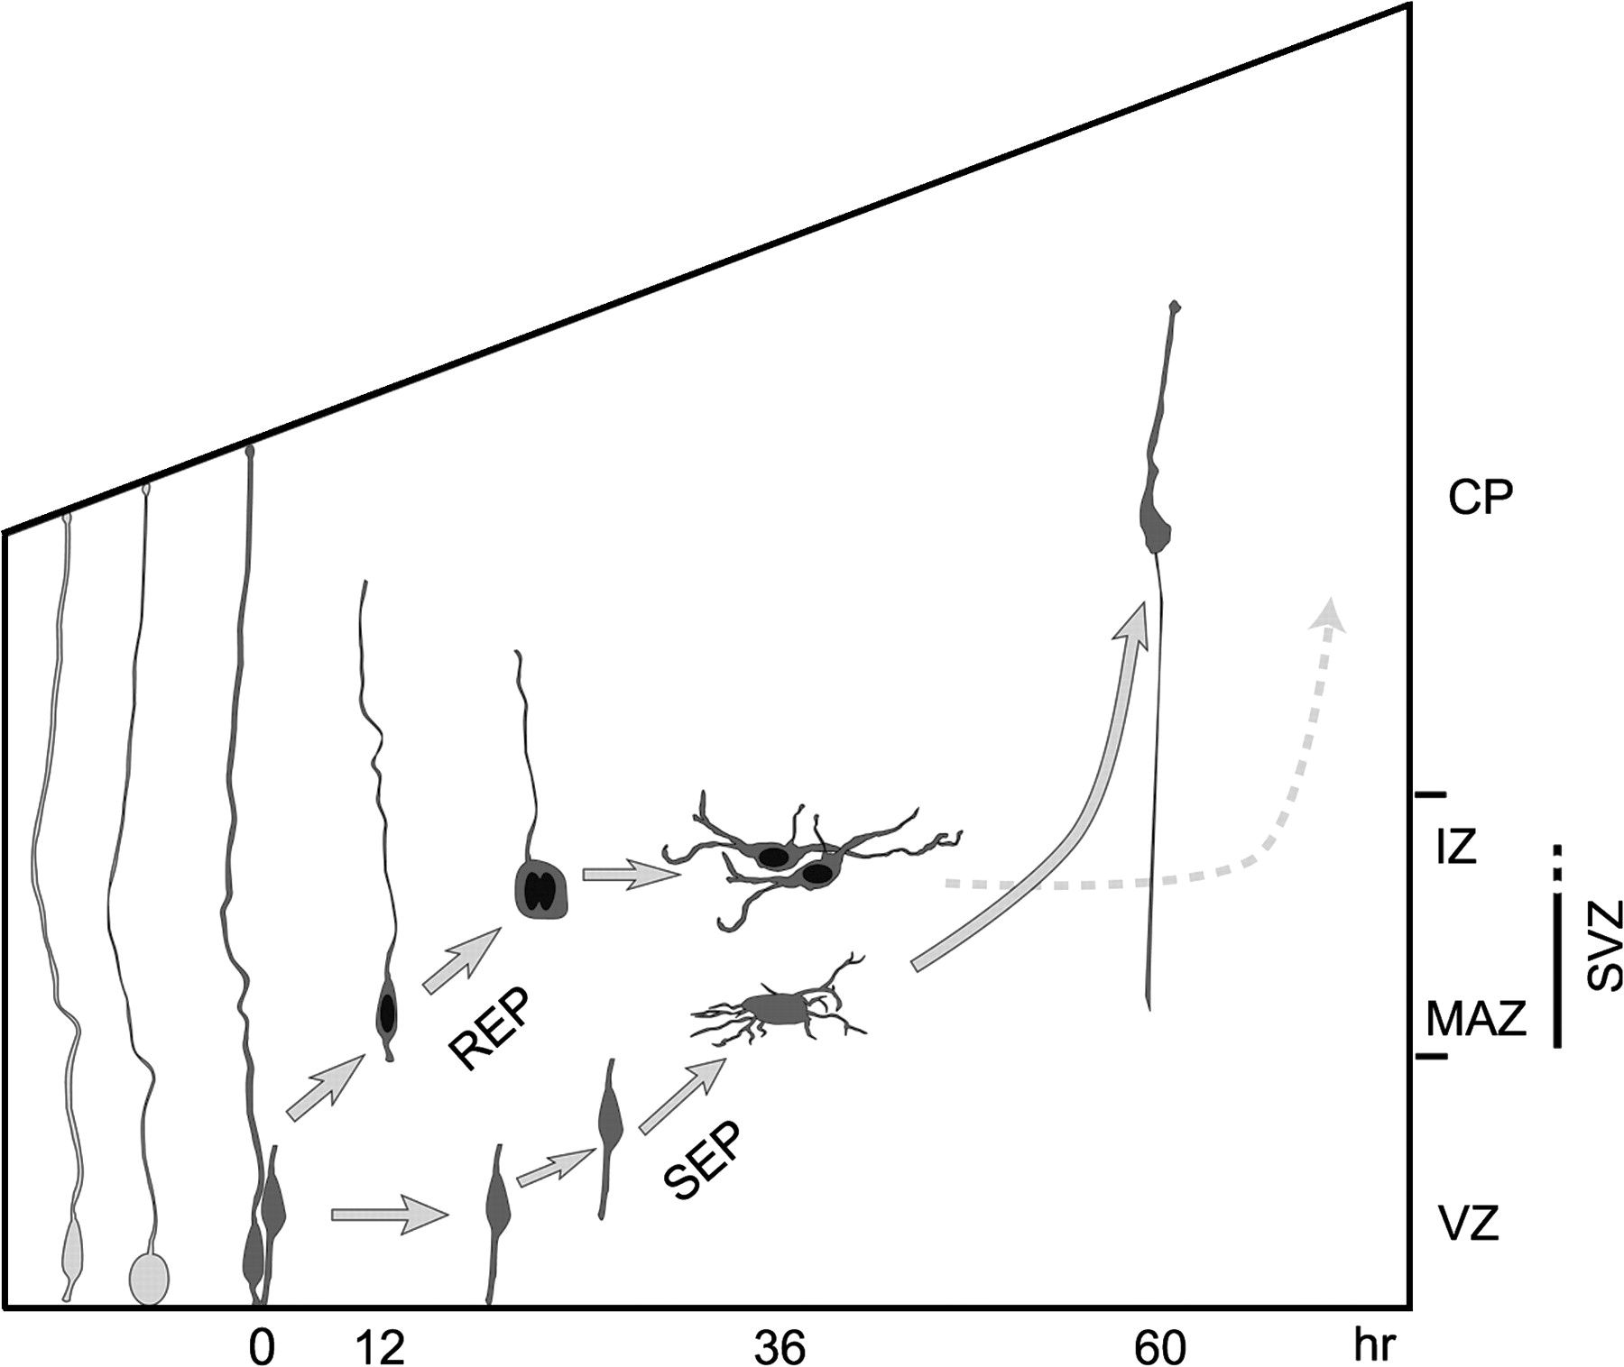
Figure 8. Model of the migratory behavior of REP and SEP cells. The cell bodies of GFP-positive cells are shown in ...
Notes:
Figure 8. Model of the migratory behavior of REP and SEP cells. The cell bodies of GFP-positive cells are shown in gray, and the BrdU-positive nuclei are shown in black.
Unless provided in the caption above, the following copyright applies to the content of this slide: © The Author 2009. Published by Oxford University Press. All rights reserved. For permissions, please e-mail: journals.permissions@oxfordjournals.org

