Slide 1
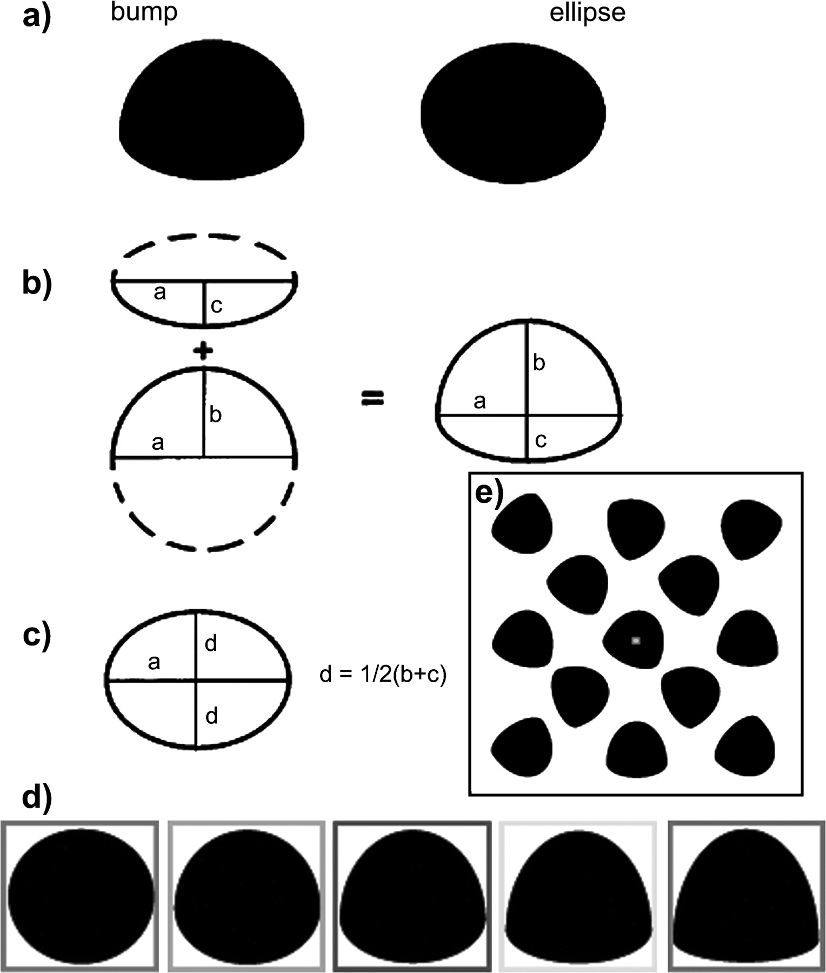
Figure 1. Bumps. (a) A bump and an ellipse. (b) The bumps were constructed by combining the bottom half of an ellipse ...
Notes:
Figure 1. Bumps. (a) A bump and an ellipse. (b) The bumps were constructed by combining the bottom half of an ellipse of major axis a and minor axis b and the top half of an ellipse with a common major axis and different minor axis c. The bumps contain a CC discontinuity along the contour where the 2 component half-ellipses meet. (c) The bump has major axis a and minor axis b + c. The ellipse has the same major axis a and minor axis 2d. By choosing (b + c) = 2d, the widths and heights of the bumps and ellipses are exactly the same because 2d = b + c. Moreover, the areas of the bumps and ellipses are identical because π × a(2d) = π × a(b + c). (d) By increasing the ratio between b and c while preserving (b + c) = 2d, the degree of CC discontinuity can be modulated while preserving the area of the stimulus. The color of the bounding box distinguishes the individual stimuli that made up each presentation group used in experiment 1. (e) In each presentation block, a set of 13 individual black stimuli was rotated against a white background. The initial orientation and direction of rotation for each stimulus was randomly determined. Subjects were required to maintain fixation on a central square whose color periodically changed.
Unless provided in the caption above, the following copyright applies to the content of this slide: © The Author 2006. Published by Oxford University Press. All rights reserved. For permissions, please e-mail: journals.permissions@oxfordjournals.org

Slide 2
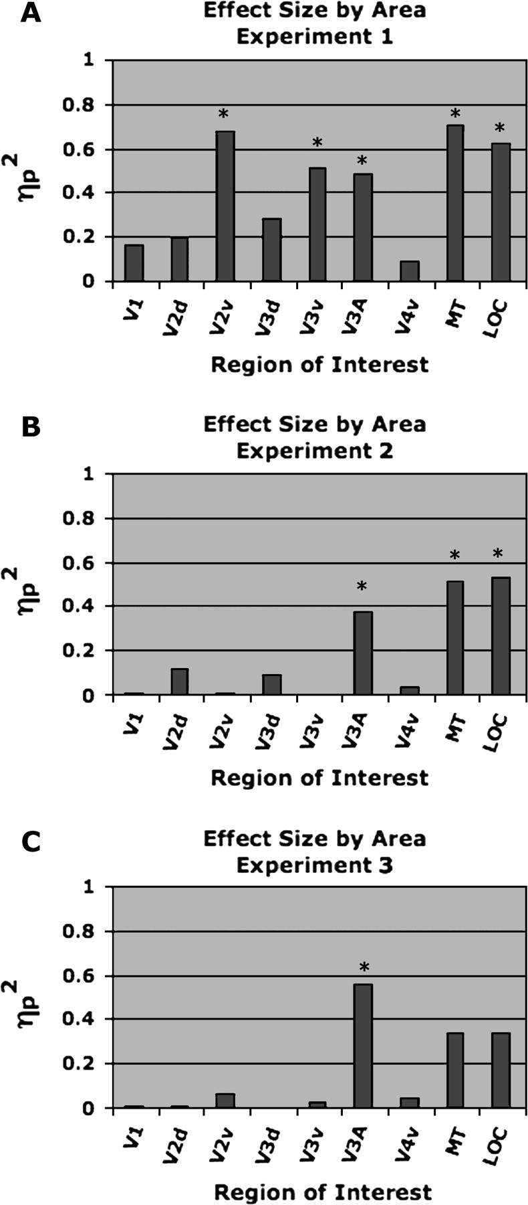
Figure 2. fMRI results. Results of a repeated-measures ANOVA linear contrast between percent BOLD signal Z scores and ...
Notes:
Figure 2. fMRI results. Results of a repeated-measures ANOVA linear contrast between percent BOLD signal Z scores and increasing CC. ηp2 values are plotted by ROI. Significance (*P < 0.05) indicates the existence of a linear relationship between percent BOLD signal and CC. (A) Experiment 1: Retinotopic areas V2v, V3v, and V3A as well as areas hMT+ and LOC modulate parametrically across stimulus condition. (B) Experiment 2: Retinotopic area V3A and areas hMT+ and LOC modulate parametrically across stimulus group. Based on this, we can no longer conclude that areas V2v and V3v, found to modulate in experiment 1, are processing CC as a cue for motion perception. (C) Experiment 3: With the stimulus groups presented so that each group was perceived to rotate at the same angular velocity, only the BOLD signal in retinotopic area V3A modulates parametrically across stimulus condition, thus enabling us to conclude that V3A processes CC as a cue for motion perception.
Unless provided in the caption above, the following copyright applies to the content of this slide: © The Author 2006. Published by Oxford University Press. All rights reserved. For permissions, please e-mail: journals.permissions@oxfordjournals.org

Slide 3
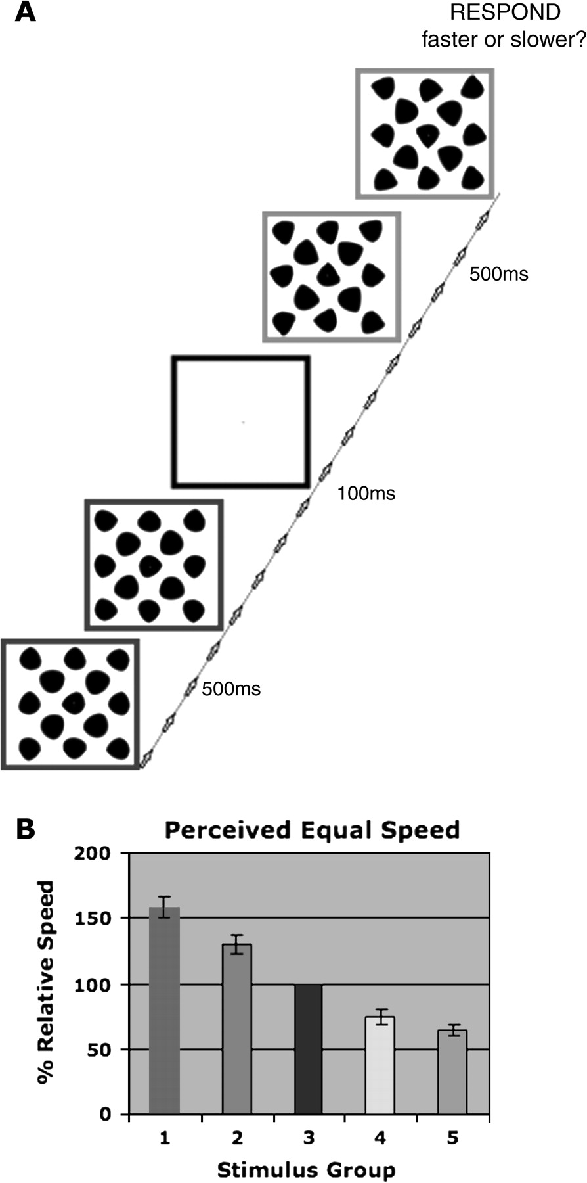
Figure 3. Experiment 3: Psychophysics. (A) Psychophysics paradigm: a group of 13 control stimuli (Fig. 2d blue) ...
Notes:
Figure 3. Experiment 3: Psychophysics. (A) Psychophysics paradigm: a group of 13 control stimuli (Fig. 2d blue) rotating at 126°/s was presented to subjects for 500 ms. Subjects were then presented with a test group, adjusted for size according to experiment 2, for 500 ms rotating either faster or slower than the control stimulus. Subjects indicated via a button press whether the test group was rotating faster or slower than the control. (B) Results of experiment 4 psychophysics: the color of the plotted bars corresponds to the stimuli bounded by similar color in Figure 2d corrected for size as in experiment 2. The magnitude of the bars indicates how much faster or slower in percentage relative to the control group, each test stimulus group needed to be rotated in order to be perceived as rotating at the same angular velocity (point of subjective equality) as the control group (blue). As the degree of CC increased, the point of subjective equality decreased. This indicates that the higher curvature bumps were perceived to rotate faster than lower curvature ones. Error bars indicate the standard error of the mean across subjects.
Unless provided in the caption above, the following copyright applies to the content of this slide: © The Author 2006. Published by Oxford University Press. All rights reserved. For permissions, please e-mail: journals.permissions@oxfordjournals.org

Slide 4
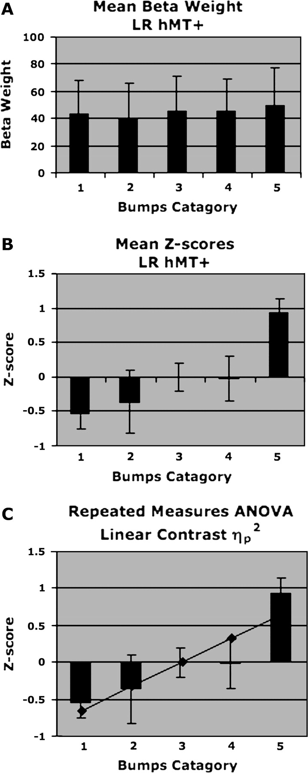
Figure 4. Individual ROI analysis. Based on a voxel by voxel GLM analysis performed in each subject individually, mean ...
Notes:
Figure 4. Individual ROI analysis. Based on a voxel by voxel GLM analysis performed in each subject individually, mean beta weights were computed within each ROI and then averaged across hemisphere. (A) The mean beta weights for each stimulus condition for area hMT+ across subject. (B) The raw beta weights for each subject converted to Z scores to eliminate between-subject magnitude variance. (C) A repeated-measures ANOVA with a linear contrast incorporating the data from all subjects performed on the Z scores to determine the degree of parametric percent BOLD signal change across stimulus condition.
Unless provided in the caption above, the following copyright applies to the content of this slide: © The Author 2006. Published by Oxford University Press. All rights reserved. For permissions, please e-mail: journals.permissions@oxfordjournals.org

Slide 5
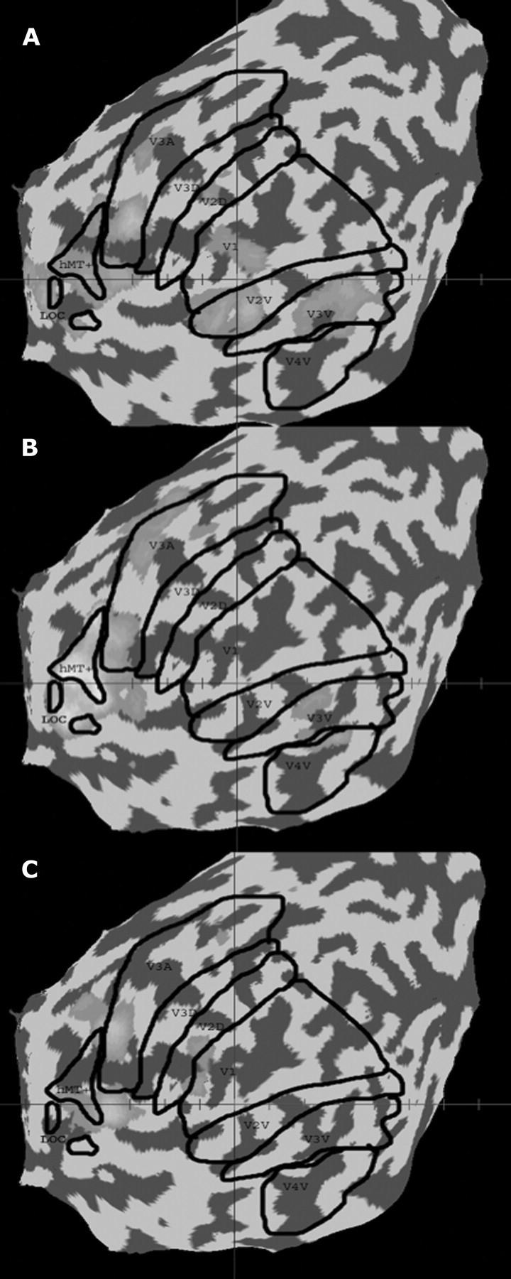
Figure 5. Single-subject activation maps. Activation map based on a single-subject GLM (fixed effects) showing ...
Notes:
Figure 5. Single-subject activation maps. Activation map based on a single-subject GLM (fixed effects) showing parametric BOLD variation as a function of CC in a single exemplar subject (left hemisphere). The activation maps for (A) experiment 1, (B) experiment 2, and (C) experiment 3 are shown overlaid with this subject's ROIs outlined in black.
Unless provided in the caption above, the following copyright applies to the content of this slide: © The Author 2006. Published by Oxford University Press. All rights reserved. For permissions, please e-mail: journals.permissions@oxfordjournals.org

