Slide 1
Figure 4. Regions of interest were dropped in the template corresponding to marked structures, which were then ...
Notes:
Figure 4. Regions of interest were dropped in the template corresponding to marked structures, which were then transferred to average feature maps for each day using the transformation for spatial normalization.
Unless provided in the caption above, the following copyright applies to the content of this slide: © The Author 2008. Published by Oxford University Press. All rights reserved. For permissions, please e-mail: journals.permissions@oxfordjournals.org

Slide 2
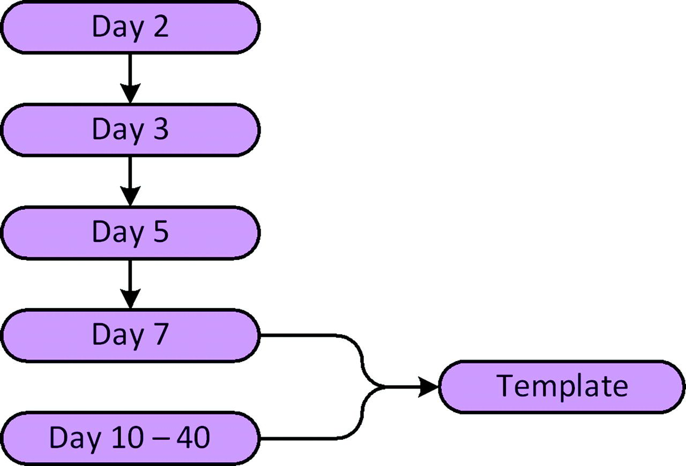
Figure 1. Spatial normalization schematic. Brains younger than day 7 are registered indirectly to the template to ...
Notes:
Figure 1. Spatial normalization schematic. Brains younger than day 7 are registered indirectly to the template to achieve higher level of accuracy.
Unless provided in the caption above, the following copyright applies to the content of this slide: © The Author 2008. Published by Oxford University Press. All rights reserved. For permissions, please e-mail: journals.permissions@oxfordjournals.org

Slide 3
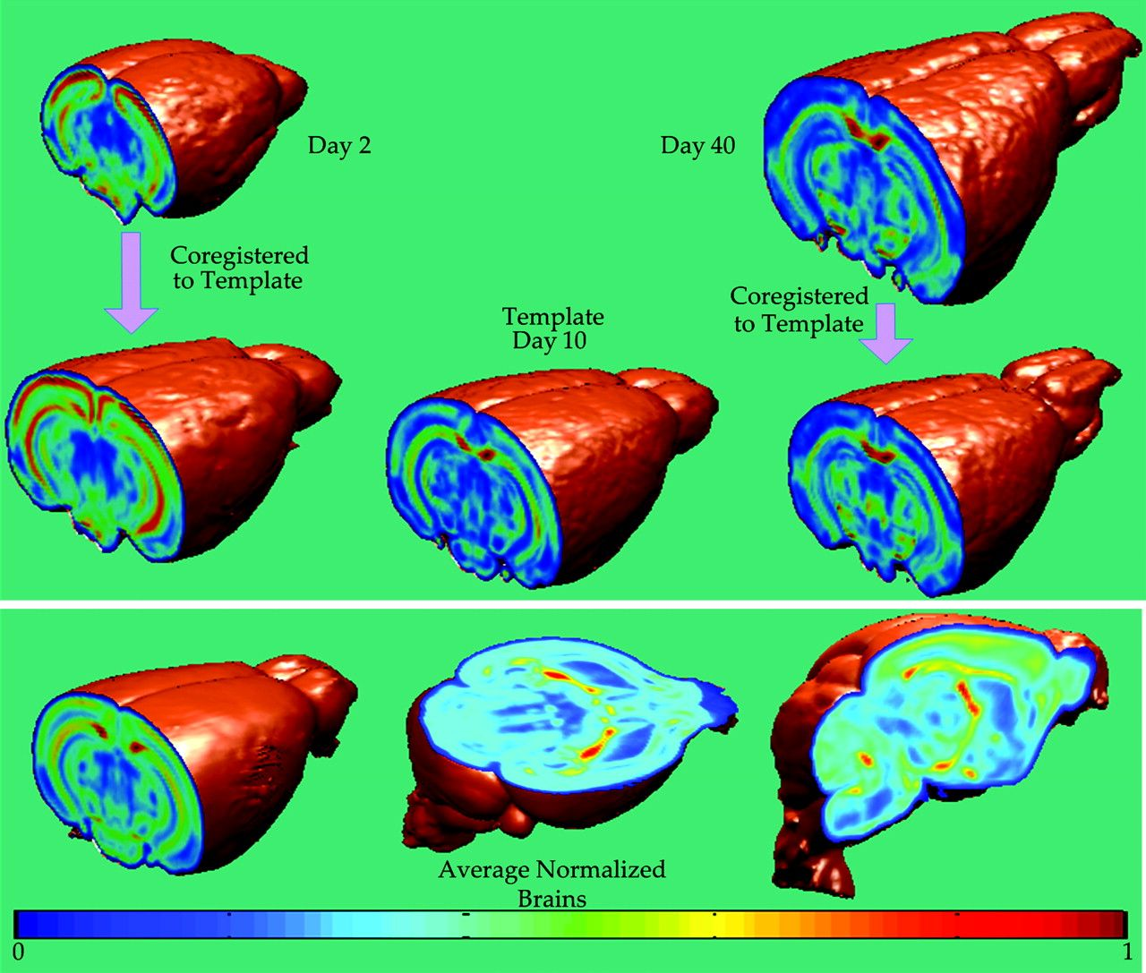
Figure 2. Spatial normalization. All brains are normalized to a common template selected on day 10. Although ...
Notes:
Figure 2. Spatial normalization. All brains are normalized to a common template selected on day 10. Although coregistration establishes correspondences, it maintains the FA values intact. (Top) Coregistration of 2 examples from day 2 and day 40. (Bottom) Clarity of mean normalized brain indicates registration accuracy.
Unless provided in the caption above, the following copyright applies to the content of this slide: © The Author 2008. Published by Oxford University Press. All rights reserved. For permissions, please e-mail: journals.permissions@oxfordjournals.org

Slide 4
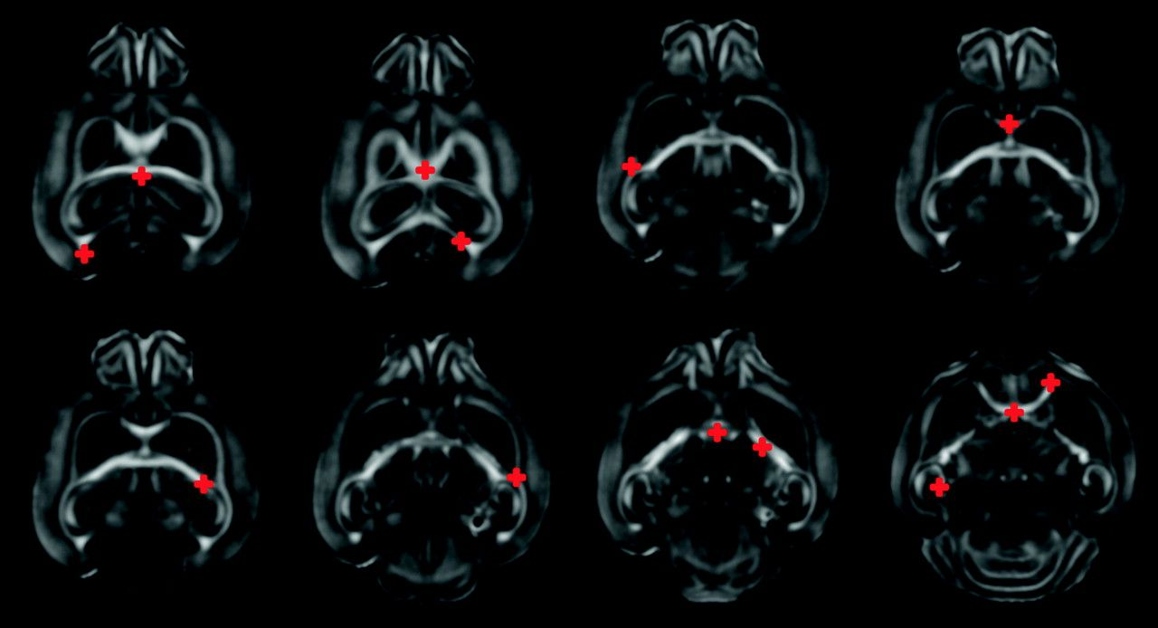
Figure 3. Analysis of registration accuracy. Fourteen landmarks were selected in the template. Same landmarks were ...
Notes:
Figure 3. Analysis of registration accuracy. Fourteen landmarks were selected in the template. Same landmarks were dropped independently in 2 images one each from day 5 and day 40. Landmarks are then mapped to the template space using (Shen and Davatzikos 2002; Xu et al. 2003), before comparing the disagreement between the mapped landmarks and the template landmarks.
Unless provided in the caption above, the following copyright applies to the content of this slide: © The Author 2008. Published by Oxford University Press. All rights reserved. For permissions, please e-mail: journals.permissions@oxfordjournals.org

Slide 5
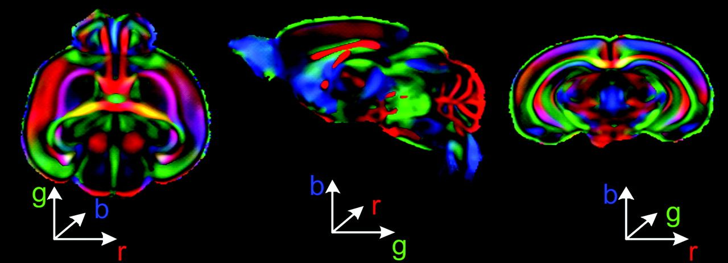
Figure 11. Average FA weighted first principal direction maps illustrated through color maps, where each component of a ...
Notes:
Figure 11. Average FA weighted first principal direction maps illustrated through color maps, where each component of a principal direction is represented as a color component. Principal direction map depicts fiber orientations in a brain. Crispness of the average color maps highlights high level of registration accuracy. As a result, after normalization most of inter-subject variability is carried in FA maps.
Unless provided in the caption above, the following copyright applies to the content of this slide: © The Author 2008. Published by Oxford University Press. All rights reserved. For permissions, please e-mail: journals.permissions@oxfordjournals.org

Slide 6
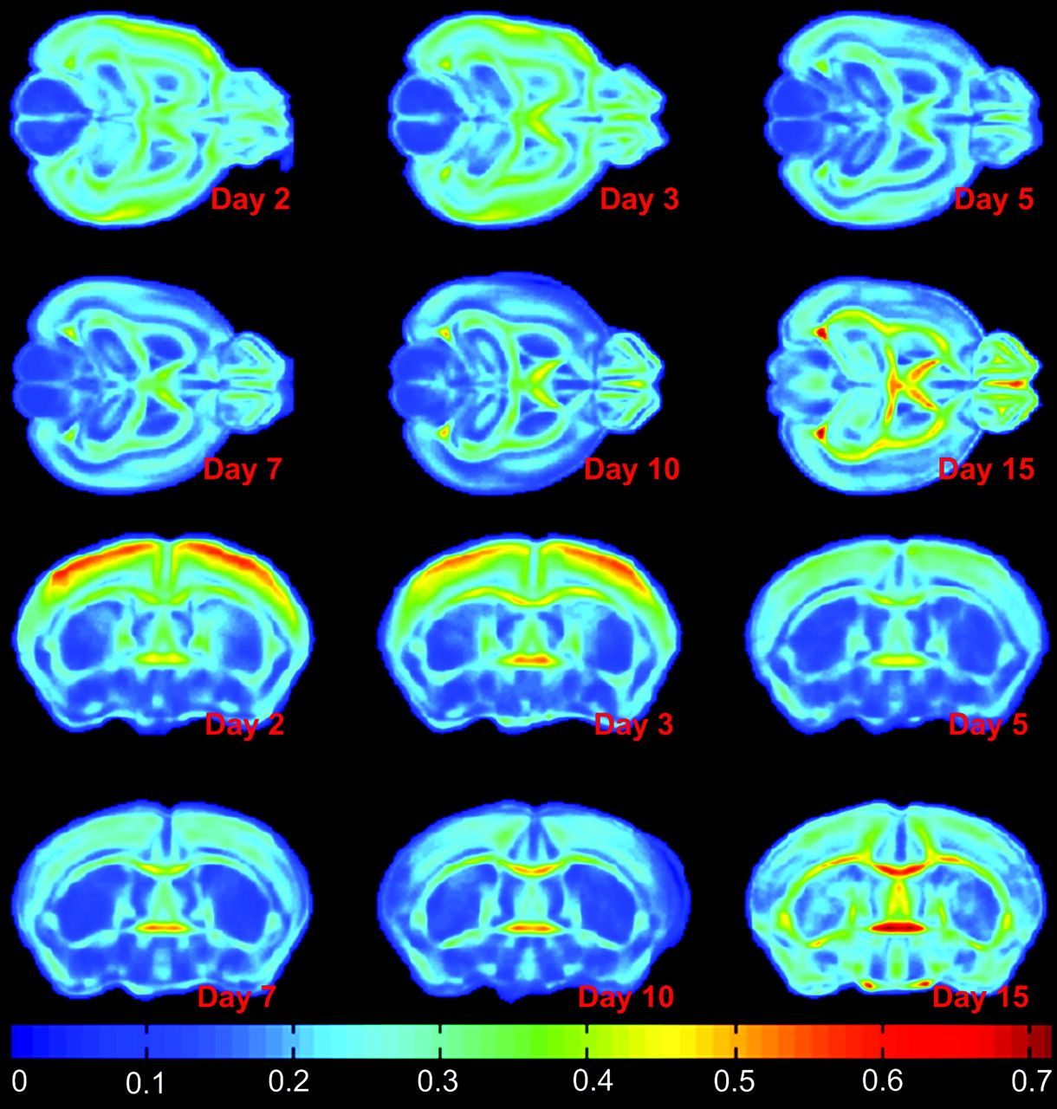
Figure 5. Average daily FA means of day 2 to day 15 (Top rows: Axial view; Bottom rows: Coronal view) indicate a ...
Notes:
Figure 5. Average daily FA means of day 2 to day 15 (Top rows: Axial view; Bottom rows: Coronal view) indicate a gradual decline in FA values in GM structures such as cortex, and a steady increase in FA in GM structures. A drop of 31% was observed in cortex from day 2 to day 5. Corresponding variance maps indicated small values except at the boundaries of various structures due to slight registration errors.
Unless provided in the caption above, the following copyright applies to the content of this slide: © The Author 2008. Published by Oxford University Press. All rights reserved. For permissions, please e-mail: journals.permissions@oxfordjournals.org

Slide 7
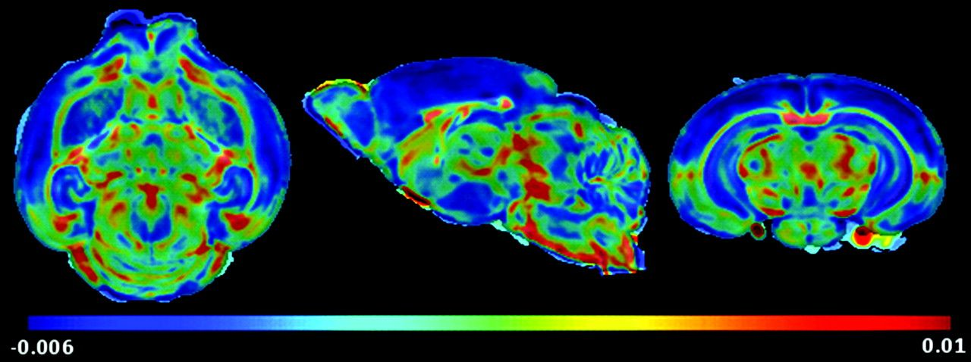
Figure 6. FA based regression map indicates gradual decline in FA values in cortex and hippocampus, showing progressive ...
Notes:
Figure 6. FA based regression map indicates gradual decline in FA values in cortex and hippocampus, showing progressive maturation in these structures with age as dendritic trees elaborate. WM structures, on the other hand, register steady increase in FA values, with the formation of tightly packed axonal pathways.
Unless provided in the caption above, the following copyright applies to the content of this slide: © The Author 2008. Published by Oxford University Press. All rights reserved. For permissions, please e-mail: journals.permissions@oxfordjournals.org

Slide 8
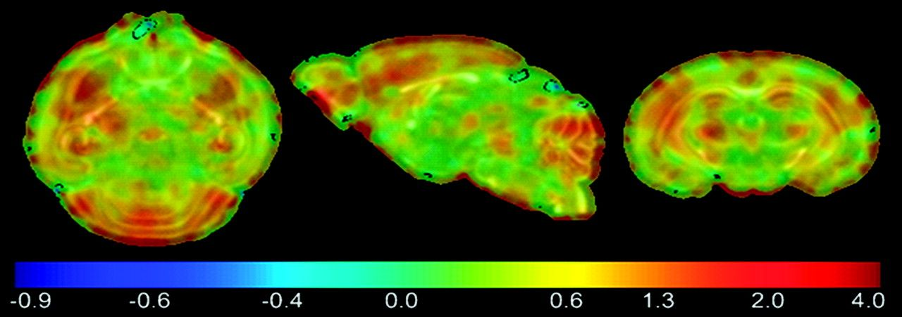
Figure 7. Regression map based on log of Jacobian determinant indicates somewhat spatially heterogeneous growth rates. ...
Notes:
Figure 7. Regression map based on log of Jacobian determinant indicates somewhat spatially heterogeneous growth rates. Cortex and cerebellum grow at a higher rate as indicated by regions in red.
Unless provided in the caption above, the following copyright applies to the content of this slide: © The Author 2008. Published by Oxford University Press. All rights reserved. For permissions, please e-mail: journals.permissions@oxfordjournals.org

Slide 9
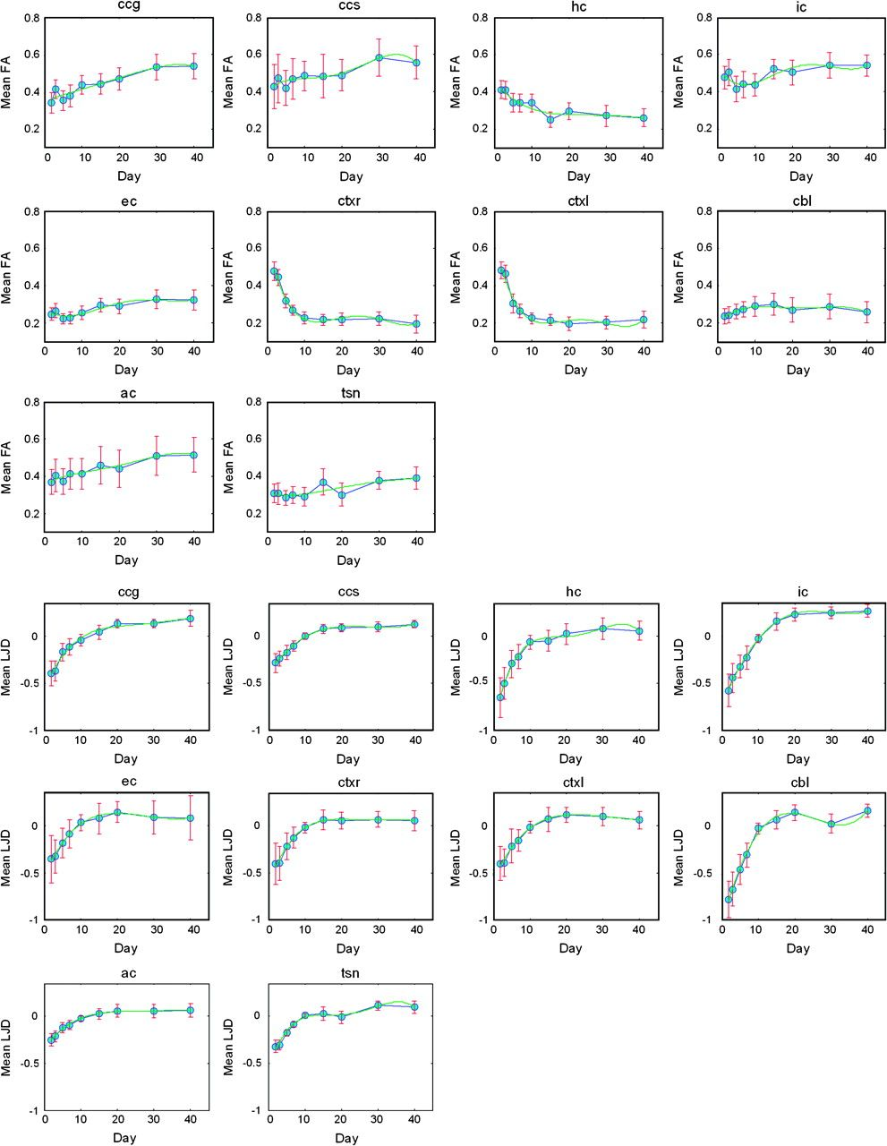
Figure 8. ROIs highlighted in Figure 4 allowed computation of daily means for FOIs in corresponding ROIs for capturing ...
Notes:
Figure 8. ROIs highlighted in Figure 4 allowed computation of daily means for FOIs in corresponding ROIs for capturing temporal profiles: (Top 3 Rows) Temporal profiles for FA based mean FOIs: All structures indicate a gradual increase in FA, except cortex and cerebellum. Decay in FA values in the cortical regions is found to be exponential; (Bottom 3 Rows) Temporal profiles for LJD (log10 scale) based mean FOIs: LJD indicates very large volumetric growth rates with an exponential profile that tapers off around day 20. Error bars indicate the standard deviation of the variation within a ROI.
Unless provided in the caption above, the following copyright applies to the content of this slide: © The Author 2008. Published by Oxford University Press. All rights reserved. For permissions, please e-mail: journals.permissions@oxfordjournals.org

Slide 10
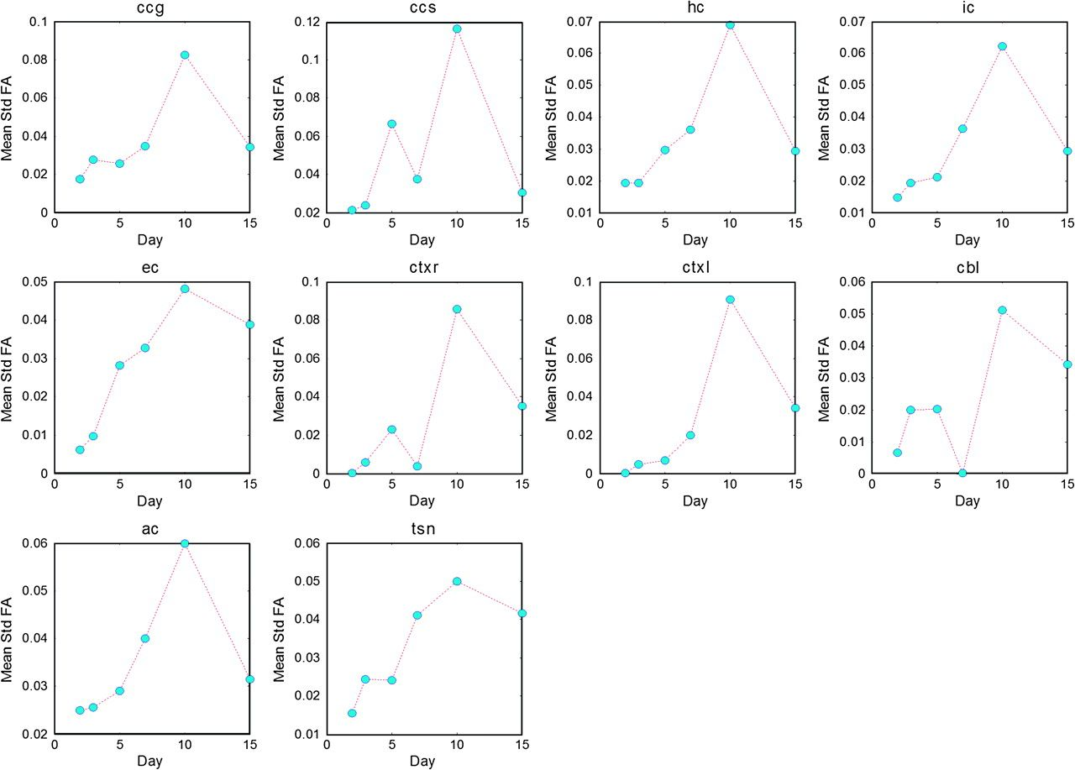
Figure 9. Mean standard deviation plots for FA as a function of time indicate the amount of variation in the ...
Notes:
Figure 9. Mean standard deviation plots for FA as a function of time indicate the amount of variation in the corresponding ROI for a given day. Corresponding mean FA plots are given in Figure 8 (Top).
Unless provided in the caption above, the following copyright applies to the content of this slide: © The Author 2008. Published by Oxford University Press. All rights reserved. For permissions, please e-mail: journals.permissions@oxfordjournals.org

Slide 11
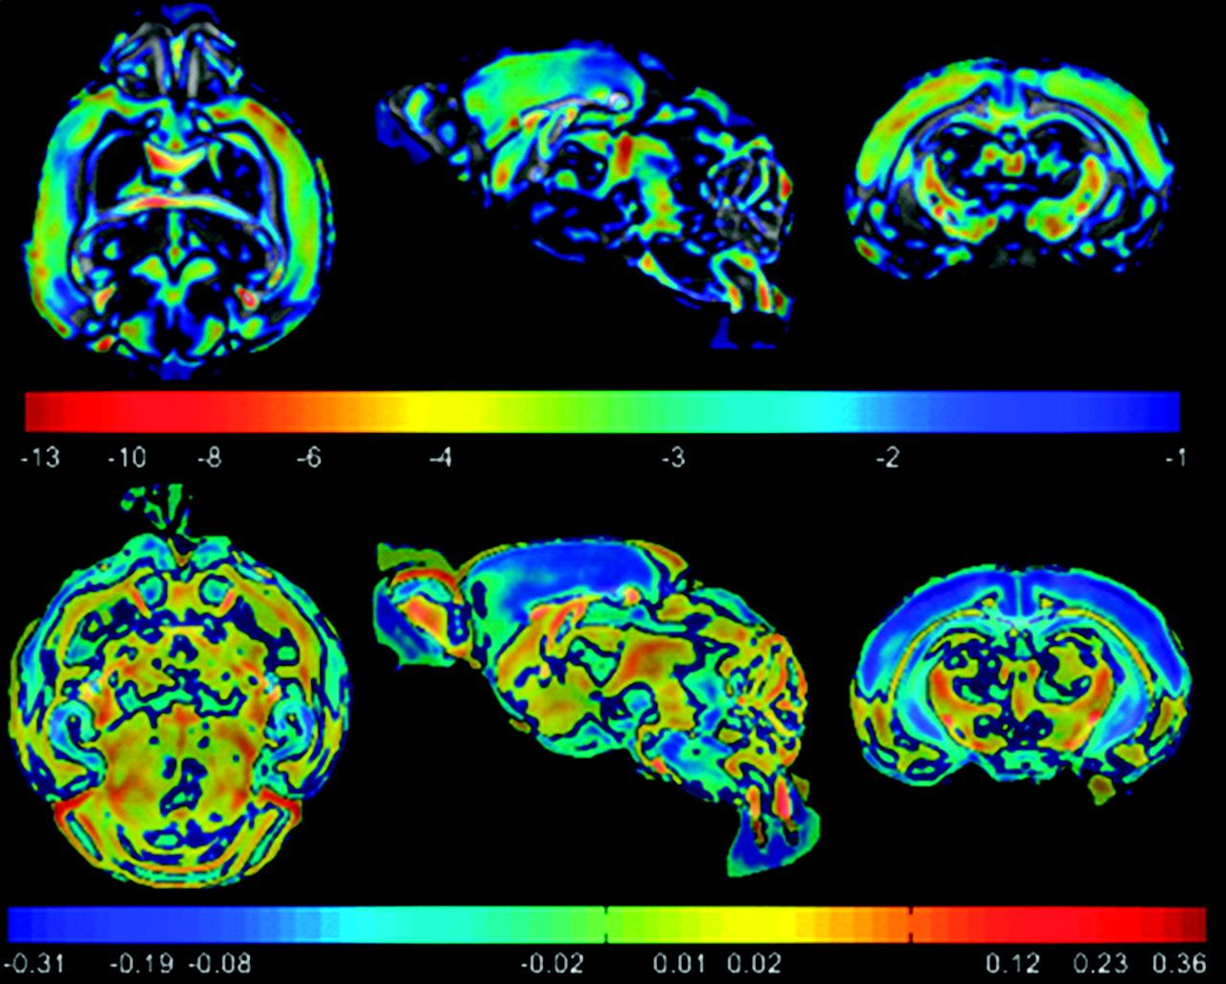
Figure 10. Statistical tests on FA maps indicate regions of significant differences in maturation between young and old ...
Notes:
Figure 10. Statistical tests on FA maps indicate regions of significant differences in maturation between young and old brains. (Top) Log of FA based P-maps; (Bottom) Difference map between the 2 groups highlighting changes in old brains versus young. GM cortical and hippocampal regions show a drop in FA values (indicated by blue) whereas WM structures such as ic, ec, genu, and splenium of cc, show an increase in FA values (indicated by red). Corresponding percent variations are given in Figure 14. The regional changes correspond to WM tracts which can be seen by comparing with Figure 8.
Unless provided in the caption above, the following copyright applies to the content of this slide: © The Author 2008. Published by Oxford University Press. All rights reserved. For permissions, please e-mail: journals.permissions@oxfordjournals.org

Slide 12
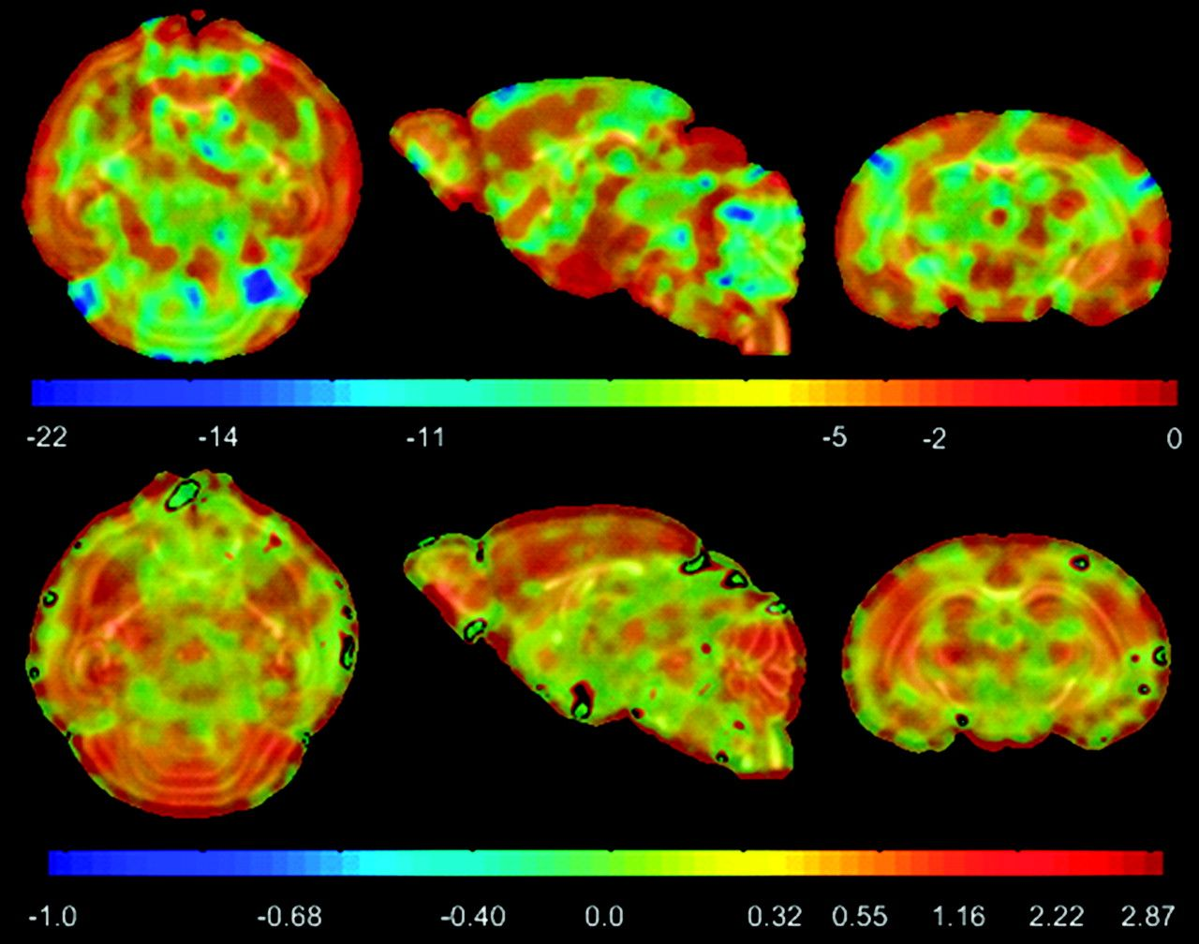
Figure 13. Statistical tests on LJD maps indicate regions of significant volumetric differences between young and old ...
Notes:
Figure 13. Statistical tests on LJD maps indicate regions of significant volumetric differences between young and old brains. (Top) Difference map between the 2 groups. (Bottom) Log of LJD based P-maps highlighting changes in old brains versus young. Regions of significant (P ≤ 10−3) growth rate differences were found in the cerebellum. Corresponding percent variations are given in Figure 14.
Unless provided in the caption above, the following copyright applies to the content of this slide: © The Author 2008. Published by Oxford University Press. All rights reserved. For permissions, please e-mail: journals.permissions@oxfordjournals.org

Slide 13
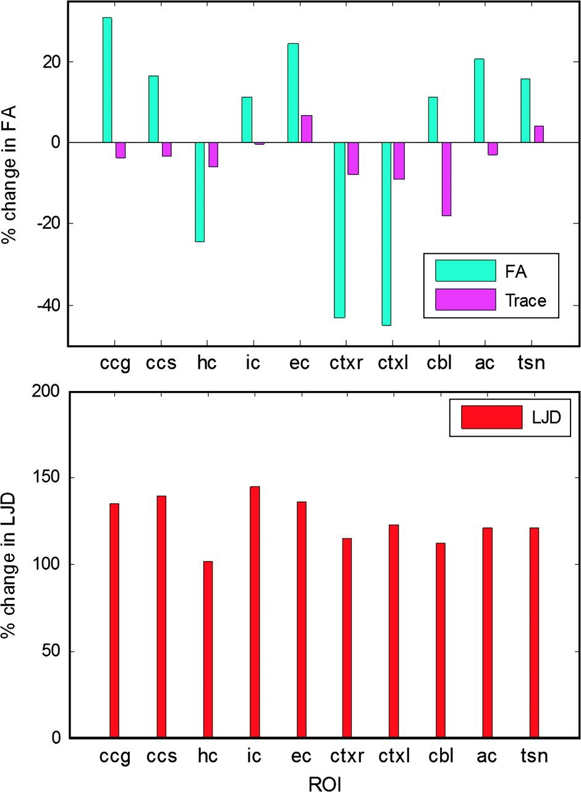
Figure 14. Percent group differences for various FA, trace and LJD computed from ROIs highlighted in Figure 4. Cortex ...
Notes:
Figure 14. Percent group differences for various FA, trace and LJD computed from ROIs highlighted in Figure 4. Cortex exhibits a huge drop in FA. LJD changes are almost similar in all structures, indicating a uniform growth of the brain.
Unless provided in the caption above, the following copyright applies to the content of this slide: © The Author 2008. Published by Oxford University Press. All rights reserved. For permissions, please e-mail: journals.permissions@oxfordjournals.org

Slide 14
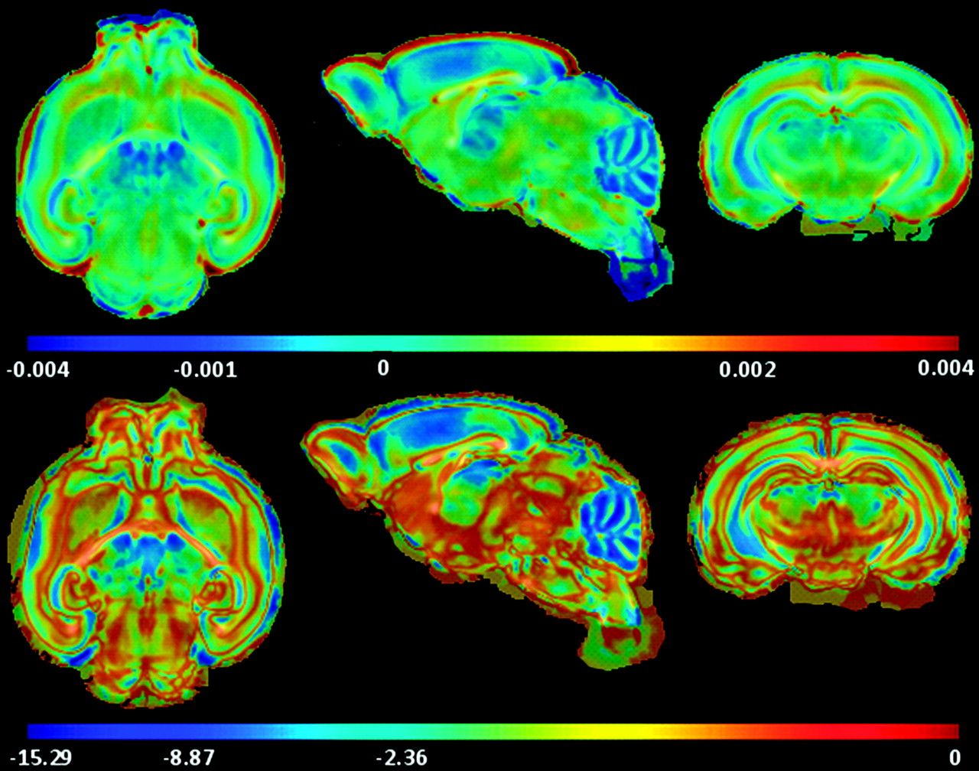
Figure 12. Statistical tests on trace indicate regions of significant organizational differences between young and old ...
Notes:
Figure 12. Statistical tests on trace indicate regions of significant organizational differences between young and old brains. (Top) Log of trace-based P-maps. (Bottom) Difference map between the 2 groups highlighting changes in old brains versus young. Regions of significant (P = 10−6) growth rate differences were found in the cerebellum. Corresponding percent variations are given in Figure 14.
Unless provided in the caption above, the following copyright applies to the content of this slide: © The Author 2008. Published by Oxford University Press. All rights reserved. For permissions, please e-mail: journals.permissions@oxfordjournals.org

