Slide 1
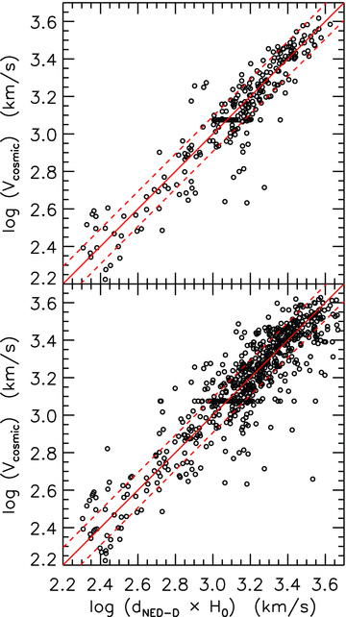
Figure 1 Accuracy of redshift distances. Top panel: recession velocities, converted into velocities V_{cosmic} ...
Notes:
Figure 1 Accuracy of redshift distances. Top panel: recession velocities, converted into velocities Vcosmic characteristic of the expansion of the universe, against the median of the NED-D redshift-independent distances for 291 galaxies with at least three independent determination (in most cases including SBF distances). The solid line is a one-to-one relation, while the dashed lines indicate ±24 per cent deviations. Bottom panel: same as in the top panel for 705 galaxies with at least one distance determination in NED-D.
Unless provided in the caption above, the following copyright applies to the content of this slide: © 2011 The Authors Monthly Notices of the Royal Astronomical Society © 2011 RAS

Slide 2
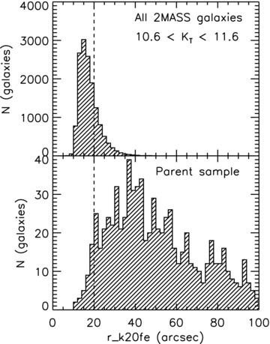
Figure 2 Apparent size distribution of 2MASS galaxies. Top panel: the apparent size, as described by the 2MASS XSC ...
Notes:
Figure 2 Apparent size distribution of 2MASS galaxies. Top panel: the apparent size, as described by the 2MASS XSC parameter r_k20fe, for all the galaxies satisfying our observability criteria and with 10.6 < KT < 11.6. Bottom panel: same as in the top panel for the galaxies in the parent sample (D < 42 Mpc and MK < −21.5 mag).
Unless provided in the caption above, the following copyright applies to the content of this slide: © 2011 The Authors Monthly Notices of the Royal Astronomical Society © 2011 RAS

Slide 3
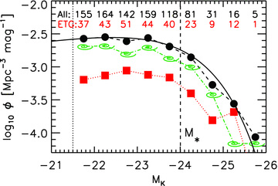
Figure 3 K_{s}-band luminosity function (LF) of the ATLAS^{3D}parent sample of 871 galaxies (black ...
Notes:
Figure 3 Ks-band luminosity function (LF) of the ATLAS3Dparent sample of 871 galaxies (black filled circles). The LF for the spiral galaxies (green spirals) and the 260 ETGs which constitute the ATLAS3D sample (red squares) separately are also shown. The solid curve shows the Schechter (1976) function derived by Bell et al. (2003) from a fit to 6282 galaxies. It was not fitted to our data! The black numbers above the symbols indicate the total number of galaxies included in each 0.5-mag bin, while the red ones are the corresponding numbers for the ETGs of the ATLAS3D sample. There is no evidence of incompleteness down to the magnitude limit of the survey (vertical dotted line), which is ≈2.5 mag below M★ (vertical dashed line).
Unless provided in the caption above, the following copyright applies to the content of this slide: © 2011 The Authors Monthly Notices of the Royal Astronomical Society © 2011 RAS

Slide 4
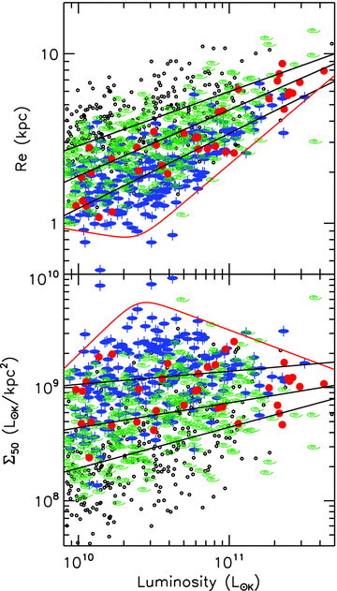
Figure 4 Top panel: size–luminosity relation for the parent sample. The K-band luminosity of all the galaxies in the ...
Notes:
Figure 4 Top panel: size–luminosity relation for the parent sample. The K-band luminosity of all the galaxies in the parent sample is plotted against the effective radius Re (Section 4.1). Red filled circles are slow rotators, blue ellipses with vertical axis are fast rotators. These 260 objects constitute the ATLAS3D sample. The green spirals represent spiral galaxies of type Sa–Sb (−0.5 4) are plotted as small open circles. The solid lines are the best-fitting relations described in the text. From the bottom to the top they are fit to the fast rotators ETGs, to the Sa–Sb and to the later spiral types. The red curve approximates the boundary of the zone of avoidance in the observed galaxy distribution. Bottom panel: effective surface brightness versus luminosity. The symbols and the lines are the same as in the top panel.
Unless provided in the caption above, the following copyright applies to the content of this slide: © 2011 The Authors Monthly Notices of the Royal Astronomical Society © 2011 RAS

Slide 5
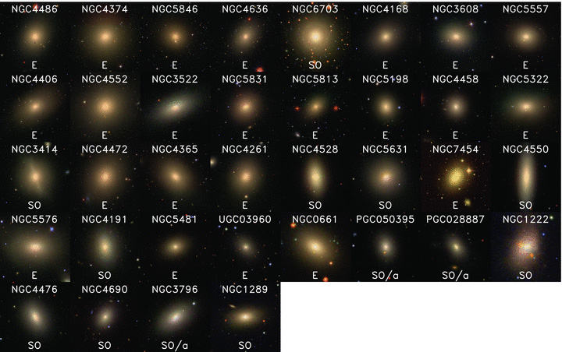
Figure 5 Morphology of slow-rotators ETGs sorted by increasing λ_{R}. Postage stamps of the SDSS DR7 and INT ...
Notes:
Figure 5 Morphology of slow-rotators ETGs sorted by increasing λR. Postage stamps of the SDSS DR7 and INT red–green–blue composite images of slow rotators in the ATLAS3D sample. The image of each galaxy was scaled so that the plot side is equal to 10Re, where Re is the projected half-light radius given in Table 3. From left to right and from top to bottom the panels are sorted according to their specific stellar angular momentum, as measured by the parameter λR given in Paper III. The galaxy name is given at the top of each panel and the morphological classification from HyperLeda at the bottom. At this scale slow-rotator ETGs appear generally featureless except for the synchrotron jet in NGC 4486 and obvious signs of interactions in NGC 1222, NGC 3414 and NGC 5557. The only significant flat galaxy in this class is NGC 4550, while two other galaxies NGC 3796 and NGC 4528 show evidence of bar perturbations, which is typically associated to stellar discs. All these three objects contain counter-rotating stellar discs (Paper II). (This figure is better appreciated on a computer screen rather than on printed paper.) A version of Figs 5 and 6 sorted by name is available at http://purl.org/atlas3d.
Unless provided in the caption above, the following copyright applies to the content of this slide: © 2011 The Authors Monthly Notices of the Royal Astronomical Society © 2011 RAS

Slide 6
Figure 6 Same as in Fig. 5 for the fast-rotators ETGs in the ATLAS^{3D} sample, sorted by increasing ...
Notes:
Figure 6 Same as in Fig. 5 for the fast-rotators ETGs in the ATLAS3D sample, sorted by increasing λR. The first panel contains mostly round objects. Many of them are barred (Paper II), nearly face-on, S0 galaxies and often contain stellar rings (e.g. NGC 4608), while others appears face-on from the geometry of their dust. This suggests that the round shape and low λR of these objects is not intrinsic, but due to their low inclination (i = 90° being edge on). On the contrary the last panel is dominated by nearly edge-on discs, which explains their high λR.
Unless provided in the caption above, the following copyright applies to the content of this slide: © 2011 The Authors Monthly Notices of the Royal Astronomical Society © 2011 RAS

Slide 7
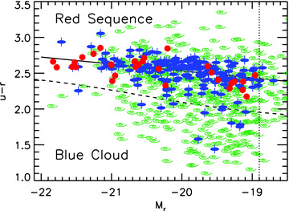
Figure 7 u−r versus M_{r} colour–magnitude diagram for the morphologically selected ATLAS^{3D} parent ...
Notes:
Figure 7 u−r versus Mr colour–magnitude diagram for the morphologically selected ATLAS3D parent sample with SDSS photometry. The blue ellipses with axis are fast-rotator ETGs, the red filled circles are slow-rotators ETGs, while the green spirals are spiral galaxies. The dashed line indicates the separation between red sequence and blue cloud established by Baldry et al. (2004, 2006), from a sample of 151 642 galaxies. The vertical dotted line indicates our approximate survey completeness limit in r band Mr≲−18.9 mag. The solid line is a linear robust fit to the ETGs only, minimizing the sum of the absolute residuals.
Unless provided in the caption above, the following copyright applies to the content of this slide: © 2011 The Authors Monthly Notices of the Royal Astronomical Society © 2011 RAS

Slide 8
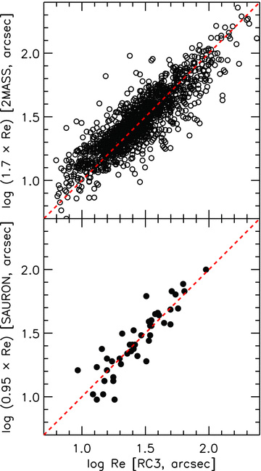
Figure 8 Testing the accuracy of R_{e} determinations. Top panel: comparison between 1353 values of ...
Notes:
Figure 8 Testing the accuracy of Re determinations. Top panel: comparison between 1353 values of Re given by RC3 and the ones given by 2MASS (computed as described in the text), scaled by the best-fitting factor of 1.7. Bottom panel: same as in the top panel for the RC3 Re and the ones for 46 ETGs of the SAURON survey. Once corrected for systematic differences, all three Re determinations are consistent with a similar error of ≈22 per cent.
Unless provided in the caption above, the following copyright applies to the content of this slide: © 2011 The Authors Monthly Notices of the Royal Astronomical Society © 2011 RAS

Slide 9
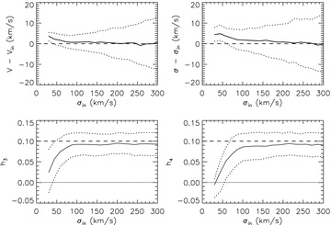
Figure 9 Testing penalization in ppxf. We simulated spectra with the S/N = 40 of our data and an LOSVD with ...
Notes:
Figure 9 Testing penalization in ppxf. We simulated spectra with the S/N = 40 of our data and an LOSVD with h3 = 0.1, h4 = 0.1 and σ in the range between 30 and 300 km s−1. We extracted the kinematics with ppxf and a penalty λ = 0.5. The lines in the top two panels show the 50th (median, solid line), 16th and 84th percentiles (1σ errors, dotted lines) of the differences between the measured values and the input values of the mean velocity Vin and the velocity dispersion σin. The bottom panels show the same lines for the recovered values of h3 and h4, compared to the input values (dashed line). The h3 and h4 parameters can only be recovered when σin≳ 100 km s−1. Typical statistical errors in the kinematics parameter for σin≈ 200 km s−1 are 6 km s−1, 7 km s−1, 0.03 and 0.03 for V, σ, h3 and h4, respectively.
Unless provided in the caption above, the following copyright applies to the content of this slide: © 2011 The Authors Monthly Notices of the Royal Astronomical Society © 2011 RAS

Slide 10
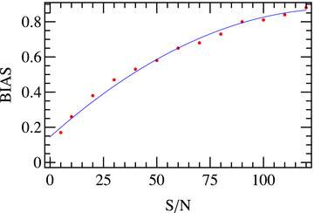
Figure 10 Relation between the S/N of the SAURON spectrum and the optimal penalty parameter λ (keyword BIAS) in ppxf. ...
Notes:
Figure 10 Relation between the S/N of the SAURON spectrum and the optimal penalty parameter λ (keyword BIAS) in ppxf. The solid line is the polynomial BIAS = 0.15 + 0.0107 S/N − 0.00004 (S/N)2.
Unless provided in the caption above, the following copyright applies to the content of this slide: © 2011 The Authors Monthly Notices of the Royal Astronomical Society © 2011 RAS

Slide 11
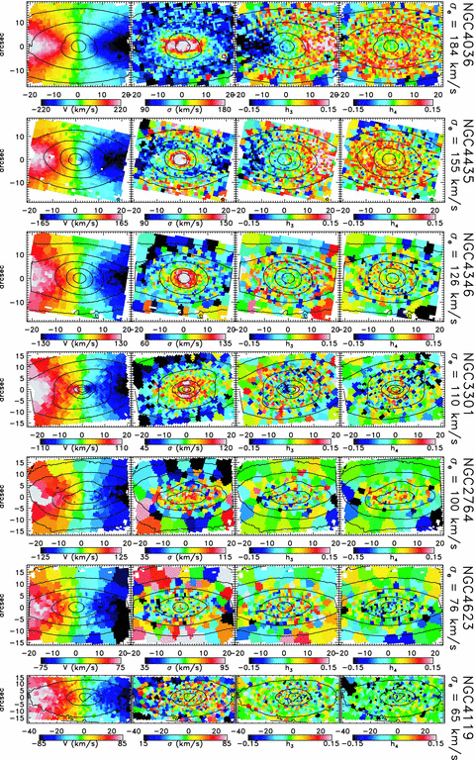
Figure 11 Quality of the SAURON stellar kinematics in the ATLAS^{3D} survey. Each column from left to right ...
Notes:
Figure 11 Quality of the SAURON stellar kinematics in the ATLAS3D survey. Each column from left to right shows the Voronoi binned kinematic moments extracted via ppxf from the SAURON data: mean velocity, V, velocity dispersion, σ, and higher Gauss–Hermite moments, h3 and h4. From top to bottom the data for seven newly observed fast rotators in the ATLAS3D sample are sorted according to the luminosity-weighted dispersion σe within 1Re. Below σe≲ 120 km s−1 the data have insufficient information to constrain the full LOSVD and the Gauss–Hermite moments are automatically and gradually suppressed by ppxf towards zero to reduce the noise in V and σ, which can still be reliably recovered. About 40 per cent of the galaxies in the sample have σe≲ 120 km s−1.
Unless provided in the caption above, the following copyright applies to the content of this slide: © 2011 The Authors Monthly Notices of the Royal Astronomical Society © 2011 RAS

