Slide 1
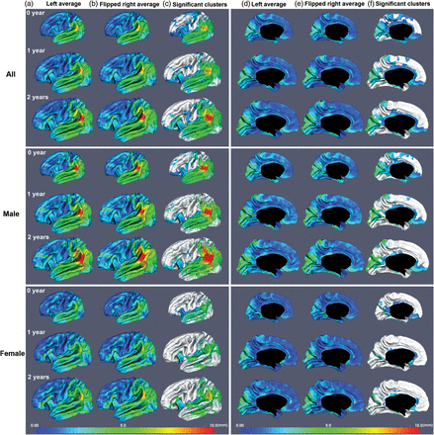
Figure 1. Hemispheric vertex position asymmetries of the cortex. (a) and (d) Average cortical surface of left ...
Notes:
Figure 1. Hemispheric vertex position asymmetries of the cortex. (a) and (d) Average cortical surface of left hemispheres. (b) and (e) Average cortical surface of mirror-flipped right hemispheres. (c) and (f) Significant clusters (nonwhite colors) of vertex position asymmetries shown on the left average cortical surface. (a), (b), (d), and (e) are color-coded by the magnitude of deformation field from the average surface of left hemispheres to the average surface of mirror-flipped right hemispheres as shown by color arrows in (c) and (f). a–c show the lateral view, and d–f show the medial view.
Unless provided in the caption above, the following copyright applies to the content of this slide: © The Author 2013. Published by Oxford University Press. All rights reserved. For Permissions, please e-mail: journals.permissions@oup.com

Slide 2
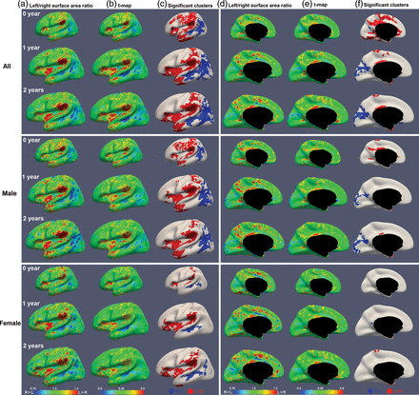
Figure 4. Hemispheric local surface area asymmetries of the cortex. (a) and (d) Maps of the ratio of average local ...
Notes:
Figure 4. Hemispheric local surface area asymmetries of the cortex. (a) and (d) Maps of the ratio of average local surface area between the left and right hemispheres. (b) and (e) Paired t-statistic map of hemispheric local surface area difference. (c) and (f) Significant clusters of local surface area asymmetries by the TFCE method (P < 0.01). Blue clusters are larger on the right than on the left, and red clusters are larger on the left than on the right. a–c show the lateral view, and d–f show the medial view.
Unless provided in the caption above, the following copyright applies to the content of this slide: © The Author 2013. Published by Oxford University Press. All rights reserved. For Permissions, please e-mail: journals.permissions@oup.com

Slide 3
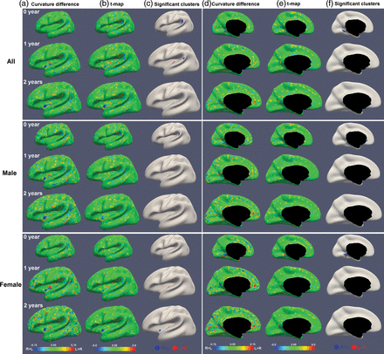
Figure 3. Hemispheric mean curvature asymmetries of the cortex. (a) and (d) Maps of average mean curvature difference ...
Notes:
Figure 3. Hemispheric mean curvature asymmetries of the cortex. (a) and (d) Maps of average mean curvature difference between the left and right hemispheres. (b) and (e) Paired t-statistic map of hemispheric mean curvature difference. (c) and (f) Significant clusters of mean curvature asymmetries by the TFCE method (P < 0.01). Blue clusters are larger on the right than on the left, and red clusters are larger on the left than on the right. a–c show the lateral view, and d–f show the medial view.
Unless provided in the caption above, the following copyright applies to the content of this slide: © The Author 2013. Published by Oxford University Press. All rights reserved. For Permissions, please e-mail: journals.permissions@oup.com

Slide 4
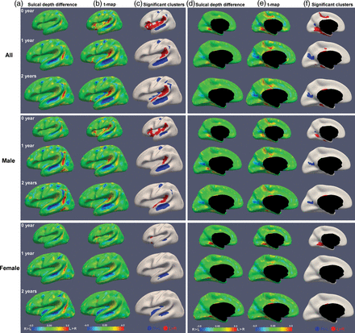
Figure 2. Hemispheric sulcal depth asymmetries of the cortex. (a) and (d) Maps of average sulcal depth difference ...
Notes:
Figure 2. Hemispheric sulcal depth asymmetries of the cortex. (a) and (d) Maps of average sulcal depth difference between the left and right hemispheres. (b) and (e) Paired t-statistic map of hemispheric sulcal depth difference. (c) and (f) Significant clusters of sulcal depth asymmetries by the TFCE method (P < 0.01). Blue clusters are deeper on the right than on the left, and red clusters are deeper on the left than on the right. a–c show the lateral view, and d–f show the medial view.
Unless provided in the caption above, the following copyright applies to the content of this slide: © The Author 2013. Published by Oxford University Press. All rights reserved. For Permissions, please e-mail: journals.permissions@oup.com

