Slide 1
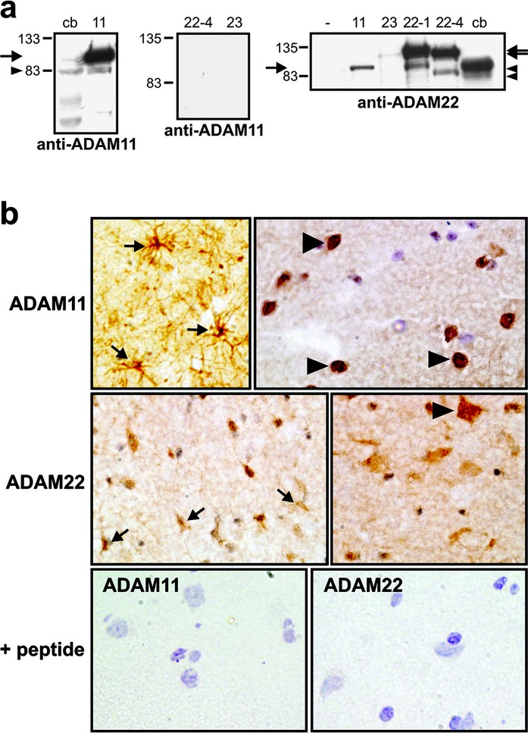
FIGURE 1. A, specificity of anti-ADAM antibodies. 293T cells were transfected with ADAM11 (11), ADAM22 isoform 1 ...
Notes:
FIGURE 1. A, specificity of anti-ADAM antibodies. 293T cells were transfected with ADAM11 (11), ADAM22 isoform 1 (22-1), ADAM22 isoform 4 (22-4), or ADAM23 (23) as indicated. Western blots of cell lysates and lysates of control human brain (cb) were probed with antibodies to either ADAM11 or ADAM22. Proform of the ADAM proteins (arrows); processed form (arrow heads. B, expression of ADAM11 and ADAM22 in control brain sections. Frozen sections of human brain were incubated with antibodies to ADAM11 and ADAM22. Arrows point to astrocytes, arrow heads to neurons expressing the antigens. Note that sections contain also cells clearly negative for antigens. Control sections were processed with antibodies preincubated with the antigen peptide.
Unless provided in the caption above, the following copyright applies to the content of this slide:

Slide 2
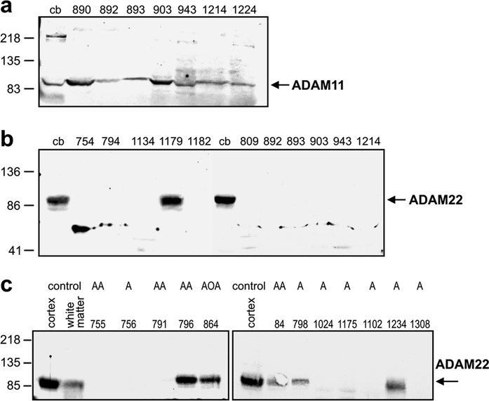
FIGURE 2. Expression of ADAM11 and ADAM22 in normal brain, in low-grade and anaplastic astrocytomas, and high-grade ...
Notes:
FIGURE 2. Expression of ADAM11 and ADAM22 in normal brain, in low-grade and anaplastic astrocytomas, and high-grade gliomas. Protein lysates of control brain (cb) and several glioblastoma specimens (all provided with separate code numbers) separated by gel electrophoresis and probed using antibodies to ADAM11 (a) and ADAM22 (b) as indicated. c, protein lysates of control brain cortex and white matter, low-grade astrocytomas (A), anaplastic astrocytomas (AA), and one anaplastic oligodendroglioma (AOA) were processed as described above and probed with antibodies to ADAM22.
Unless provided in the caption above, the following copyright applies to the content of this slide:

Slide 3
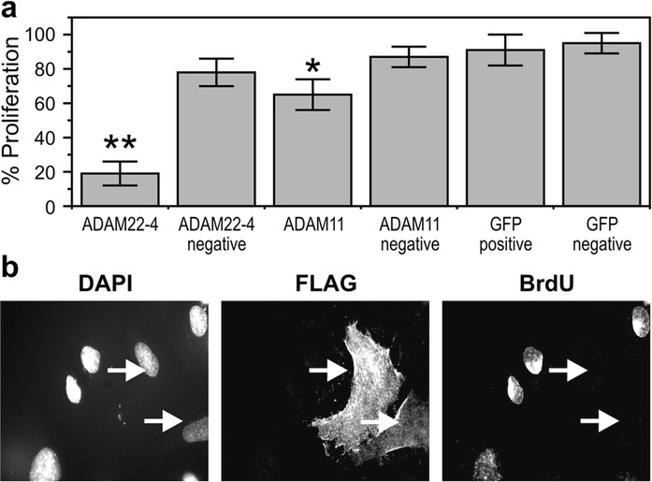
FIGURE 3. A, ADAM22 inhibits growth of D645 glioma cells. Cells were transfected with FLAG-tagged ADAM11 or ADAM22 or a ...
Notes:
FIGURE 3. A, ADAM22 inhibits growth of D645 glioma cells. Cells were transfected with FLAG-tagged ADAM11 or ADAM22 or a green fluorescence protein expression plasmid, and subsequent incorporation of BrdU into FLAG positive cells was compared with incorporation into FLAG-negative control cells on same coverslip. **, P < 0.005; *, P < 0.01. B, immunostaining of proliferating D645 cells in presence of ADAM22. Cell location is shown using nuclear DAPI stain. Cells expressing transfected ADAM22 are shown using anti-FLAG antibody and proliferating cells using the anti-BrdU antibody. Arrows point to cells that express FLAG-tagged ADAM22 and failed to proliferate.
Unless provided in the caption above, the following copyright applies to the content of this slide:

Slide 4
FIGURE 4. A, integrin binding to disintegrin domains of ADAM11, ADAM22, and ADAM23 linked to GST. Tissue culture wells ...
Notes:
FIGURE 4. A, integrin binding to disintegrin domains of ADAM11, ADAM22, and ADAM23 linked to GST. Tissue culture wells were coated with GST, GST-ADAM11, ADAM22, or ADAM23 disintegrin domain fusion proteins as indicated or with fibronectin. Parental CHO cells or clones of CHO cells over-expressing individual integrin subunits were plated into the wells for 1.5 hours before analysis. B, integrin β3 expression on D645 and CHO-β3 cells. Protein lysates of D645, CHO, and CHO-β3 cells were electrophoretically separated, transferred onto nitrocellulose membranes, and probed with antibodies to the integrin β3 subunit.
Unless provided in the caption above, the following copyright applies to the content of this slide:

Slide 5
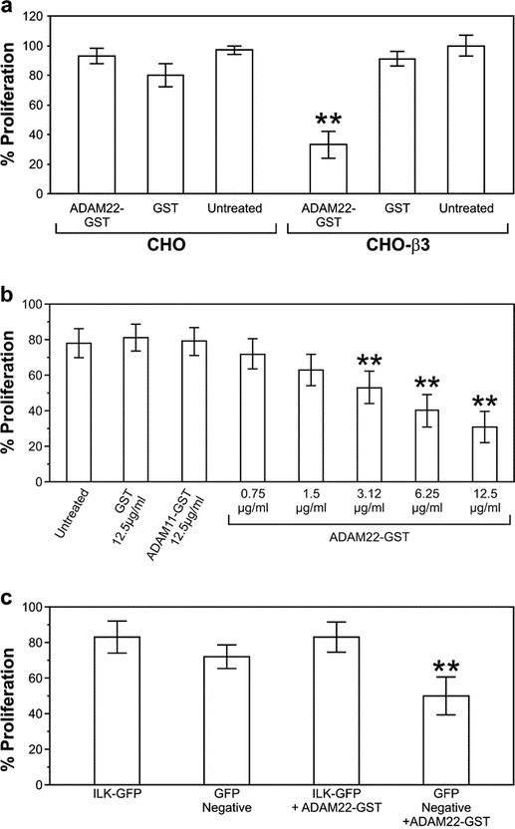
FIGURE 5. A, growth inhibition caused by disintegrin domain of ADAM22 depends on the presence of appropriate integrin. ...
Notes:
FIGURE 5. A, growth inhibition caused by disintegrin domain of ADAM22 depends on the presence of appropriate integrin. CHO and CHO cells expressing integrin β3 subunit (CHO-β3) were incubated for 24 hours in the presence of 12 μg/ml GST or ADAM22-GST disintegrin before analysis for proliferation as described inFigure 3A. Control samples were left untreated. B, growth regulation in D645 cells. D645 cells were left untreated or treated with GST, ADAM11-GST, and ADAM22-GST at the concentrations indicated followed by proliferation analysis as above. C, effect of ILK expression on growth regulation. D645 cells were transfected with green fluorescence protein (GFP)-tagged ILK and subjected to growth analysis in presence or absence of GST-ADAM22. Untransfected cells on same coverslips (GFP negative) serve as internal controls. Effects of GFP-ILK alone were assessed in parallel. **, P < 0.005.
Unless provided in the caption above, the following copyright applies to the content of this slide:

