Slide 1
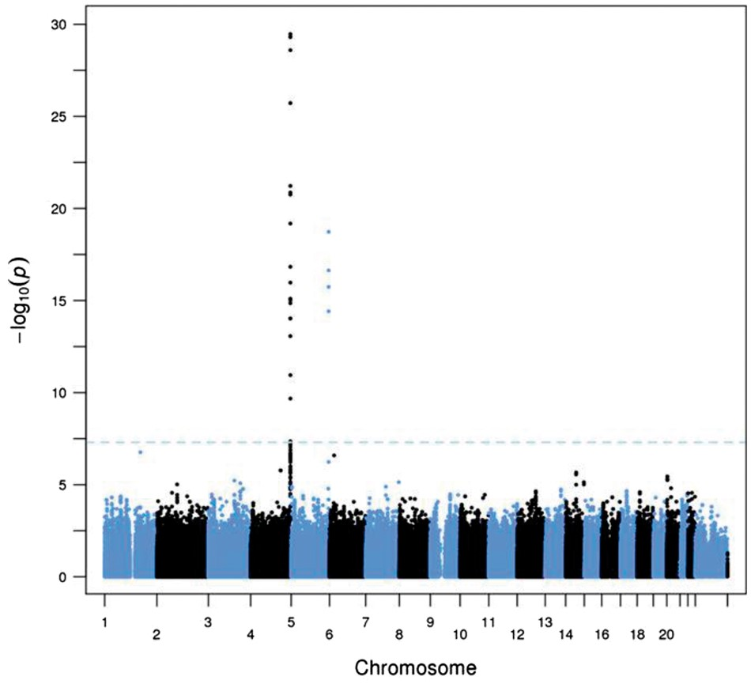
Figure 1 Discovery of novel loci on chromosome 4q35 (KLKB1, Fletcher factor) and chromosome 5 (F12, Hageman factor) ...
Notes:
Figure 1 Discovery of novel loci on chromosome 4q35 (KLKB1, Fletcher factor) and chromosome 5 (F12, Hageman factor) that influence plasma concentrations of CHGA fragments. Results from meta-analysis of UCSD and QIMR GWAS results for CHGA 361–372 (catestatin). Summary of allelic effects at KLKB1 and F12 on circulating chromogranin A (CHGA) and B (CHGB) fragments, showing results for the lead SNPs at the chromosome 4 and 5 loci for the UCSD and QIMR cohorts and results from meta-analysis. SNPChrBP (Build 37)GenePhenotypeSubjectsA1/A2Freq A1BetaSE betaP-valuep Metap Hetrs42533114187,174,683KLKB1CHGA 361–372UCSDG/A0.5010.4390.0655.65 × 10−133.40 × 10−300.347CHGA 361–372QIMRG/A0.5110.4470.0479.07 × 10−22CHGA 116–439UCSDG/A0.501−0.2050.0660.00140.00110.346CHGA 116–439QIMRG/A0.511−0.1160.0600.054CHGA 116–130UCSDG/A0.501−0.0300.0880.820––CHGB 312–331UCSDG/A0.5010.0290.0660.555––CHGB 439–451UCSDG/A0.5010.3310.0711.45 × 10−61.39 × 10−70.044CHGB 439–451QIMRG/A0.5110.1560.0466.5 × 10−4CHGB 568–577UCSDG/A0.5010.6420.0891.53 × 10−12––rs27316725176,842,474F12CHGA 361–372UCSDC/T0.7590.3270.0757.35 × 10−61.85 × 10−190.038CHGA 361–372QIMRC/T0.7470.4620.0568.58 × 10−17CHGA 116–439UCSDC/T0.759−0.1800.0740.0160.00220.843CHGA 116–439QIMRC/T0.747−0.1580.0730.031CHGA 116–130UCSDC/T0.7590.1900.1060.095––CHGB 312–331UCSDC/T0.7590.0580.0810.437––CHGB 439–451UCSDC/T0.7590.2520.0870.00342.93 × 10−40.278CHGB 439–451QIMRC/T0.7470.1380.0540.011CHGB 568–577UCSDC/T0.7590.4640.1072.70 × 10−5––
Unless provided in the caption above, the following copyright applies to the content of this slide: © The Author 2016. Published by Oxford University Press. All rights reserved. For Permissions, please email: journals.permissions@oup.com

Slide 2
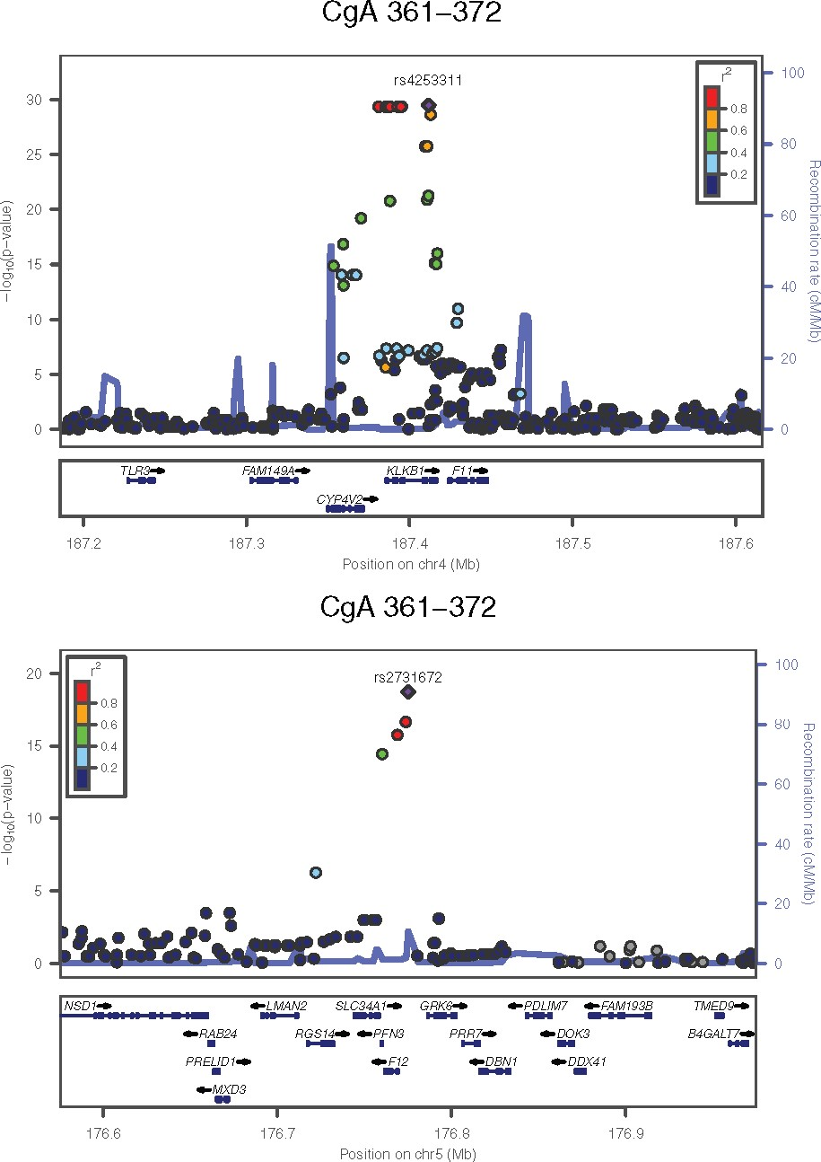
Figure 2 Regional plots for the chromosome 4 and chromosome 5 loci; combined data from UCSD and QIMR for CHGA 361–372 ...
Notes:
Figure 2 Regional plots for the chromosome 4 and chromosome 5 loci; combined data from UCSD and QIMR for CHGA 361–372 (catestatin).
Unless provided in the caption above, the following copyright applies to the content of this slide: © The Author 2016. Published by Oxford University Press. All rights reserved. For Permissions, please email: journals.permissions@oup.com

Slide 3
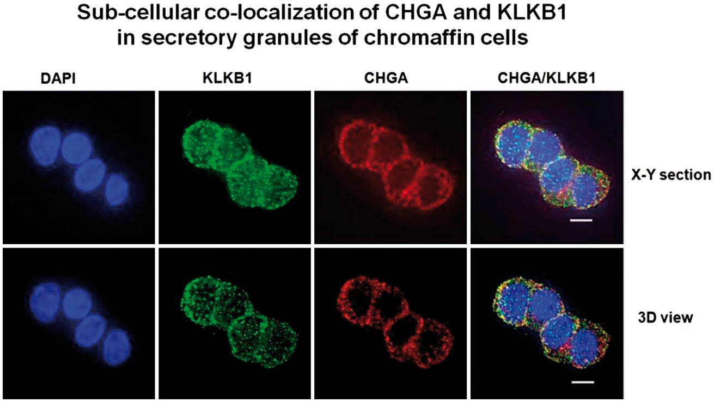
Figure 3 Sub-cellular co-localization of CHGA and KLKB1 in catecholamine storage vesicles of chromaffin cells. ...
Notes:
Figure 3 Sub-cellular co-localization of CHGA and KLKB1 in catecholamine storage vesicles of chromaffin cells. Experiments were conducted in PC12 cells, with immuno-staining of KLKB1 (green conjugate) and CHGA (red conjugate). A series of x/y optical sections along z-axis were acquired with increments of 0.2 µm. Data were processed to generate pseudo-three-dimensional (3D) or representative x/y sections. Co-localization of KLKB1 (green) and CHGA (red) was shown by yellow fluorescence, with a Pearson coefficient of overlap = 0.67.
Unless provided in the caption above, the following copyright applies to the content of this slide: © The Author 2016. Published by Oxford University Press. All rights reserved. For Permissions, please email: journals.permissions@oup.com

Slide 4
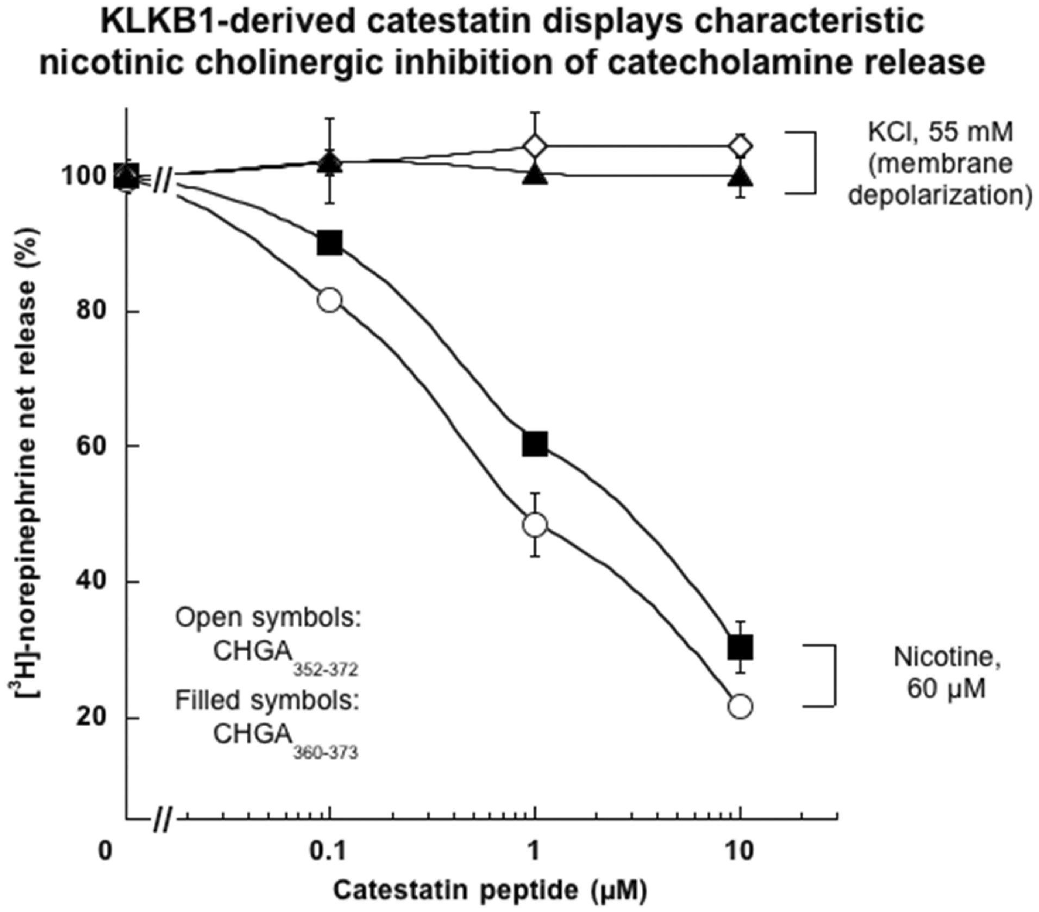
Figure 4 Catestatin derived by KLKB1 digestion of recombinant human CHGA: Synthesis potency and selective effects on ...
Notes:
Figure 4 Catestatin derived by KLKB1 digestion of recombinant human CHGA: Synthesis potency and selective effects on catecholamine secretion triggered by the nicotinic cholinergic pathway in chromaffin cells. PC12 cells were labelled with [3H]-norepinephrine and then incubated with either 60 µM nicotine, or 55 mM KCl (for membrane depolarization), or vehicle. Secretory stimulation occurred either alone or in combination with ascending doses (0.1, 1 and 10 µM) of each catestatin peptide, either the KLKB1-derived (and then synthesized) version ARAYGFRGPGPQLR (hCgA360–373), or the usual longer version (hCgA352–372). Control (100%) net norepinephrine release represents the release in the presence of nicotine or KCl (without inhibitor).
Unless provided in the caption above, the following copyright applies to the content of this slide: © The Author 2016. Published by Oxford University Press. All rights reserved. For Permissions, please email: journals.permissions@oup.com

Slide 5
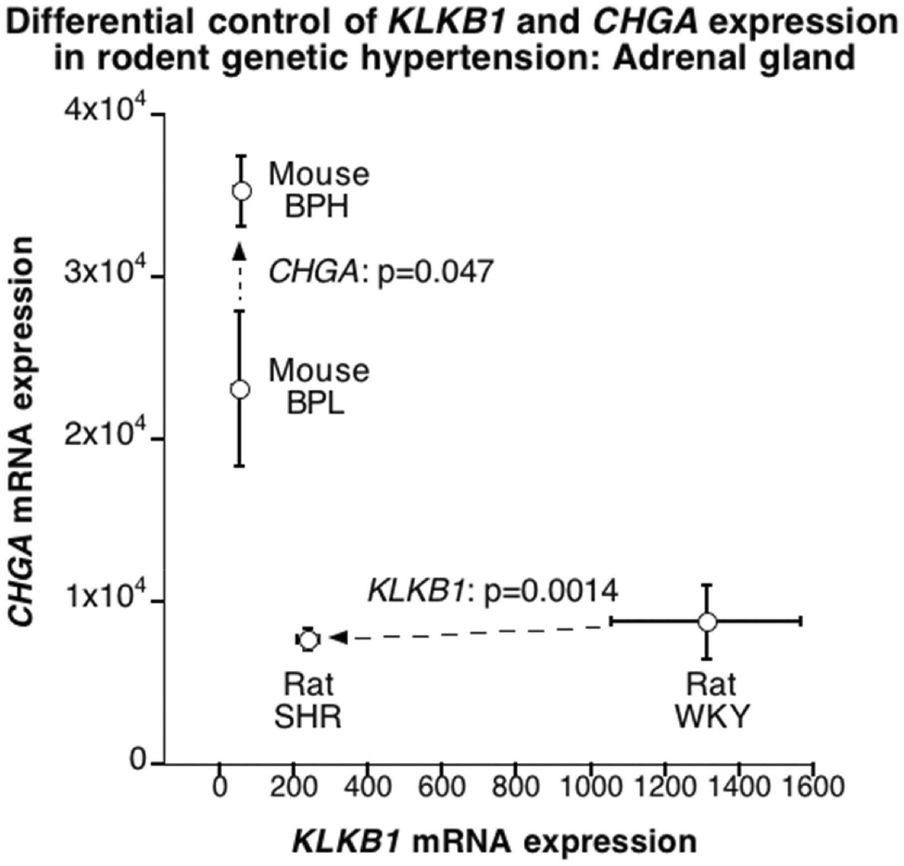
Figure 5 Differential control of expression of Chga versus Klkb1 mRNA in the adrenal gland for two rodent models of ...
Notes:
Figure 5 Differential control of expression of Chga versus Klkb1 mRNA in the adrenal gland for two rodent models of human essential (genetic) hypertension: rat SHR (Spontaneously Hypertensive rat, versus its WKY [Wistar-Kyoto] control); and mouse BPH (Blood Pressure High, versus its BPL [Blood Pressure Low] control).
Unless provided in the caption above, the following copyright applies to the content of this slide: © The Author 2016. Published by Oxford University Press. All rights reserved. For Permissions, please email: journals.permissions@oup.com

Slide 6
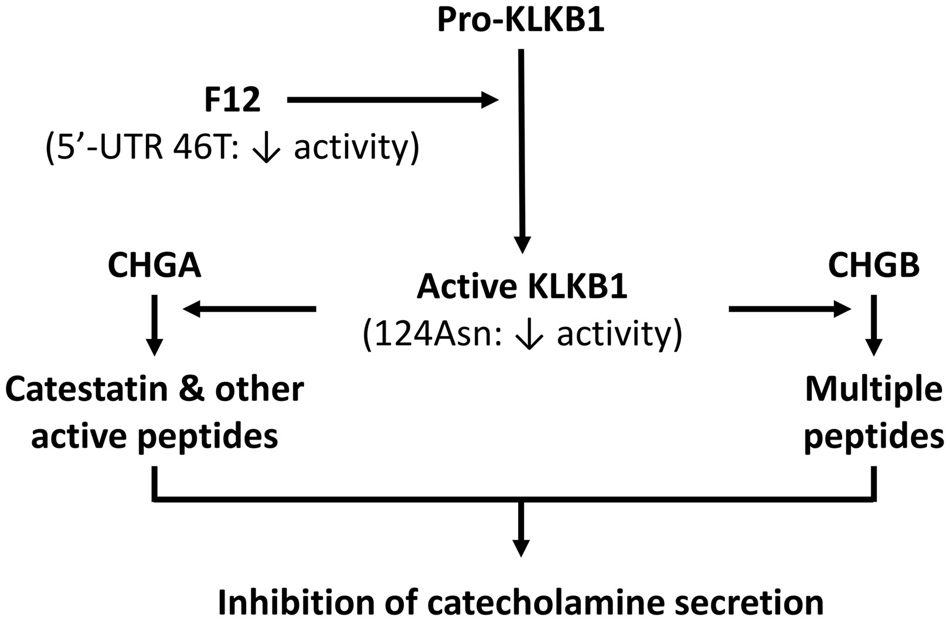
Figure 6 Proposed schema for the effects of functional genetic variation at sequential serine proteases F12 (Hageman ...
Notes:
Figure 6 Proposed schema for the effects of functional genetic variation at sequential serine proteases F12 (Hageman Factor; 5’-UTR C46T, rs2731672) and KLKB1 (Fletcher factor; Asn124Ser, rs3733402), on formation of active peptides by proteolytic cleavage of CHGA or CHGB.
Unless provided in the caption above, the following copyright applies to the content of this slide: © The Author 2016. Published by Oxford University Press. All rights reserved. For Permissions, please email: journals.permissions@oup.com

