Slide 1
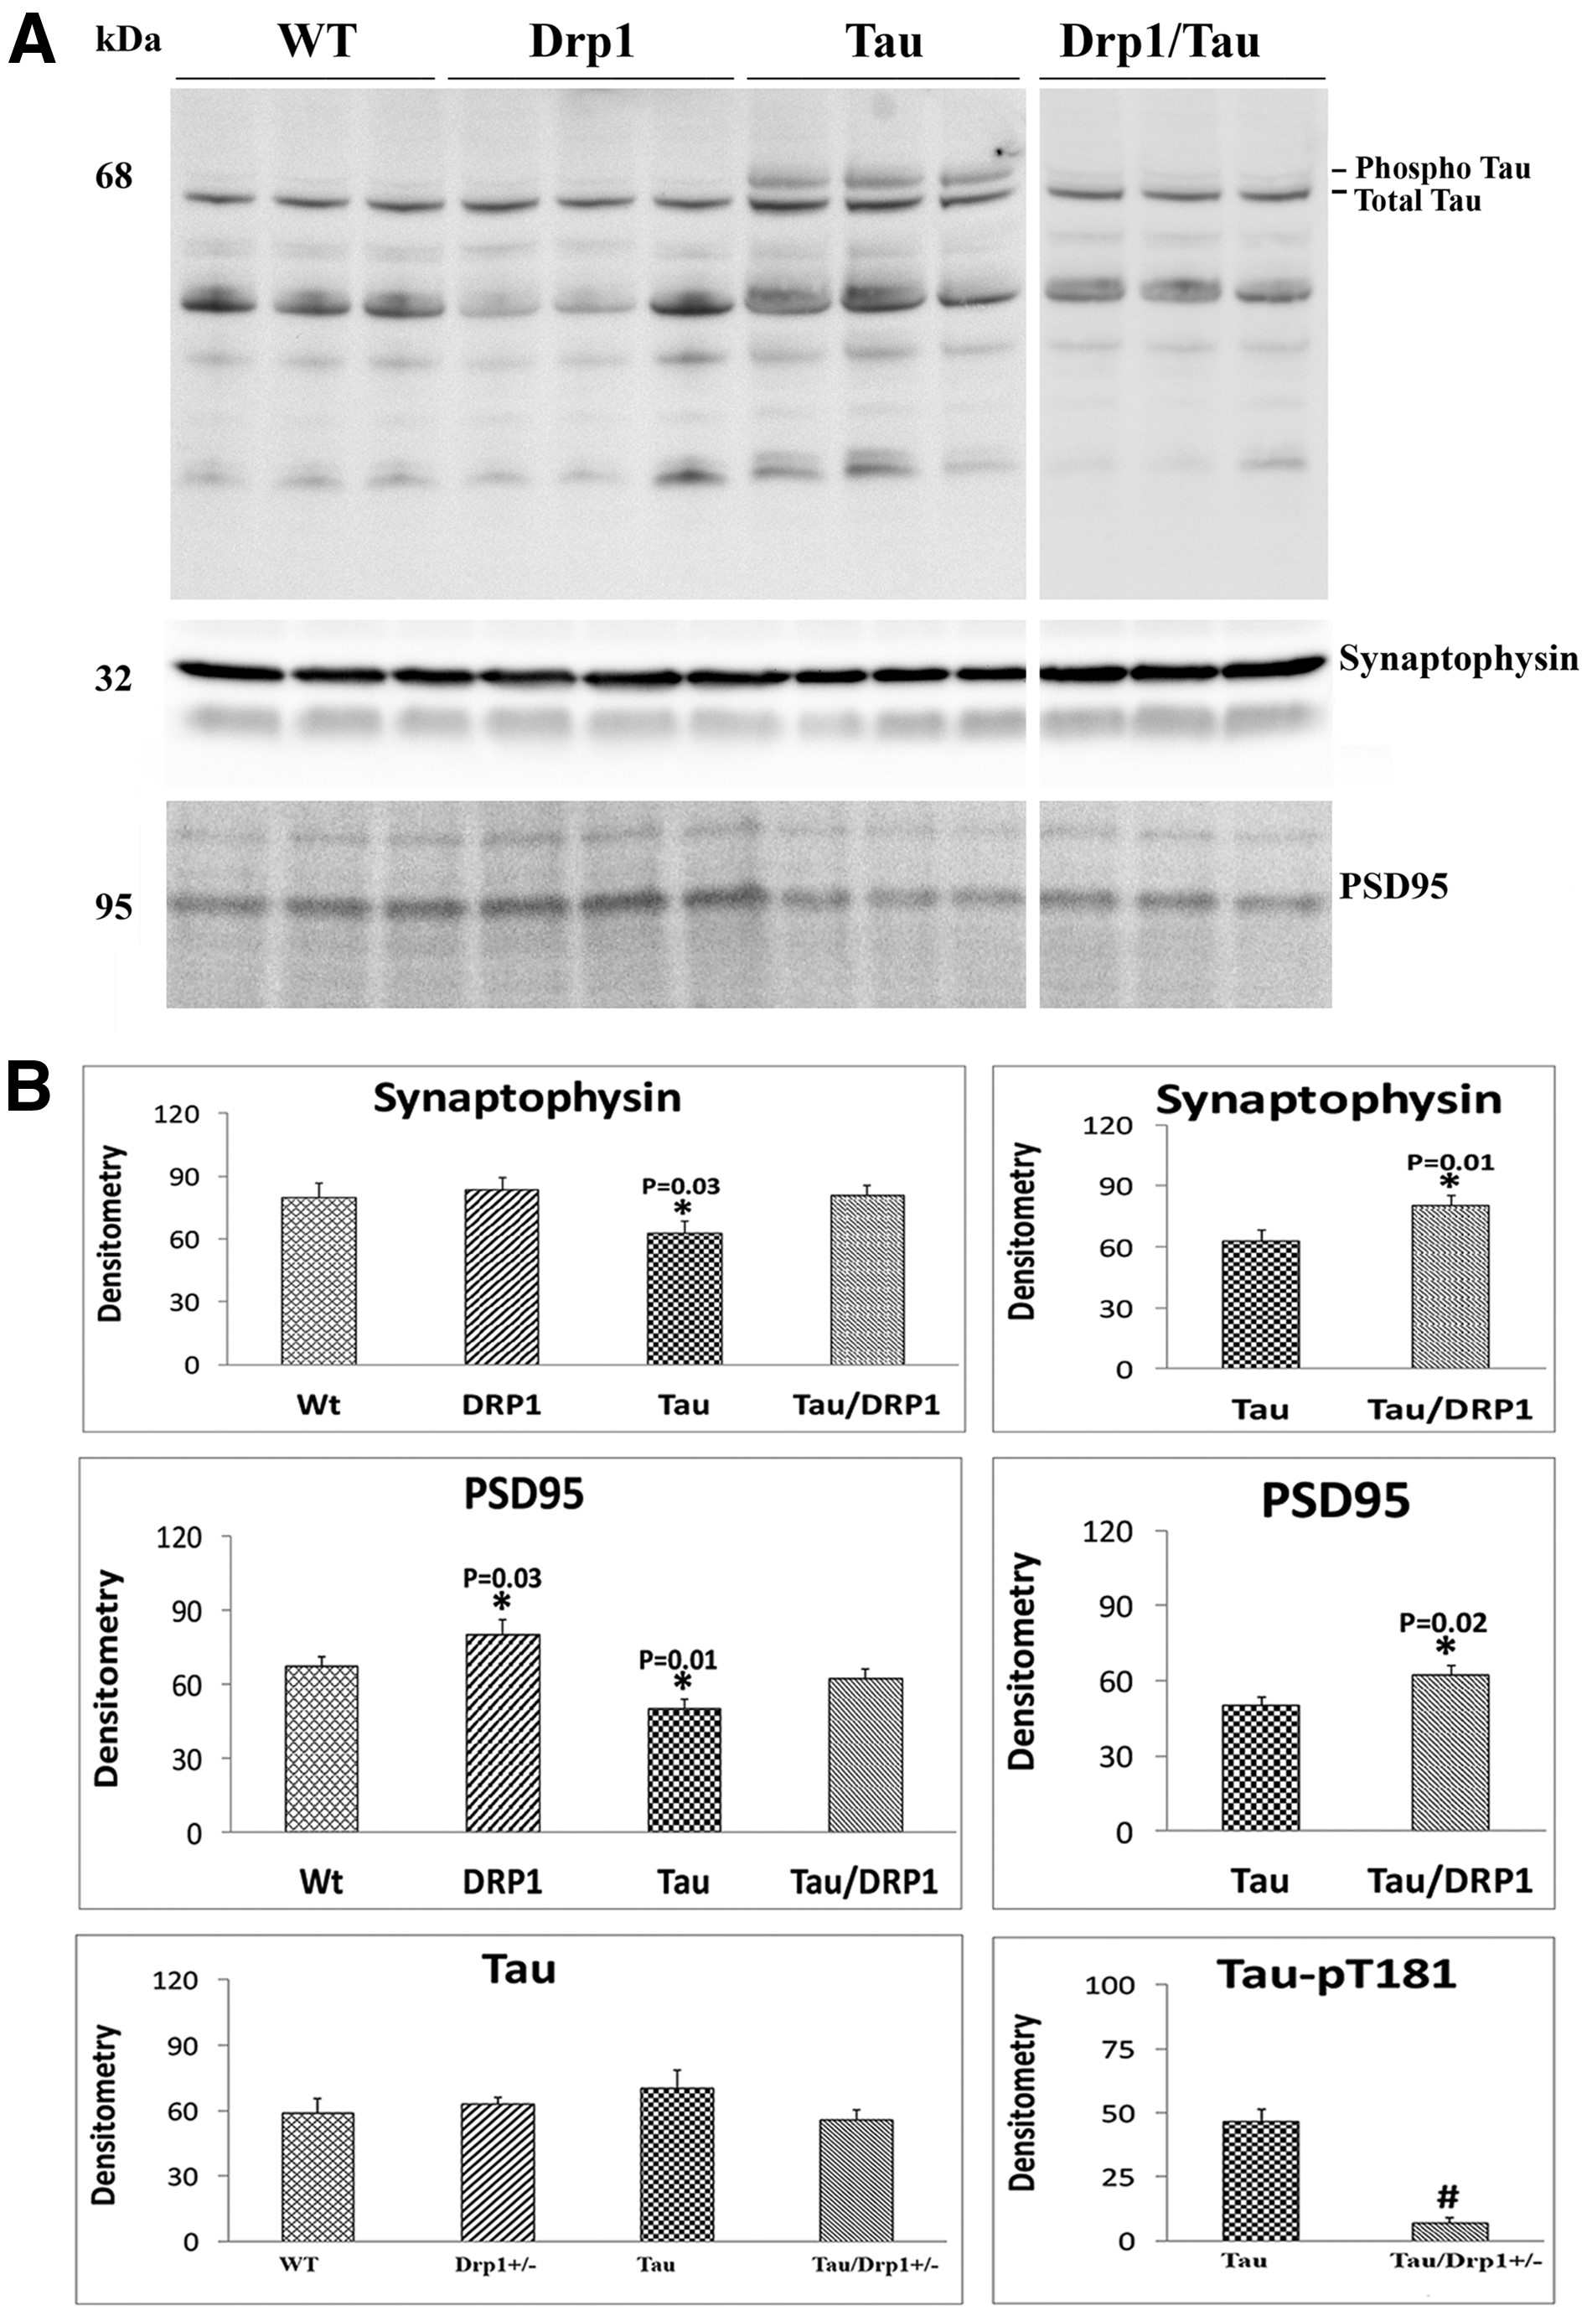
Figure 2 Immunoblotting analysis of phospho Tau and synaptic proteins. (A) Represents immunoblotting analysis. (B) ...
Notes:
Figure 2 Immunoblotting analysis of phospho Tau and synaptic proteins. (A) Represents immunoblotting analysis. (B) Represents quantitative immunoblotting analysis. Synaptophysin and PSD95 proteins were significantly decreased in Tau mice relative to WT mice. On the contrary, synaptophysin and PSD95 proteins were increased in TauXDrp1+/− mice relative to Tau mice. Phosphorylated Tau protein is significantly decreased in TauXDrp1+/− mice relative to Tau mice.
Unless provided in the caption above, the following copyright applies to the content of this slide: © The Author 2016. Published by Oxford University Press. All rights reserved. For Permissions, please email: journals.permissions@oup.com

Slide 2
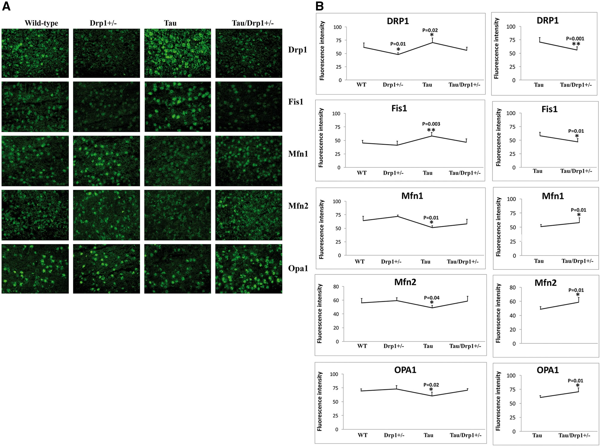
Figure 3 Immunofluorescence analysis of mitochondrial dynamics proteins. (A) Represents immunofluorescence analysis. ...
Notes:
Figure 3 Immunofluorescence analysis of mitochondrial dynamics proteins. (A) Represents immunofluorescence analysis. (B) Represents quantitative immunofluorescence analysis. The fission proteins Drp1 and Fis1 and matrix protein CypD were significantly increased; and the fusion proteins Mfn1, Mfn2, and Opa1 were significantly decreased in Tau mice relative to WT mice. On the contrary, the fission proteins Drp1 and Fis1 and matrix protein CypD were significantly decreased; and the fusion proteins Mfn1, Mfn2, and Opa1 were significantly increased TauXDrp1+/− mice relative to Tau mice. These immunofluorescence findings agree with immunoblotting results.
Unless provided in the caption above, the following copyright applies to the content of this slide: © The Author 2016. Published by Oxford University Press. All rights reserved. For Permissions, please email: journals.permissions@oup.com

Slide 3
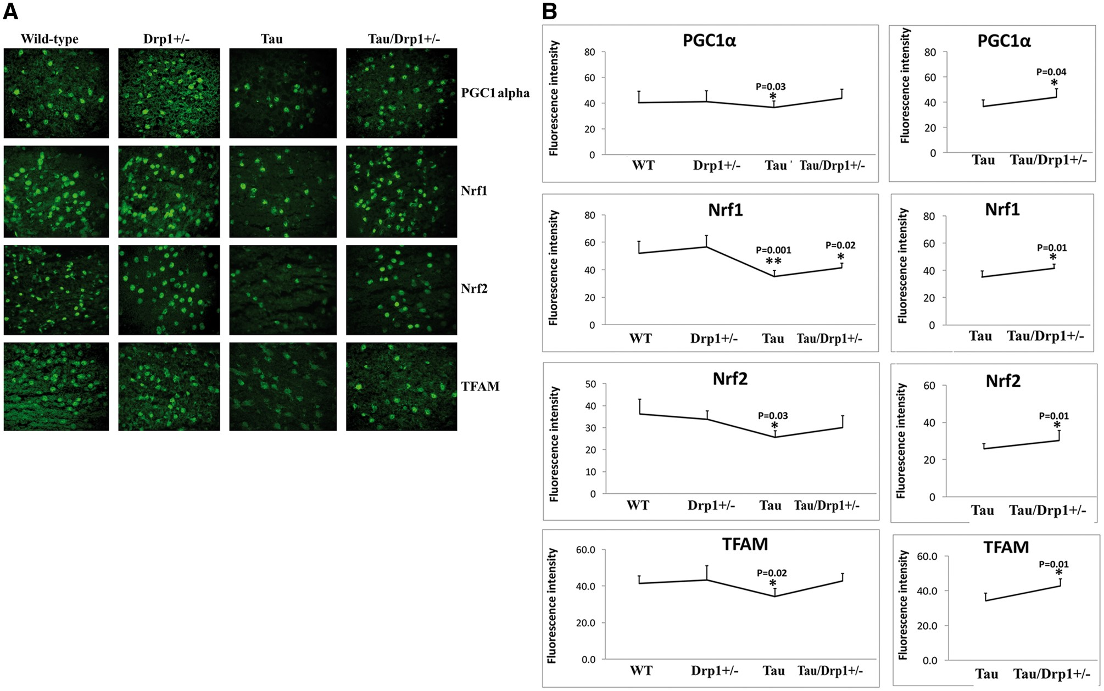
Figure 4 Immunofluorescence analysis of mitochondrial biogenesis proteins. (A) Represents immunofluorescence analysis. ...
Notes:
Figure 4 Immunofluorescence analysis of mitochondrial biogenesis proteins. (A) Represents immunofluorescence analysis. (B) Represents quantitative immunofluorescence analysis. Significantly reduced levels of PGC1α (P = 0.03), Nrf1 (P = 0.001), Nrf2 (P = 0.03) and TFAM (P = 0.02) were found in Tau mice relative to WT mice. On the contrary, increased protein levels were found in PGC1α (P = 0.04), Nrf1 (P = 0.01), Nrf2 (P = 0.01) and TFAM (P = 0.01) in TauXDrp1+/− mice relative to Tau mice.
Unless provided in the caption above, the following copyright applies to the content of this slide: © The Author 2016. Published by Oxford University Press. All rights reserved. For Permissions, please email: journals.permissions@oup.com

Slide 4
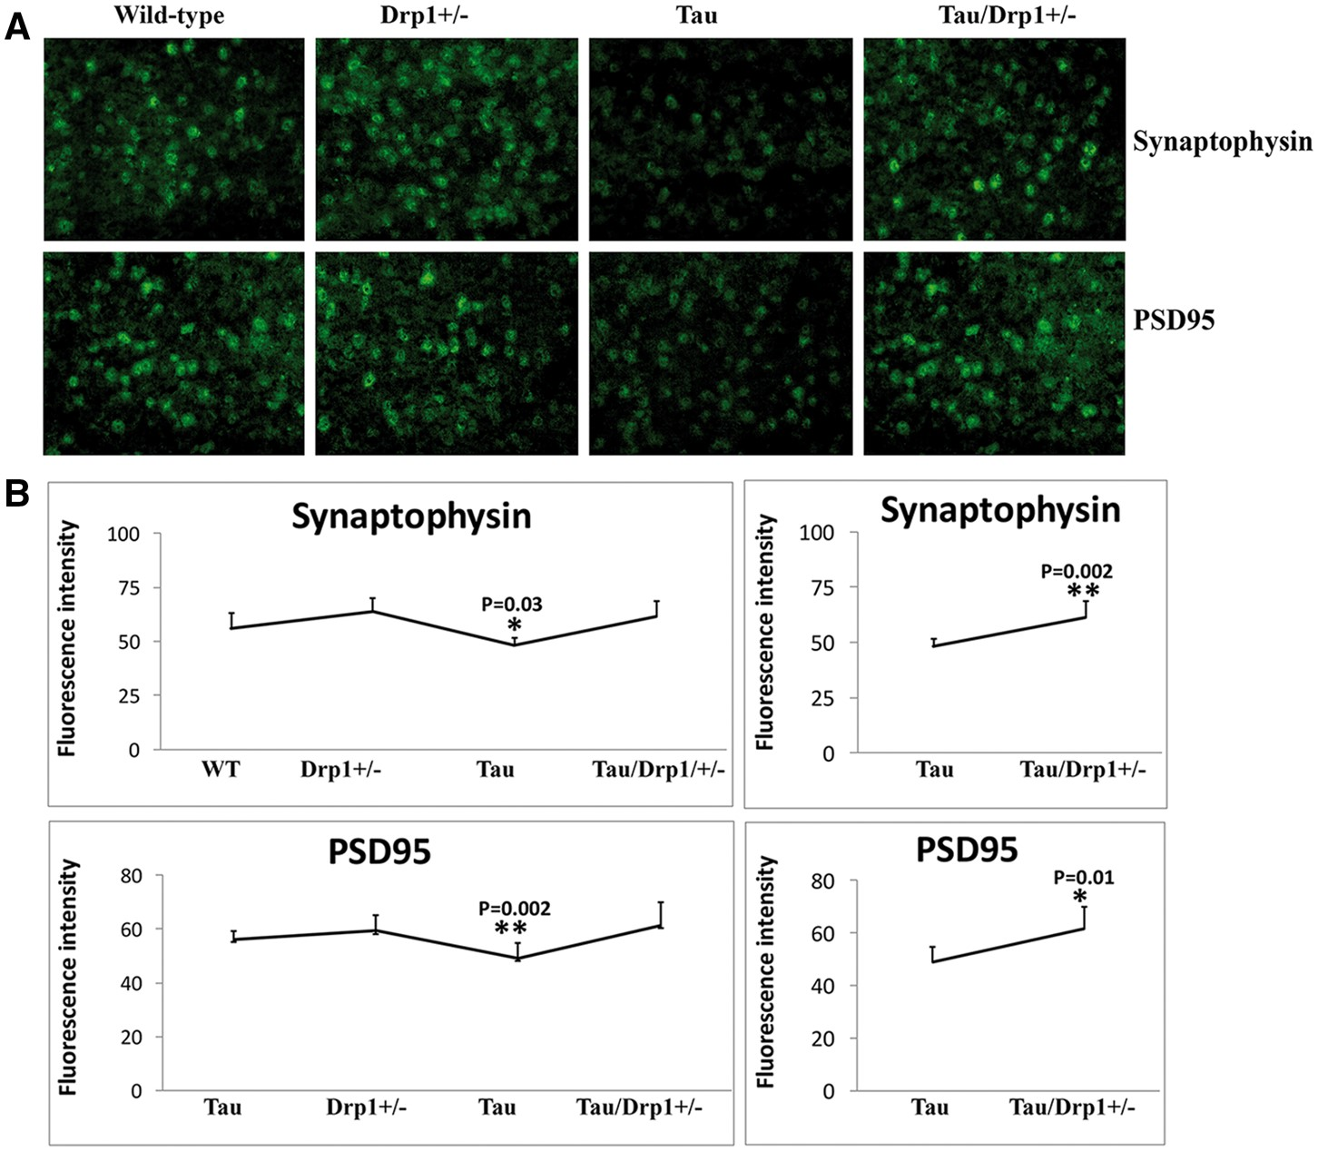
Figure 5 Immunofluorescence analysis of synaptic proteins. (A) Represents immunofluorescence analysis. (B) Represents ...
Notes:
Figure 5 Immunofluorescence analysis of synaptic proteins. (A) Represents immunofluorescence analysis. (B) Represents quantitative immunofluorescence analysis. Synaptic proteins synaptophysin (P = 0.03) and PSD95 (P = 0.002) were significantly decreased in Tau mice relative WT mice (A, B). Synaptic proteins synaptophysin (P = 0.03) and PSD95 (P = 0.002) were significantly increased in TauXDrp1+/− mice relative Tau mice (A, B).
Unless provided in the caption above, the following copyright applies to the content of this slide: © The Author 2016. Published by Oxford University Press. All rights reserved. For Permissions, please email: journals.permissions@oup.com

Slide 5
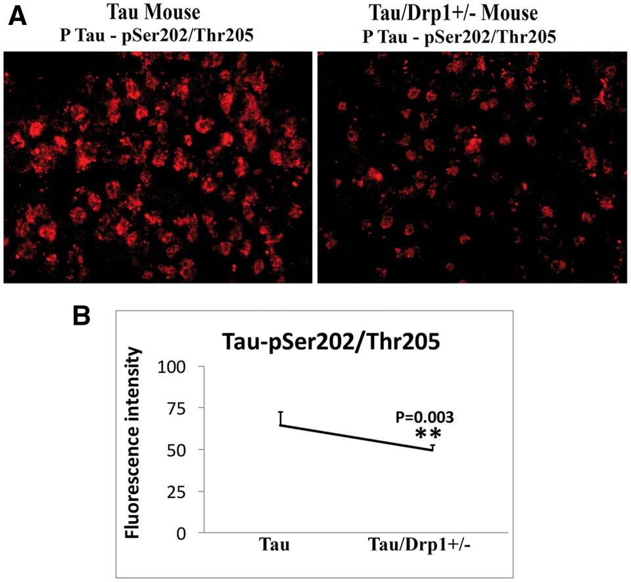
Figure 6 Immunofluorescence analysis of phosphorylated Tau in Tau mice and TauXDrp1+/− mice. (A) Represents ...
Notes:
Figure 6 Immunofluorescence analysis of phosphorylated Tau in Tau mice and TauXDrp1+/− mice. (A) Represents immunofluorescence analysis. (B) Represents quantitative immunofluorescence analysis. Immunoreactivity levels of phosphorylated Tau were significantly reduced in TauXDrp1+/− mice relative to Tau mice (P = 0.003), indicating that a partial reduction of Drp1 reduces phosphorylated Tau in Tau mice.
Unless provided in the caption above, the following copyright applies to the content of this slide: © The Author 2016. Published by Oxford University Press. All rights reserved. For Permissions, please email: journals.permissions@oup.com

Slide 6
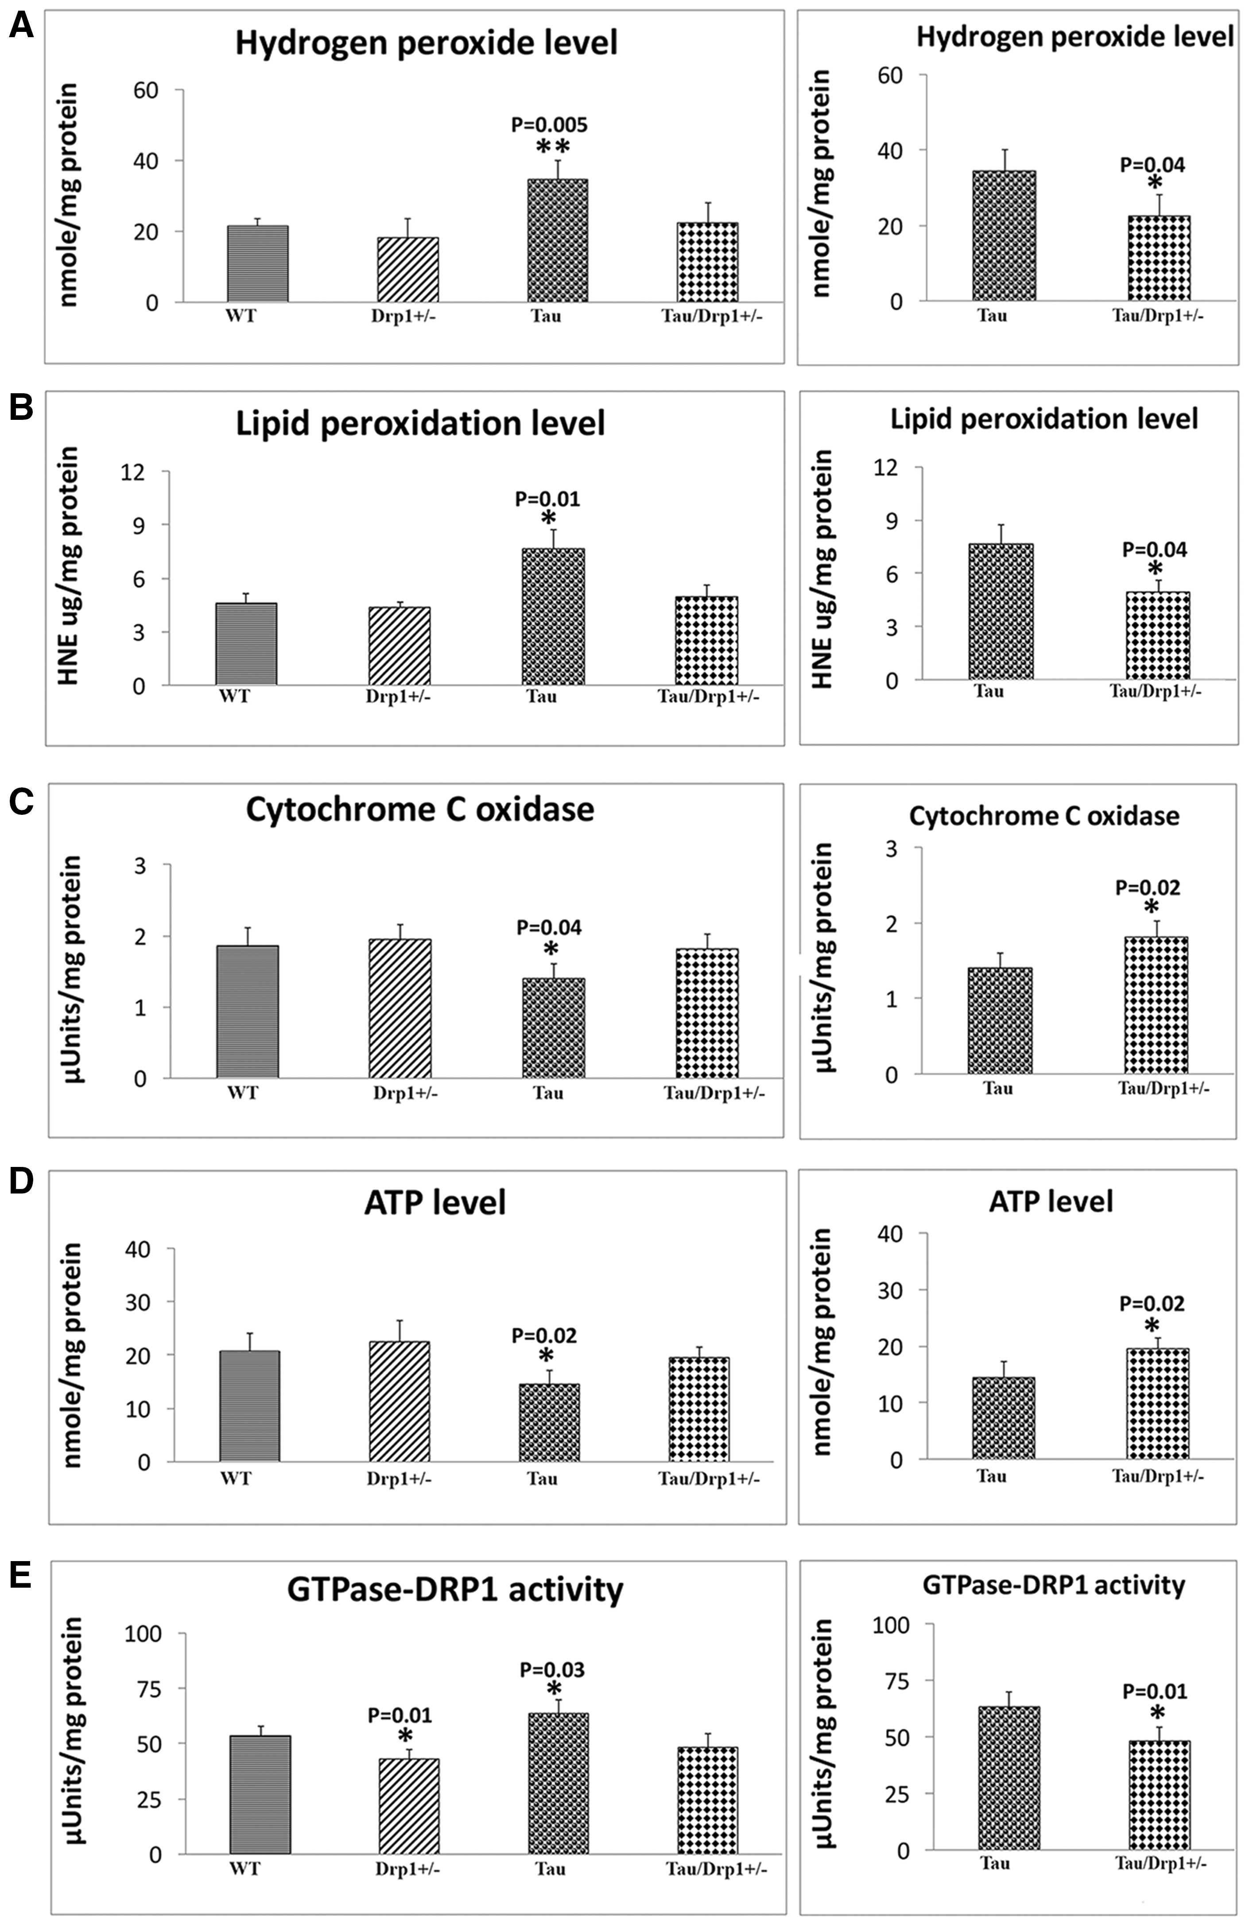
Figure 7 Mitochondrial functional parameters in 6-month-old Drp1+/−, Tau, TauXDrp1+/− and WT mice. Mitochondrial ...
Notes:
Figure 7 Mitochondrial functional parameters in 6-month-old Drp1+/−, Tau, TauXDrp1+/− and WT mice. Mitochondrial function was assessed by measuring: (A) H2O2 production, (B) Lipid peroxidation, (C) Cytochrome oxidase activity (D) ATP levels, and (E) GTPase Drp1. The levels of H2O2 (P = 0.005) (A) and HNE (P = 0.04) (B) were significantly increased and the levels of cytochrome oxidase (P = 0.04) (C) and ATP (P = 0.02) (D) significantly decreased found in Tau mice relative to WT mice. The levels of H2O2 (P = 0.04) (A) and HNE (P = 0.04) (B) were significantly decreased and the levels of cytochrome oxidase (P = 0.02) (C) and ATP (P = 0.02) (D) significantly increased found in Tau/Drp1+/− mice relative to Tau mice. The levels of GTPase Drp1 activity was significantly reduced in Drp1+/− mice (P = 0.01) and increased in Tau mice (P = 0.03) relative to WT mice. In contrast, significantly decreased levels were found TauXDrp1+/− mice (P = 0.01) relative to Tau mice.
Unless provided in the caption above, the following copyright applies to the content of this slide: © The Author 2016. Published by Oxford University Press. All rights reserved. For Permissions, please email: journals.permissions@oup.com

