Slide 1
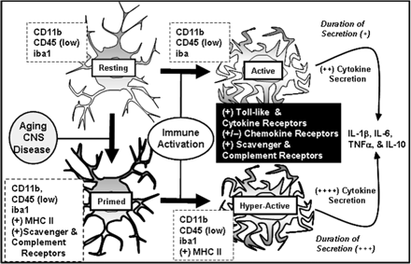
Fig. 1 Microglial priming in the aged brain. This figure illustrates that aging is associated with increased ...
Notes:
Fig. 1 Microglial priming in the aged brain. This figure illustrates that aging is associated with increased reactive or primed microglia in the CNS. Primed microglia express a subset of activation markers, but exhibit minimal pro-inflammatory cytokine release in the absence of immune stimulus. When these primed microglia are activated, they are activated to a greater extent than are non-primed microglia. Therefore, the inflammatory cytokine response initiated by microglia is amplified and prolonged in the aged brain.
Unless provided in the caption above, the following copyright applies to the content of this slide: © The Author 2009. Published by Oxford University Press on behalf of the Society for Integrative and Comparative Biology. All rights reserved. For permissions please email: journals.permissions@oxfordjournals.org.

Slide 2
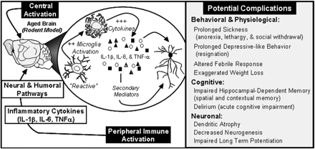
Fig. 2 Potential complications associated with exaggerated neuroinflammation following peripheral immune challenge. ...
Notes:
Fig. 2 Potential complications associated with exaggerated neuroinflammation following peripheral immune challenge. Enhanced neuroinflammation after stimulation of the central or peripheral innate immune system is associated with amplified activation of microglia, which can lead to a number of behavioral, cognitive, and neuronal complications.
Unless provided in the caption above, the following copyright applies to the content of this slide: © The Author 2009. Published by Oxford University Press on behalf of the Society for Integrative and Comparative Biology. All rights reserved. For permissions please email: journals.permissions@oxfordjournals.org.

Slide 3
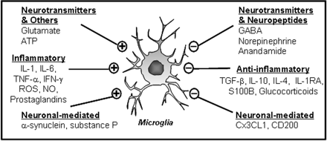
Fig. 3 Microglial regulatory systems. There are several systems involved in microglial regulation. ...
Notes:
Fig. 3 Microglial regulatory systems. There are several systems involved in microglial regulation. This figure illustrates factors that either activate (+) or (–) inhibit microglia. It is plausible that one or more of these pathways are altered in aging, leading to enhanced microglial priming or reactivity.
Unless provided in the caption above, the following copyright applies to the content of this slide: © The Author 2009. Published by Oxford University Press on behalf of the Society for Integrative and Comparative Biology. All rights reserved. For permissions please email: journals.permissions@oxfordjournals.org.

