Slide 1
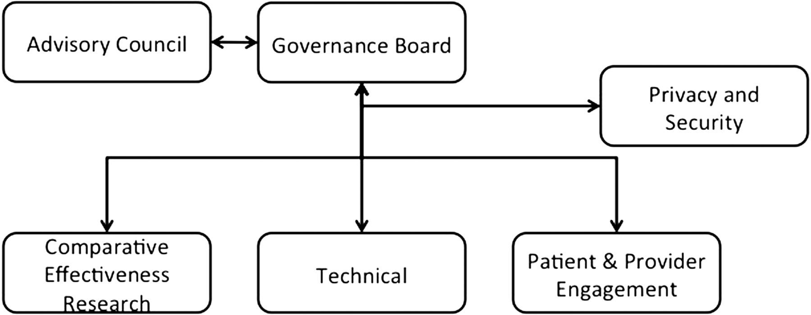
Figure 1 Organizational structure of NYC-CDRN (New York City Clinical Data Research Network).
Notes:
Figure 1 Organizational structure of NYC-CDRN (New York City Clinical Data Research Network).
Unless provided in the caption above, the following copyright applies to the content of this slide: Published by the BMJ Publishing Group Limited. For permission to use (where not already granted under a licence) please go to http://group.bmj.com/group/rights-licensing/permissionsThis is an Open Access article distributed under the terms of the Creative Commons Attribution-NonCommercial licence (http://creativecommons.org/licenses/by-nc/3.0/) which permits non-commercial reproduction and distribution of the work, in any medium, provided the original work is not altered or transformed in any way, and that the work is properly cited. For commercial re-use, please contact journals.permissions@oup.com

Slide 2
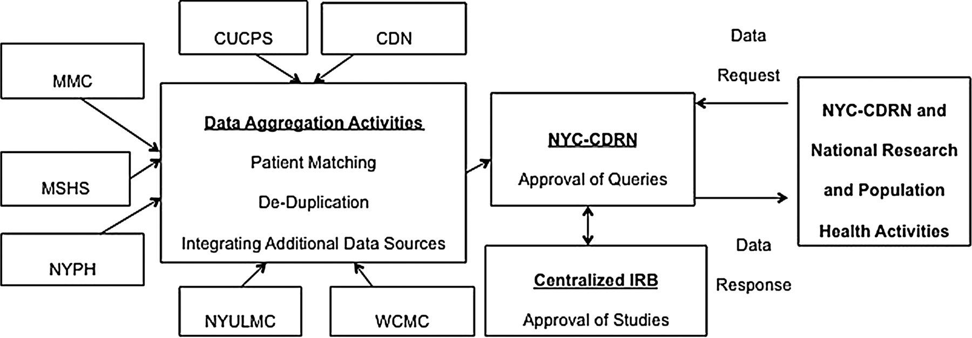
Figure 2 NYC-CDRN (New York City Clinical Data Research Network) data flows.
Notes:
Figure 2 NYC-CDRN (New York City Clinical Data Research Network) data flows.
Unless provided in the caption above, the following copyright applies to the content of this slide: Published by the BMJ Publishing Group Limited. For permission to use (where not already granted under a licence) please go to http://group.bmj.com/group/rights-licensing/permissionsThis is an Open Access article distributed under the terms of the Creative Commons Attribution-NonCommercial licence (http://creativecommons.org/licenses/by-nc/3.0/) which permits non-commercial reproduction and distribution of the work, in any medium, provided the original work is not altered or transformed in any way, and that the work is properly cited. For commercial re-use, please contact journals.permissions@oup.com

