Slide 1
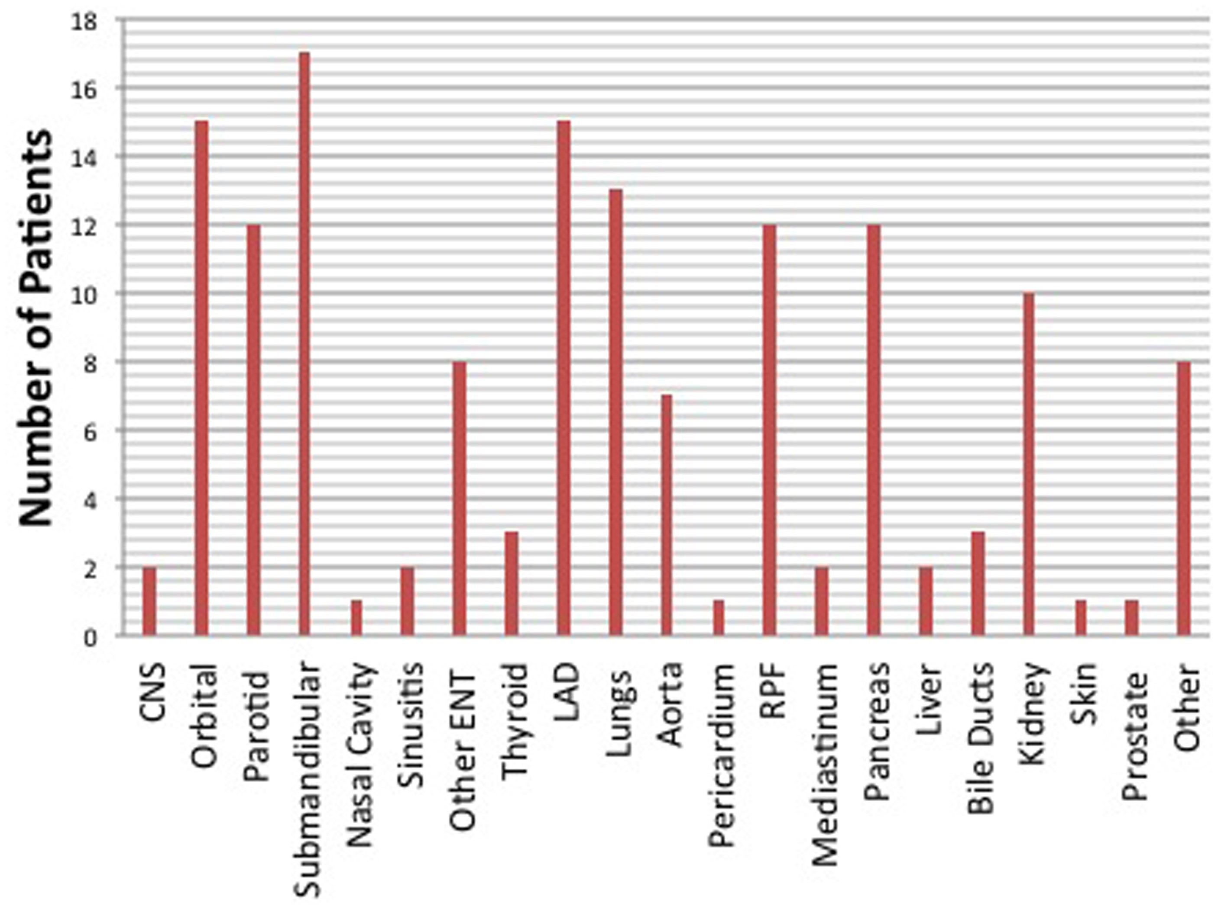
Fig. 1 Baseline organ involvement in the treatment cohort
Notes:
Fig. 1 Baseline organ involvement in the treatment cohort
Unless provided in the caption above, the following copyright applies to the content of this slide: © The Author 2016. Published by Oxford University Press on behalf of the British Society for Rheumatology. All rights reserved. For Permissions, please email: journals.permissions@oup.com

Slide 2
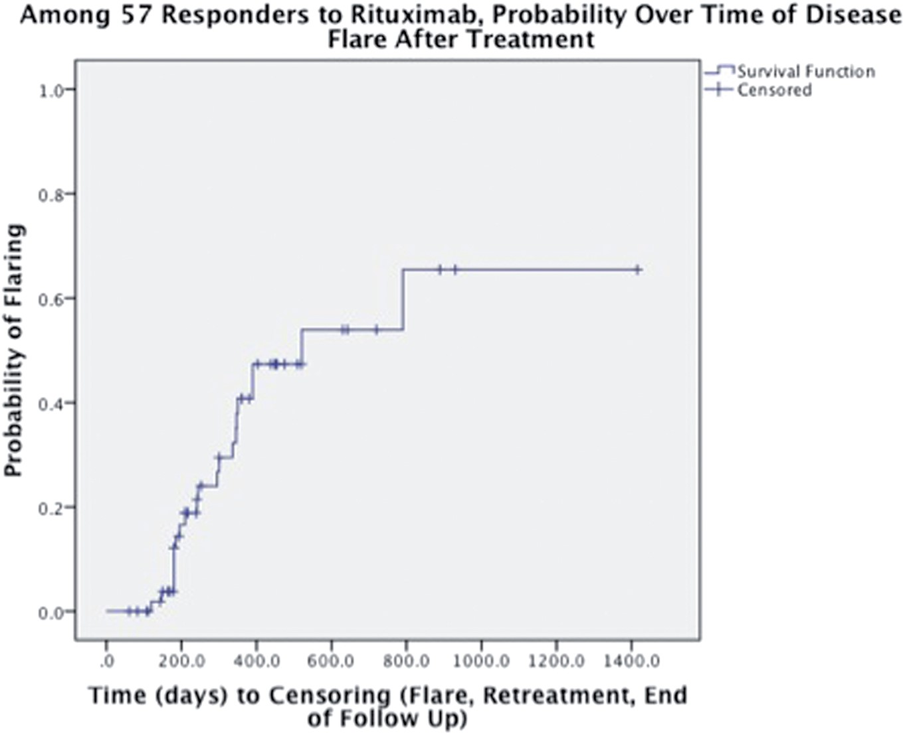
Fig. 2 Probability of disease relapse over time following rituximab response
Notes:
Fig. 2 Probability of disease relapse over time following rituximab response
Unless provided in the caption above, the following copyright applies to the content of this slide: © The Author 2016. Published by Oxford University Press on behalf of the British Society for Rheumatology. All rights reserved. For Permissions, please email: journals.permissions@oup.com

Slide 3
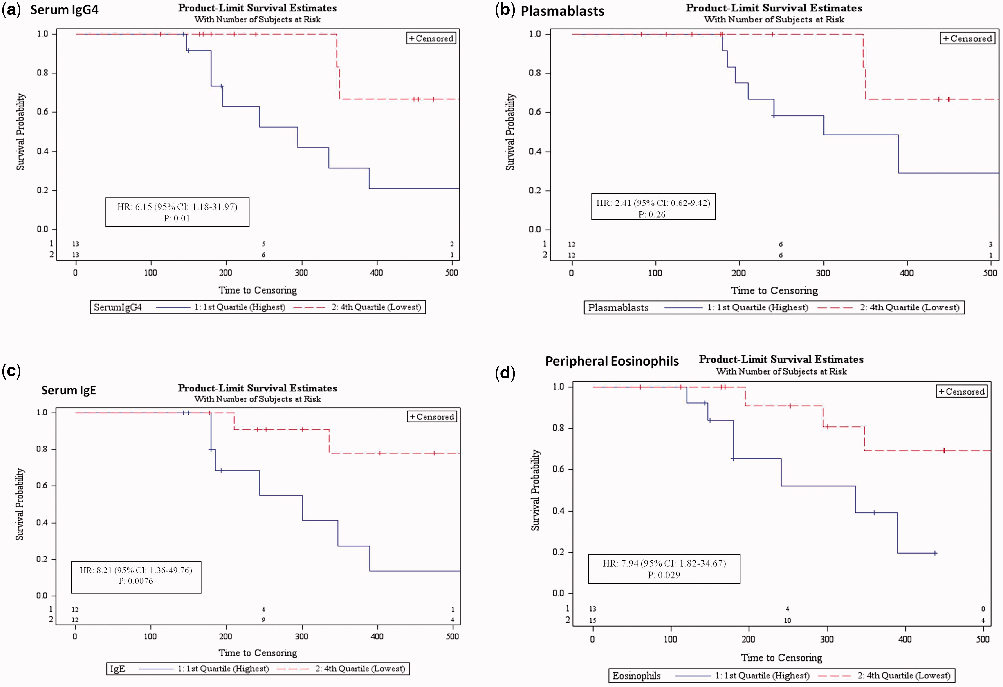
Fig. 3 Kaplan–Meier plots of the risk of disease relapse for the highest and lowest quartiles of potential ...
Notes:
Fig. 3 Kaplan–Meier plots of the risk of disease relapse for the highest and lowest quartiles of potential predictors
Unless provided in the caption above, the following copyright applies to the content of this slide: © The Author 2016. Published by Oxford University Press on behalf of the British Society for Rheumatology. All rights reserved. For Permissions, please email: journals.permissions@oup.com

