Slide 1
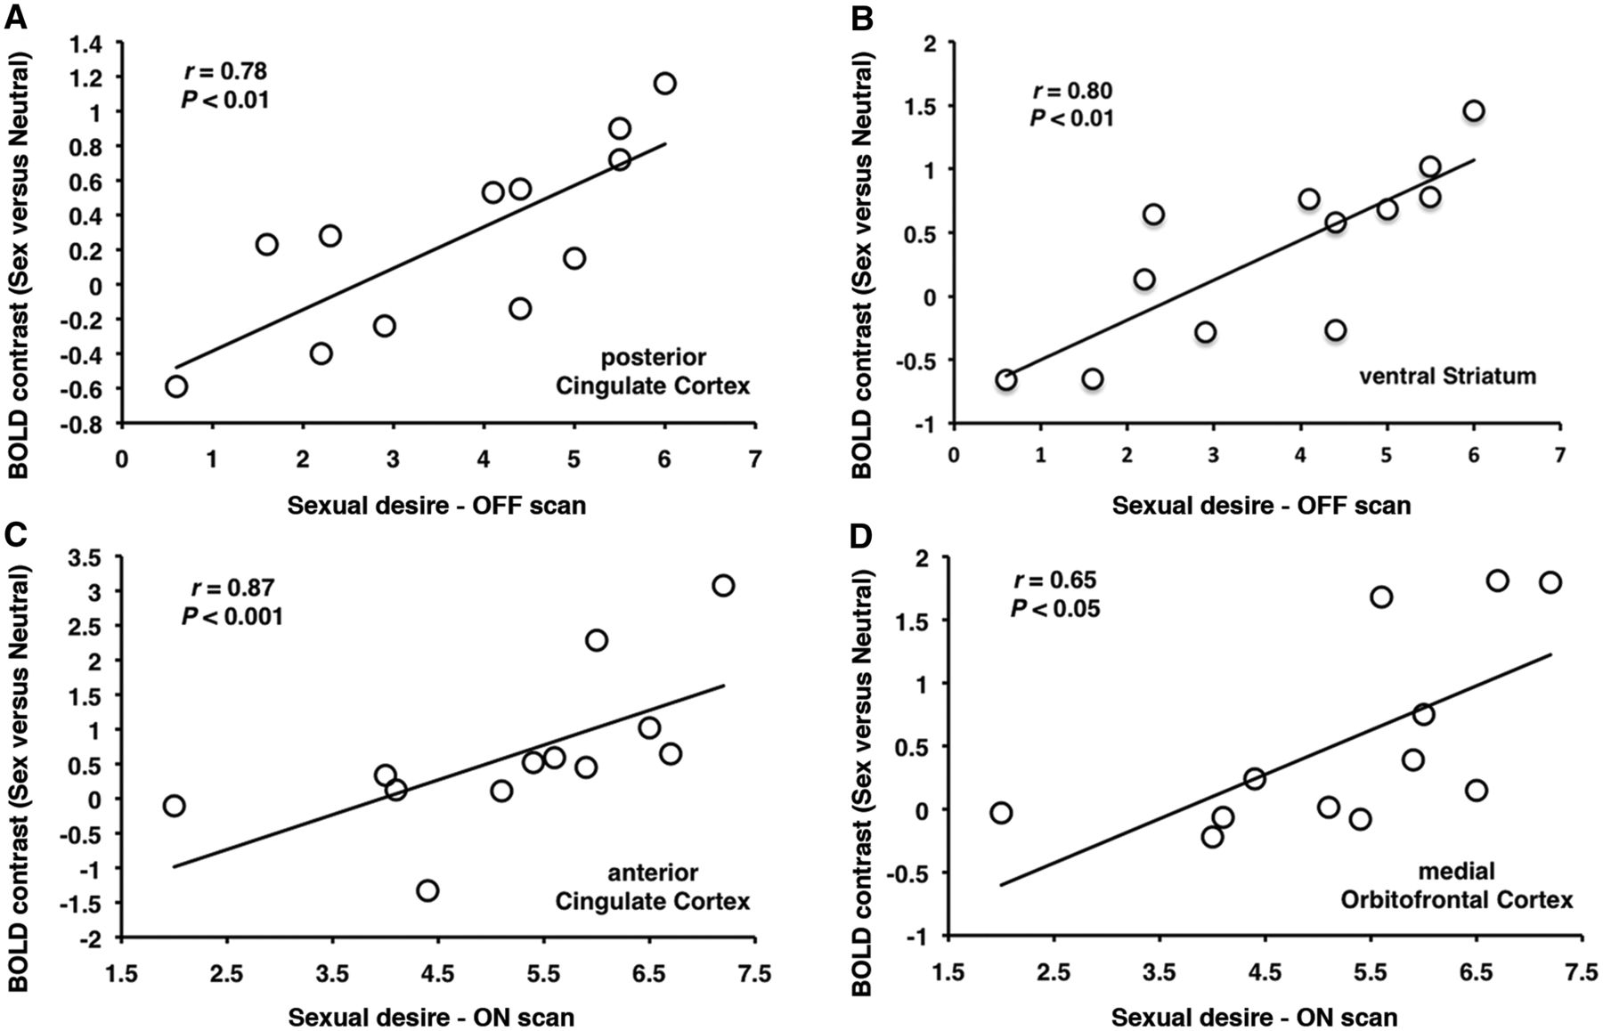
Figure 3 In patients with Parkinson’s disease with hypersexuality, sexual desire post-exposure to sexual imagery ...
Notes:
Figure 3 In patients with Parkinson’s disease with hypersexuality, sexual desire post-exposure to sexual imagery correlates with increases in activation in (A) posterior cingulate cortex and (B) ventral striatum in the OFF medication state and with increases in activation in (C) anterior cingulate cortex and (B) and medial orbitofrontal cortex during the ON medication state.
Unless provided in the caption above, the following copyright applies to the content of this slide: © The Author (2013). Published by Oxford University Press on behalf of the Guarantors of Brain. All rights reserved. For Permissions, please email: journals.permissions@oup.com

