Slide 1
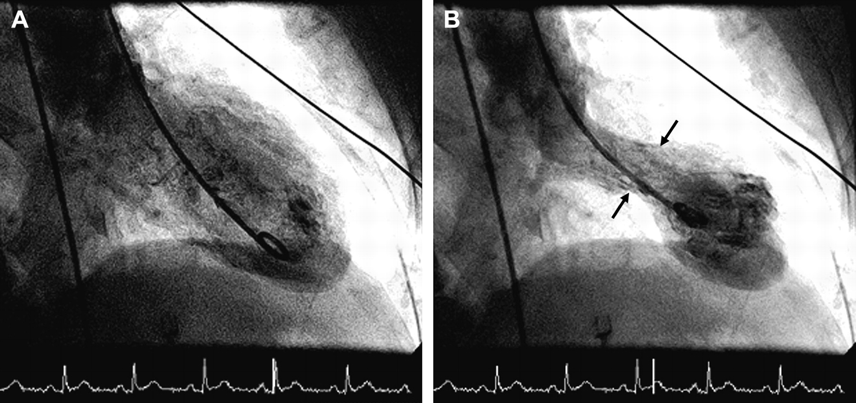
Figure 1 Case 2. End-diastolic and end-systolic left ventriculograms on admission. (A) End-diastole, (B) end-systole. ...
Notes:
Figure 1 Case 2. End-diastolic and end-systolic left ventriculograms on admission. (A) End-diastole, (B) end-systole. End-systolic ventriculogram looks like a ‘Japanise pot’ (Tako-Tsubo) with a round bottom and a narrow neck (arrowed).
Unless provided in the caption above, the following copyright applies to the content of this slide: Copyright © 2005, The European Society of Cardiology

Slide 2
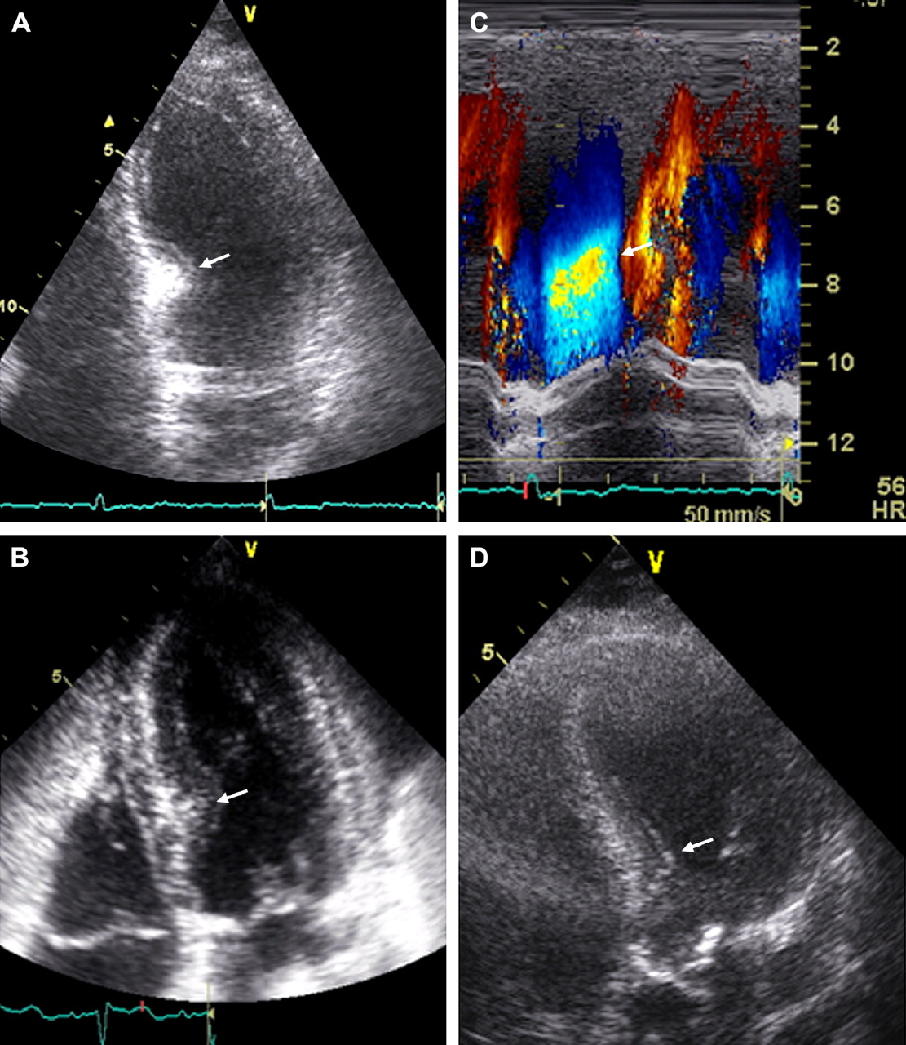
Figure 2 (A,B,D) Left ventricular 4-chamber view in Cases 1, 2 and 3, respectively. The area of mid-basal septal ...
Notes:
Figure 2 (A,B,D) Left ventricular 4-chamber view in Cases 1, 2 and 3, respectively. The area of mid-basal septal thickness is arrowed. (C) Color M-mode across the left ventricle showing the presence of a region of flow acceleration in correspondence of the mid-basal septal thickness.
Unless provided in the caption above, the following copyright applies to the content of this slide: Copyright © 2005, The European Society of Cardiology

Slide 3
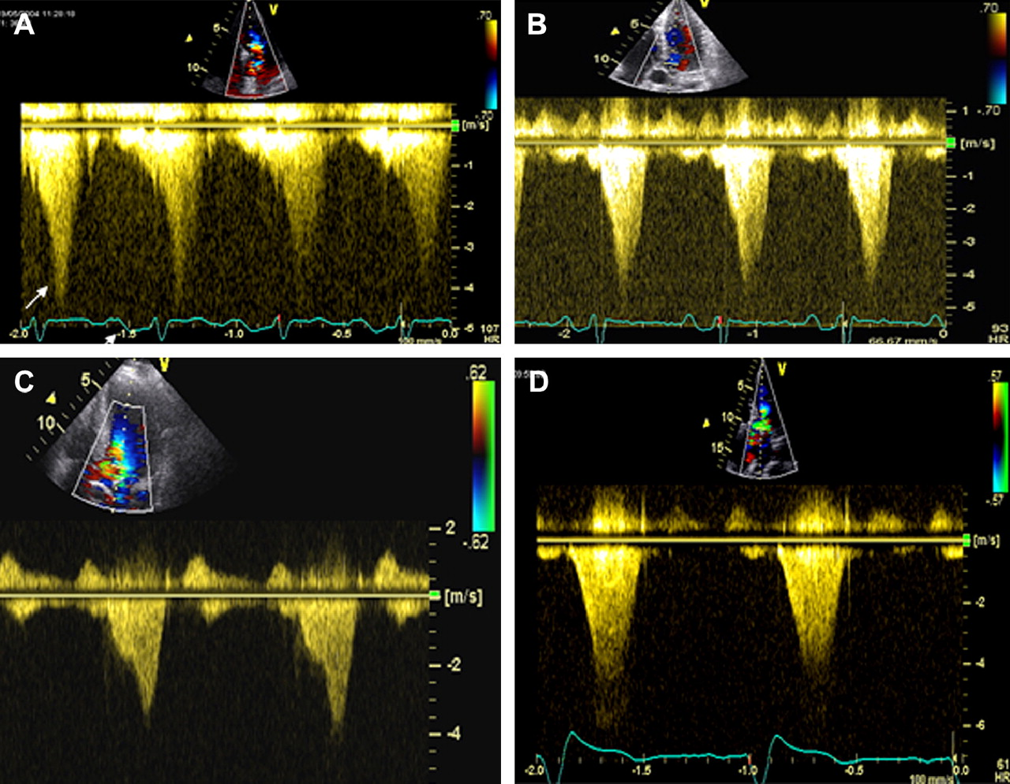
Figure 3 Continuous wave velocity flow profile of the left ventricular peak mid-cavity dynamic gradient recorded on ...
Notes:
Figure 3 Continuous wave velocity flow profile of the left ventricular peak mid-cavity dynamic gradient recorded on admission in Cases 1, 2, 3 and 4 (A,B,C and D, respectively).
Unless provided in the caption above, the following copyright applies to the content of this slide: Copyright © 2005, The European Society of Cardiology

Slide 4
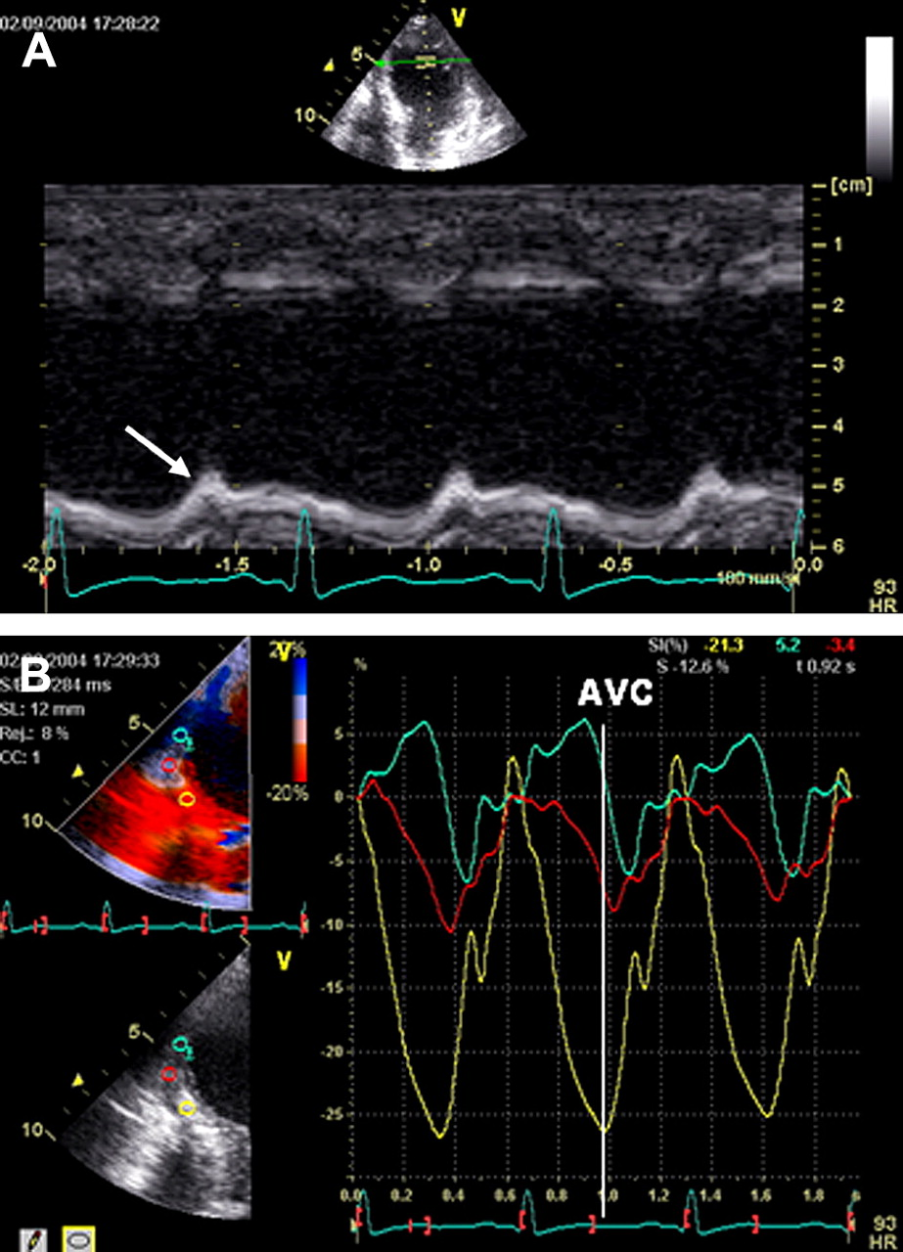
Figure 4 (A) Case 2. Anatomical M-mode of the apical septum on admission showing the absence of systolic thickening ...
Notes:
Figure 4 (A) Case 2. Anatomical M-mode of the apical septum on admission showing the absence of systolic thickening with marked post-systolic thickening (arrow). (B) Strain curve of the corresponding septal segment showing reduced apical systolic deformation ( εsys =−4%) with significant post-systolic deformation ( εmax =−10%; PSI=150%, pattern consistent with post-ischaemic myocardium) and normal systolic deformation in the mid-septum.
Unless provided in the caption above, the following copyright applies to the content of this slide: Copyright © 2005, The European Society of Cardiology

Slide 5
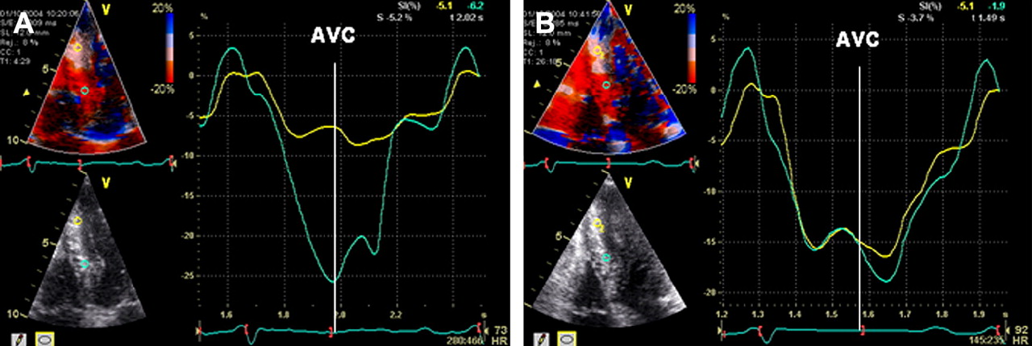
Figure 5 Case 2. Strain curve of basal and apical septum during low-dose dobutamine stress-echocardiography. (A) At ...
Notes:
Figure 5 Case 2. Strain curve of basal and apical septum during low-dose dobutamine stress-echocardiography. (A) At baseline mid-basal systolic deformation is normal ( εsys =−20%) whereas apical systolic deformation is reduced ( εsys =−6%) with significant post-systolic deformation ( εmax =−9%; PSI=50%; pattern consistent with post-ischaemic myocardium). (B) At peak dose apical systolic deformation normalised: εsys =−15%; εmax =−16%; PSI=6%. This response is typical for stunning myocardium. AVC=Aortic valve closure.
Unless provided in the caption above, the following copyright applies to the content of this slide: Copyright © 2005, The European Society of Cardiology

