Slide 1
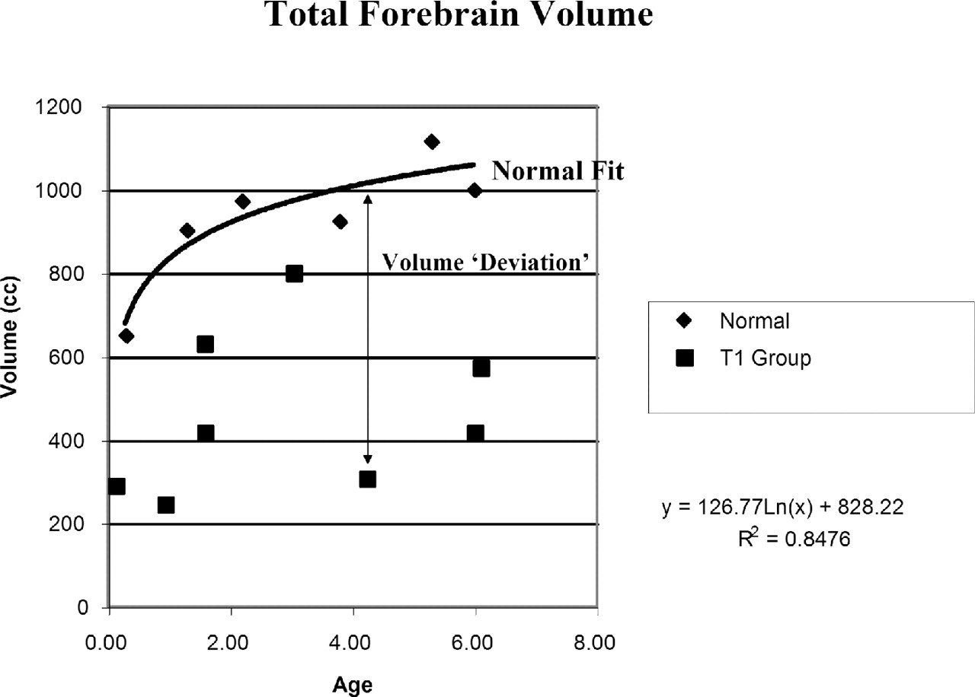
Figure 1. Normal growth curves. This plot demonstrates the volume of the total forebrain as a function of ...
Notes:
Figure 1. Normal growth curves. This plot demonstrates the volume of the total forebrain as a function of age. The normative subjects (diamonds) demonstrate logarithmic growth as a function of age (curve fit and parameters indicated). For any given HPE subject (squares), the deviation from the normative curve for the subjects age can be calculated.
Unless provided in the caption above, the following copyright applies to the content of this slide:

Slide 2
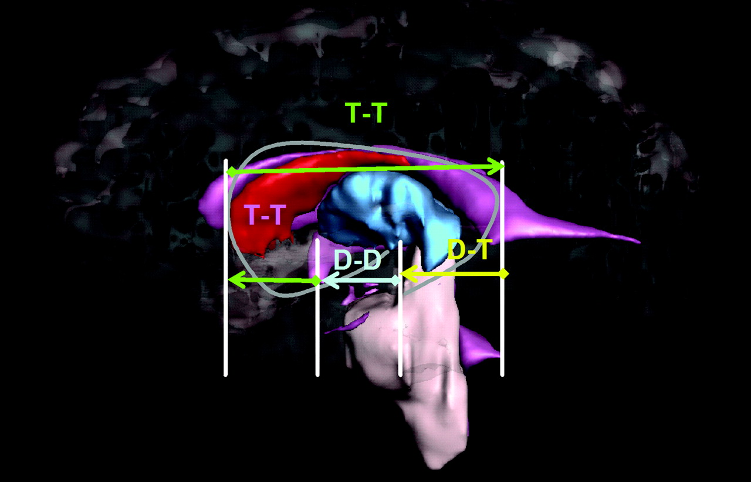
Figure 2. Schematic diagram of topographic segments pertaining to developmental staging as superimposed upon ...
Notes:
Figure 2. Schematic diagram of topographic segments pertaining to developmental staging as superimposed upon a three dimensional reconstruction of the midsagittal aspect of the normal brain. DD is the diencephalic segment extending from the subthalamus to the suprachiasmatic junction with telencephalon. TT is the telencephalic segment extending from the DD segment through the septal limb of the prosencephalic ventricles to the hippocampal commissure. DT is the diencephalic-telencephalic segment which diverges laterally from the midline to follow the temporal limb of the choroid fissure to the amygdala.
Unless provided in the caption above, the following copyright applies to the content of this slide:

Slide 3
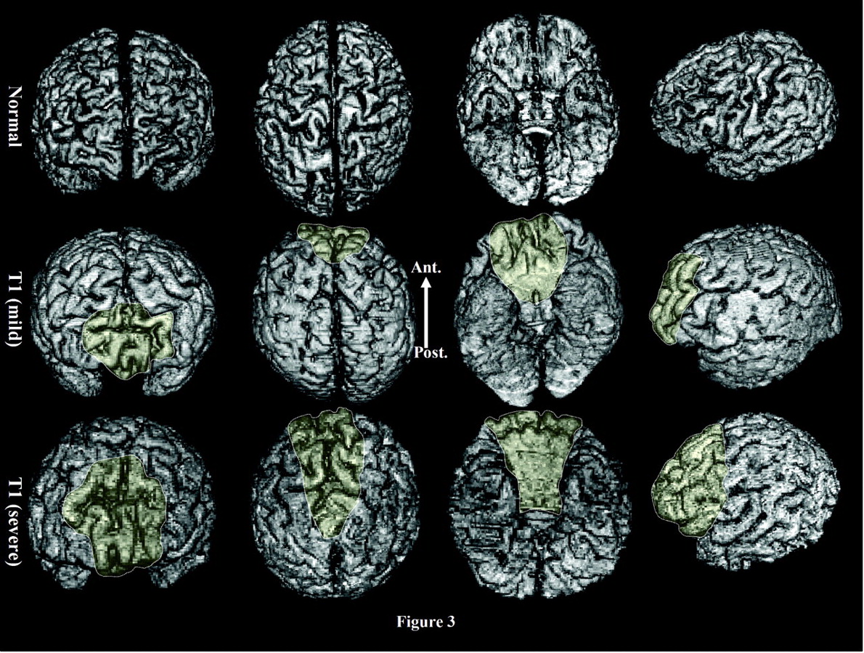
Figure 3. Surface reconstructions of control and HPE brains as seen from frontal, superior, inferior and left ...
Notes:
Figure 3. Surface reconstructions of control and HPE brains as seen from frontal, superior, inferior and left lateral aspects. A transparent veil is superposed over the rostral region of conjunction of left and right cortex with no intervening interhemispheric fissure. The two HPE brains present the minimal and maximal extremes of midline cortical conjunction from the series. In the minimal example, the zone without interhemispheric fissure extends from the suprachiasmatic through the frontopolar region and the zone of partial fissure into the posterior frontal region. In the maximal example the corresponding zones without fissure and with partial fissure continue further caudally into the frontoparietal region.
Unless provided in the caption above, the following copyright applies to the content of this slide:

Slide 4
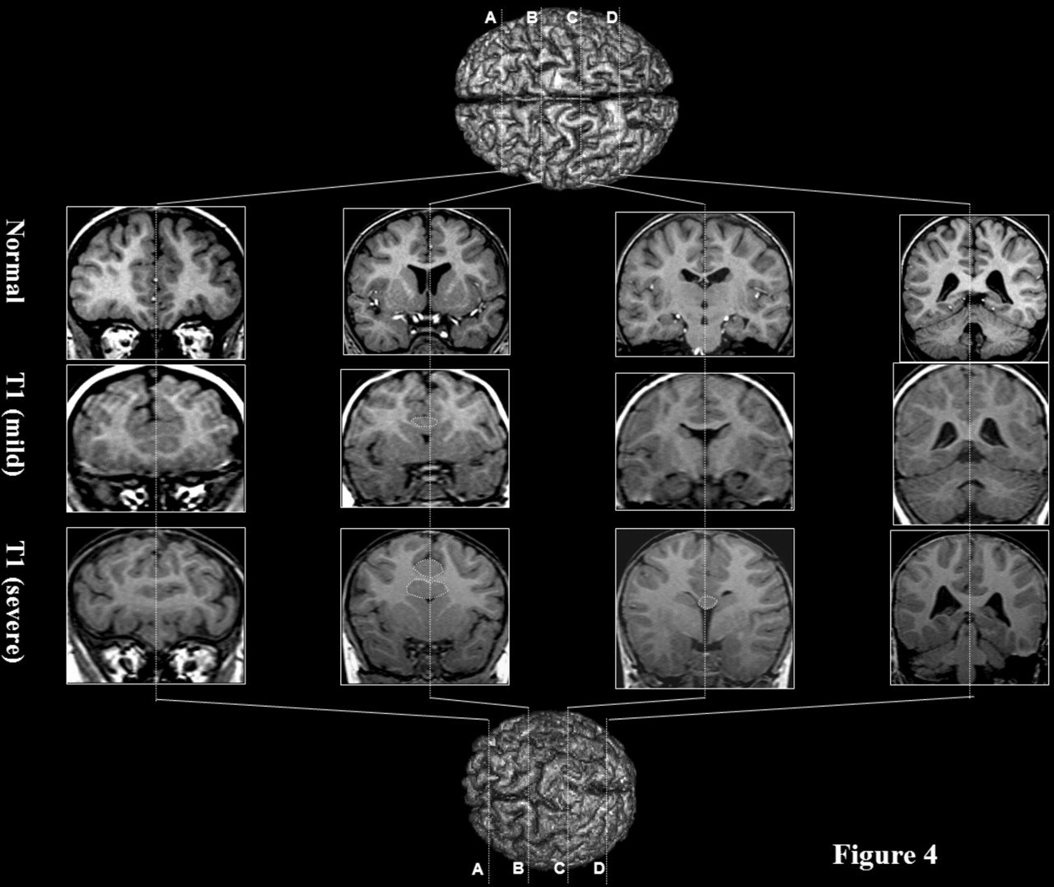
Figure 4. Coronal images of control and HPE brains, referenced to cerebral exteriors, with minimal and ...
Notes:
Figure 4. Coronal images of control and HPE brains, referenced to cerebral exteriors, with minimal and maximal degrees of malformation. The midforebrain images (B–D) of the control brain illustrate discontinuity of neocortical faces of interhemispheric fissure in superior relation to corpus callosum. The fornices are separated from thalamus by closed choroid fissure and choroid plexus (B–D). Rostrally in the two brains with HPE left and right cortex are continuous at the fundus of a partial depth interhemispheric fissure (A, B). There are no evident septal nuclei, fornix or septal choroid plexus and the ventricular system is continuous through the open septal limbs of the choroid fissures (B, C). Caudally the interhemispheric fissure becomes full depth and left and right cortical faces are bridged at the fundus by a seam of gray matter (C) (masks). The seam may be traced rostrally to where it becomes continuous with the conjoined heads of the caudate encapsulating the anterior tip of a probe shaped tip of the forebrain ventricle. In caudal relation to the corpus callosum, left and right cortex are normally discontinuous in the fundus of the full depth interhemispheric fissure. Occipital and temporal structures are topologically normal (D). In contrast to the abnormal structures of the septal limb, the temporal limb of choroid fissure and hippocampus extending from amygdale to hippocampal commissure (B–D) as well as the topology of internal capsules, thalamus (B), subthalamus, peduncles (C) and lower brain stem and cerebellum (D) are normal.
Unless provided in the caption above, the following copyright applies to the content of this slide:

Slide 5
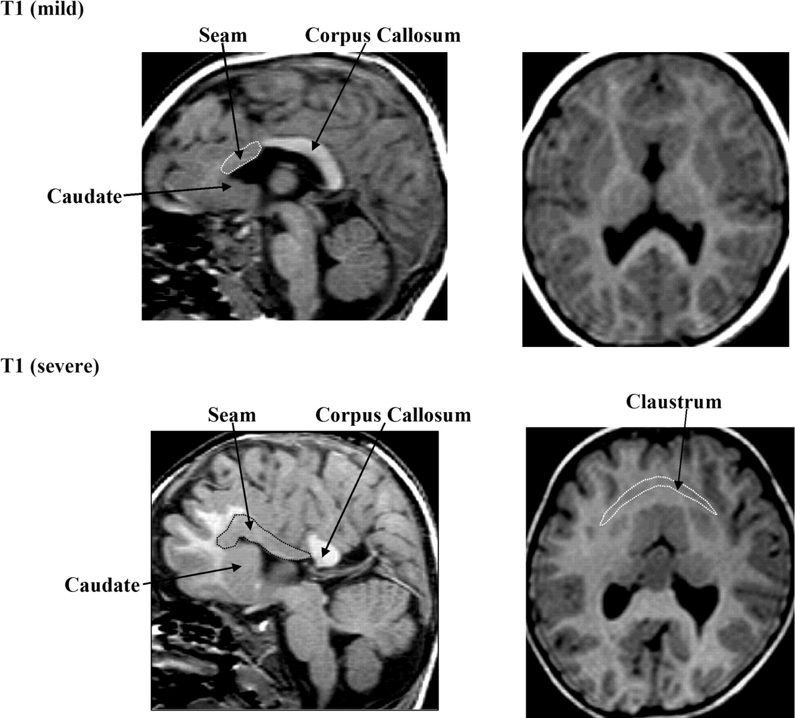
Figure 5. Minimal and maximal degrees of malformation in the present series as viewed in midsagittal and ...
Notes:
Figure 5. Minimal and maximal degrees of malformation in the present series as viewed in midsagittal and axial planes. The cortical contribution to the seam is covered by masks in the sagittal images. The extent of corpus callosum is greatly different. At its rostral edge it abuts the caudal limit of the seam. Continuity of claustrum across the midline (covered by mask) is evident, in the axial image from the maximally involved. The sagittal views of the HPE brains confirm the normal contours of diencephalon, brain stem and cerebellum.
Unless provided in the caption above, the following copyright applies to the content of this slide:

Slide 6
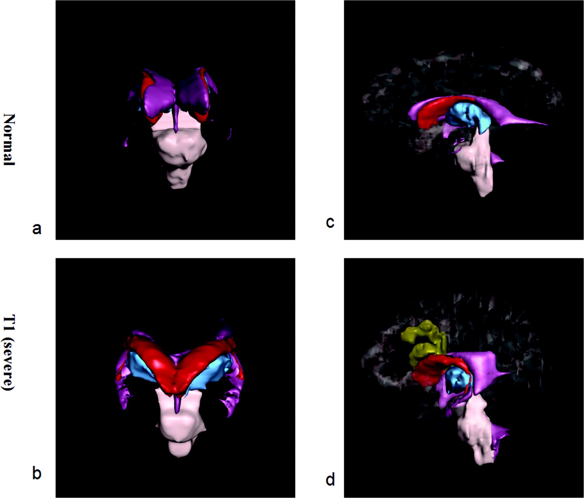
Figure 6. Three-dimensional reconstruction of frontal (a, b) and interhemispheric (c, d) perspectives of ...
Notes:
Figure 6. Three-dimensional reconstruction of frontal (a, b) and interhemispheric (c, d) perspectives of brain from the T1 series of HPE (b, d) and a normal brain (a, c). The cerebral exterior is projected as a transparency in (c, d). Normally paired caudates (red) are conjoined over the ventricular (purple) anterior tip in HPE. The rostral infolded cortex and cortical contribution to the seam (yellow) are continuous with surface and interhemispheric cortex and are part of a gray matter continuum with caudate heads rostrally. The gray matter continuum terminates caudally at the callosal decussation (not reconstructed). The thalamus (blue) lies deep and medial to the temporal to septal arc of the ventricular system and choroid fissure.
Unless provided in the caption above, the following copyright applies to the content of this slide:

Slide 7
Figure 7. The three grades of anomaly ranging from no interhemispheric fissure, to partial and full depth ...
Notes:
Figure 7. The three grades of anomaly ranging from no interhemispheric fissure, to partial and full depth fissure with seam are referenced to the appearance in coronal images. Topology is normal caudally in dorsal relation to the corpus callosum.
Unless provided in the caption above, the following copyright applies to the content of this slide:

Slide 8
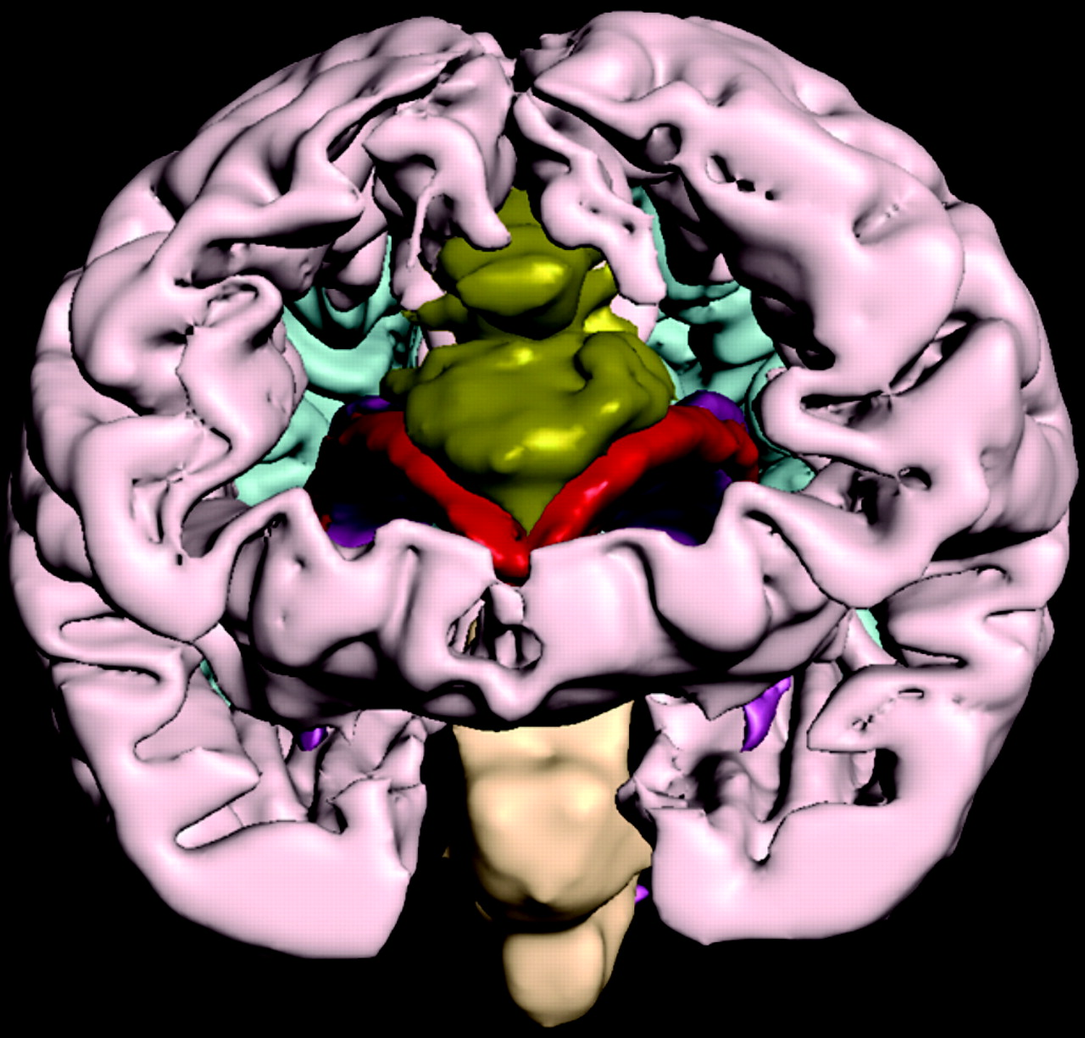
Figure 8. Three dimensional frontal reconstruction of cerebrum in T1 HPE brain. The conjoined polar region of ...
Notes:
Figure 8. Three dimensional frontal reconstruction of cerebrum in T1 HPE brain. The conjoined polar region of the cerebrum and the central white matter are computationally removed. As noted earlier by Yakovlev (Yakovlev, 1959), there is apparent continuity of insular cortex across the midline at expense of frontal association regions. The rostral infolded cortex and its continuity with the gray matter seam (yellow), continuing into the caudate heads (red) is visible through the rostral window of the reconstruction. The inner surface of posterior convexity cortex visually flanking the deep gray structures is rendered in blue in order to heighten the apparent depth projection of the central gray matter structures. The temporal tips of the ventricular system (purple) are visible through the windowed anterior temporal lobes.
Unless provided in the caption above, the following copyright applies to the content of this slide:

Slide 9
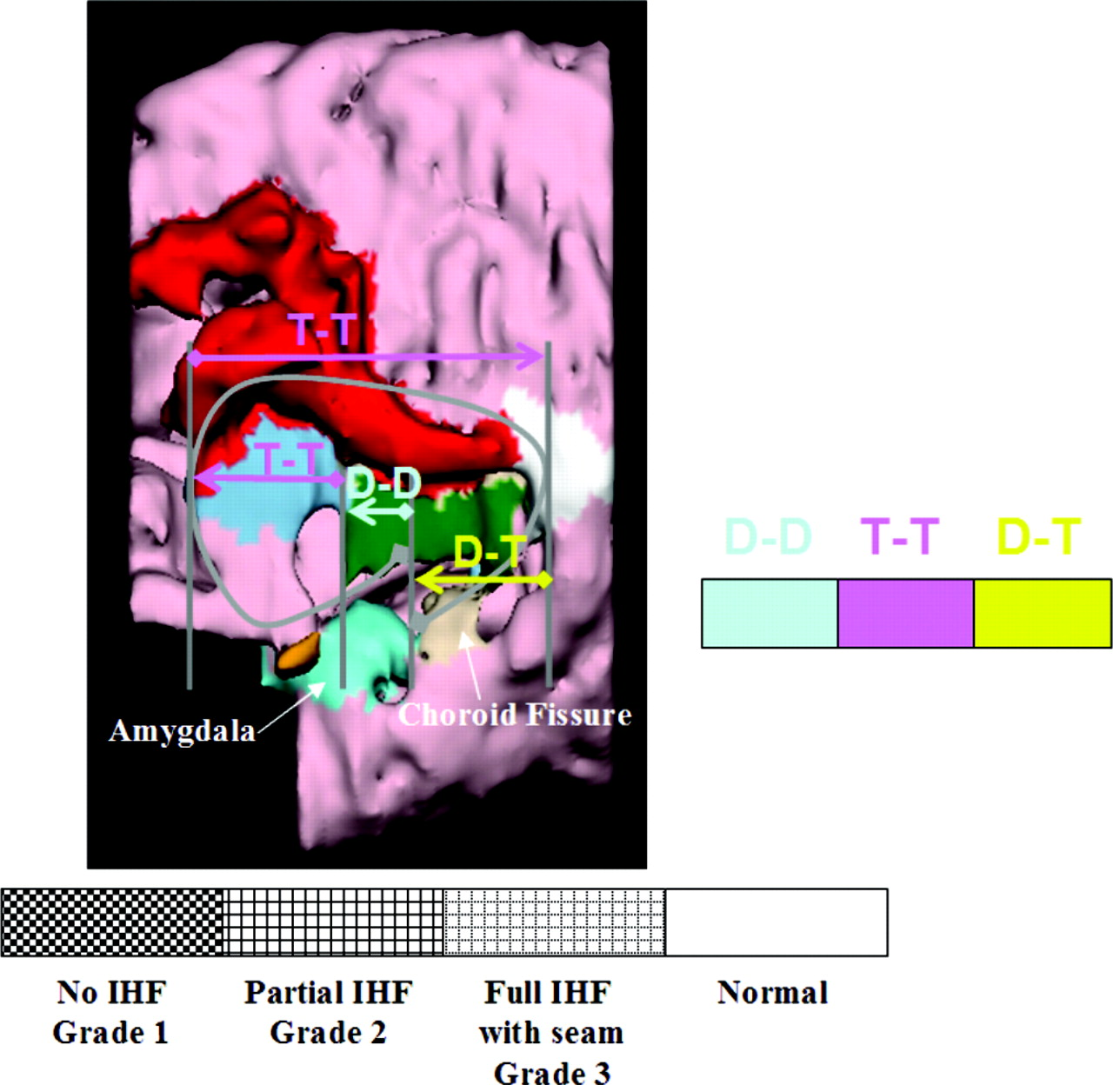
Figure 9. Three dimensional reconstruction of seam and adjacent structures as seen from the midsagittal ...
Notes:
Figure 9. Three dimensional reconstruction of seam and adjacent structures as seen from the midsagittal aspect in HPE with maximal malformation in the series. The locations of diencephalic-diencephalic (DD), telencephalic-telencephalic (TT) and diencephalic-telencephalic (DT) segments are projected upon the reconstruction.
Unless provided in the caption above, the following copyright applies to the content of this slide:

Slide 10
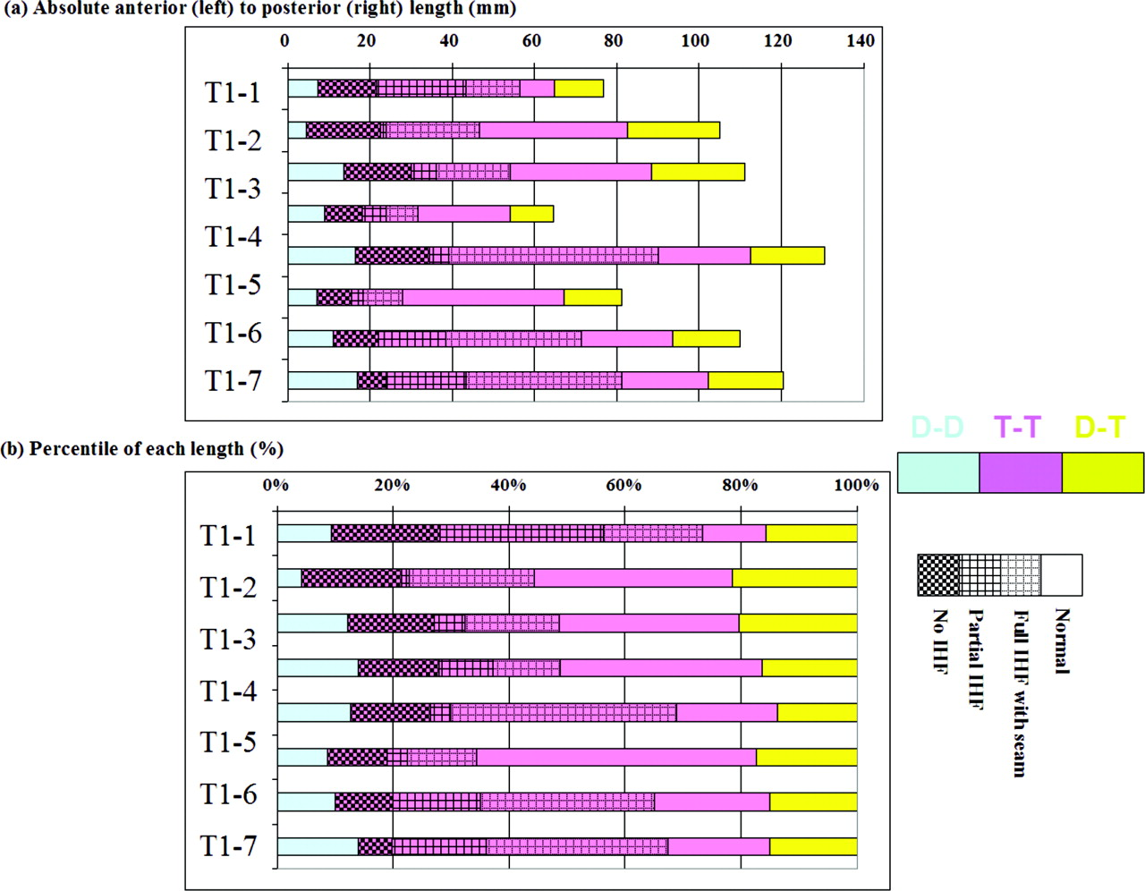
Figure 10. Linearized schema of diencephalon and rim of telencephalic vesicles in the control and the T1 ...
Notes:
Figure 10. Linearized schema of diencephalon and rim of telencephalic vesicles in the control and the T1 series of HPE brains. From left to right, the normal sequence is diencephalic-diencephalic (DD), telencephalic-telencephalic (TT) and diencephalic-telencephalic (DT) segments. In the HPE series, the DD and DT segments are topologically normal. The grades of topological anomaly in the TT segment includes ‘no interhemispheric fissure’, followed by ‘partial’ and then ‘full depth interhemispheric fissure’ where there is cortical continuity across midline in the first two grades and seam as continuity for the third. The absolute lengths correspond to the number of inclusive coronal planes multiplied by the coronal plane thickness. These lengths are also represented a percentiles normalized to the total length of the full sequence for each brain.
Unless provided in the caption above, the following copyright applies to the content of this slide:

Slide 11
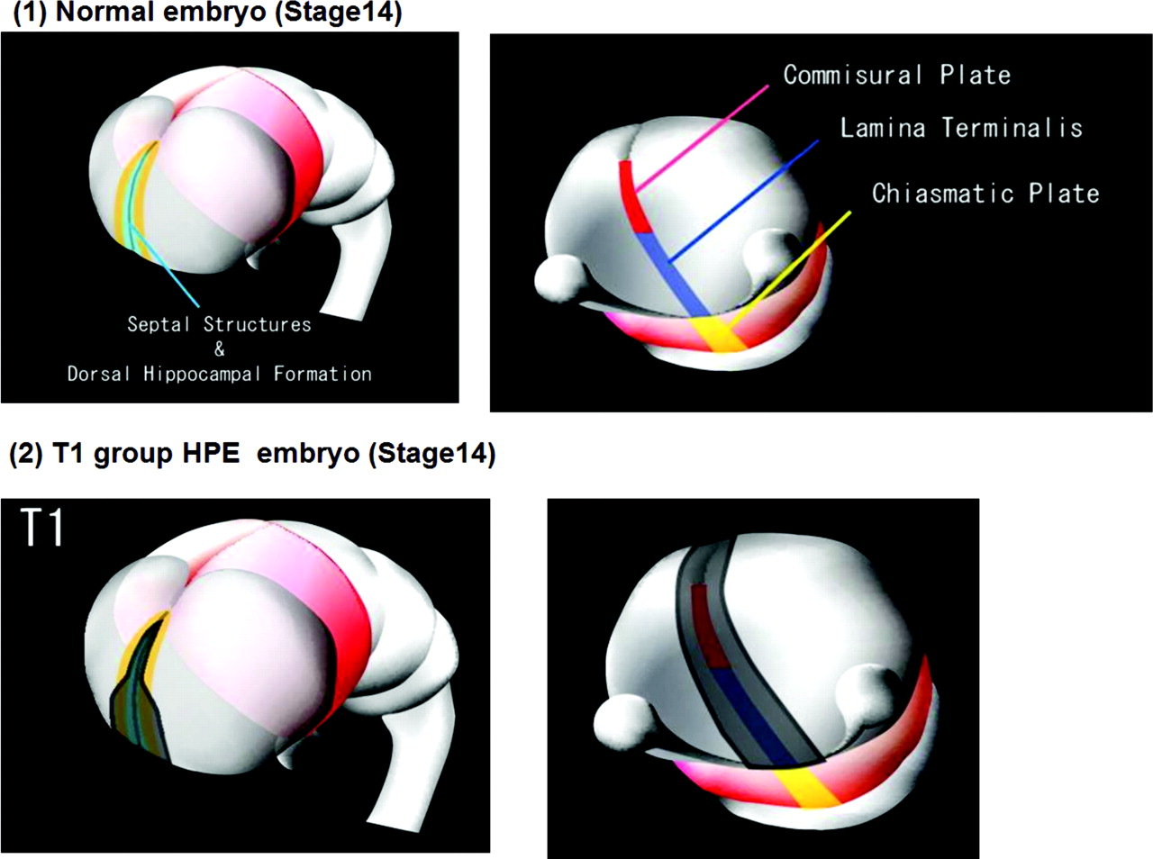
Figure 11. Schematic representations of model for the projection of the postulated grades of induction ...
Notes:
Figure 11. Schematic representations of model for the projection of the postulated grades of induction failure reconstructed for a stage 14 human embryo. (A, B) The cerebral hemispheres emerge as bilaterally paired evaginations from the single telencephalic vesicle of the terminal neural tube (Muller and O’Rahilly, 1985, 1986, 1987, 1988a,b,c; O’Rahilly and Muller, 1989, 1994) (Figure 8). The anterior arcs of evagination of right and left vesicles are paramedian and parallel within the telencephalic vesicle. The posterior arcs of evagination of right and left vesicles, by contrast, diverge laterally from the midline to follow the right and left telencephalic–diencephalic borders. That is, the telencephalic rims of the two hemispheres arise from the midline but the telencephalic–diencephalic rims of the two hemispheres emerge from opposite sides of the neural tube (C, D) In the present series of HPE brains the topologic anomaly is expressed only within the telencephalic regions of evagination. We have described three grades of anomaly which we suggest correspond to the relative degrees of failure of specification (darkly shaded at midline) and differential growth (lightly shaded paramedian). Thus, the rostral zone where there is no interhemispheric fissure represents the maximum degree of failure of differential growth and failure of specification, the zone of partial fissure represents partial failure of differential growth and complete failure of specification and the zone of cortex to seam continuity at the fundus of a fissure of full depth represents normal differential growth and partial failure of specification
Unless provided in the caption above, the following copyright applies to the content of this slide:

