Slide 1
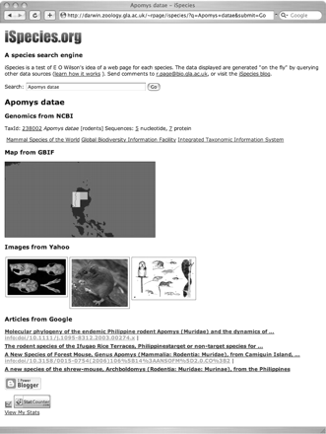
Figure 1: iSpecies web site displaying information retrieved from separate queries to NCBI, GBIF, Yahoo and Google ...
Notes:
Figure 1: iSpecies web site displaying information retrieved from separate queries to NCBI, GBIF, Yahoo and Google using the search term ‘Apomys datae’.
Unless provided in the caption above, the following copyright applies to the content of this slide: © The Author 2008. Published by Oxford University Press. For Permissions, please email: journals.permissions@oxfordjournals.org

Slide 2
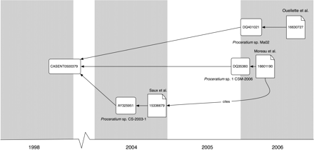
Figure 2: Sequencing history for the ant specimen casent0500379, which was collected in November 1998. Three 28S rRNA ...
Notes:
Figure 2: Sequencing history for the ant specimen casent0500379, which was collected in November 1998. Three 28S rRNA sequences have been obtained from the same specimen (casent0500379), published in three different papers [9–11], and deposited in GenBank using three different names for the ant. The sequences are placed on the timeline based on their date of submission, publications (identified by their PubMed number) by date of publication.
Unless provided in the caption above, the following copyright applies to the content of this slide: © The Author 2008. Published by Oxford University Press. For Permissions, please email: journals.permissions@oxfordjournals.org

Slide 3
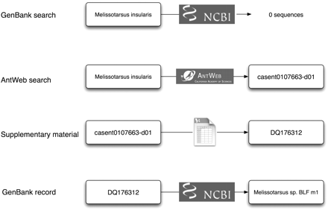
Figure 3: A search of GenBank for Melissotarsus insularis finds no sequences. However, a search of AntWeb finds a ...
Notes:
Figure 3: A search of GenBank for Melissotarsus insularis finds no sequences. However, a search of AntWeb finds a specimen listed as having been barcoded, and the paper publishing the barcodes has a supplementary table that lists the specimen as the source for sequence DQ176312. GenBank lists this sequence as being from taxon Melissotarsus sp. BLF m1.
Unless provided in the caption above, the following copyright applies to the content of this slide: © The Author 2008. Published by Oxford University Press. For Permissions, please email: journals.permissions@oxfordjournals.org

Slide 4
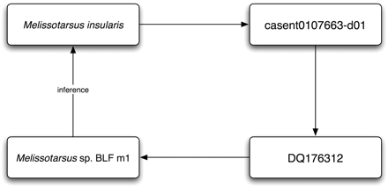
Figure 4: Linking the identifiers in Figure 3 together enables us to infer that the taxon GenBank refers to as ...
Notes:
Figure 4: Linking the identifiers in Figure 3 together enables us to infer that the taxon GenBank refers to as Melissotarsus sp. BLF m1 is M. insularis.
Unless provided in the caption above, the following copyright applies to the content of this slide: © The Author 2008. Published by Oxford University Press. For Permissions, please email: journals.permissions@oxfordjournals.org

Slide 5
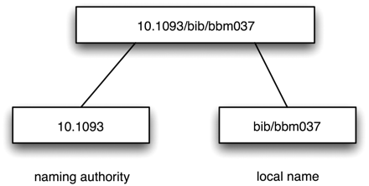
Figure 5: A doi (10.1093/bib/bbm037) and its constituent parts. This DOI identifies reference [3].
Notes:
Figure 5: A doi (10.1093/bib/bbm037) and its constituent parts. This DOI identifies reference [3].
Unless provided in the caption above, the following copyright applies to the content of this slide: © The Author 2008. Published by Oxford University Press. For Permissions, please email: journals.permissions@oxfordjournals.org

Slide 6
Figure 6: A LSID is prefixed with ‘urn:lsid’, then follows the authority, namespace and identifier components.
Notes:
Figure 6: A LSID is prefixed with ‘urn:lsid’, then follows the authority, namespace and identifier components.
Unless provided in the caption above, the following copyright applies to the content of this slide: © The Author 2008. Published by Oxford University Press. For Permissions, please email: journals.permissions@oxfordjournals.org

Slide 7
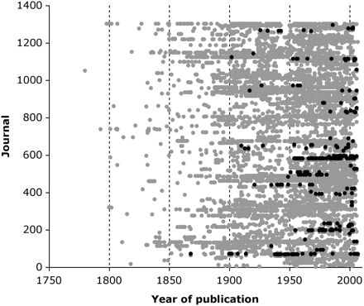
Figure 7: Digital accessibility of literature on ants and other hymenopterans. Each point represents an article in the ...
Notes:
Figure 7: Digital accessibility of literature on ants and other hymenopterans. Each point represents an article in the Hymenoptera Name Server database. References that have DOIs are indicated by black dots.
Unless provided in the caption above, the following copyright applies to the content of this slide: © The Author 2008. Published by Oxford University Press. For Permissions, please email: journals.permissions@oxfordjournals.org

Slide 8
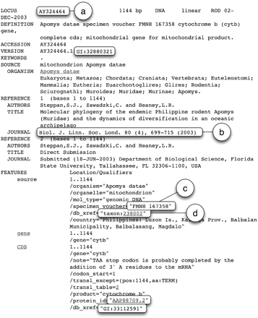
Figure 8: Metadata in a GenBank record for the sequence AY324464 with identifiers, or potential identifiers ...
Notes:
Figure 8: Metadata in a GenBank record for the sequence AY324464 with identifiers, or potential identifiers highlighted. In addition, the sequence accession number (a) and taxon number (d), there are text strings that can be transformed into identifiers, such as a bibliographic citation (b) and a museum specimen code (c).
Unless provided in the caption above, the following copyright applies to the content of this slide: © The Author 2008. Published by Oxford University Press. For Permissions, please email: journals.permissions@oxfordjournals.org

Slide 9
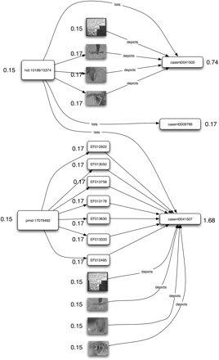
Figure 9: Graph depicting the links between three specimens of the ant P. tani, and the images, sequences and ...
Notes:
Figure 9: Graph depicting the links between three specimens of the ant P. tani, and the images, sequences and publications that refer to those specimens. Each node in the graph is labelled with its PageRank. The specimen that has been photographed and sequenced has the highest PageRank (1.68). The holotype of P. tani, casent0041505, has the next highest PageRank.
Unless provided in the caption above, the following copyright applies to the content of this slide: © The Author 2008. Published by Oxford University Press. For Permissions, please email: journals.permissions@oxfordjournals.org

