Slide 1
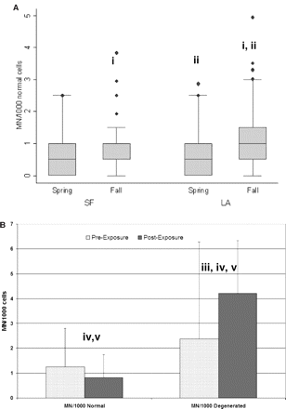
Fig. 1. MN assay in exfoliated buccal cells. (A) Results of normal buccal cells by permanent residence location and ...
Notes:
Fig. 1. MN assay in exfoliated buccal cells. (A) Results of normal buccal cells by permanent residence location and season of specimen collection. (B) Results for 15 subjects with controlled, 4-h exposure to 200 p.p.b. O3. (i) Significant difference comparing MN frequency by season within the same geographical group (spring versus fall), P < 0.05 (paired two-sample t-test); (ii) significant difference comparing geographical location within the same season (LA versus SF), P = 0.04 (paired two-sample t-test); (iii) significant difference comparing pre- versus post-exposure levels, P = 0.04 (paired two-sample t-test); (iv) significant difference comparing normal versus degenerated cells pre-exposure (P = 0.004, paired two sample t-test); and (v) significant difference comparing MN frequency in normal versus degenerated cells post-exposure (P = 0.04, paired two sample t-test).
Unless provided in the caption above, the following copyright applies to the content of this slide: © The Author 2006. Published by Oxford University Press on behalf of the UK Environmental Mutagen Society. All rights reserved. For permissions, please email: journals.permissions@oxfordjournals.org

