Slide 1
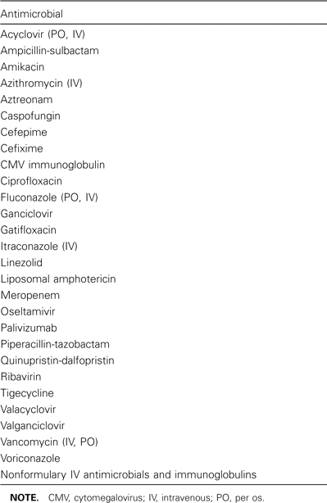
Table 1 Restricted antimicrobials requiring pediatric identification approval during the study period.
Notes:
Table 1 Restricted antimicrobials requiring pediatric identification approval during the study period.
Unless provided in the caption above, the following copyright applies to the content of this slide: © 2008 Infectious Diseases Society of America.

Slide 2
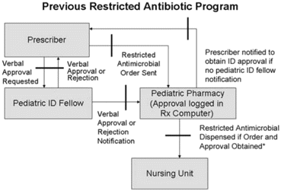
Figure 1 Schematic of the original antimicrobial restriction program at Johns Hopkins Children's Medical and Surgery ...
Notes:
Figure 1 Schematic of the original antimicrobial restriction program at Johns Hopkins Children's Medical and Surgery Center. *Prescription of the first dose only is allowed between 11 p.m. and 8 a.m. or when the infectious diseases (ID) fellow cannot be contacted. Black bars indicate potential breaks in the system.
Unless provided in the caption above, the following copyright applies to the content of this slide: © 2008 Infectious Diseases Society of America.

Slide 3
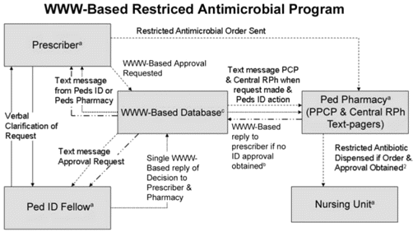
Figure 2 Schematic of the World Wide Web (WWW)–based antimicrobial restriction program at Johns Hopkins Children's ...
Notes:
Figure 2 Schematic of the World Wide Web (WWW)–based antimicrobial restriction program at Johns Hopkins Children's Medical and Surgery Center. aThe prescriber, pediatric (Ped) infectious diseases (ID) fellow, Ped pharmacy (Ped point-of-care [PPCP] pharmacist, and central registered pharmacist [RPh]), and nursing units have the capacity to view progress of the request by viewing the centralized database. bOff-hour prescription of doses is allowed only between 11 p.m. and 8 a.m. or when the ID fellow cannot be contacted. cPrescriber and pharmacy are notified when approval is about to expire.
Unless provided in the caption above, the following copyright applies to the content of this slide: © 2008 Infectious Diseases Society of America.

Slide 4
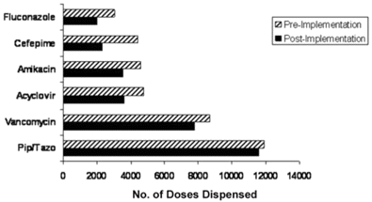
Figure 3 Most commonly requested and dispensed restricted antimicrobials during the pre- and postimplementation ...
Notes:
Figure 3 Most commonly requested and dispensed restricted antimicrobials during the pre- and postimplementation periods.
Unless provided in the caption above, the following copyright applies to the content of this slide: © 2008 Infectious Diseases Society of America.

Slide 5
Table 2 Prescriber perception of missed and delayed doses during the month before the survey.
Notes:
Table 2 Prescriber perception of missed and delayed doses during the month before the survey.
Unless provided in the caption above, the following copyright applies to the content of this slide: © 2008 Infectious Diseases Society of America.

Slide 6
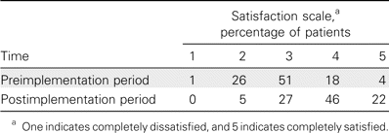
Table 3 Prescriber satisfaction during the pre- and postimplementation periods of the World Wide Web–based program.
Notes:
Table 3 Prescriber satisfaction during the pre- and postimplementation periods of the World Wide Web–based program.
Unless provided in the caption above, the following copyright applies to the content of this slide: © 2008 Infectious Diseases Society of America.

