Slide 1
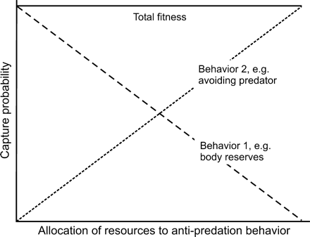
Figure 1 How allocation of resources from one antipredation behavior to another may result in equal fitness despite a ...
Notes:
Figure 1 How allocation of resources from one antipredation behavior to another may result in equal fitness despite a low allocation to one of the behaviors. Increasing body reserves do generally come with a survival cost (e.g., due to increased foraging effort), whereas increasing predator avoidance enhances survival. This graph depicts how the costs of increasing body reserves can be compensated for fully if more resources are allocated to an antipredation behavior resulting in equal fitness as when allocation to body reserves and to predator avoidance are reduced.
Unless provided in the caption above, the following copyright applies to the content of this slide: © The Author 2005. Published by Oxford University Press on behalf of the International Society for Behavioral Ecology. All rights reserved. For permissions, please e-mail: journals.permissions@oupjournals.org

Slide 2
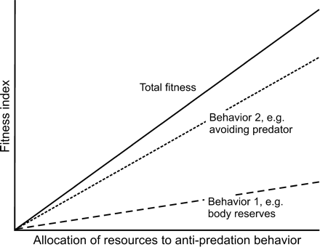
Figure 2 How allocation of resources to one antipredation behavior may be more important to fitness than another ...
Notes:
Figure 2 How allocation of resources to one antipredation behavior may be more important to fitness than another antipredation behavior.
Unless provided in the caption above, the following copyright applies to the content of this slide: © The Author 2005. Published by Oxford University Press on behalf of the International Society for Behavioral Ecology. All rights reserved. For permissions, please e-mail: journals.permissions@oupjournals.org

