Slide 1
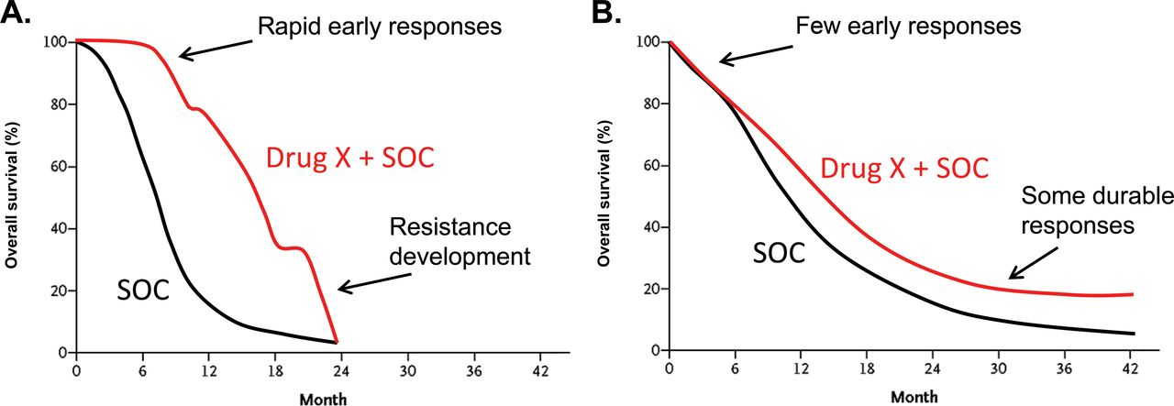
Figure 1. Hypothetical examples of Kaplan–Meier overall survival curves comparing drug developments in a selected ...
Notes:
Figure 1. Hypothetical examples of Kaplan–Meier overall survival curves comparing drug developments in a selected patient population based on biomarkers vs unselected patient population. A) Like many drug trials directed at specific populations of patients based on biomarker selection, the initial part of the curve separates early in the targeted agent group (Drug X) compared with the standard of care (SOC) arm, but eventually resistance develops in the majority of these patients. B) For a trial testing the efficacy of Drug X in an unselected group of patients, practically no real separation is seen in the curves between the experimental (Drug X + SOC) and SOC arms early on; the curves eventually split, and a statistically significant separation occurs later in the trial, with some patients having durable responses.
Unless provided in the caption above, the following copyright applies to the content of this slide: © The Author 2013. Published by Oxford University Press. All rights reserved. For Permissions, please e-mail: journals.permissions@oup.com.

Slide 2
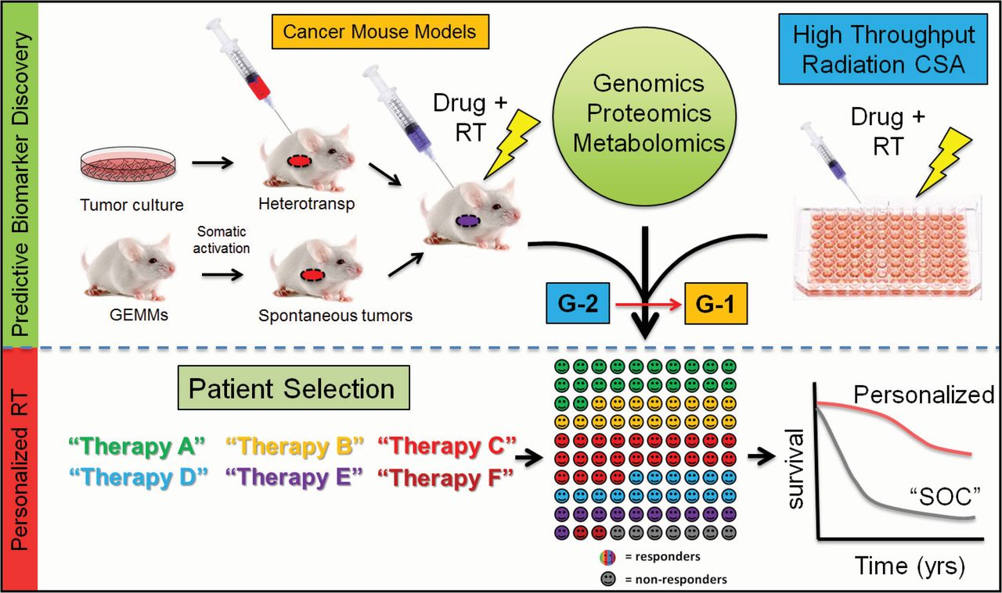
Figure 2. Schematic to accelerate progress in molecular-targeted radiation therapy. To bring upfront patient selection ...
Notes:
Figure 2. Schematic to accelerate progress in molecular-targeted radiation therapy. To bring upfront patient selection into radiation treatment selection, we need more predictive biomarker discovery and validation, which will increase the number of established biomarkers associated with novel therapeutics and subsequent improvement in patient outcome. CSA = clonogenic survival assays; GEMM = genetically engineered mouse models; G-1 = group 1 drugs (drugs with biomarkers); G-2 = group 2 drugs (drugs without biomarkers); RT = radiation therapy; SOC = standard of care.
Unless provided in the caption above, the following copyright applies to the content of this slide: © The Author 2013. Published by Oxford University Press. All rights reserved. For Permissions, please e-mail: journals.permissions@oup.com.

