Slide 1
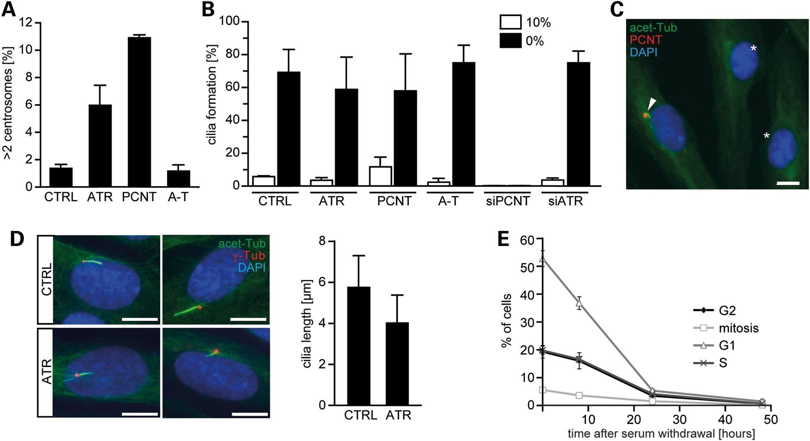
Figure 1. ATR-SS cells show supernumerary centrosome and shortened cilia. (A) Exponentially growing hTERT fibroblasts ...
Notes:
Figure 1. ATR-SS cells show supernumerary centrosome and shortened cilia. (A) Exponentially growing hTERT fibroblasts from a control (1BR3) (C), an ATR-SS patient (ATR), a PCNT-MOPD type-II patient (PCNT) or an A-T patient (A-T) were analysed for centrosome numbers following staining with anti-γ-tubulin. Cells with more than two centrosomes were scored. (B) Patient hTERT fibroblasts [as in (A)] or 1BR3 hTERT cells subjected to PCNT or ATR siRNA were serum-starved for 48 h (0%) or maintained in serum (10%) and processed to identify cilia using anti-acetylated tubulin and anti-γ-tubulin antibodies, which mark the entire cilia or basal body, respectively. (C) Typical cells lacking cilia following siRNA PCNT. The arrow shows PCNT staining (i.e. no siRNA-mediated knockdown) and a cilium; asterisks denote cells with no PCNT or cilia. (D) Cilia forming in ATR-SS cells are slightly shorter than those in control cells. This is evident visually (left panel) and following quantification of length (right panel). P < 0.01, Mann–Whitney rank-sum test. (E) Control cells exit the cell cycle 24 h after serum starvation. Similar kinetics of cell cycle exit were observed in ATR-SS and PCNT cells (data not shown). Cell cycle markers were: G1, P-Rb+; S phase, BrdU+; G2, CENPF-positive; mitosis, P-H3+. All results represent the mean ± SD of three experiments.
Unless provided in the caption above, the following copyright applies to the content of this slide: © The Author 2016. Published by Oxford University Press.This is an Open Access article distributed under the terms of the Creative Commons Attribution License (http://creativecommons.org/licenses/by/4.0/), which permits unrestricted reuse, distribution, and reproduction in any medium, provided the original work is properly cited.

Slide 2
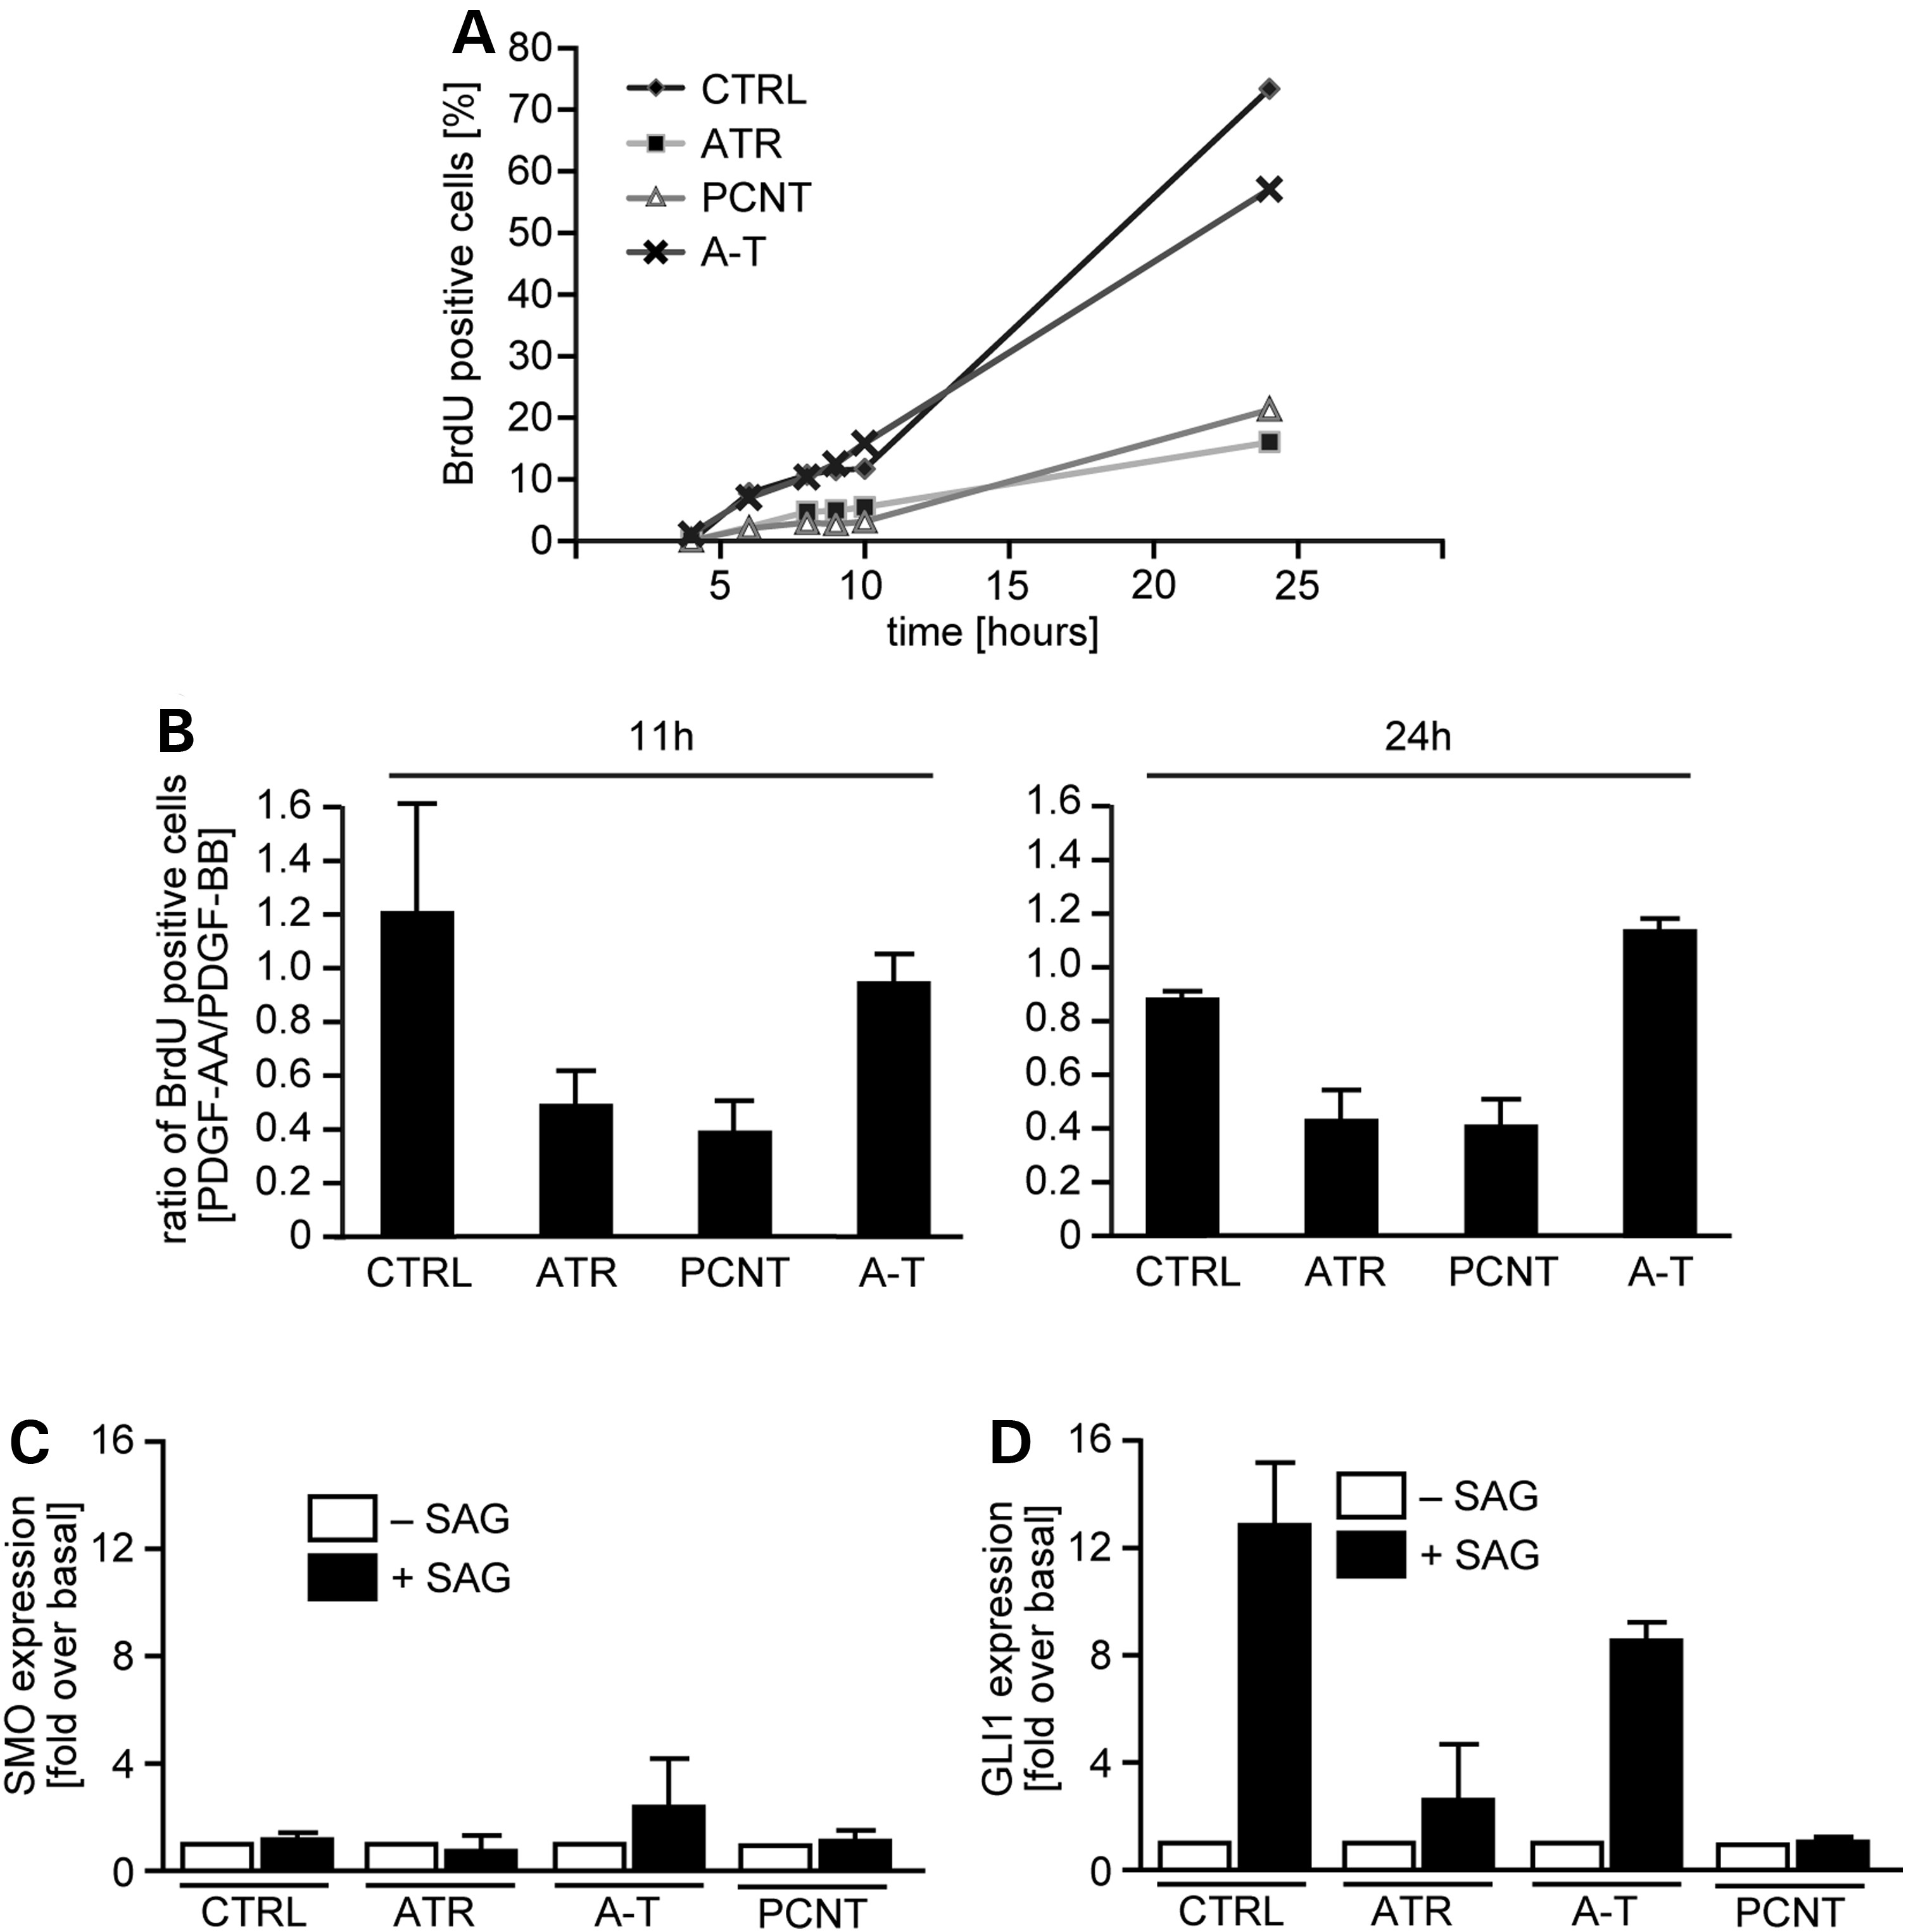
Figure 2. ATR-SS cells show impaired cilia-dependent growth-factor signalling. (A) Patient-derived hTERT fibroblasts ...
Notes:
Figure 2. ATR-SS cells show impaired cilia-dependent growth-factor signalling. (A) Patient-derived hTERT fibroblasts were serum-depleted for 48 h. Following serum and BrdU addition, the percentage of BrdU+ S phase cells was monitored as indicated. At least 200 cells were monitored. (B) The indicated hTERT fibroblasts were serum-depleted for 48 h. PDGF-AA or -BB and BrdU were then added and the percentage of BrdU+ cells (i.e. cells that have entered S phase) estimated by IF 11 and 24 h later. Results are expressed as the ratio of BrdU+ cells following treatment with PDGF-AA versus PDGF-BB. A ratio of 1 demonstrates equal signalling from PDGF ligand isoforms (-AA or -BB) and <1 demonstrates an impaired response to PDGF-AA. The percentage of BrdU+ cells after PDGF-BB treatment after all siRNA treatments is shown in Supplementary Material, Figure S1. This verifies that the indicated siRNA does not impact upon PDGF-BB signalling. Results represent the mean ± SD of three experiments. (C and D) qRT–PCR analysis of SMO and GLI1 transcript levels in the indicated cells with or without SAG at 24 h. SMO is a reference as it does not change after SAG addition. The WT and PCNT data are part of a previously published data set (16). The analysis of ATR- and A-T-deficient cells was carried in the same experiments and has not been previously published. Results represent the mean ± SD of three experiments.
Unless provided in the caption above, the following copyright applies to the content of this slide: © The Author 2016. Published by Oxford University Press.This is an Open Access article distributed under the terms of the Creative Commons Attribution License (http://creativecommons.org/licenses/by/4.0/), which permits unrestricted reuse, distribution, and reproduction in any medium, provided the original work is properly cited.

Slide 3
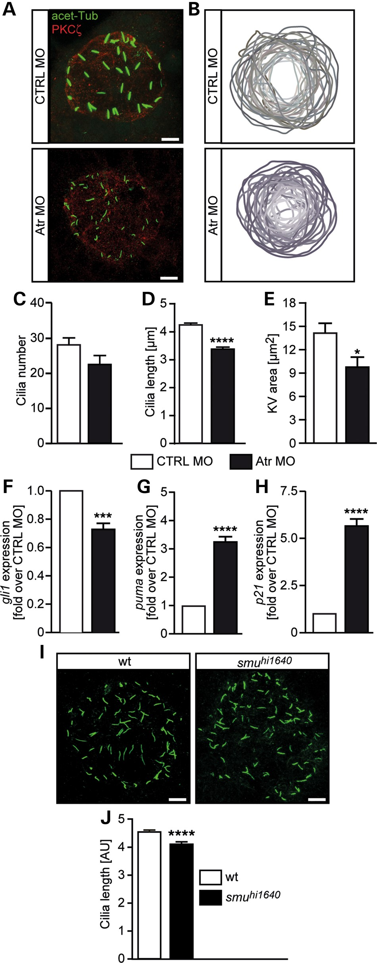
Figure 3. Atr depletion confers shorter cilia in zebrafish. (A) Representative images of cilia in the KV of zebrafish ...
Notes:
Figure 3. Atr depletion confers shorter cilia in zebrafish. (A) Representative images of cilia in the KV of zebrafish embryos. Cilia were stained with an antibody against acetylated tubulin. Outlines of the KV were visualized by counterstaining with an antibody against atypical PKC (PKCζ). Scale bars: 5 µm. (B) Overlay of KV outlines of CTRL MO- or Atr MO-injected embryos [eight somite stage (ss)]. Depletion of Atr results in slightly smaller KVs. (C) Cilia number was not significantly altered upon Atr depletion. Three independent experiments with 31 embryos per condition. P = 0.0770, Student's t-test. (D) KV cilia were short in embryos depleted for Atr. n = 7. About 10–831 cilia from 29 to 31 embryos. P < 0.0001, Student's t-test. (E) KV area measurements of CTRL- and Atr MO-injected embryos at eight ss. Three independent experiments with 31 embryos in total. P = 0.0166, Student's t-test. (F) gli1 expression at 24 hpf after injection of either CTRL MO or Atr MO. Four independent experiments. P = 0.0008, Student's t-test. (G) Relative expression of puma in injected embryos (24 hpf). n = 4, P < 0.0001, Student's t-test. (H) p21 expression in 24 hpf embryos summarizing four independent experiments. P < 0.0001, Student's t-test. (I) Representative images of KV cilia in a zebrafish mutant for Smo (smuhi1640). Scale bars: 5 µm. (J) Average cilia length in smuhi1640 mutants and wild-type littermates. n = 1094–1826 cilia from 20 to 27 singly genotyped embryos. P < 0.0001, Student's t-test.
Unless provided in the caption above, the following copyright applies to the content of this slide: © The Author 2016. Published by Oxford University Press.This is an Open Access article distributed under the terms of the Creative Commons Attribution License (http://creativecommons.org/licenses/by/4.0/), which permits unrestricted reuse, distribution, and reproduction in any medium, provided the original work is properly cited.

Slide 4
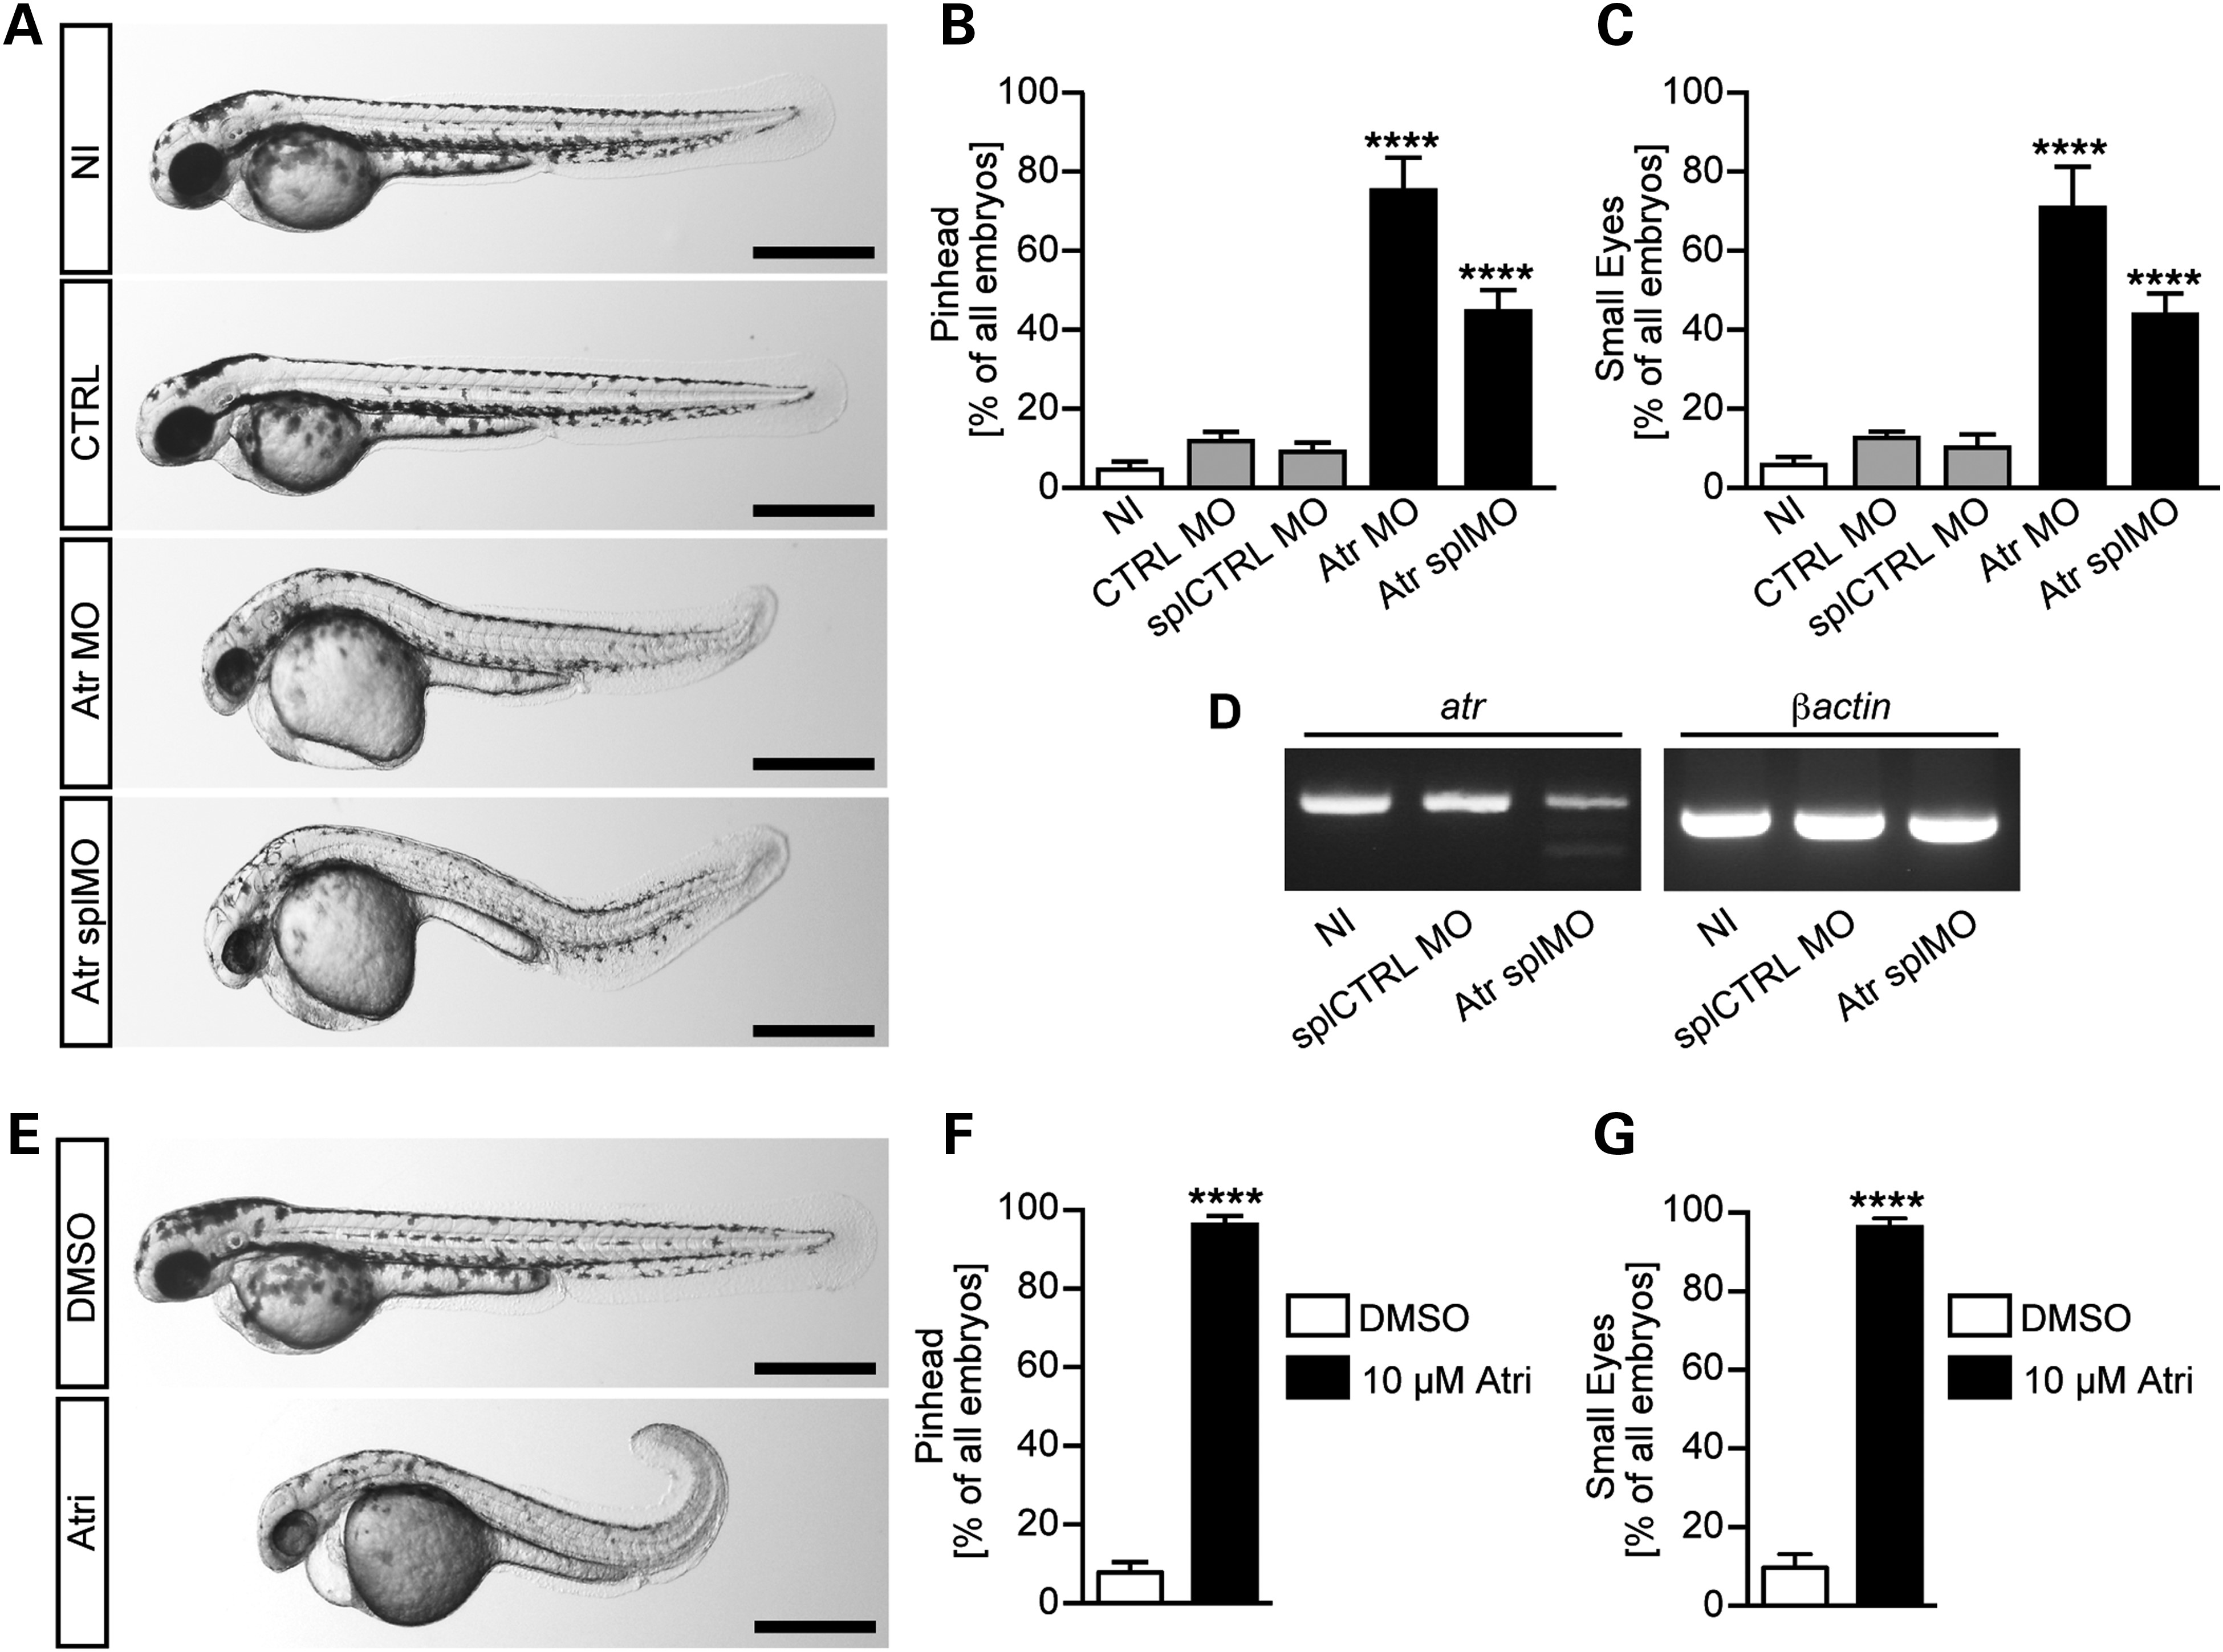
Figure 4. Morphological changes caused by Atr depletion in zebrafish. (A) Live images of 48 hpf zebrafish embryos. As ...
Notes:
Figure 4. Morphological changes caused by Atr depletion in zebrafish. (A) Live images of 48 hpf zebrafish embryos. As controls, zebrafish were either left uninjected (NI) or control injected (CTRL) with a standard control MO (CTRL MO) or a 5 base mismatch MO (splCTRL MO), respectively. To generate Atr loss of function, injections with a translation blocking MO against Atr (Atr MO) or an MO interfering with Atr splicing (Atr splMO) were performed. Scale bars: 500 µm. (B) The percentage of embryos with an underdeveloped head. Graph displays mean values ± SEM, and n = 111–193 embryos in 5–11 experiments. ****P < 0.0001, one-way ANOVA. (C) Loss of Atr interferes with regular eye development. Graph displays means ± SEM, and n = 93–113 embryos in 5–11 experiments. ****P < 0.0001, one-way ANOVA. (D) Representative images of RT–PCR experiments assessing splice blocking efficiency of Atr splMO compared with controls. Left panel shows PCR of exons 2–4 of atr with a weaker band at the expected size and an additional smaller band representing the mis-spliced product upon Atr splMO injection. Right panel shows a PCR fragment of βActin as loading control. (E) Live images of zebrafish embryos (48 hpf) treated with either 1% DMSO or 10 µm Atr inhibitor (ATRi-1) from the tailbud stage on. Scale bars: 500 µm. (F) Inhibition of Atr by chemical means (ATRi-1) results in a similar reduction of the head size of 48 hpf embryos. Graph displays mean values ± SEM, and n = 95–217 embryos in five experiments. P < 0.0001, Student's t-test. (G) The percentage of embryos developing smaller eyes upon Atr inhibition. Results show the mean values ± SEM, and n = 95–217 embryos in five experiments. P < 0.0001, Student's t-test.
Unless provided in the caption above, the following copyright applies to the content of this slide: © The Author 2016. Published by Oxford University Press.This is an Open Access article distributed under the terms of the Creative Commons Attribution License (http://creativecommons.org/licenses/by/4.0/), which permits unrestricted reuse, distribution, and reproduction in any medium, provided the original work is properly cited.

Slide 5
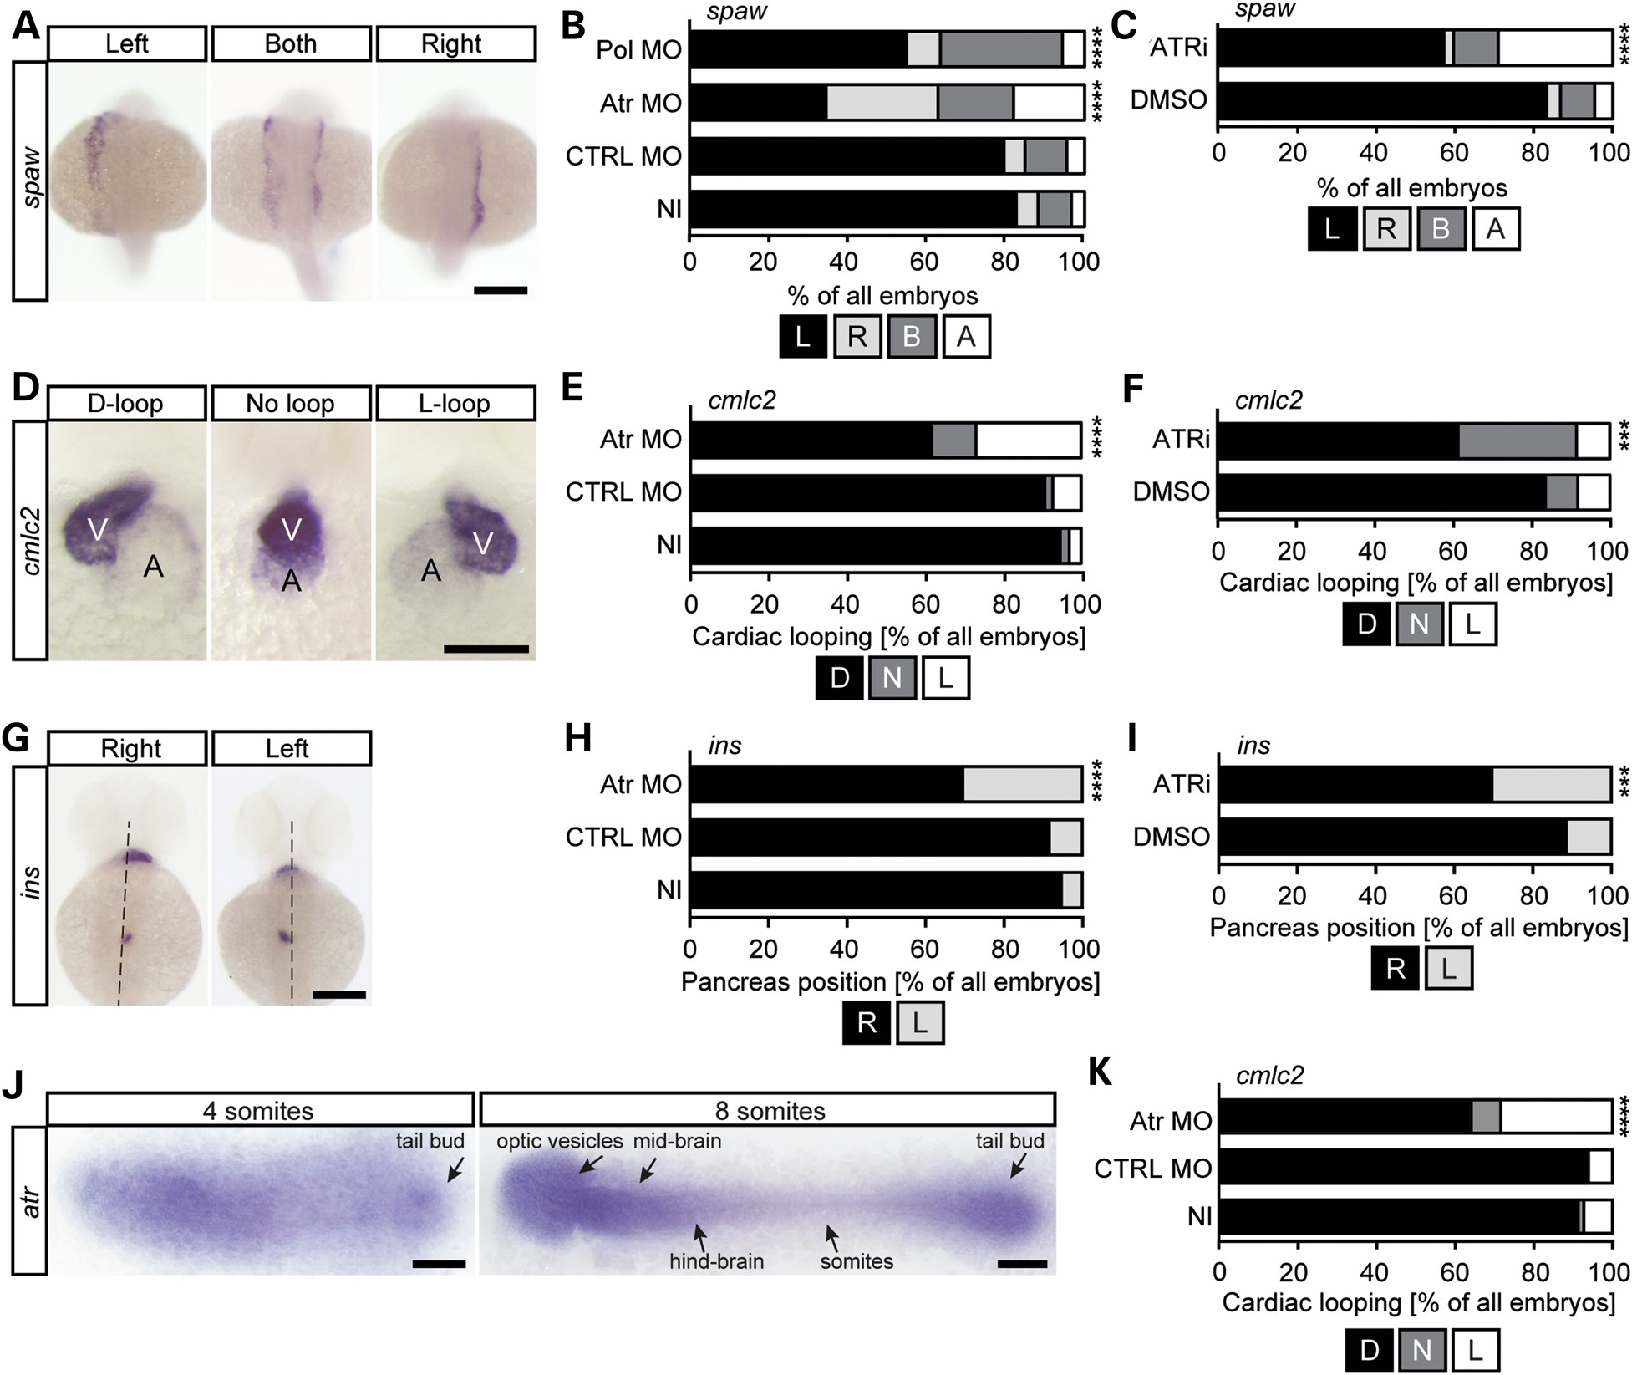
Figure 5. Loss of Atr impairs cilia function in zebrafish. (A) WMISH of 22 ss embryos illustrating southpaw (spaw) ...
Notes:
Figure 5. Loss of Atr impairs cilia function in zebrafish. (A) WMISH of 22 ss embryos illustrating southpaw (spaw) expression in the left lateral plate mesoderm (left panel). Ambiguous (middle panel) or right-sided expression (right panel) indicates aberrant left-right asymmetry. Scale bar: 200 µm. (B) Percentage of embryos with left-sided (L), right-sided (R), ambiguous (B) or no spaw expression upon Atr MO. n= 93–125 embryos; four experiments. P < 0.0001. (C) Chemical inhibition of Atr (ATRi-1) randomizes spaw expression. n = 124–197 embryos; six experiments. P < 0.0001. (D) Representative images of WMISH for cardiac myosin light chain 2 (cmlc2) showing heart looping in 48 hpf embryos. Left panel, a correctly looped heart (D-loop); middle panel, a heart with no looping (no loop); right panel, an inversely looped heart (L-loop). A, atrium; V, ventricle. Scale bar: 100 µm. (E) Atr depletion impedes heart looping (48 hpf). Stacked bar graph displaying the percentage of embryos with a properly looped heart (D), an unlooped heart (N) or an inversely looped heart (L). n = 94–108; four experiments. P < 0.0001. (F) ATRi-1 inhibitor treatment randomizes cardiac looping similar to that observed in knockdown embryos. n = 106–243; seven experiments. P = 0.009. (G) WMISH for insulin (ins) labelling of pancreatic cells to assess abdominal situs development. Left panel, a dorsal view of a control. The ins expression domain is right of the midline (dashed line). Right panel, pancreas located left of the midline. Embryos were 48 hpf. Scale bar: 200 µm. (H) Stacked bar graph summarizing correct (R) or wrong-sided (L) expression of ins in injected embryos. n = 94–105 embryos; four experiments. P = 0.001. (I) Aberrant pancreas placement after Atr depletion (48 hpf). n = 118–245 embryos; seven experiments. P = 0.008. (J) Flat mounts of four and eight ss embryos after WMISH for Atr. Note the stronger staining and higher Atr expression in the tailbud region, where the KV forms. Anterior to the left. Scale bars: 150 µm (four ss) and 200 µm (eight ss). (K) KV-specific Atr knockdown randomizes cardiac looping. Stacked bar graph of embryos processed for cmlc2 WMISH. n = 66–67 embryos; three experiments. P < 0.0001. Significance was assessed using Fisher's exact test.
Unless provided in the caption above, the following copyright applies to the content of this slide: © The Author 2016. Published by Oxford University Press.This is an Open Access article distributed under the terms of the Creative Commons Attribution License (http://creativecommons.org/licenses/by/4.0/), which permits unrestricted reuse, distribution, and reproduction in any medium, provided the original work is properly cited.

Slide 6
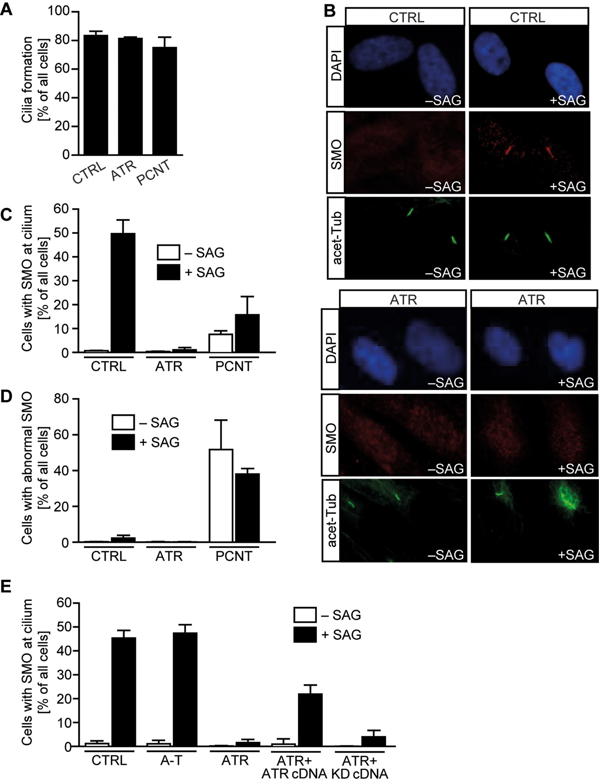
Figure 6. ATR-SS cells show defects in SMO recruitment to cilia and GLI1 transcript activation. Patient-derived hTERT ...
Notes:
Figure 6. ATR-SS cells show defects in SMO recruitment to cilia and GLI1 transcript activation. Patient-derived hTERT fibroblasts were serum-depleted for 48 h. SAG was then added for 24 h. (A) Under this prolonged condition of serum starvation (72 h), cilia form normally in all cell lines. (B) In control cells, in the absence of SAG, SMO localized diffusely and not specifically at cilia. In the presence of SAG, strong uniform SMO staining is observed along the cilia length (detected using acetylated tubulin). (C) The percentage of cells with co-localized cilia and SMO with or without SAG treatment. (D) The percentage of ciliated cells with abnormally localized SMO with or without SAG treatment. (E) SMO localization at cilia in ATR-SS cells can be restored following expression of ATR cDNA but not kinase dead ATR cDNA (KD). Results represent the mean ± SD of three experiments. WT and PCNT data are part of the data set previously published in Stiff et al. (16).
Unless provided in the caption above, the following copyright applies to the content of this slide: © The Author 2016. Published by Oxford University Press.This is an Open Access article distributed under the terms of the Creative Commons Attribution License (http://creativecommons.org/licenses/by/4.0/), which permits unrestricted reuse, distribution, and reproduction in any medium, provided the original work is properly cited.

Slide 7
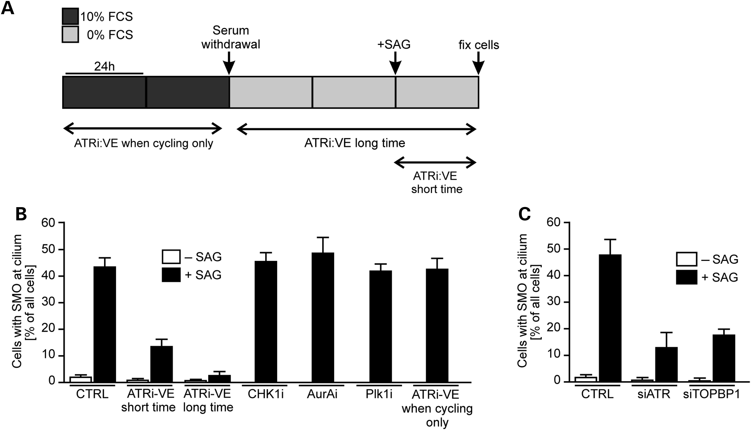
Figure 7. Deficiency in TOPBP1 but not inhibition of CHK1, PLK1 or Aurora A also causes defective cilia signalling. (A) ...
Notes:
Figure 7. Deficiency in TOPBP1 but not inhibition of CHK1, PLK1 or Aurora A also causes defective cilia signalling. (A) Diagram showing the timing of ATRi:VE addition, serum withdrawal and SAG addition. (B) Control cells were treated with an ATR inhibitor (ATRi:VE) concurrent with serum deprivation for 72 h (long time) or deprived of serum for 48 h and ATRi:VE added for 24 h (short time). In both cases, SAG was added for the final 24 h. The percentage of cells with SMO localized at cilia was scored. Control cells were similarly treated with inhibitors against CHK1 (UCN01), Aurora A (AurAi) or PLK1 (Plk1i), concurrent with serum deprivation. For ATRi:VE when cycling, cells were treated for 48 h with the ATRi:VE before it was washed out and cells deprived of serum for 72 h as before, with SAG being added for the final 24 h. The results represent the mean ± SD of three experiments. Note that analysis of cells without SAG was not undertaken for the inhibitor experiments, as we had routinely observed that the absence of SAG led to very low numbers of cells with SMO localized at the cilia. (C) 1BR3 hTERT cells were treated with oligonucleotides directed against non-specific control sequences (C), ATR (siATR) or TOPBP1 (siTOPBP1). SAG was added for the final 24 h, and the percentage of cells with SMO localized at the cilia was scored as in (B).
Unless provided in the caption above, the following copyright applies to the content of this slide: © The Author 2016. Published by Oxford University Press.This is an Open Access article distributed under the terms of the Creative Commons Attribution License (http://creativecommons.org/licenses/by/4.0/), which permits unrestricted reuse, distribution, and reproduction in any medium, provided the original work is properly cited.

