Slide 1
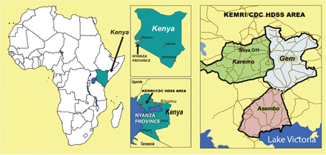
Figure 1 KEMRI/CDC Health and Demographic Surveillance System, Kenya
Notes:
Figure 1 KEMRI/CDC Health and Demographic Surveillance System, Kenya
Unless provided in the caption above, the following copyright applies to the content of this slide: Published by Oxford University Press on behalf of the International Epidemiological Association © The Author 2012; all rights reserved.

Slide 2
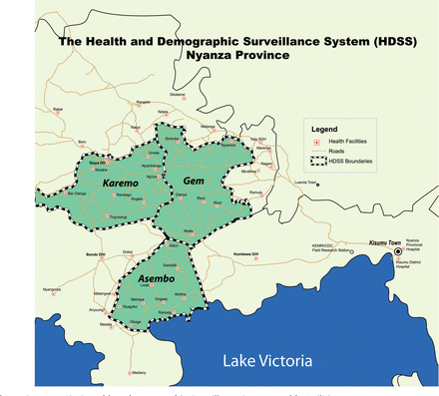
Figure 2 KEMRI/CDC Health and Demographic Surveillance System, Health Facilities Map
Notes:
Figure 2 KEMRI/CDC Health and Demographic Surveillance System, Health Facilities Map
Unless provided in the caption above, the following copyright applies to the content of this slide: Published by Oxford University Press on behalf of the International Epidemiological Association © The Author 2012; all rights reserved.

Slide 3
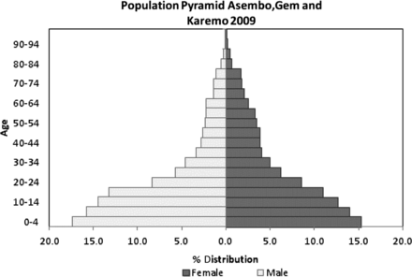
Figure 3 Population Pyramid Asembo, Gem and Karemo, KEMRI/CDC HDSS, 2009
Notes:
Figure 3 Population Pyramid Asembo, Gem and Karemo, KEMRI/CDC HDSS, 2009
Unless provided in the caption above, the following copyright applies to the content of this slide: Published by Oxford University Press on behalf of the International Epidemiological Association © The Author 2012; all rights reserved.

Slide 4
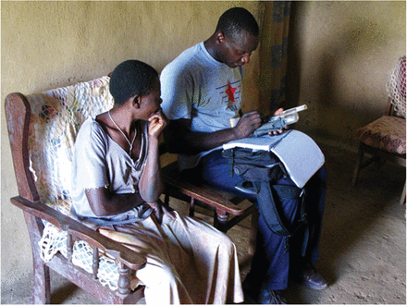
Community interviewer interviewing an HDSS participant
Notes:
Community interviewer interviewing an HDSS participant
Unless provided in the caption above, the following copyright applies to the content of this slide: Published by Oxford University Press on behalf of the International Epidemiological Association © The Author 2012; all rights reserved.

Slide 5
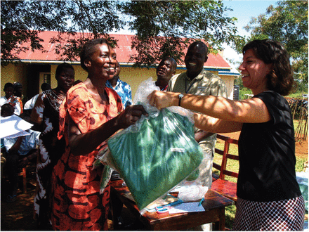
Donation of insecticide treated bed nets to internally displaced persons in the HDSS, following post-election ...
Notes:
Donation of insecticide treated bed nets to internally displaced persons in the HDSS, following post-election violence in Kenya
Unless provided in the caption above, the following copyright applies to the content of this slide: Published by Oxford University Press on behalf of the International Epidemiological Association © The Author 2012; all rights reserved.

Slide 6
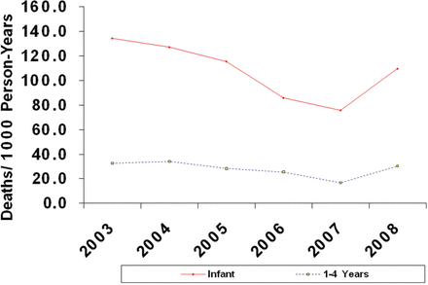
Figure 4 All cause childhood mortality KEMRI/CDC HDSS, 2003–08*. *From: Hamel MJ, Adazu K, Obor D et al. A reversal in ...
Notes:
Figure 4 All cause childhood mortality KEMRI/CDC HDSS, 2003–08*. *From: Hamel MJ, Adazu K, Obor D et al. A reversal in reductions of child mortality in western Kenya, 2003-2009. Am J Trop Med Hyg85:597–605
Unless provided in the caption above, the following copyright applies to the content of this slide: Published by Oxford University Press on behalf of the International Epidemiological Association © The Author 2012; all rights reserved.

Slide 7
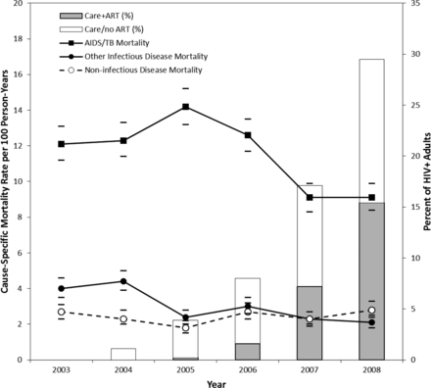
Figure 5 Population cause-specific mortality rates and 95% confidence intervals (lines, y-axis on left), and estimated ...
Notes:
Figure 5 Population cause-specific mortality rates and 95% confidence intervals (lines, y-axis on left), and estimated proportion of HIV-positive patients in care and receiving ART (stacked bars, y-axis on right), by year, KEMRI/CDC HDSS, 2003–08*. *Source: Gargano JW, Laserson K, Muttai H et al. The adult population impact of HIV care and antiretroviral therapy (ART)—Nyanza Province, Kenya, 2003–2008. AIDS, Vol. 26, Wolters Kluwer Health, 2012
Unless provided in the caption above, the following copyright applies to the content of this slide: Published by Oxford University Press on behalf of the International Epidemiological Association © The Author 2012; all rights reserved.

