Slide 1
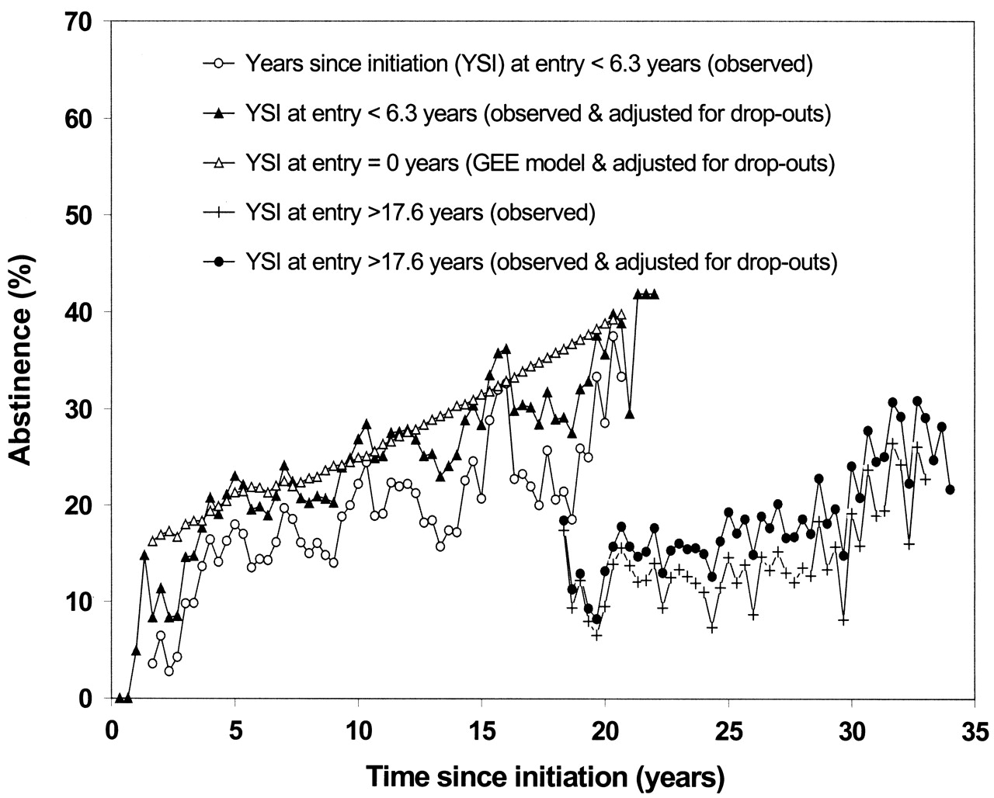
FIGURE 2. Prevalence of abstinence (≥4 months) from illicit drug use among those still alive (according to ...
Notes:
FIGURE 2. Prevalence of abstinence (≥4 months) from illicit drug use among those still alive (according to definition 2: no use of illicit drugs, leaving methadone use out of consideration), by 4-month interval since initiation of illicit drug use, Amsterdam Cohort Study among Drug Users, 1985–2002. Prevalence was calculated according to the categorized number of years since initiation at study entry (lowest and highest quintiles are shown). The prevalence modeled by means of generalized estimating equations (GEE) was estimated by combining all data in one model and including the number of years since initiation (YSI) at study entry as a covariate (see Materials and Methods).
Unless provided in the caption above, the following copyright applies to the content of this slide:

Slide 2
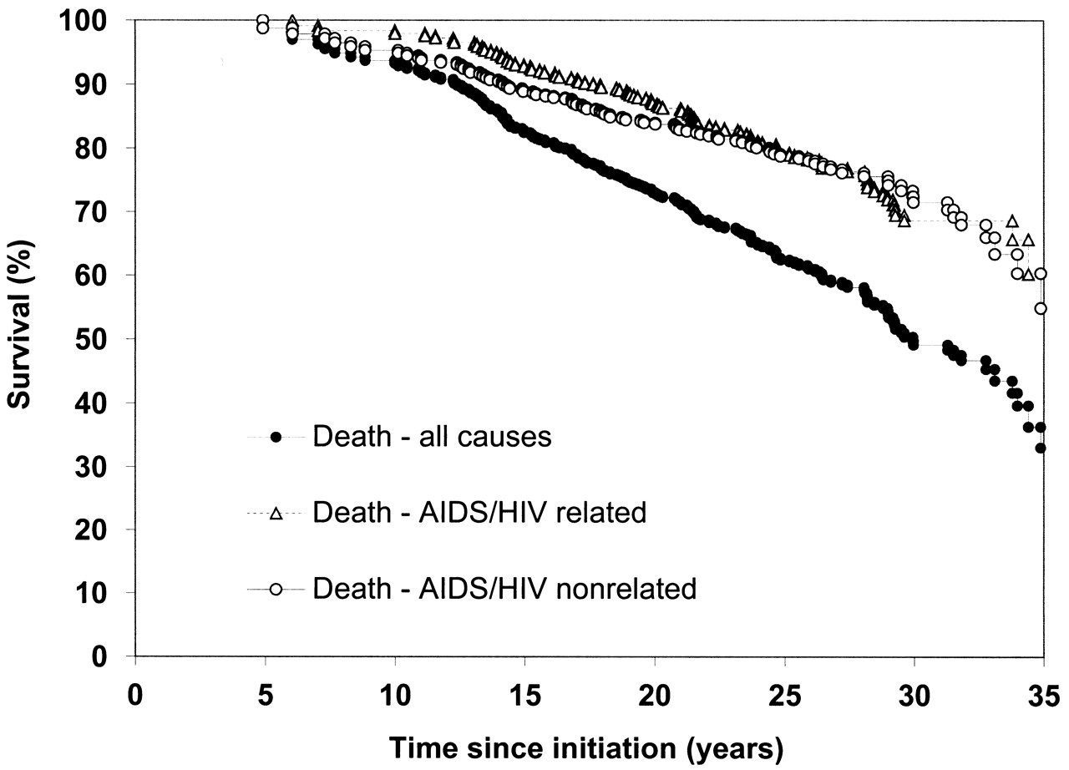
FIGURE 1. Survival over time since the start of regular use of illicit drugs, Amsterdam Cohort Study among ...
Notes:
FIGURE 1. Survival over time since the start of regular use of illicit drugs, Amsterdam Cohort Study among Drug Users, 1985–2002. The graph shows Kaplan-Meier product-limit estimates for left-truncated data, including deaths from all causes, deaths related to human immunodeficiency virus (HIV)/acquired immunodeficiency syndrome (AIDS) only, and HIV/AIDS-nonrelated deaths only.
Unless provided in the caption above, the following copyright applies to the content of this slide:

