Slide 1
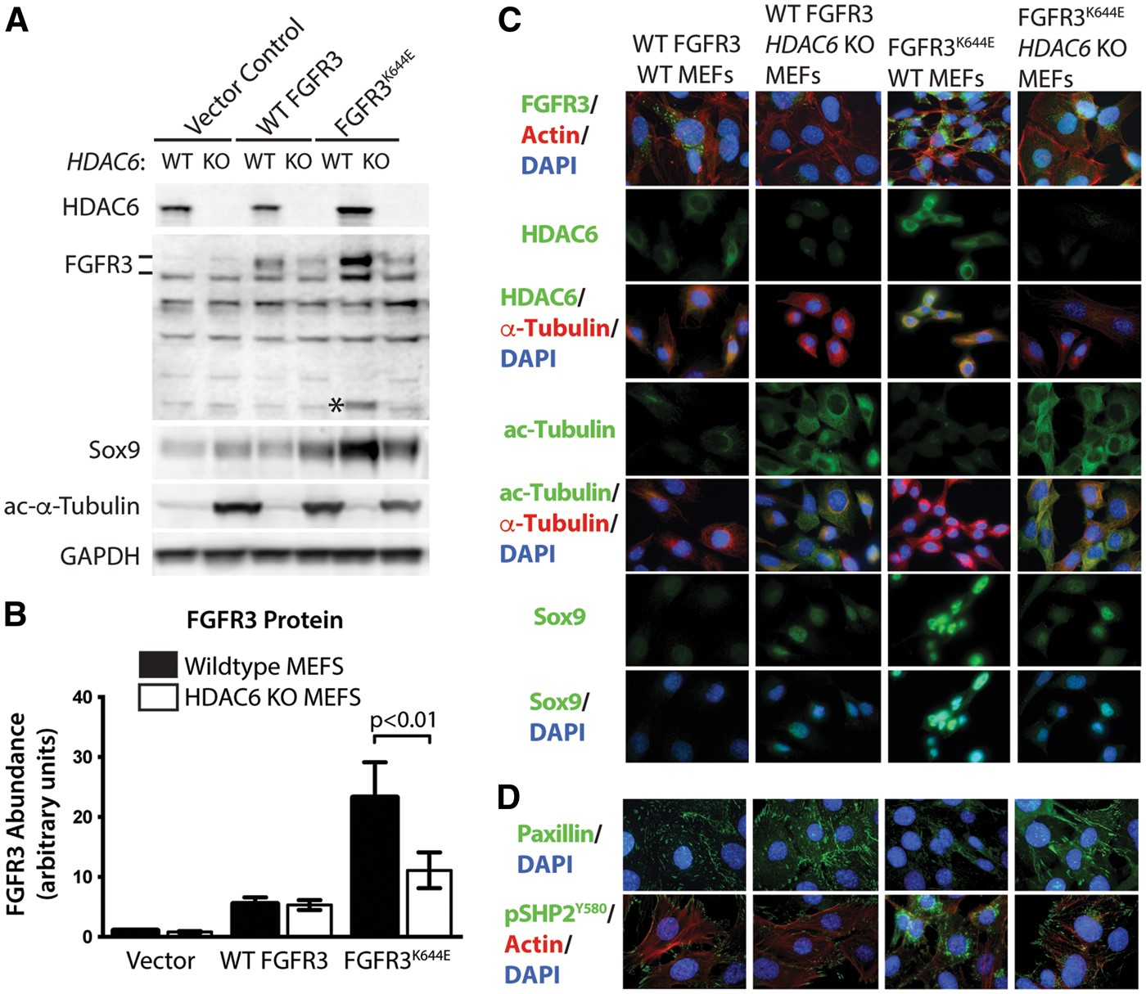
Figure 1. HDAC6 is required for the accumulation of mutant FGFR3. (A) Immunoblot analysis for abundance of the ...
Notes:
Figure 1. HDAC6 is required for the accumulation of mutant FGFR3. (A) Immunoblot analysis for abundance of the indicated proteins in wildtype and HDAC6 KO MEF cell lines expressing wildtype FGFR3, FGFR3K644E or no ectopic FGFR3 (pFBneo vector control). Acetylated (ac-) α−tubulin was used as a control for HDAC6 activity and GAPDH was used as a loading control. *Indicates the approximately 50kDa cleavage form of FGFR3 (48). (B) Quantitation of the abundance of FGFR3 relative to FGFR3 in vector control MEFS (n = 3). Mean and standard deviations are shown along with the p-value for the comparison between mutant FGFR3 in control MEFs versus HDAC6 KO MEFs. (C,D) Immunoflourescence of the indicated, (color-coded) proteins in either wildtype or HDAC6 KO MEFs expressing either FGFR3WT or FGFR3K644E. DAPI was used as a nuclear stain.
Unless provided in the caption above, the following copyright applies to the content of this slide: © The Author 2016. Published by Oxford University Press. All rights reserved. For Permissions, please email: journals.permissions@oup.com

Slide 2
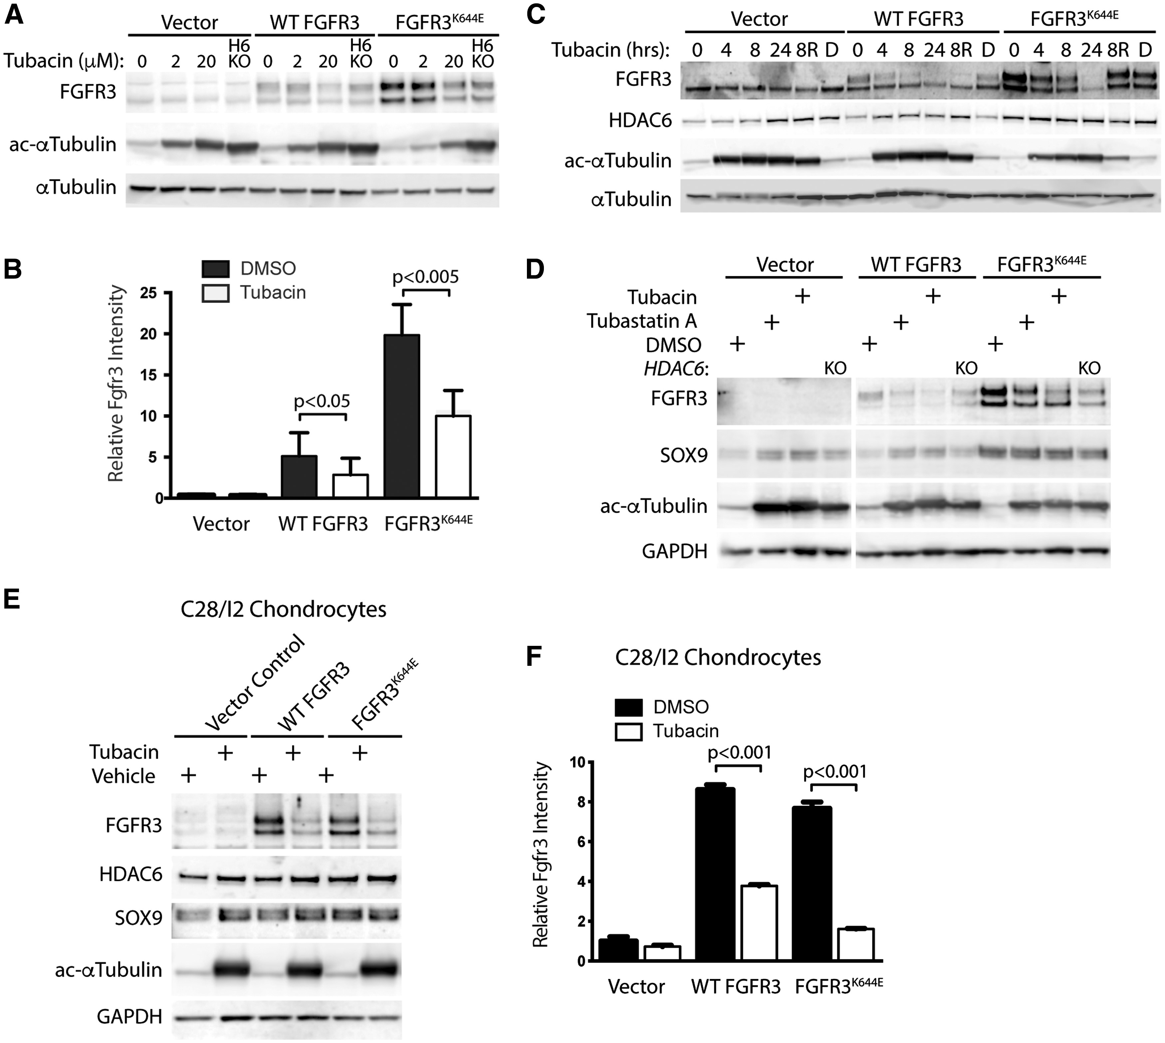
Figure 2. Accumulation of mutant FGFR3 is blocked by small molecule HDAC6 inhibition in MEFs and chondrocytes. (A) ...
Notes:
Figure 2. Accumulation of mutant FGFR3 is blocked by small molecule HDAC6 inhibition in MEFs and chondrocytes. (A) Immunoblot showing the effect of vehicle control, 2µM tubacin or 20 µM tubacin treatment for 4 h on the accumulation of FGFR3 in vector control cells and cells expressing ectopic FGFR3WT or FGFR3K644E. HDAC6 KO MEFs with either vector control, FGFR3WT or FGFR3K644E MEFs were included for comparison as indicated. ac-α−tubulin was used to show the activity of tubacin, and α−tubulin was used as a loading control. (B) Quantitation of FGFR3 abundance before and after tubacin treatment for 6 h (n = 3). Mean, standard deviations and relevant p-values for significant differences are indicated. (C) Immunoblot showing the time-dependent effect of HDAC6 inhibition on accumulation of wildtype and mutant FGFR3. For lanes labelled 8R, cells were treated for 8 h with 20µM tubacin, then washed to remove the drug and incubated for 16 h in medium lacking tubacin before harvesting lysates. Ac-α−tubulin and α−tubulin were used as drug activity and loading controls respectively. D - DMSO vehicle control at 24 h. (D) Immunoblot comparing the effect of tubacin and tubastatin A, another selective HDAC6 deacetylase inhibitor (22), on accumulation of wildtype and mutant FGFR3 after 6 h treatment. Note the FGFR3-independent induction of Sox9 by both tubacin and tubastatin A. (E) Immunoblot of the indicated proteins in C28/I2 chondrocytes ectopically expressing wildtype FGFR3 and FGFR3K644E 6 h after treatment with DMSO (vehicle) or 20µM tubacin. (F) Quantitation of FGFR3 abundance in C28/I2 cells before and after tubacin treatment for 6 h (n = 3). Ac-α−tubulin was used to show the activity of tubacin and either α−tubulin or GAPDH were used as loading controls.
Unless provided in the caption above, the following copyright applies to the content of this slide: © The Author 2016. Published by Oxford University Press. All rights reserved. For Permissions, please email: journals.permissions@oup.com

Slide 3
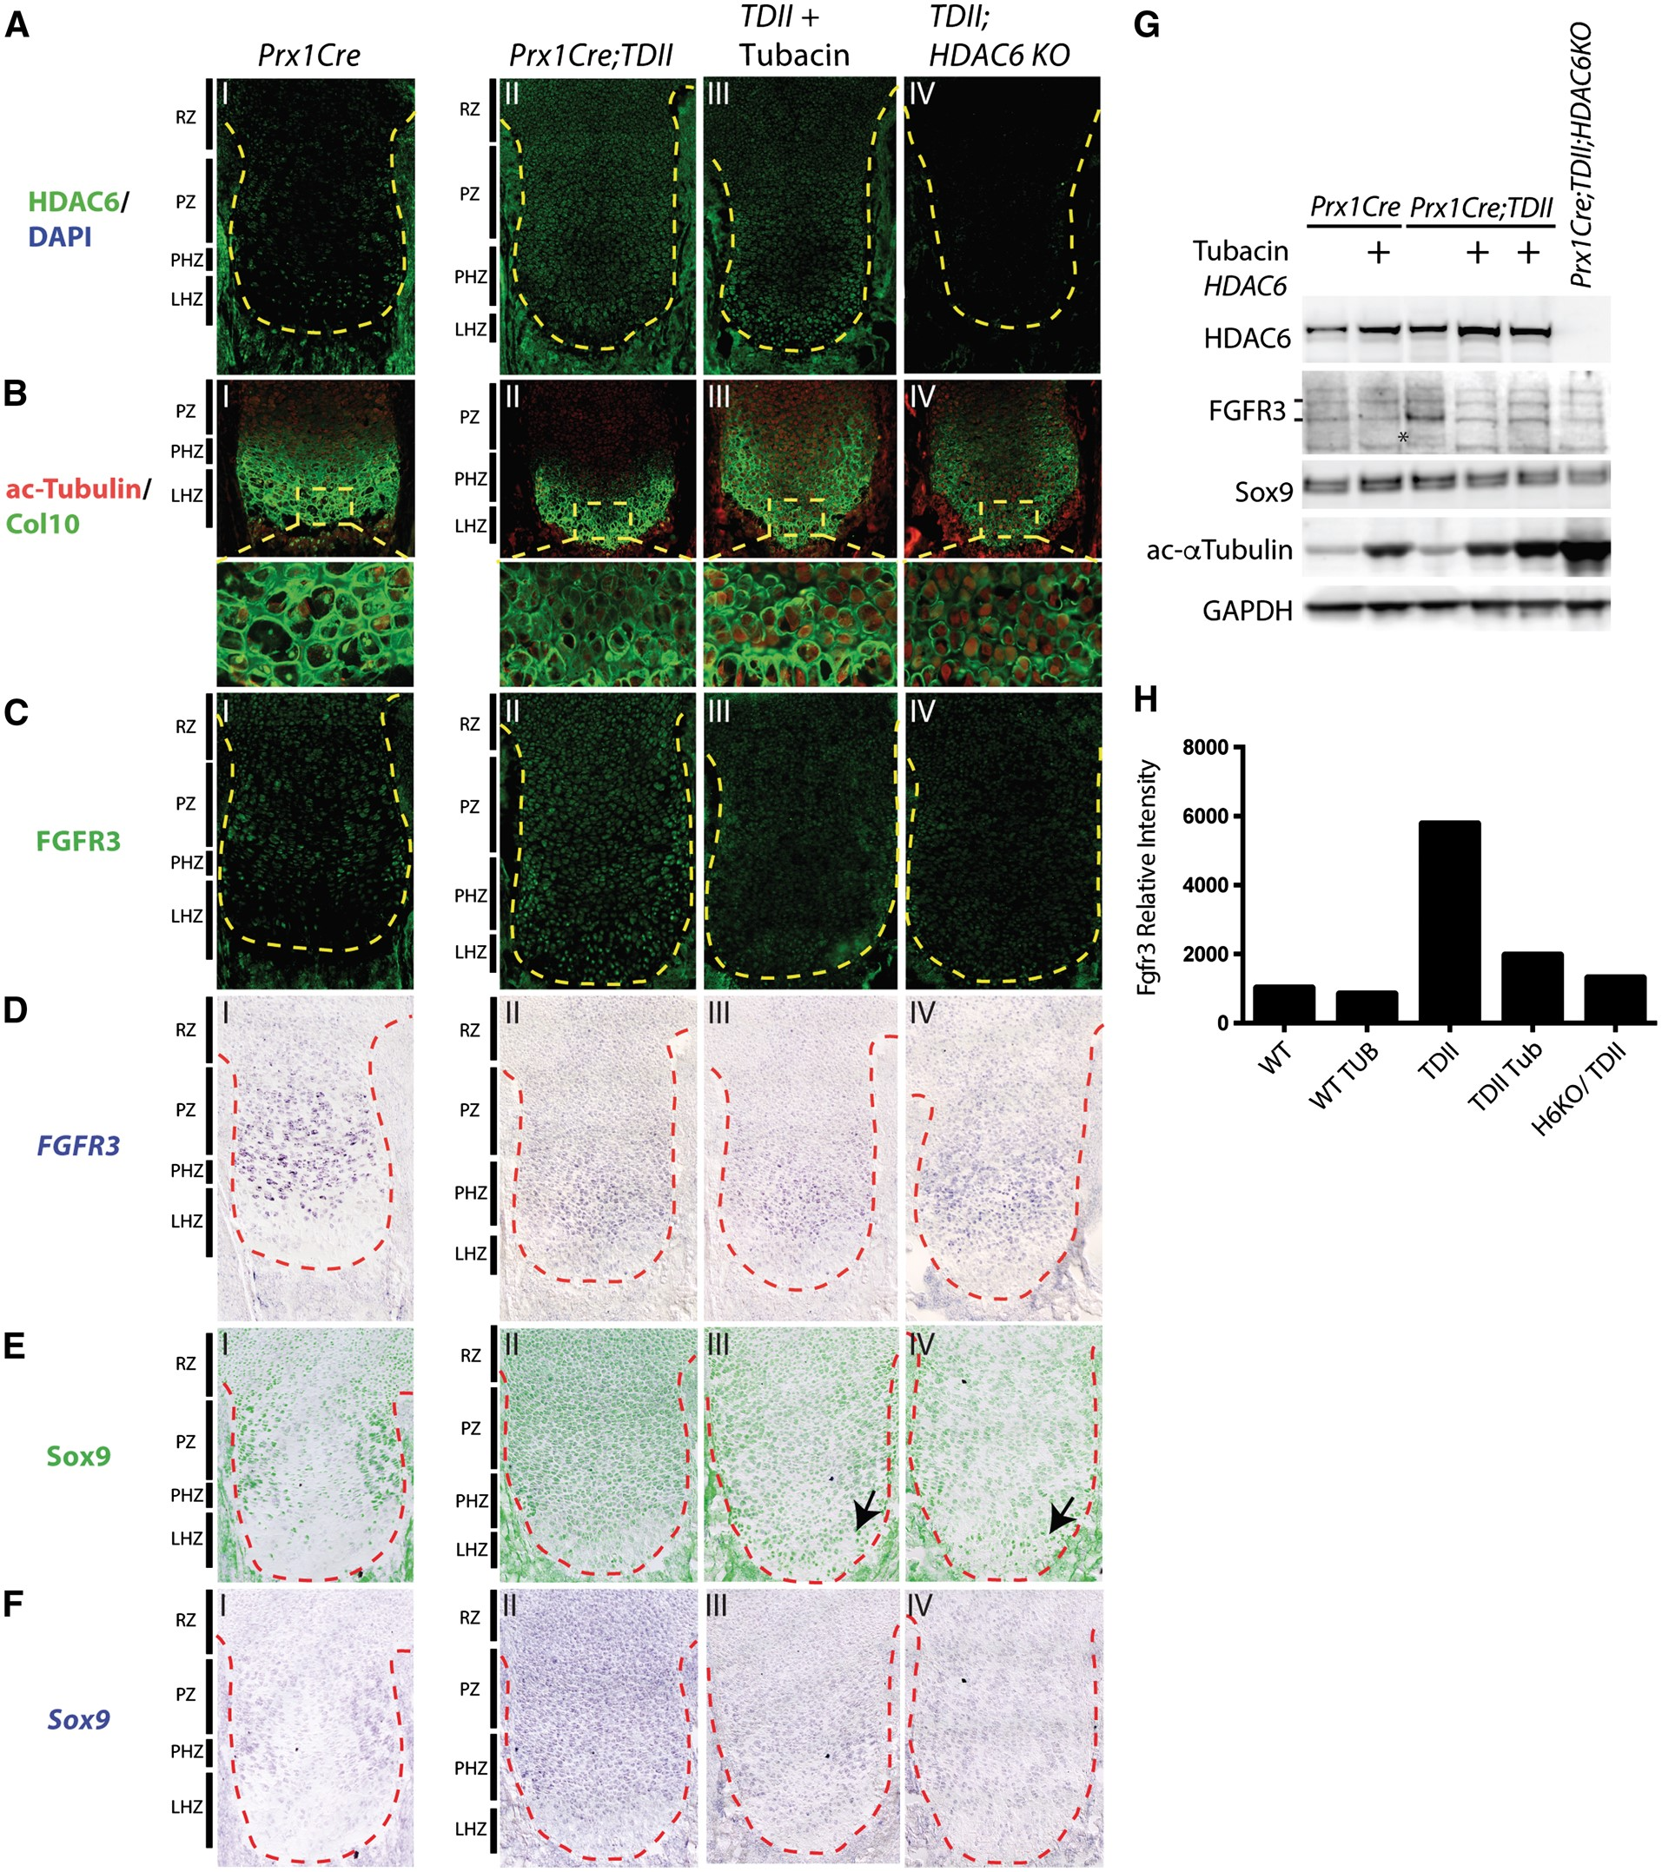
Figure 10. Effect of HDAC6 loss and inhibition on FGFR3 and Sox9 expression in vivo. Proximal tibia sections from E18.5 ...
Notes:
Figure 10. Effect of HDAC6 loss and inhibition on FGFR3 and Sox9 expression in vivo. Proximal tibia sections from E18.5 embryos with the indicated genotypes were stained with antibodies to (A) HDAC6, (B) combined acetylated α−tubulin and Collagen Type 10 (Col10), (C), FGFR3, and (E) Sox9, or subjected to in situ hybridization using probes for (D) FGFR3 and F) Sox9. The growth plates are demarcated by yellow or red lines. Enlarged images of the yellow-boxed regions shown in B) are indicated. The approximate locations of the resting zone (RZ), proliferating zone (PZ), prehypertrophic zone (PHZ) and late hypertrophic zone (LHZ) of Prx1Cre and TDII growth plates are shown. (G) Immunoblots of lysates prepared from hindlimb bones from embryos at E14.5 with the indicated genotypes. Tubacin treated embryos are indicated. The ∼135Kd and 90Kd forms of FGFR3 are indicated by bars and an additional unique immunoreactive form found in the untreated TDII cartilage is denoted with an asterisk. Ac-α−tubulin was used as an indicator of HDAC6 inhibition and either GAPDH was used as a loading control. (H) Quantitation of FGFR3 from the immunoblot in (G). The TDII-Tub value is the average of the two samples in (G).
Unless provided in the caption above, the following copyright applies to the content of this slide: © The Author 2016. Published by Oxford University Press. All rights reserved. For Permissions, please email: journals.permissions@oup.com

Slide 4
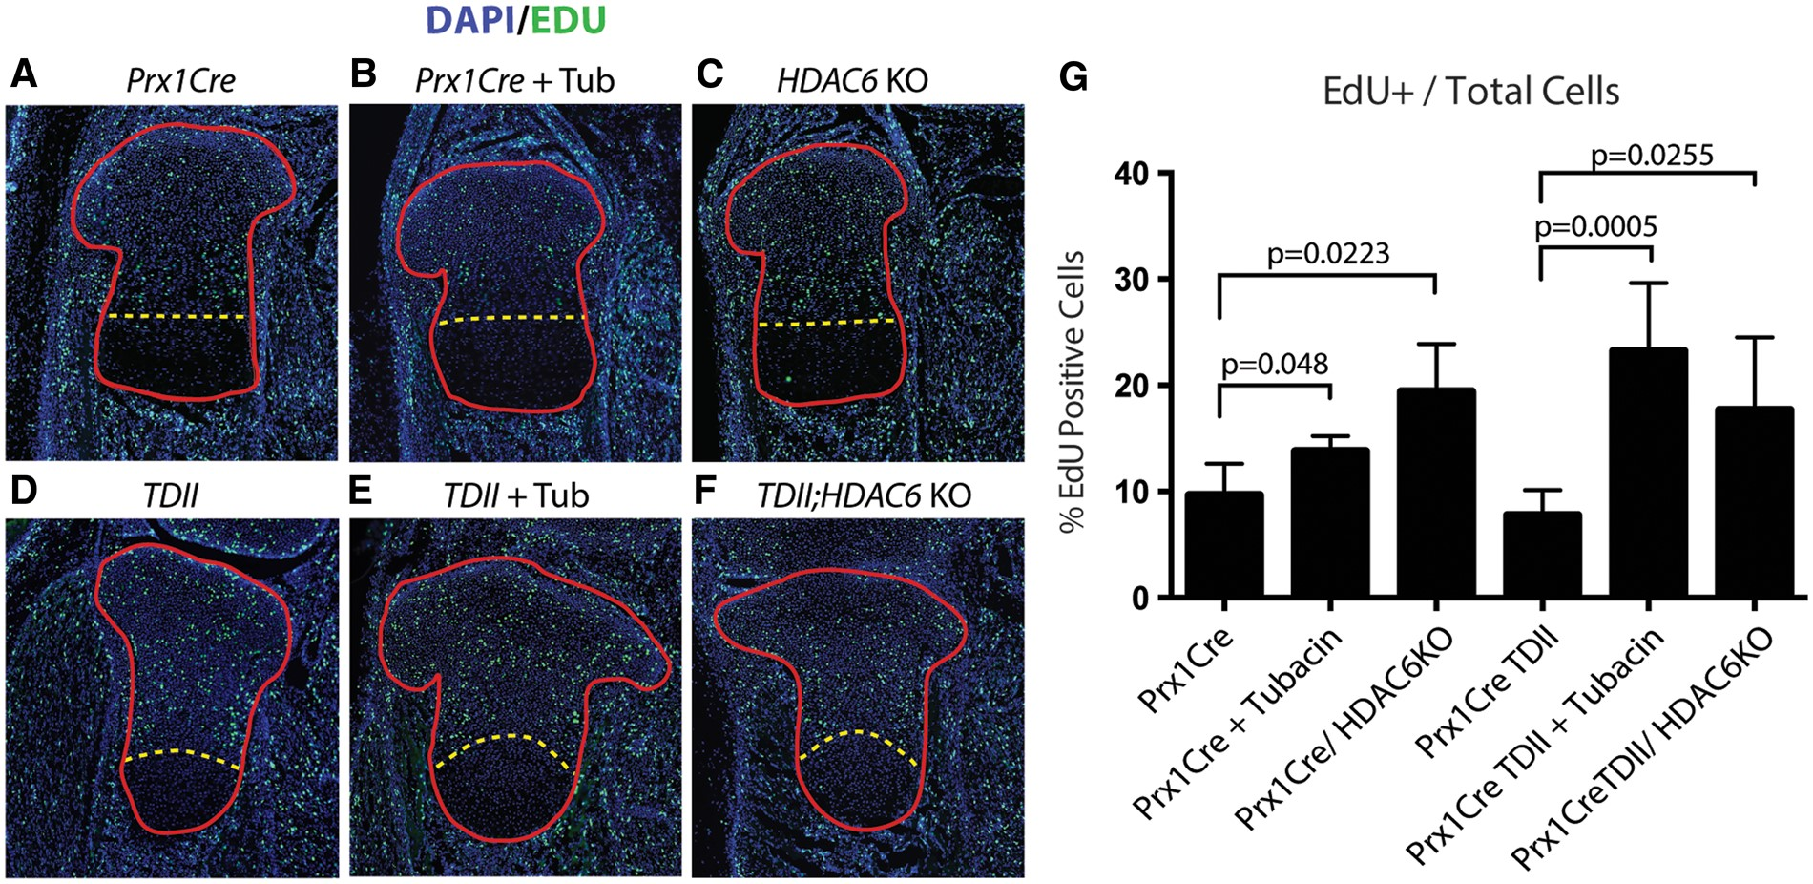
Figure 9. Increased chondrocyte proliferation in the TDII growth plate caused by HDAC6 deficiency or inhibition. (A–F) ...
Notes:
Figure 9. Increased chondrocyte proliferation in the TDII growth plate caused by HDAC6 deficiency or inhibition. (A–F) EdU incorporation (green) and DAPI staining of E18.5 tibias from mice with the indicated genotypes. Growth plates are outlined in red and the yellow line demarcates the approximate boundary between the proliferative zone and the post-mitotic compartment of differentiating (prehypertrophic and hypertrophic) chondrocytes. (G) EdU- and DAPI-positive cells were identified and counted using Cell Profiler software and EdU-positive cells are presented as a percentage of the total (DAPI-positive) within the sub-prehypertrophic region. p-values for specific comparisons are indicated.
Unless provided in the caption above, the following copyright applies to the content of this slide: © The Author 2016. Published by Oxford University Press. All rights reserved. For Permissions, please email: journals.permissions@oup.com

Slide 5
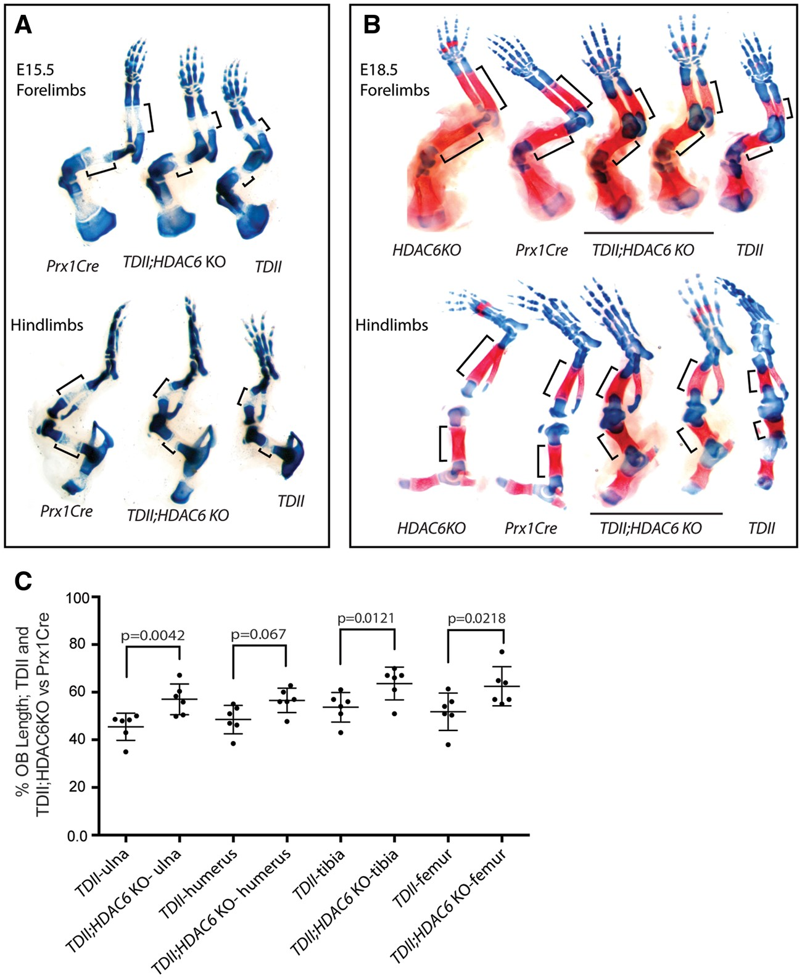
Figure 7. Loss of HDAC6 increases bone growth in TDII mice. (A) Alcian blue and Alizarin red staining of forelimb and ...
Notes:
Figure 7. Loss of HDAC6 increases bone growth in TDII mice. (A) Alcian blue and Alizarin red staining of forelimb and hindlimbs from E15.5 embryo littermates of the indicated genotypes. The primary ossification center (which is not sufficiently mature to stain with Alizarin red) is highlighted by black brackets. (B) Same as in A), but with E18.5 forelimbs and hindlimbs. Note that this litter, unlike the one in A) includes an HDAC6 KO embryo. (C) Dot plots showing the percent change in OB length between TDII and Prx1Cre E18.5 long bones (n = 6) and between TDII;HDAC6 KO and Prx1Cre long bones (n = 6). All comparisons were made between littermates (exact same age). Mean, standard deviation and p-values are indicated.
Unless provided in the caption above, the following copyright applies to the content of this slide: © The Author 2016. Published by Oxford University Press. All rights reserved. For Permissions, please email: journals.permissions@oup.com

Slide 6
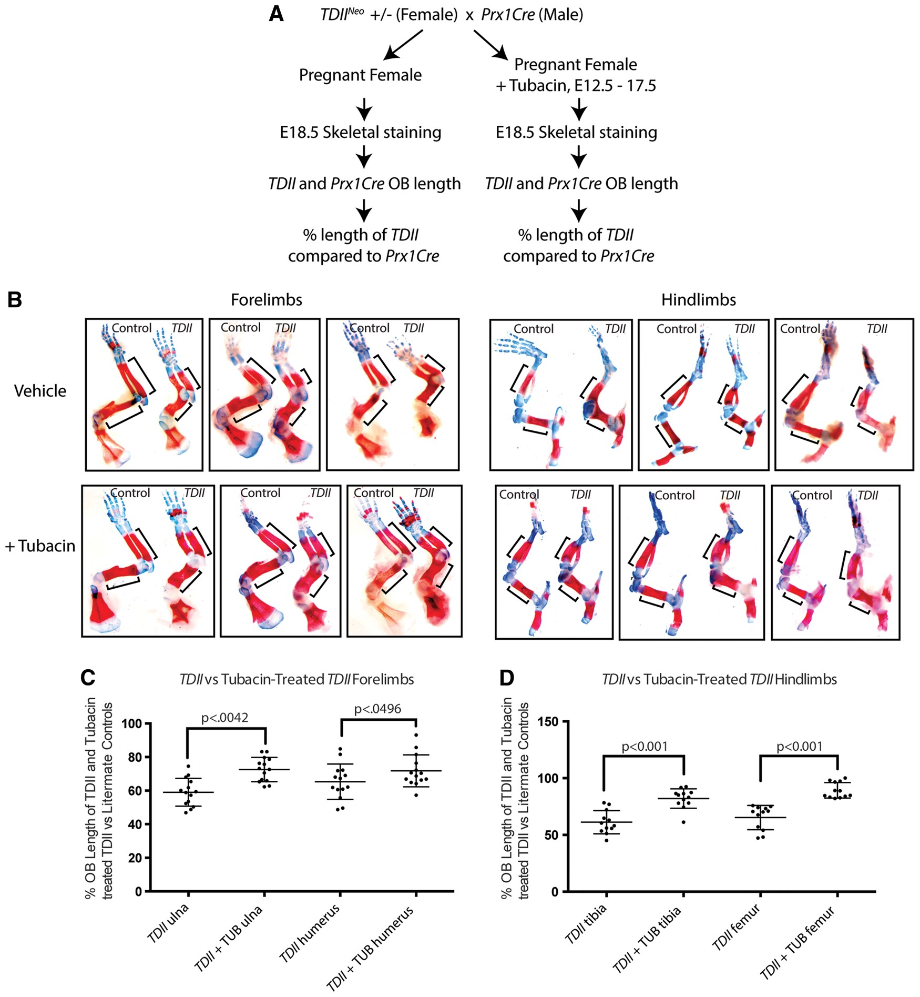
Figure 6. Tubacin increases bone growth in a mouse model of TDII. (A) Diagram outlining the strategy used to determine ...
Notes:
Figure 6. Tubacin increases bone growth in a mouse model of TDII. (A) Diagram outlining the strategy used to determine the effect of tubacin on TDII long bones. (B) Alizarin red and Alcian blue stained forelimbs and hindlimbs from three different sets of embryos from vehicle-treated or tubacin-treated mothers. Bars show approximate OB length. (C) Dot plots with each dot representing the percent change in OB length for littermate comparisons between TDII and Prx1Cre (control) forelimb long bones (n = 14) and between TDII and Prx1Cre forelimb long bones treated with tubacin (n = 14). (D) Same as in C) but with hindlimbs long bones (n = 12). The mean OB percent change, standard deviation and p-values for each littermate comparison is indicated.
Unless provided in the caption above, the following copyright applies to the content of this slide: © The Author 2016. Published by Oxford University Press. All rights reserved. For Permissions, please email: journals.permissions@oup.com

Slide 7
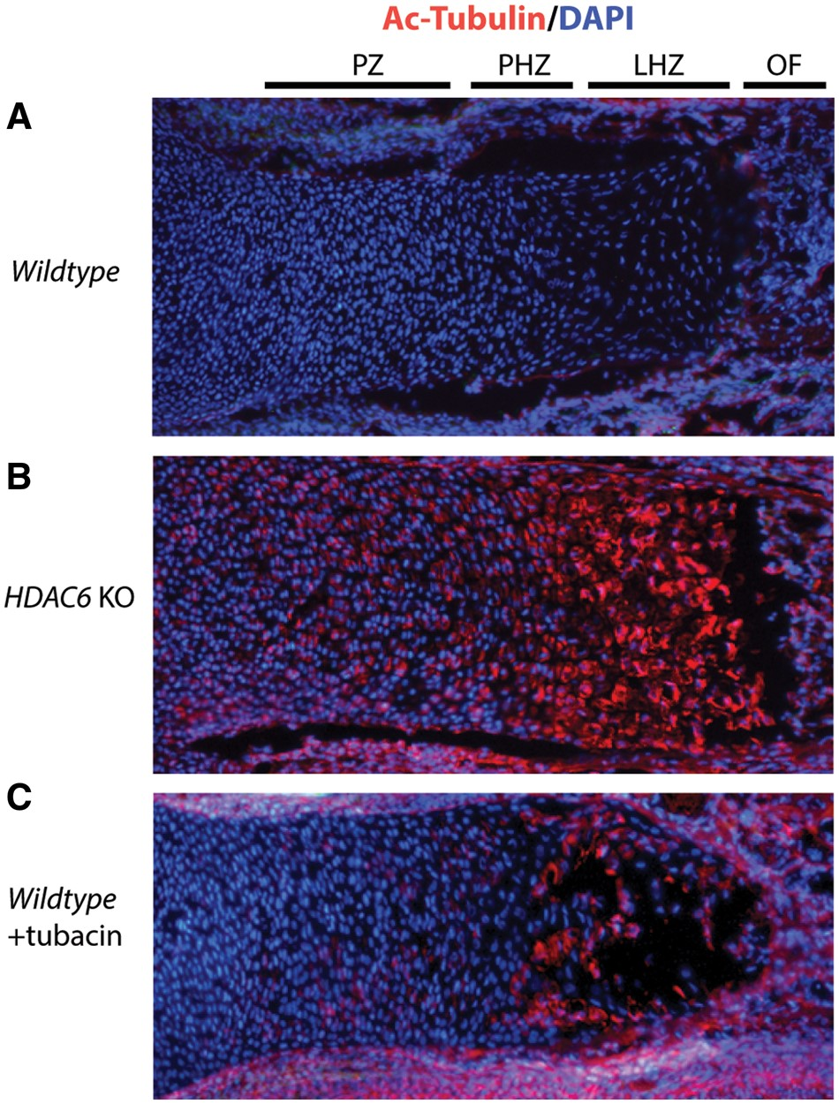
Figure 5. Increased α−tubulin acetylation in the growth plate caused by HDAC6 loss or inhibition. (A–C) ...
Notes:
Figure 5. Increased α−tubulin acetylation in the growth plate caused by HDAC6 loss or inhibition. (A–C) Immunohistochemical staining for ac-α-tubulin (red) performed on E18.5 tibia sections from a control (Prx1Cre) embryo, an embryo from a mother injected with tubacin and a HDAC6 KO embryo. Tubacin injections were on consecutive days beginning on gestation day 12.5 and ending on day 17.5. Nuclei were stained with DAPI. The approximate locations of the proliferative zone (PZ), prehypertrophic zone (PHZ), late hypertrophic zone (LHZ) and ossification front (OF) are indicated.
Unless provided in the caption above, the following copyright applies to the content of this slide: © The Author 2016. Published by Oxford University Press. All rights reserved. For Permissions, please email: journals.permissions@oup.com

Slide 8
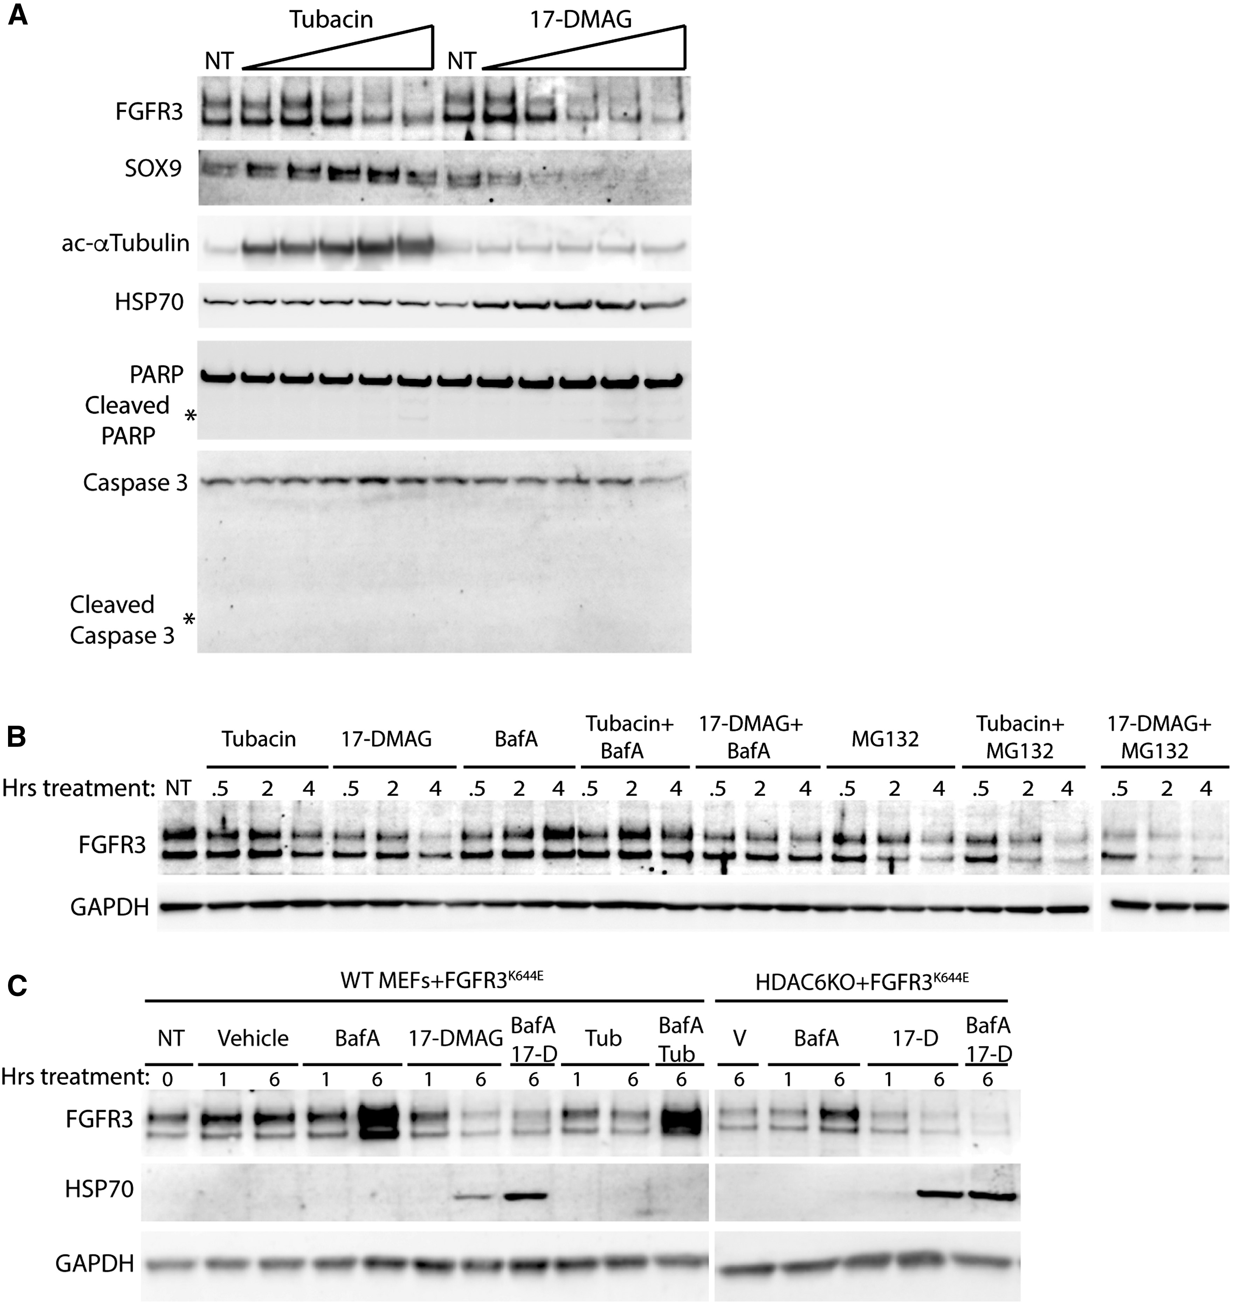
Figure 4. HDAC6 inhibition and HSP90 inhibition decrease accumulation of mutant FGFR3 accumulation through different ...
Notes:
Figure 4. HDAC6 inhibition and HSP90 inhibition decrease accumulation of mutant FGFR3 accumulation through different mechanisms. (A) Immunoblots showing the dose-dependent regulation of mutant FGFR3 and Sox9 accumulation by tubacin and 17-DMAG. C28/I2 cells were treated with tubacin (0–NT, 1.25, 2.5, 5, 10 and 20μM) or 17-DMAG (0-NT, 25, 50, 100, 200 and 400nM) for 24 h. Induction of HSP70 was monitored as an indicator of HSP90 inhibition by 17-DMAG and ac-α−tubulin was monitored as an indicator of tubacin inhibition of HDAC6. PARP and Caspase 3 cleavage were used as indicators for the induction of apoptosis. (B) Immunoblot analysis of FGFR3K644E accumulation in C28/I2 cells treated with tubacin or 17-DMAG for the indicated times, either alone or together with the lysosome inhibitor BafA or proteosome inhibitor MG132. (C) Immunoblot analysis of mutant FGFR3K644Eaccumulation in wildtype (WT) or HDAC6 KO MEFs treated with tubacin or 17-DMAG either alone or together with the lysosome inhibitor BafA for the indicated times. HSP70 induction is a control for 17-DMAG activity and GAPDH is a loading control.
Unless provided in the caption above, the following copyright applies to the content of this slide: © The Author 2016. Published by Oxford University Press. All rights reserved. For Permissions, please email: journals.permissions@oup.com

Slide 9
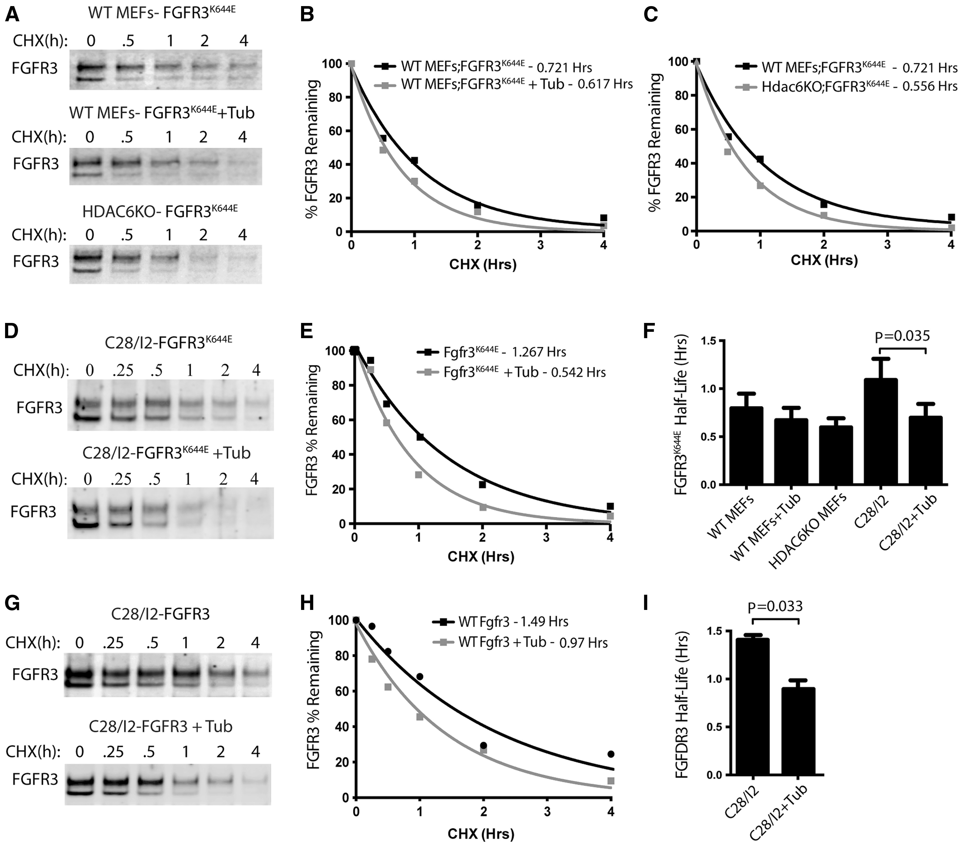
Figure 3. HDAC6 loss or inhibition decreases the stability of FGFR3. (A) Immunoblots comparing the decay of ...
Notes:
Figure 3. HDAC6 loss or inhibition decreases the stability of FGFR3. (A) Immunoblots comparing the decay of FGFR3K644E in wildtype MEFs, wildtype MEFs treated with 20µM tubacin and in HDAC6 KO MEFs following treatment with CHX for the indicated times. B,C) Graphs showing the decay of mutant FGFR3 in tubacin treated and HDAC6 KO MEFs determined from immunoblots shown in (B) and (C) respectively. The half-lives are indicated. (D) Immunoblots showing the decay of FGFR3K644E in C28/I2 chondrocytes in the presence or absence of tubacin. (E) Graph showing the decay of mutant FGFR3 determined from the immunoblot shown in D). (F) Compilation of half-life data for FGFR3K644E in MEFs and C28/I2 cells under the indicated conditions (n = 3 for each condition). Mean half-life, standard deviations and the p-value for the comparison between treated and untreated C28/I2 cells are plotted. (G) Immunoblots showing the decay of wildtype FGFR3 in C28/I2 chondrocytes treated with vehicle or tubacin. (H) Plots of FGFR3 decay from G). (I) Summary of wildtype FGFR3 CHX experiments (n = 3). Mean, standard deviations and p-value are shown.
Unless provided in the caption above, the following copyright applies to the content of this slide: © The Author 2016. Published by Oxford University Press. All rights reserved. For Permissions, please email: journals.permissions@oup.com

Slide 10
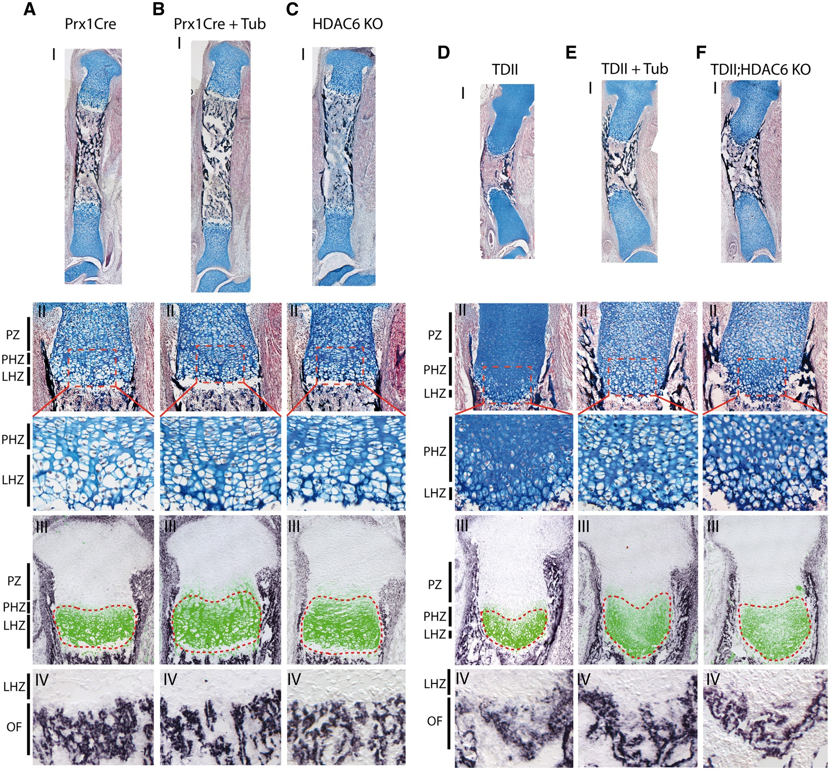
Figure 8. Analysis of HDAC6 deficiency and inhibition on growth plate and bone morphology and organization. (A–F) ...
Notes:
Figure 8. Analysis of HDAC6 deficiency and inhibition on growth plate and bone morphology and organization. (A–F) Combined Alcian blue, von Kossa (mineralized bone) and H&E staining of E18.5 tibias from mice with the indicated genotypes or following treatment with tubacin (tub) as indicated. Higher magnification images of the proximal tibia are shown at below (AII–FII) with approximate locations of the proliferative zone (PZ), prehypertrophic zone (PHZ) and late hypertrophic zone (LHZ) indicated. AIII-FIII). Combined Col10a1 immunohistochemistry (green) and Col1a1 in situ hybridization (dark purple) of E18.5 tibias. The Col10a1-positive area is highlighted by red dashed line. AIV-FIV) Higher magnification images of Col1a1 in situ hybridization at the subchondral ossification front (OF).
Unless provided in the caption above, the following copyright applies to the content of this slide: © The Author 2016. Published by Oxford University Press. All rights reserved. For Permissions, please email: journals.permissions@oup.com

