Slide 1
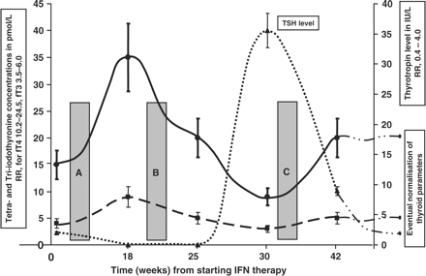
Figure 1. The evolving biochemical profile of thyroid hormones in IFN-induced thyroiditis. Each time point represents ...
Notes:
Figure 1. The evolving biochemical profile of thyroid hormones in IFN-induced thyroiditis. Each time point represents the mean value of each thyroid parameters with 95% CI bar. Testing at point [A] will falsely reassure with normal thyroid tests. Testing at point [B] will detect hyperthyroidism. Point [C] indicates hypothyroidism, which may be deemed permanent and required unnecessary life-long thyroxine therapy. fT4 levels (solid line); fT3 levels (dashed line), TSH concentrations (dotted line). The right Y-axis is the secondary axis for TSH.
Unless provided in the caption above, the following copyright applies to the content of this slide: © The Author 2008. Published by Oxford University Press on behalf of the Association of Physicians. All rights reserved. For Permissions, please email: journals.permissions@oxfordjournals.org

