Slide 1
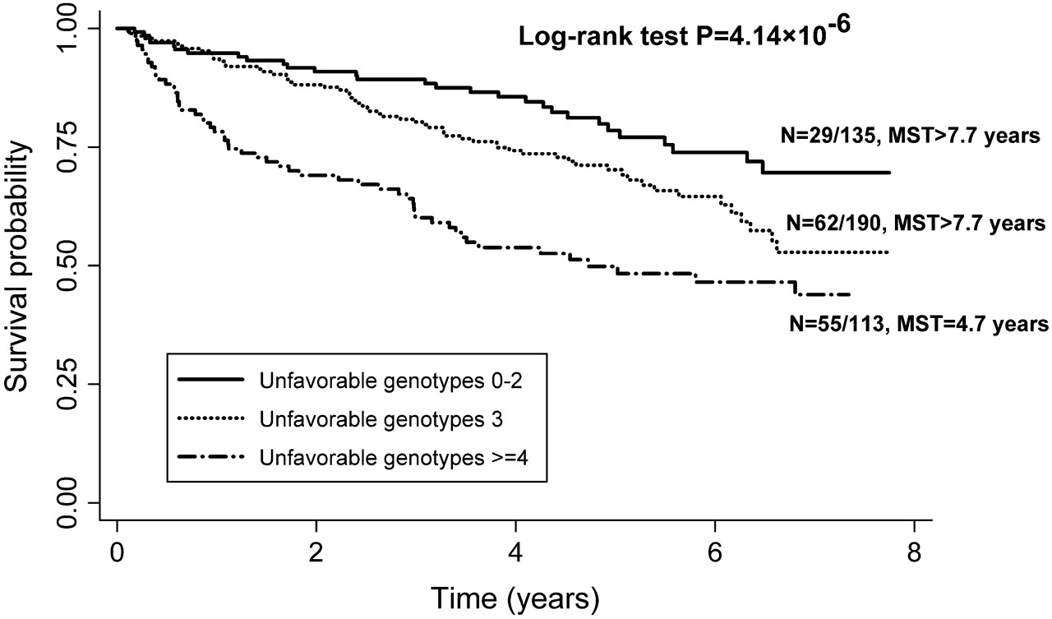
Fig. 1. Kaplan–Meier survival estimates for patients carrying unfavorable genotypes of RGS gene in the risk of ...
Notes:
Fig. 1. Kaplan–Meier survival estimates for patients carrying unfavorable genotypes of RGS gene in the risk of SPT/recurrence. MST, median survival time (event-free time).
Unless provided in the caption above, the following copyright applies to the content of this slide: © The Author 2010. Published by Oxford University Press. All rights reserved. For Permissions, please email: journals.permissions@oxfordjournals.org

Slide 2
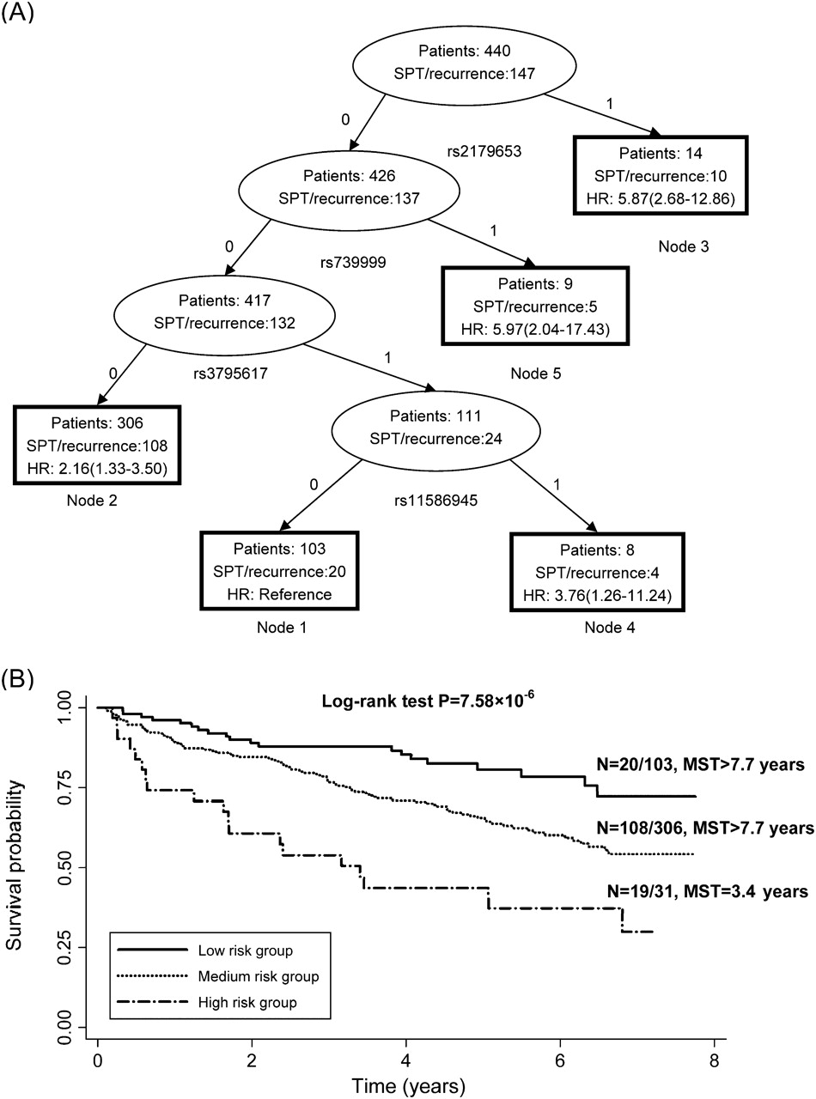
Fig. 2. Survival tree analysis on the association between RGS genetic polymorphisms and SPT/recurrence among HNSCC ...
Notes:
Fig. 2. Survival tree analysis on the association between RGS genetic polymorphisms and SPT/recurrence among HNSCC patients. ( A ) Survival tree model partitioning of 440 patients was performed. The resulting tree with five terminal nodes was split by rs2179653, rs739999, rs3795617 and rs11586945. For each SNP, ‘0’ represents common homozygous genotype; ‘1’ represents heterozygous or homozygous variant genotype. ( B ) Kaplan–Meier curves based on survival tree analysis in RGS genes for selected nodes. MST, median survival time (event-free time).
Unless provided in the caption above, the following copyright applies to the content of this slide: © The Author 2010. Published by Oxford University Press. All rights reserved. For Permissions, please email: journals.permissions@oxfordjournals.org

