Slide 1
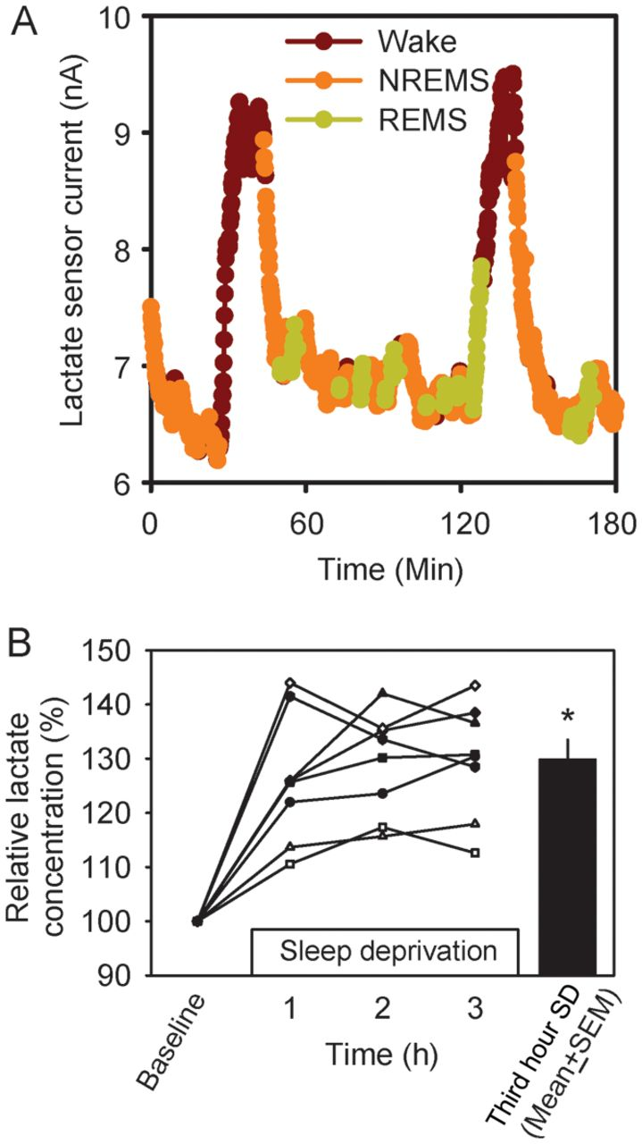
Figure 1. Cerebral cortex lactate concentration varies across sleep–wake states. (A) A sample trace of current measured ...
Notes:
Figure 1. Cerebral cortex lactate concentration varies across sleep–wake states. (A) A sample trace of current measured by a lactate sensor across 3 h of spontaneous sleep/wake. Data are color coded according to the EEG-defined state. Data collected during wakefulness are shown in brown, NREMS in orange, and REMS in green. (B) The effect of 3-h SD on lactate concentration in the cerebral cortex. Each curve represents data from an individual mouse. Data are normalized to the baseline value measured during the hour immediately preceding the onset of SD. The black bar denotes mean + standard error of the mean (SEM) of group values during the third hour of SD. *P < 0.05 versus baseline, Student's t-test.
Unless provided in the caption above, the following copyright applies to the content of this slide: © The Author 2012. Published by Oxford University Press. All rights reserved. For Permissions, please e-mail: journals.permissions@oup.com

Slide 2
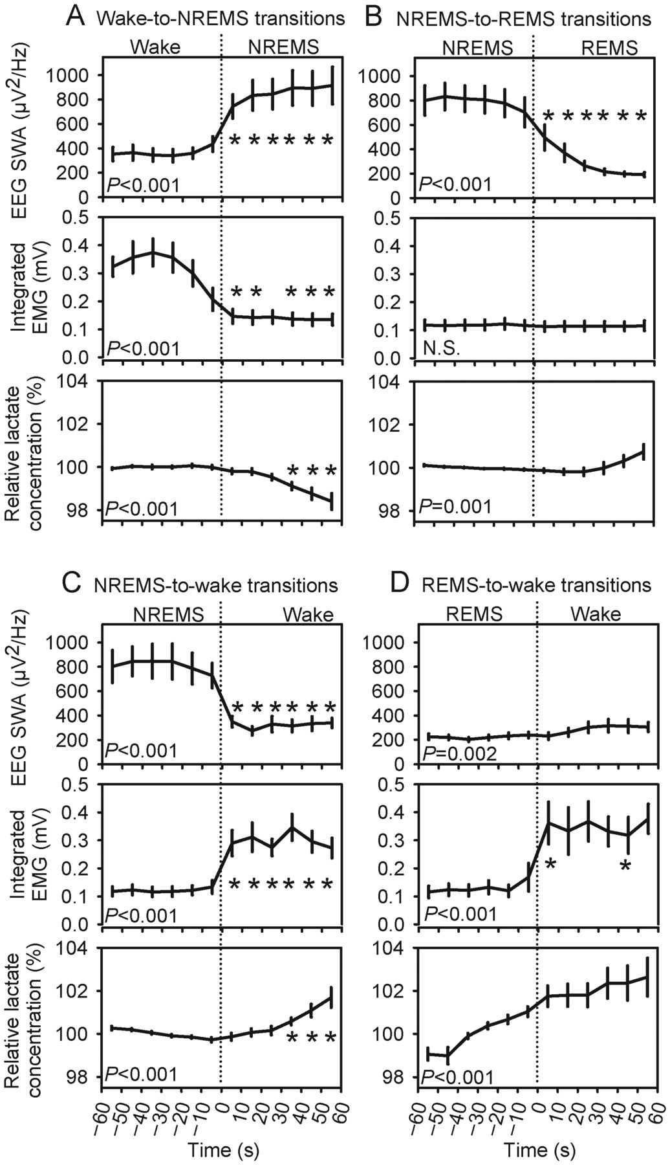
Figure 2. Lactate concentration decreases during NREMS and increases during wake and REMS. Data are from 2-min ...
Notes:
Figure 2. Lactate concentration decreases during NREMS and increases during wake and REMS. Data are from 2-min intervals characterized by state transitions. Transitions occurred at time 0: Wake-to-NREMS (A), NREMS-to-REMS (B), NREMS-to-wake (C), and REMS-to-wake (D). EEG SWA (upper panels) and integrated EMG (middle panels) are raw values; lactate concentration (lower panels) is normalized to the mean of the first 6 epochs within each transition. Variables were averaged across all such transitions exhibited by each animal. Group mean ± SEM of these averaged values are shown (n= 7 mice). P-values are those associated with main effect of time in repeated-measures ANOVA. *P < 0.05 versus last epoch before state transition, Student's t-test with Bonferroni correction.
Unless provided in the caption above, the following copyright applies to the content of this slide: © The Author 2012. Published by Oxford University Press. All rights reserved. For Permissions, please e-mail: journals.permissions@oup.com

Slide 3
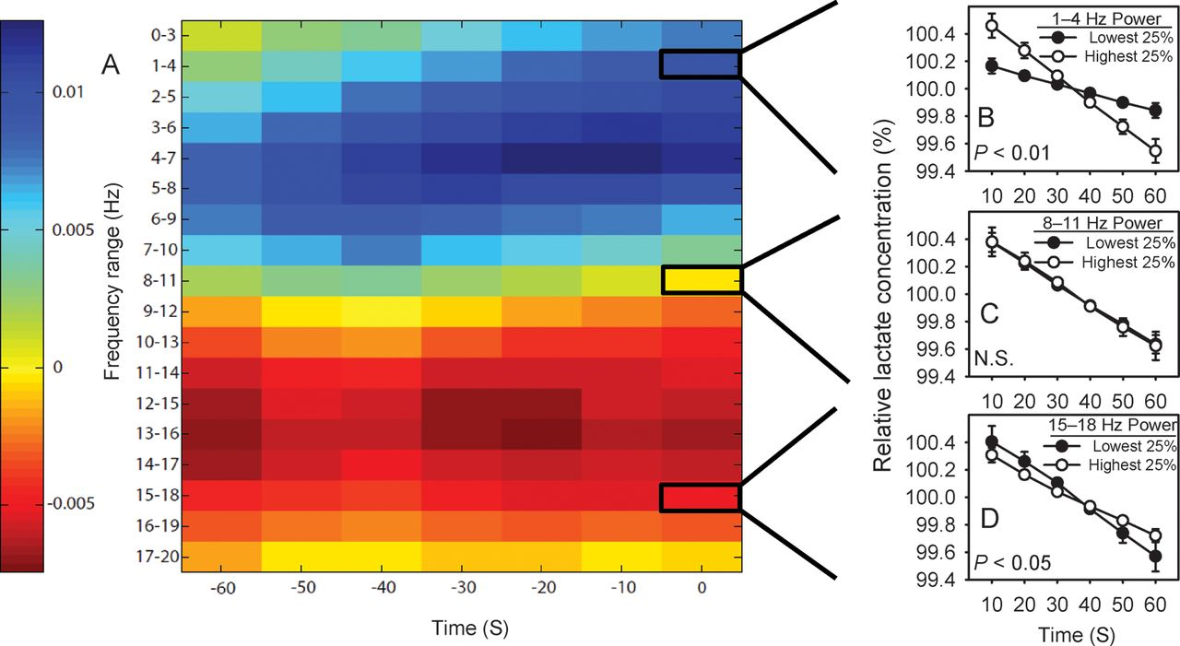
Figure 3. EEG power predicts the rate of decline of lactate concentration during NREMS. (A) A heat map indicates the ...
Notes:
Figure 3. EEG power predicts the rate of decline of lactate concentration during NREMS. (A) A heat map indicates the magnitude of the effect of EEG power at each frequency bin × time window of the matrix on the rate of decline in lactate concentration across 1-min NREMS segments. Cold colors indicate a direct relationship between EEG power and the rate of decline in lactate concentration. Hot colors indicate an inverse relationship between EEG power and the rate of decline in lactate concentration. (B–D) Examples of the relationships between EEG power in 3 EEG frequency bins and relative lactate concentration. (B) The rate of decline of lactate concentration averaged across the 25% of 1-min segments with the highest EEG power in the 1–4 Hz range (white symbols) versus the 25% of 1-min segments with the lowest EEG power in the 1–4 Hz range (black symbols). (C) The rate of decline of lactate concentration averaged across the 25% of 1-min segments with the highest EEG power in the 8–11 Hz range (white symbols) versus the 25% of 1-min segments with the lowest EEG power in the 8–11 Hz range (black symbols). (D) The rate of decline of lactate concentration averaged across the 25% of 1-min segments with the highest EEG power in the 15–18 Hz range (white symbols) versus the 25% of 1-min segments with the lowest EEG power in the 15–18 Hz range (black symbols). P-values are those associated with EEG power × epoch interaction in repeated-measures ANOVA.
Unless provided in the caption above, the following copyright applies to the content of this slide: © The Author 2012. Published by Oxford University Press. All rights reserved. For Permissions, please e-mail: journals.permissions@oup.com

Slide 4
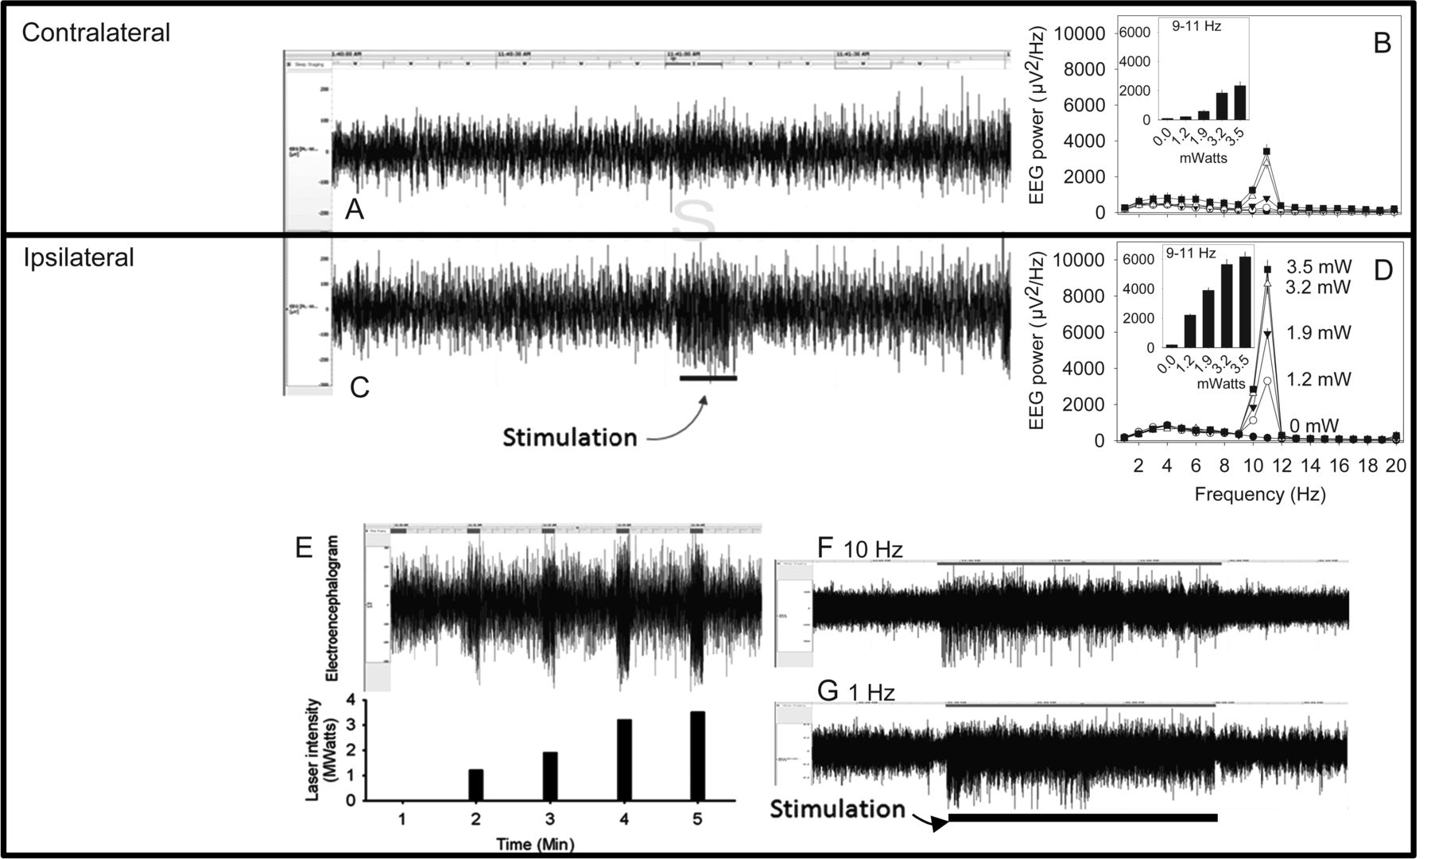
Figure 4. Optogenetic manipulation of the cerebral cortical electroencephalogram in Thy1/ChR2-eGFP transgenic mice. (A ...
Notes:
Figure 4. Optogenetic manipulation of the cerebral cortical electroencephalogram in Thy1/ChR2-eGFP transgenic mice. (A and C) A 2-min bilateral EEG recording demonstrates the effect of 10-Hz stimulation with 1.2-mW blue light on the waking EEG recorded contralaterally (A) and ipsilaterally (C) to the fiber optic probe. The 10-s application of the 10 Hz stimulus began 1-min into the 2-min recording. (B and D) Intensity-response curve for the effects of 10-Hz stimuli on EEG power spectra contralateral (B) and ipsilateral (D) to the stimulus. Insets show power in the 9–11 Hz range. Stimuli were delivered once per minute, during the first 10-s of the minute, at increasing intensities. (E) A 5-min EEG recording (upper panel) from the side ipsilateral to the fiber optic stimulus demonstrates an intensity-proportionate response to 10-Hz stimulation at increasing light intensities (lower panel). (F and G) Sixty-min EEG recordings from EEGs ipsilateral to a fiber optic stimulus probe demonstrate sustained responsiveness to continuous optogenetic stimulation. The mouse was subjected to a 30-min interval of continuous optogenetic stimulation at 10 Hz (F) or 1 Hz (G). The timing of stimulation is indicated by the bar at the base of the figure.
Unless provided in the caption above, the following copyright applies to the content of this slide: © The Author 2012. Published by Oxford University Press. All rights reserved. For Permissions, please e-mail: journals.permissions@oup.com

Slide 5
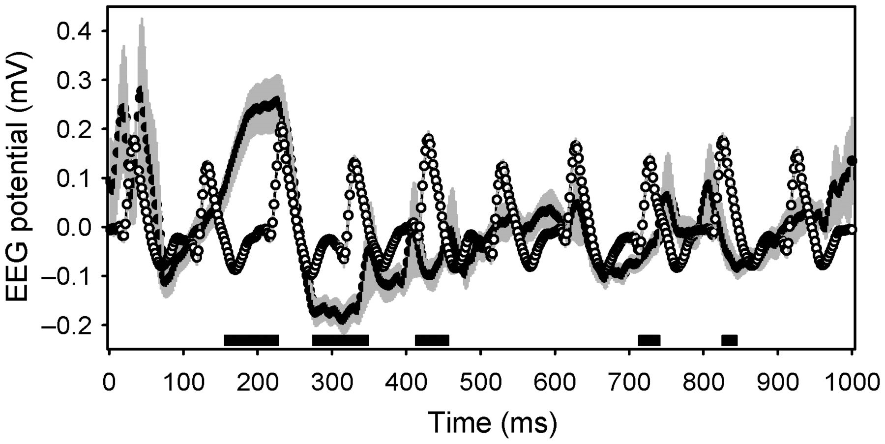
Figure 5. Averaged event-triggered EEG traces from the hemisphere contralateral to the optogenetic stimulus. Open ...
Notes:
Figure 5. Averaged event-triggered EEG traces from the hemisphere contralateral to the optogenetic stimulus. Open symbols with gray error bars denote the effect of a 10-Hz stimulus. Closed symbols with gray error bars denote the effect of a 1-Hz stimulus. Black bars at the base of the graph denote times when the 2 traces were statistically significantly different by Student's t-test (corrected to P < 0.0001).
Unless provided in the caption above, the following copyright applies to the content of this slide: © The Author 2012. Published by Oxford University Press. All rights reserved. For Permissions, please e-mail: journals.permissions@oup.com

Slide 6
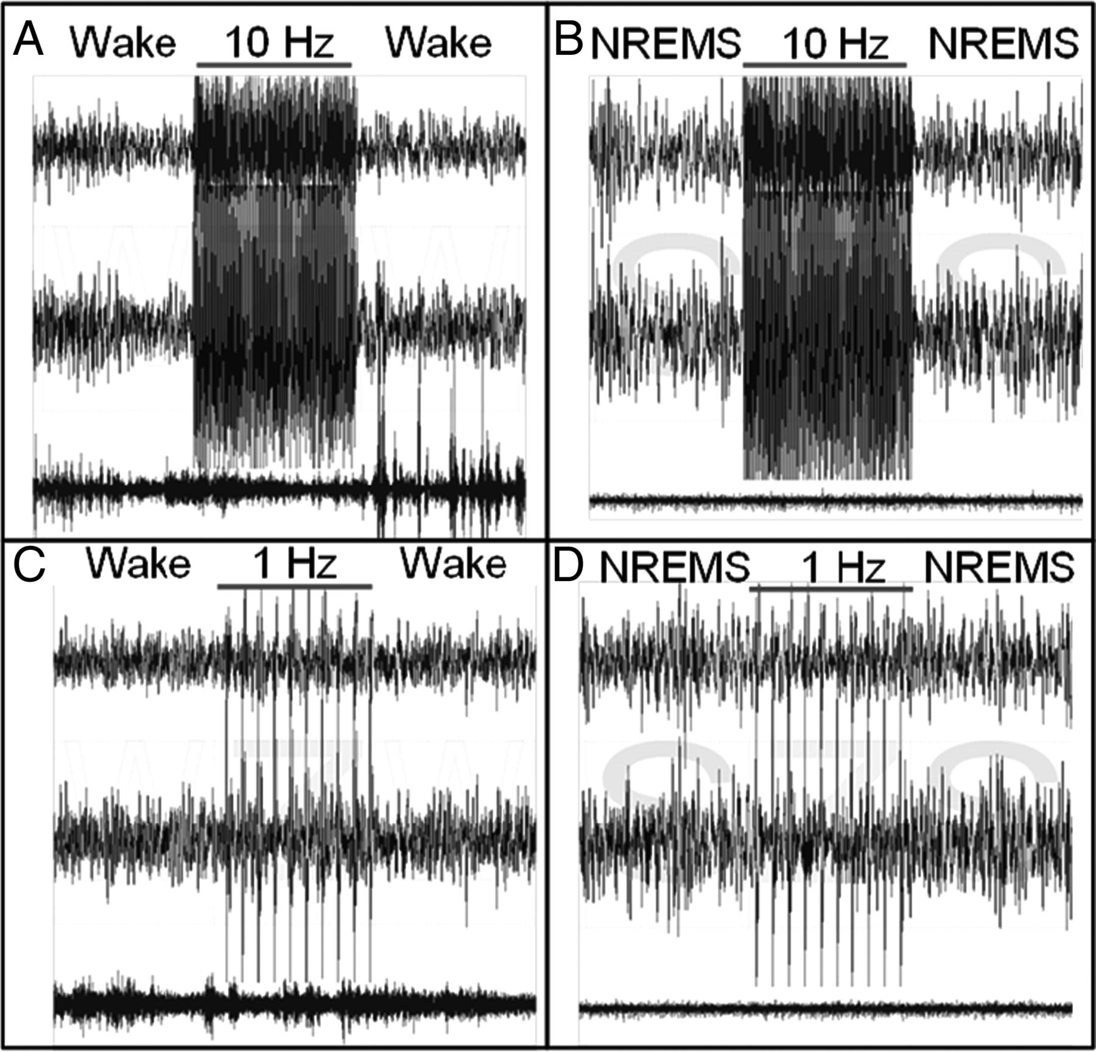
Figure 6. Continuity of sleep states during optogenetic stimulation. Each panel contains 30-s traces of EEG ...
Notes:
Figure 6. Continuity of sleep states during optogenetic stimulation. Each panel contains 30-s traces of EEG contralateral to the optogenetic stimulating cannula (upper trace), EEG ipsilateral to the optogenetic stimulating cannula (middle trace), and EMG (lower trace). The cerebral cortex was subjected to 10-s trains of 1.5-ms blue light pulses at 10 Hz (A and B) or 1 Hz (C and D) administered during spontaneous sleep/wake cycles. The stimulus induces a bilateral EEG response without altering the state of vigilance, whether the stimulus is delivered during wakefulness (A and C) or NREMS (B and D).
Unless provided in the caption above, the following copyright applies to the content of this slide: © The Author 2012. Published by Oxford University Press. All rights reserved. For Permissions, please e-mail: journals.permissions@oup.com

Slide 7
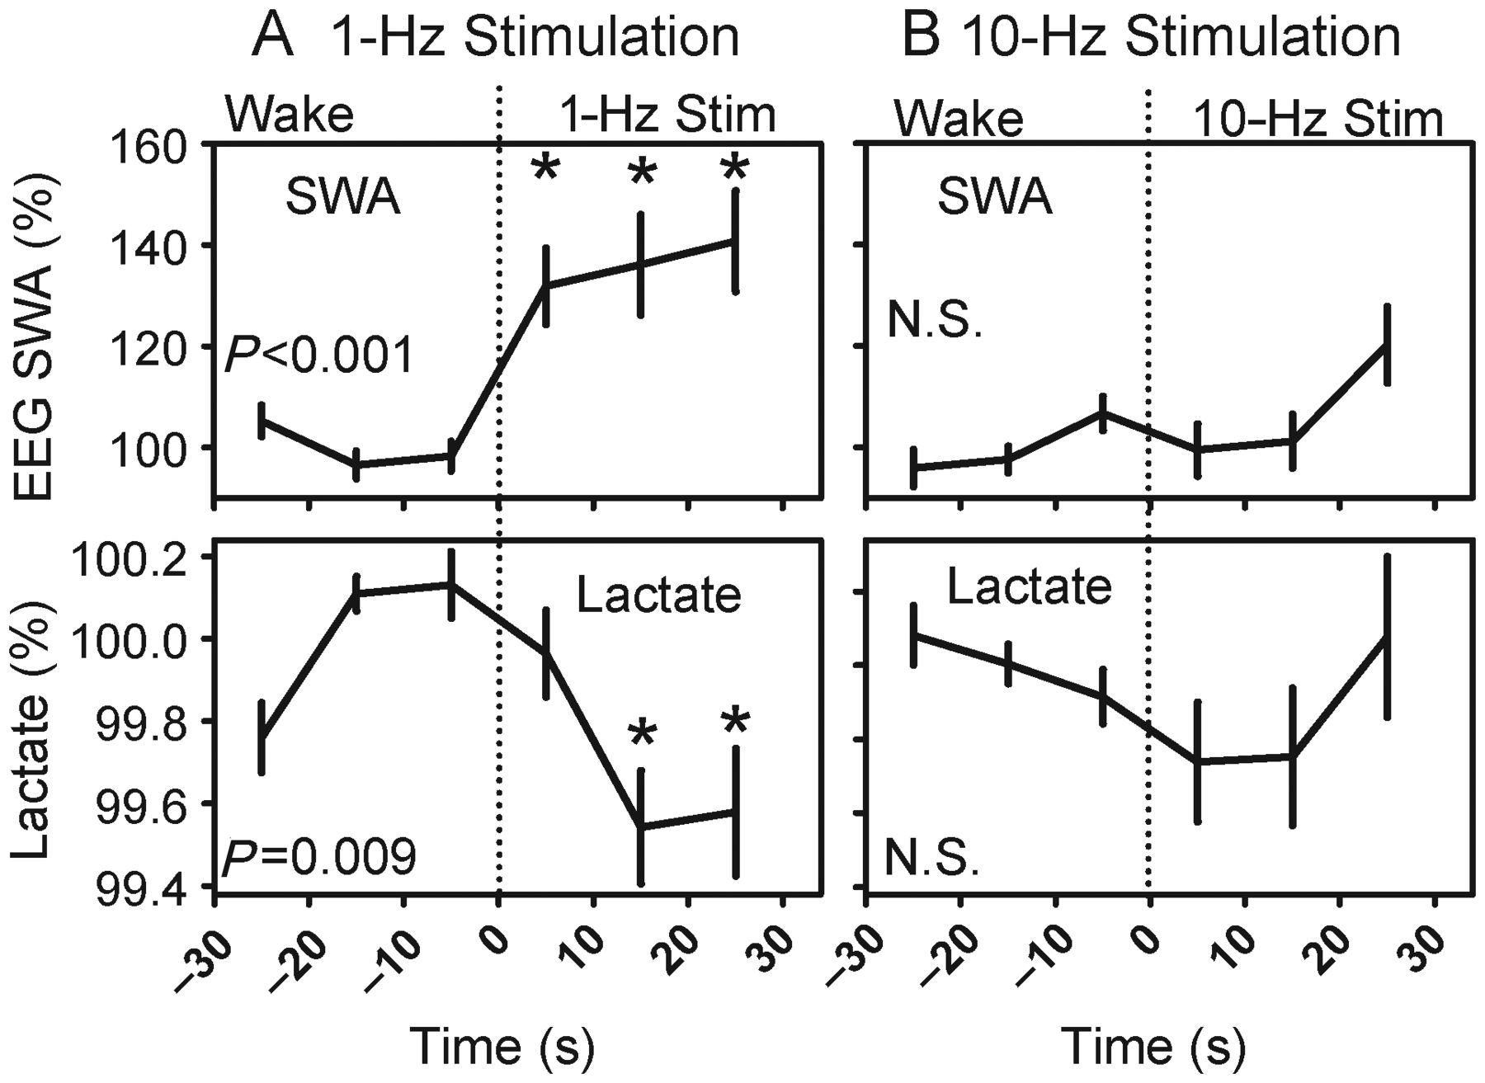
Figure 7. Effects of 1 Hz (A) or 10 Hz (B) optogenetic stimulation on EEG SWA (upper panels) and lactate concentration ...
Notes:
Figure 7. Effects of 1 Hz (A) or 10 Hz (B) optogenetic stimulation on EEG SWA (upper panels) and lactate concentration (lower panels). Each panel contains data from a 1-min interval. The first 30 s were spent in wakefulness and the last 30 s in optogenetic stimulation. P-values denote main effect of time on dependent variables. *P < 0.05 versus last epoch before stimulation, Student's t-test with Bonferroni correction.
Unless provided in the caption above, the following copyright applies to the content of this slide: © The Author 2012. Published by Oxford University Press. All rights reserved. For Permissions, please e-mail: journals.permissions@oup.com

