Slide 1
Figure 1. Rich club organization. (A) Rich club curve Φ(k) averaged over the group of subjects (black line), rich club ...
Notes:
Figure 1. Rich club organization. (A) Rich club curve Φ(k) averaged over the group of subjects (black line), rich club curve Φrandom(k) averaged over the group of subjects (gray line, mean of 1000 random networks per subject, averaged over the group of subjects), and the normalized rich club curve Φnorm(k) (i.e., the ratio between Φ(k) and Φrandom(k), red line). Figure shows a significant Φnorm(k) >1 (over the group of subjects, P 19 to k > 23. The rich club selected as the top 12% of nodes, matching k > 19. The selected rich club included bilateral precuneus, superior frontal cortex, insular cortex, and superior parietal cortex (red nodes in panel C). (B) Selection of the rich club allowed for the classification of the nodes of the network into rich club (red nodes) and non-rich club (gray nodes) members and a categorization of the connections of the network into rich club (red), feeder (orange), and local (yellow) connections. (C) Panel shows a graph plot of a group-average reconstructed structural brain network. Nodes reflect cortical brain regions. Connections between nodes represent reconstructed white matter pathways. Plot shows connections that were found to be present in at least 60% of the subjects (de Reus and van den Heuvel 2013). The size of the nodes reflects the number of connections (i.e., group-average degree) of each brain region.
Unless provided in the caption above, the following copyright applies to the content of this slide: © The Author 2013. Published by Oxford University Press.This is an Open Access article distributed under the terms of the Creative Commons Attribution License (http://creativecommons.org/licenses/by-nc/4.0/), which permits non-commercial use, distribution, and reproduction in any medium, provided the original work is properly cited. For commercial re-use, please contact journals.permissions@oup.com

Slide 2
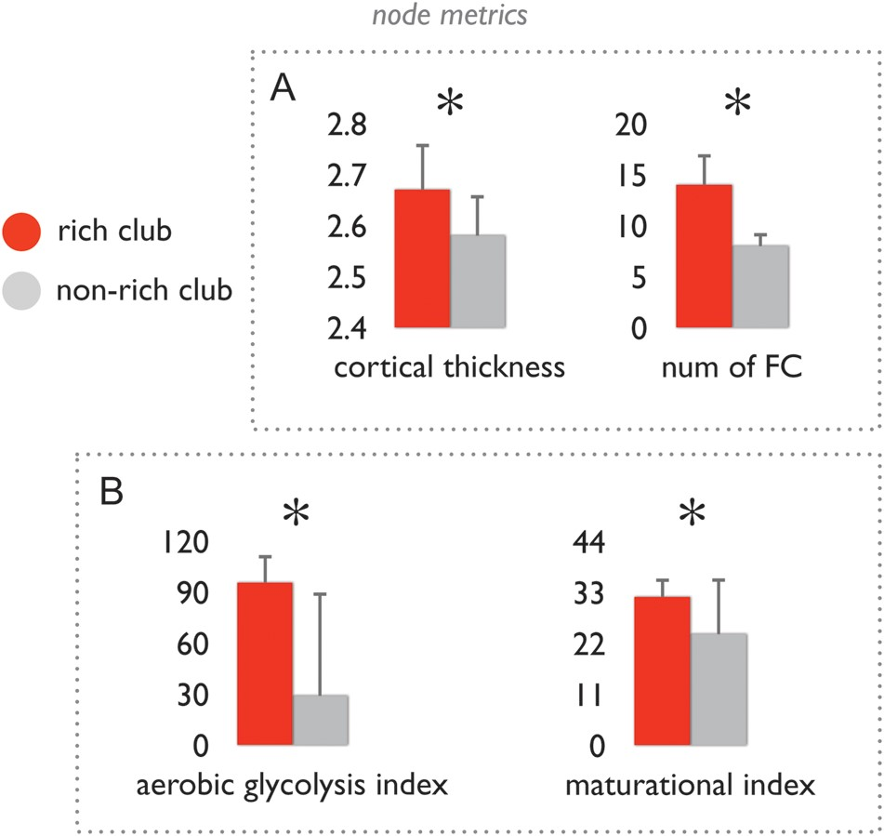
Figure 2. Structural and functional aspects of rich club and non-rich club nodes. (A) Left bar graph shows the ...
Notes:
Figure 2. Structural and functional aspects of rich club and non-rich club nodes. (A) Left bar graph shows the class-average levels of cortical thickness (corrected for differences in regional volume). Right bar graph shows the number of positive (Tfc > 0) functional connections of rich club and non-rich club nodes, showing that the number of functional connections of rich club nodes was significantly higher than that of non-rich club nodes. Error bars express variation of node class values over the group of subjects. (B) Bar graphs show the mean values of the class of rich club nodes and non-rich club nodes of the aerobic glycolysis index as taken from (Vaishnavi et al. 2011) and the maturational index as taken from (Glasser and Van Essen 2011). Data shows that rich club nodes display a significantly higher metabolic energy use as compared to non-rich club nodes, and a significantly longer maturational trajectory than non-rich club nodes. *P < 0.05 (permutation testing, 10 000 permutations). Error bars express variation of values over the group of included regions.
Unless provided in the caption above, the following copyright applies to the content of this slide: © The Author 2013. Published by Oxford University Press.This is an Open Access article distributed under the terms of the Creative Commons Attribution License (http://creativecommons.org/licenses/by-nc/4.0/), which permits non-commercial use, distribution, and reproduction in any medium, provided the original work is properly cited. For commercial re-use, please contact journals.permissions@oup.com

Slide 3
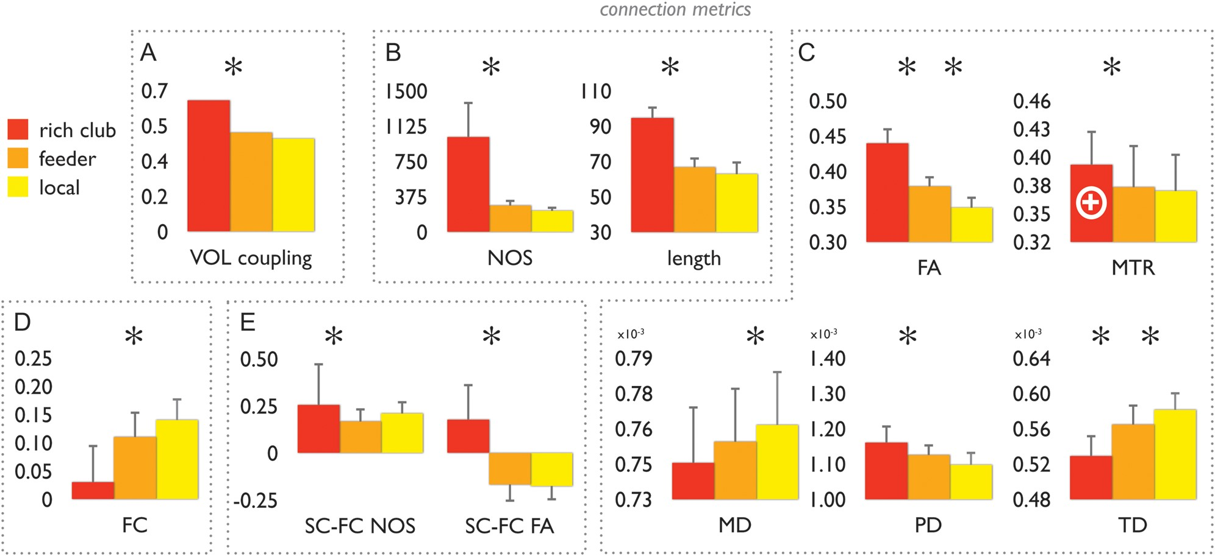
Figure 3. Structural and functional aspects of rich club, feeder, and local connections. Bar graphs show the class ...
Notes:
Figure 3. Structural and functional aspects of rich club, feeder, and local connections. Bar graphs show the class values of rich club, feeder and local connections. Data are shown for multiple metrics of structural and functional properties of rich club formation. Panel (A) shows the values of volumetric coupling, between rich club (red), feeder (orange), and local (yellow) connections. Panel (B) shows data on the number of streamlines (NOS) and projection length of the 3 connection categories. Panel (C) shows values of FA, MD, PD, TD, and MTR of rich club, feeder, and local connections. FA, fractional anisotropy; MD, mean diffusivity; PD, parallel diffusion, TD, transverse diffusion; MTR, magnetic transfer ratio. Panel (D) shows levels of functional coupling of all intrahemispheric connections (correlation between time series of the structurally connected regions); marks the inner core of the rich club, reflecting the connections between the left, right precuneus and left, right superior frontal cortex (see text). Panel (E) shows levels of structural–functional coupling (SC–FC), with SC based on the number of streamlines and with SC based on FA. Taken together, data show a significantly higher level of microstructural organization of rich club connections as compared to the classes of feeder and local connections (e.g., higher FA, lower MD and lower TD, higher SC–FC NOS/FA coupling). Error bars express variation (standard deviations) of measures for each connection class over the group of subjects. *P < 0.05 (permutation testing; 10 000 permutations).
Unless provided in the caption above, the following copyright applies to the content of this slide: © The Author 2013. Published by Oxford University Press.This is an Open Access article distributed under the terms of the Creative Commons Attribution License (http://creativecommons.org/licenses/by-nc/4.0/), which permits non-commercial use, distribution, and reproduction in any medium, provided the original work is properly cited. For commercial re-use, please contact journals.permissions@oup.com

