Slide 1
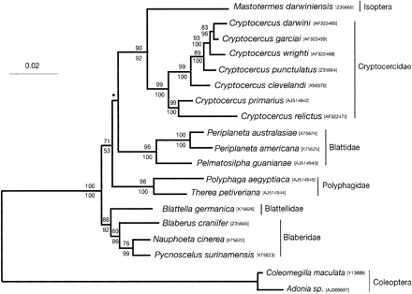
Fig. 1. Phylogeny of Blattabacterium spp. from representatives of each of the five cockroach families as well as the ...
Notes:
Fig. 1. Phylogeny of Blattabacterium spp. from representatives of each of the five cockroach families as well as the termite Mastotermes darwiniensis, based on 16S rDNA sequences. Species names are those of the hosts. Note that current evidence for species-level status for C. darwini, C. garciai, and C. wrighti may be premature (Nalepa et al. 2002). Topology shown is the maximum parsimony (MP) tree obtained via a heuristic search. Tree length: 549, consistency index: 0.68, branch lengths fitted by ML analysis. Values above and below branches are bootstrap and posterior probability percentages from MP and Bayesian analyses, respectively. The bullet indicates a node that had less than 50% support from both analyses. Trees were rooted with 16S rDNA sequences from intracellular bacteria from two ladybird beetle species. Accession numbers for each bacterial sequence are shown adjacent to host species names. Scale bar indicates inferred substitutions/site
Unless provided in the caption above, the following copyright applies to the content of this slide: Society for Molecular Biology and Evolution

Slide 2
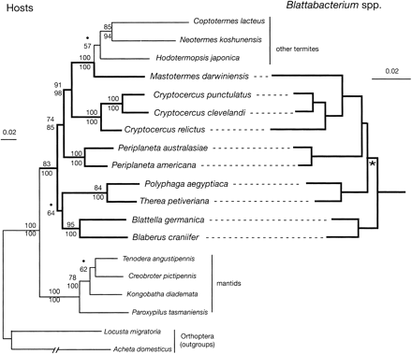
Fig. 2. Phylogeny of dictyopteran species and a comparison with the phylogeny of Blattabacterium spp. The host ...
Notes:
Fig. 2. Phylogeny of dictyopteran species and a comparison with the phylogeny of Blattabacterium spp. The host phylogeny was based on a combined analysis of 18S rDNA and mitochondrial COII, 12S rDNA, and 16S rDNA sequences. The topology shown is the MP tree obtained via a heuristic search. Tree length: 2901, consistency index: 0.55. Support values and other details are as given in figure 1. Bold lines indicate those dictyopteran taxa that harbor Blattabacterium spp., and that were examined in host–endosymbiont congruence tests. The phylogeny of Blattabacterium spp. was based on those species for which the host phylogeny was performed, to allow statistical testing of congruence. Support values and other characteristics of this tree were very similar to those in figure 1. The asterisk indicates the only node in the topology that was in disagreement with that based on the host phylogeny. Outgroups were as for figure 1 but are not shown
Unless provided in the caption above, the following copyright applies to the content of this slide: Society for Molecular Biology and Evolution

Slide 3
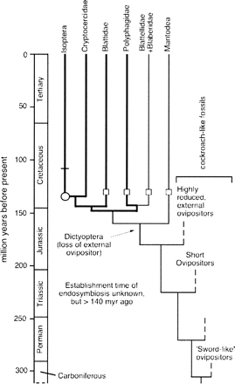
Fig. 3. Timescale for the evolution of Dictyoptera. Ovipositor length of cockroach-like fossils decreases in time ...
Notes:
Fig. 3. Timescale for the evolution of Dictyoptera. Ovipositor length of cockroach-like fossils decreases in time from Carboniferous specimens through to those in the late Jurassic, where they become highly reduced. The relationships shown among these fossils are taken from Grimaldi (1997). The relationships within Dictyoptera are based on those in figure 2. Clock-like behavior in the 16S rDNA of Blattabacterium spp. from lineages in bold permitted their approximate times of divergence to be determined (see text). Calibration for the rate of Blattabacterium 16S rDNA evolution was based on early Cretaceous termite fossils, indicated by a circle. Squares indicate the presence of the earliest known fossils within other lineages, also from the early Cretaceous. The 16S rDNA in the Blaberidae + Blattellidae lineage has apparently evolved in a slower manner than those in bold, and thus its time of divergence from the latter is not clear. The lack of endosymbionts in the Mantodea lineage precludes an estimation of its divergence time, and the time shown is based on Grimaldi (1997). The bar on the termite lineage represents loss of Blattabacterium from all other lineages other than that leading to M. darwiniensis (see also fig. 2)
Unless provided in the caption above, the following copyright applies to the content of this slide: Society for Molecular Biology and Evolution

