Slide 1
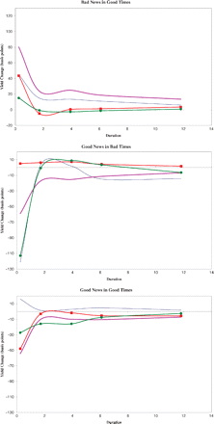
Figure 1 Asymmetric Effects on Yields. The plots show the estimated effect on yields of a one-standard deviation ...
Notes:
Figure 1 Asymmetric Effects on Yields. The plots show the estimated effect on yields of a one-standard deviation surprise in CPI (continuous line), NFP (bold line), CUR (circled line), and PPI (squared line).
Unless provided in the caption above, the following copyright applies to the content of this slide: © Oxford University Press 2009

Slide 2
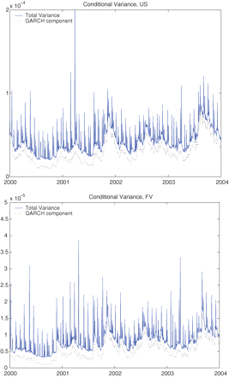
Figure 2 Conditional Variance. The plots show the conditional variance implied by the state-dependent jump model in ...
Notes:
Figure 2 Conditional Variance. The plots show the conditional variance implied by the state-dependent jump model in the last four years of our sample – from the beginning of 2000 to the end of 2003 – for the 30-year Treasury bond futures (US) and for the 5-year Treasury note futures (FV). The total conditional variance is the sum of a GARCH component and a jump component.
Unless provided in the caption above, the following copyright applies to the content of this slide: © Oxford University Press 2009

Slide 3
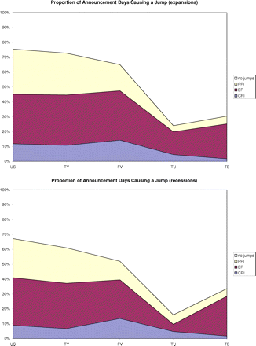
Figure 3 Jumps Induced by Macroeconomic News. The plots show the proportion of CPI, ER, PPI release days that in our ...
Notes:
Figure 3 Jumps Induced by Macroeconomic News. The plots show the proportion of CPI, ER, PPI release days that in our estimated model result in a jump for expansions and recessions and for the 30-year Treasury bond futures (US), the 10-year Treasury note futures (TY), the 5-year Treasury note futures(FV), the 2-year Treasury note futures (TU), and the 90-day Treasury bill futures (TB).
Unless provided in the caption above, the following copyright applies to the content of this slide: © Oxford University Press 2009

Slide 4
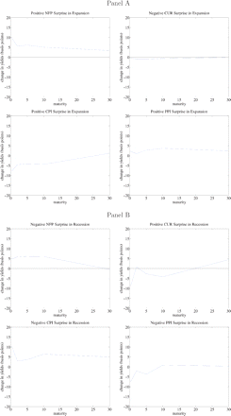
Figure 4 Asymmetric Jump Effects. The plots show the estimated effect of a one-standard deviation surprise in NFP, ...
Notes:
Figure 4 Asymmetric Jump Effects. The plots show the estimated effect of a one-standard deviation surprise in NFP, CUR, CPI, and PPI on the mean of the jump size distribution of yields at different maturities. We also depict 95% confidence bands. Panel A illustrates the effect of positive surprises – negative surprise for the CUR release – in an expansion phase of the business cycle. Panel B shows the effect of negative surprises – positive surprises for the CUR release – in a recession phase of the business cycle.
Unless provided in the caption above, the following copyright applies to the content of this slide: © Oxford University Press 2009

Slide 5
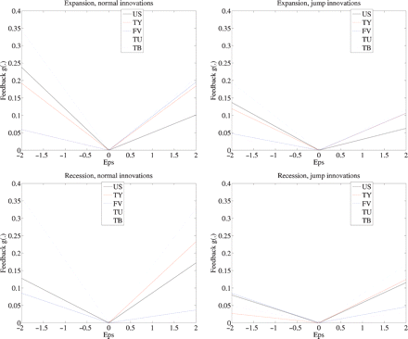
Figure 5 Persistence of Shocks on Future Volatility. The plots show the estimated value for the function g(.) with ...
Notes:
Figure 5 Persistence of Shocks on Future Volatility. The plots show the estimated value for the function g(.) with respect to positive and negative innovations in the equation for conditional volatility: The estimates of the parameters are reported in Table VI. We plot the effect of normal innovations (i.e., ϵt has zero probability of being a jump) and jump innovations (i.e., ϵt has a probability of at least 50% of being a jump) in recessions and expansions.
Unless provided in the caption above, the following copyright applies to the content of this slide: © Oxford University Press 2009

