Slide 1
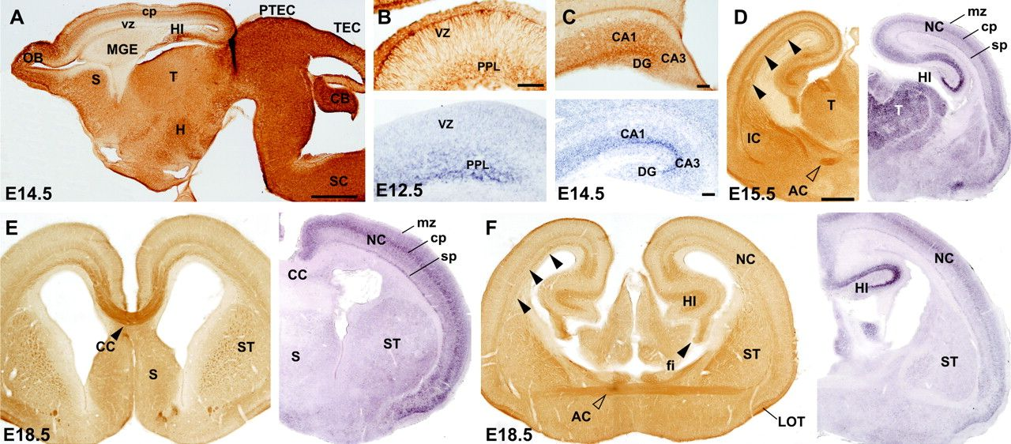
Figure 1. Expression of Nogo-A in the embryonic mouse forebrain. (A) Low-power photomicrographs illustrating the ...
Notes:
Figure 1. Expression of Nogo-A in the embryonic mouse forebrain. (A) Low-power photomicrographs illustrating the distribution of Nogo-A in a sagittal section of an E14.5 telencephalon. Nogo-A labeling was very intense in the olfactory bulb. In dorsal telencephalic regions, Nogo-A labeling follows a rostrocaudal gradient in the cerebral cortex and the medial ganglionic eminence displayed low levels of Nogo-A compared with neocortex and hippocampus. Cortical layers can be easily delineated. (B, C) In the developing hippocampus, Nogo-A protein and mRNA are relevant in the hippocampal preplate at E12.5 and in the pyramidal cell layer with lower levels in the remaining layers at E14.5. (D–F) Paired sections at different rostrocaudal levels at E15.5 and E18.5 processed for Nogo-A ICC and Nogo ISH. (D) At E15.5, in medial telecenphalic levels, Nogo-A immunoreactivity is particularly intense in cortical axonal tracts (arrowheads) and the anterior commissure (open arrowhead). In parallel sections, Nogo mRNA levels are high in the neocortex or hippocampus and thalamic nuclei (D). (E, F) At E18.5, Nogo-A is enriched in the cortico-cortical connections at the corpus callosum (E), the anterior commissure (F), and the lateral olfactory tract (E, F). Nogo mRNA is specially enriched in the cerebral cortex and subcortical regions (e.g., striatum). In the developing cortex, Nogo mRNA labels the lower portion of the cortical plate (layer VI–V) and the subplate-layer VIb (E, F). Abbreviations: AC, anterior commissure; CB, cerebellum; CC, corpus callosum; cp, cortical plate; fi, hippocampal fimbria; MGE, medial ganglionic eminence; H, hypothalamus; HI, hippocampus; IC, internal capsule; LOT, lateral olfactory tract; NC, neocortex, SC, spinal cord; mz, marginal zone; OB, olfactory bulb; PPL, preplate, PTEC, pretectum; S, septum; ST, striatum; sp, subplate; T, thalamus; TEC tectum; vz, ventricular zone. Scale bars: A = 500μm; B, C = 100μm; D–F = 500μm.
Unless provided in the caption above, the following copyright applies to the content of this slide: © The Author 2007. Published by Oxford University Press. All rights reserved. For permissions, please e-mail: journals.permissions@oxfordjournals.org

Slide 2
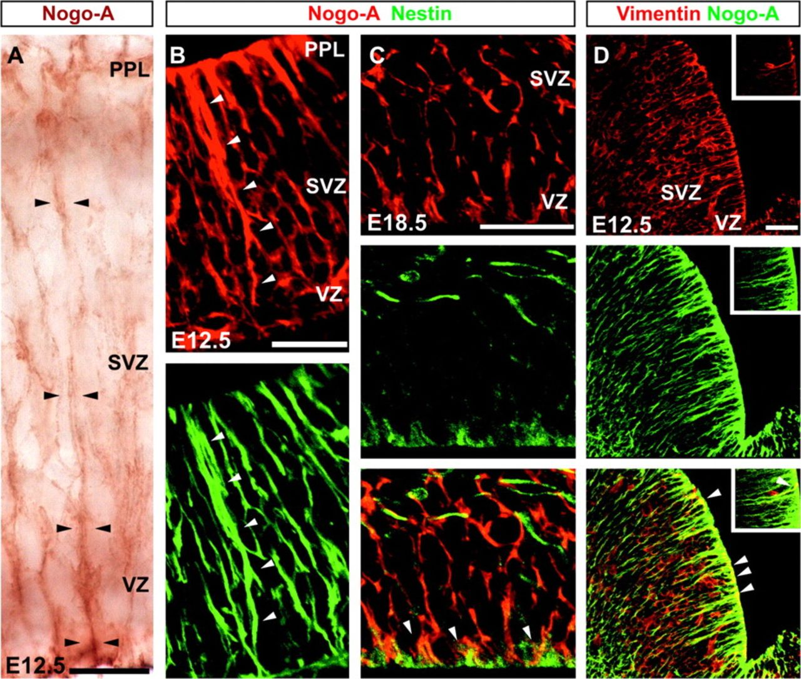
Figure 2. Expression of Nogo-A by radial glial cells. (A) Example of Nogo-A–positive radially oriented cell ...
Notes:
Figure 2. Expression of Nogo-A by radial glial cells. (A) Example of Nogo-A–positive radially oriented cell (arrowheads) spanning the cortical width at E12.5. (B, C) Double immunostaining of Nogo-A polyclonal antibody and Nestin in the cortex of E12.5 and E18.5 mice (B and C, respectively) showing precise colocalization of both proteins in radial glia at E12.5 (B–B′) and partial collocation at E18.5, when Nogo-A is still detected at glial endfeet (arrowheads in C). (D) Glial identity was also confirmed by Vimentin colocalization in the lateral ganglionic eminence using an anti-Nogo-A monoclonal antibody (see Methods and supplementary Fig. 1 for details). Insert highlights localization of Nogo-A in the process of a Vimentin-positive cell but not in the soma. The fluorochromes used to label Nogo-A, Nestin, and Vimentin are indicated with different colors in the text in each panel, as well as the immunoperoxidase staining. Abbreviations: PPL, preplate, VZ, ventricular zone. Scale bars: A = 25μm; B–D = 50μm.
Unless provided in the caption above, the following copyright applies to the content of this slide: © The Author 2007. Published by Oxford University Press. All rights reserved. For permissions, please e-mail: journals.permissions@oxfordjournals.org

Slide 3
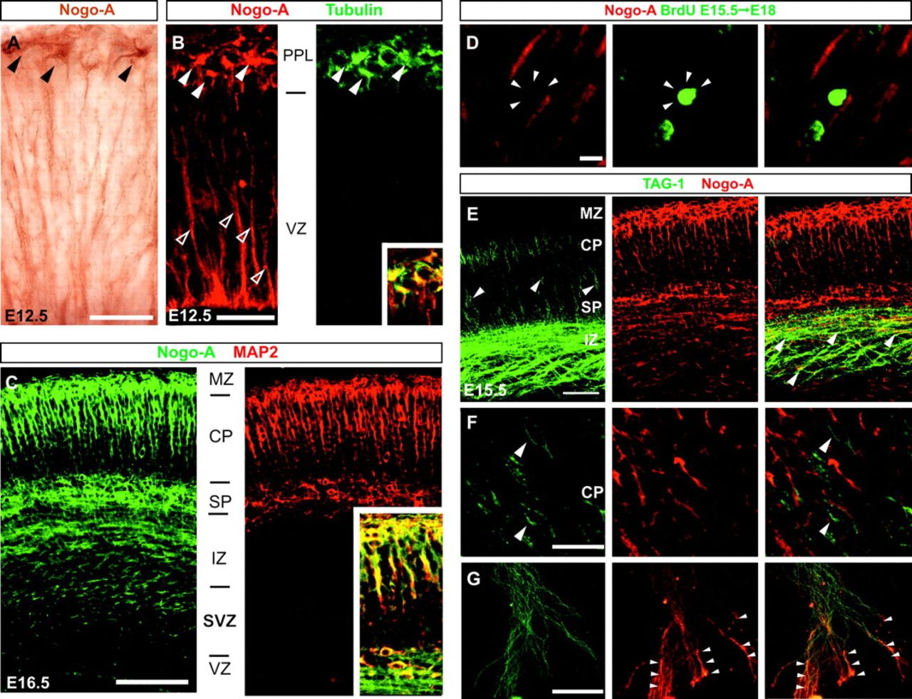
Figure 3. Nogo-A is expressed by postmigratory differentiating neurons in the developing cortex. (A–C) At E12.5, Nogo-A ...
Notes:
Figure 3. Nogo-A is expressed by postmigratory differentiating neurons in the developing cortex. (A–C) At E12.5, Nogo-A is detected in pioneering neurons in the preplate (arrowheads) contrasting with the nonneuronal Nogo-A radial glial pattern in the background (open arrowheads). Expression of Nogo-A progresses in parallel with neuronal maturation, as assessed by MAP2 colocalization (C). (D) Double Nogo-A/BrdU labeling at E18.5 (following BrdU injection at E15.5) shows that Nogo-A is not expressed by radially migrating neurons. (E–G) Double labeling of Nogo-A with TAG-1 demonstrates that Nogo-A is not localized in the perikaryon of cortical projecting neurons (TAG-1 positive) at E14.5. (G) High-power photomicrographs of the double-immunoreacted (TAG-1 and Nogo-A) axons emerging from cortical explants from E15.5 mice cultured for 3 days. TAG-1 immunostaining is distributed equally in the growing axons, whereas Nogo-A is enriched in their terminal axonal portions (arrowheads). The fluorochrome used in each double immunofluorescence is indicated in each panel as in Figure 2. Abbreviations as in Figures 1 and 2. Scale bars: A = 25 μm; B = 50 μm; C = 100 μm; D = 10 μm; E = 150 μm; F = 50 μm; G = 100 μm.
Unless provided in the caption above, the following copyright applies to the content of this slide: © The Author 2007. Published by Oxford University Press. All rights reserved. For permissions, please e-mail: journals.permissions@oxfordjournals.org

Slide 4
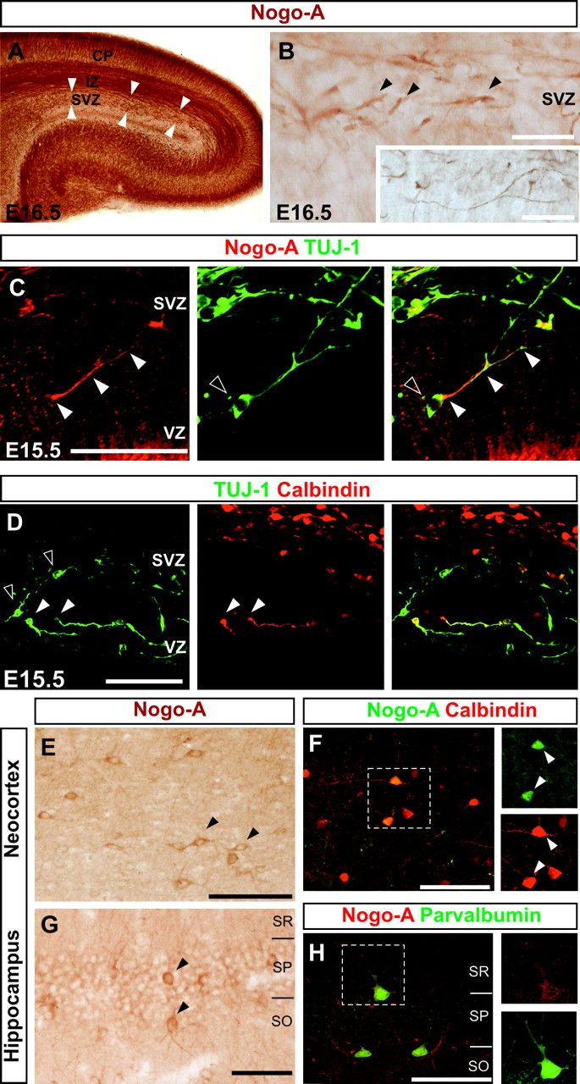
Figure 4. Nogo-A is enriched in the leading process of tangential migrating interneurons. (A, B) Nogo-A immunostaining ...
Notes:
Figure 4. Nogo-A is enriched in the leading process of tangential migrating interneurons. (A, B) Nogo-A immunostaining highlights a stream of tangential orientated structures in the SVZ and ventricular zone of the cerebral cortex at E16.5 (arrowheads). Their localization and morphology closely resemble those of tangentially migrating neurons (B and insert in B). (C) Representative photomicrographs of tangentially migrating interneurons double immunoreacted using TUJ-1 and Nogo-A antibodies. Nogo-A labeling corresponds to leading processes of tangentially migrating neurons (arrowheads), as demonstrated by TUJ-1 immunostaining, but not to cell bodies (open arrowhead). (D) Nogo-A–expressing TUJ-1–positive neurons include part of the Calbindin population of migrating interneurons. (E–H) Examples of Nogo-A immunoreactive interneurons (arrowheads in E, G) in the neocortex (E, F) and hippocampus (G, H) of the adult mice. Nogo-A–positive interneurons are also labeled with Calbindin or Parvalbumin antibodies (F, H). Note that Nogo-A is distributed equally in the mature interneuron in contrast with the localization during migration. The fluorochrome used in each double immunofluorescence is indicated as above. Abbreviations as in Figures 1 and 2. SO, stratum oriens; SP, stratum pyramidale; SR, stratum radiatum. Scale bars: A = 250 μm; B and insert in B = 25 μm; C = 50 μm; D = 100 μm. E and G = 75 μm, F and H = 50 μm.
Unless provided in the caption above, the following copyright applies to the content of this slide: © The Author 2007. Published by Oxford University Press. All rights reserved. For permissions, please e-mail: journals.permissions@oxfordjournals.org

Slide 5
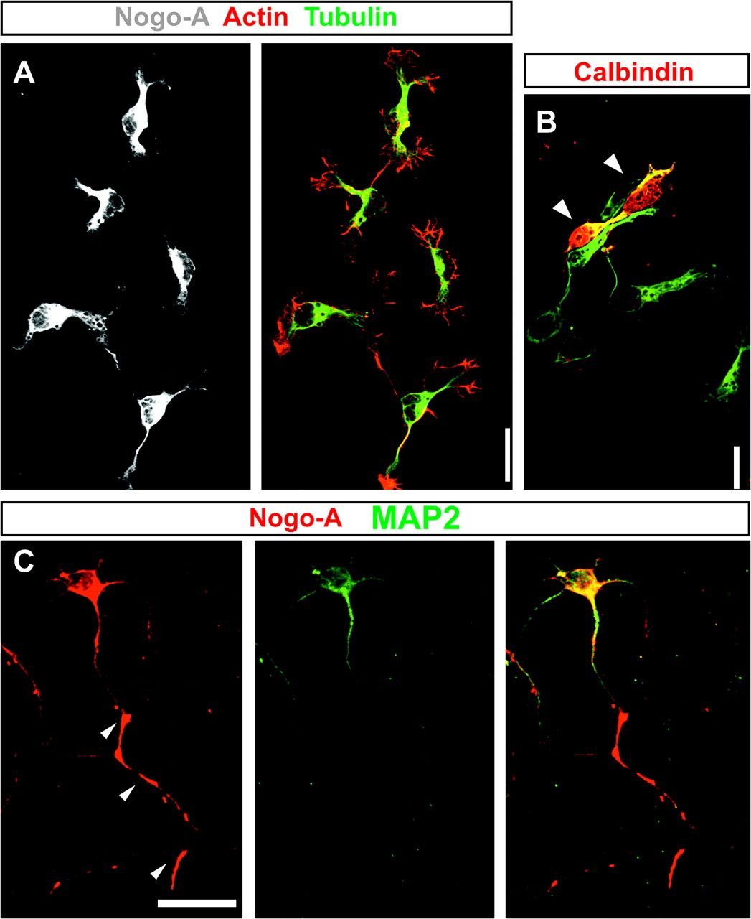
Figure 5. Nogo-A redistribution in cortical neurons in vitro. (A, B) Expression of Nogo-A is detected in 100% of ...
Notes:
Figure 5. Nogo-A redistribution in cortical neurons in vitro. (A, B) Expression of Nogo-A is detected in 100% of neurons from medial ganglionic eminence following dissociation. Note that in isolated interneurons (identified with Calbindin antibody) Nogo-A is redistributed to neurites and soma, in contrast to that observed during tangential migration. (C) Nogo-A is enriched in growing axons of 8-day in vitro cortical cultures as demonstrated by MAP2 (dendritic marker). The fluorochrome used in each double immunofluorescence is indicated in the Figure panels. Scale bars: A, B = 25 μm; D = 25 μm.
Unless provided in the caption above, the following copyright applies to the content of this slide: © The Author 2007. Published by Oxford University Press. All rights reserved. For permissions, please e-mail: journals.permissions@oxfordjournals.org

Slide 6
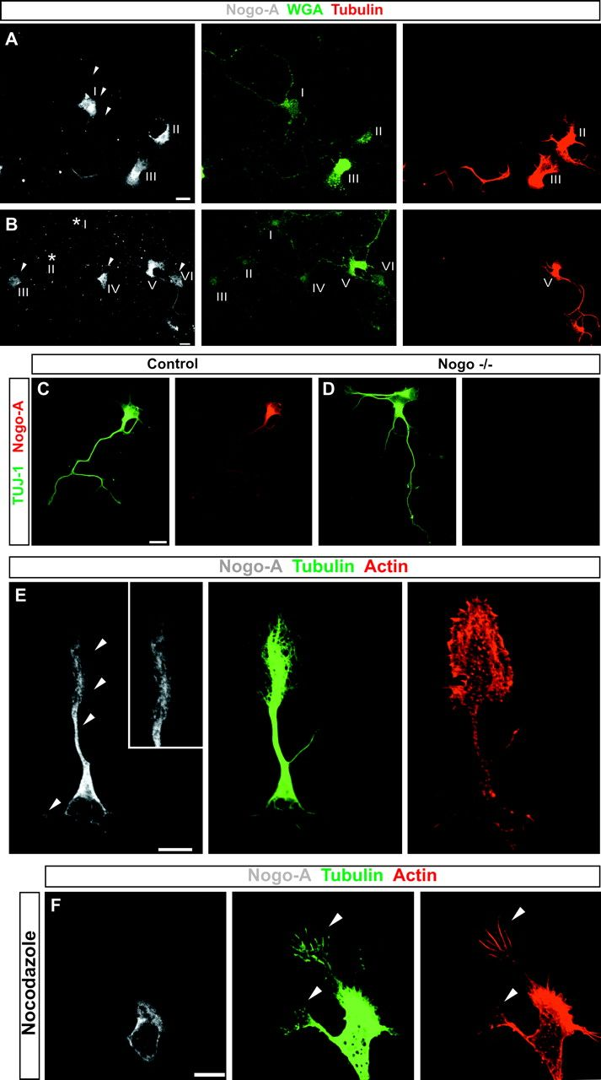
Figure 6. Subcellular localization of Nogo-A in cortical neurons in vitro. (A, B) WGA-positive Tubulin-negative neurons ...
Notes:
Figure 6. Subcellular localization of Nogo-A in cortical neurons in vitro. (A, B) WGA-positive Tubulin-negative neurons were analyzed for detection of Nogo-A in nonpermeabilized neuronal cultures (see Methods for details). Neurons I (in A) and III–IV (in B) display Nogo-A labeling revealing the extracellular exposure of the N-terminal domain of Nogo-A at their plasma membrane. Neurons II and III in (A) and neuron V in (B) showed Tubulin staining, which indicates undesired permeabilization. (C, D) The Nogo-A antibody used in the experiments of panels A, B does not label permeabilized neurons from Nogo-deficient mice (D) in contrast to wild-type neurons (C). (E) Nogo-A staining in growth cones occupies the central domain in close colocalization with Tubulin (arrowheads) but does not enter the peripheral actin-rich domain. (F) Cell treatment with Nocodazone causes loss of lamella from growth cones and redistribution of Nogo-A from neurites (arrowheads) to the cell soma. The fluorochrome used in each double immunofluorescence is indicated as above. Scale bars A–F = 10 μm.
Unless provided in the caption above, the following copyright applies to the content of this slide: © The Author 2007. Published by Oxford University Press. All rights reserved. For permissions, please e-mail: journals.permissions@oxfordjournals.org

Slide 7
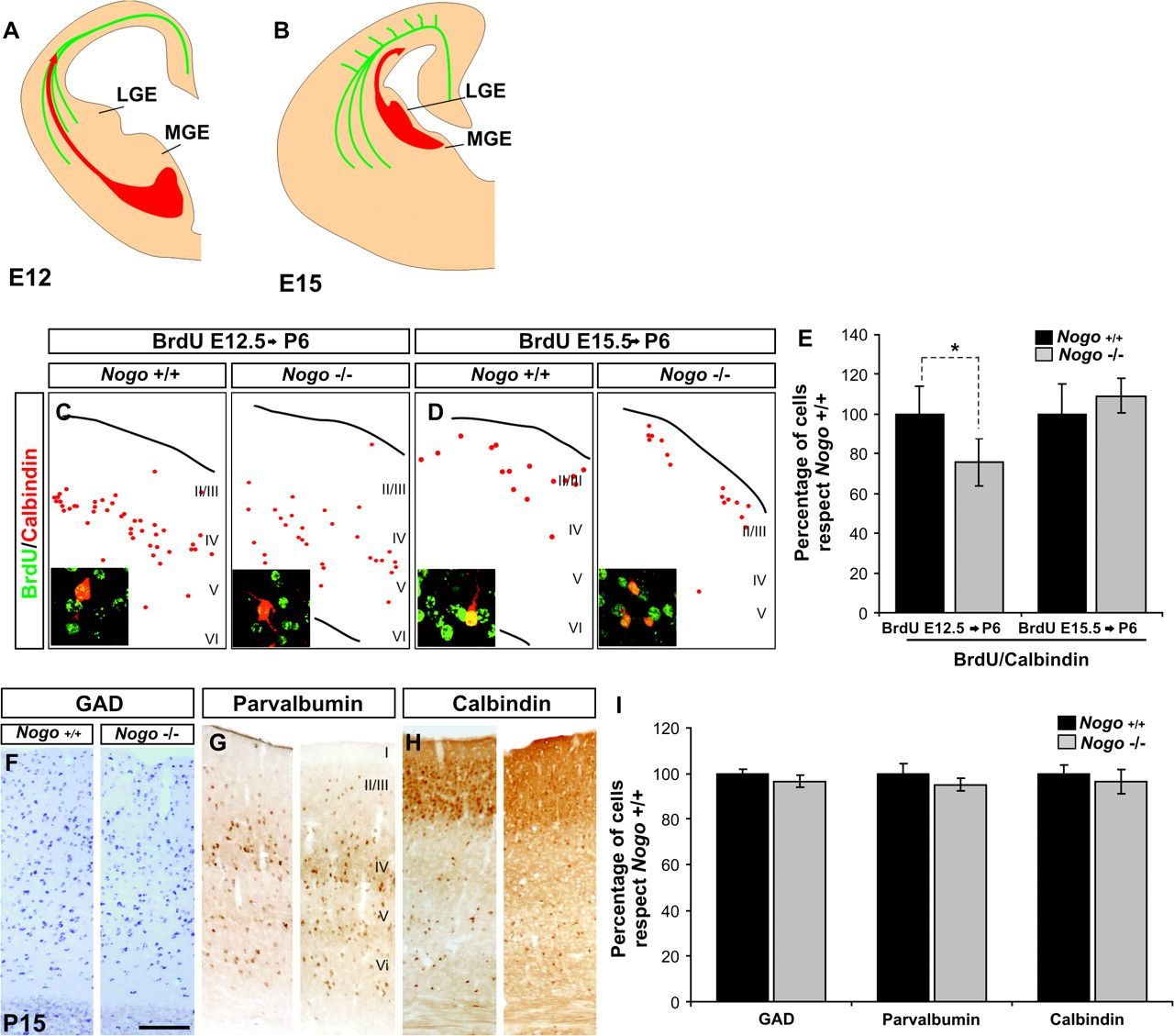
Figure 8. Absence of Nogo alters the migration of early cohorts of cortical interneurons. (A, B) Scheme of the ...
Notes:
Figure 8. Absence of Nogo alters the migration of early cohorts of cortical interneurons. (A, B) Scheme of the migratory routes followed by early and late-generated interneurons. Although early (E12; A) generated interneurons from the MGE preferentially follow the IZ, in close contact with corticofugal axons (green), later generated interneurons (E15; B) from the lateral ganglionic eminence use a different route. (C, D) BrdU/Calbindin colocalization following BrdU injection at E12.5 in the SS cortex of P6 mice. (E) Nogo-deficient mice display a 25% reduction in the number of E12.5-generated interneurons compared with control littermates (*P < 0.05 in a 2-tailed t-test) but not in the number of E15-generated interneurons. This reduction cannot be further detected at P15 (F–I) by counting total GABA-ergic neurons (F–I), total Parvalvumin- (G–I), or total Calbindin-positive interneurons (H, I). The fluorochrome used in each double immunofluorescence is indicated as above. Abbreviations as in Figures 1 and 2. I–VI; neocortical layers. Scale bars: F–H = 200 μm.
Unless provided in the caption above, the following copyright applies to the content of this slide: © The Author 2007. Published by Oxford University Press. All rights reserved. For permissions, please e-mail: journals.permissions@oxfordjournals.org

Slide 8
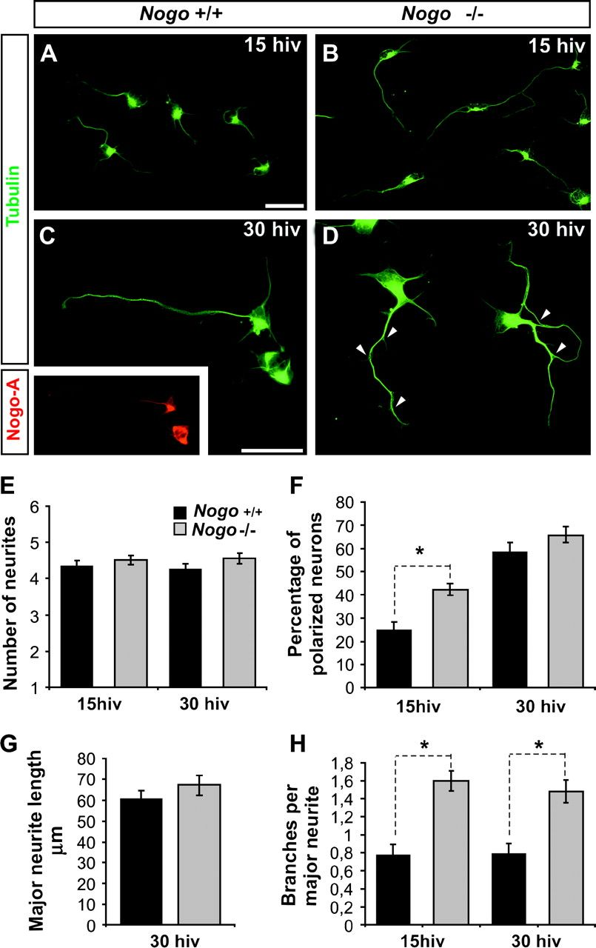
Figure 7. Absence of Nogo induces axonal branching in vitro. (A–D) Representative images of TUJ-1 immunoreacted ...
Notes:
Figure 7. Absence of Nogo induces axonal branching in vitro. (A–D) Representative images of TUJ-1 immunoreacted cortical neurons from wild-type (Nogo +/+) and Nogo-A/B/C–deficient (Nogo −/−) mice after 15 h (A, B) or 30 h in vitro (C, D). Insert in (C) shows Nogo-A expression in Nogo +/+ cells. (E) Quantification of the mean number of neurites per neuron showing no differences between Nogo +/+ and Nogo −/− neurons. (F) Bar graph comparing the percentage of neurons with polarized morphology at 15 or 30 h in vitro. Note that initial differences in polarization (*P < 0.01 in a 2-tailed t-test) are lost at 30 h in vitro (F). (G) Comparison of major neurite length after 30 h in vitro. Earlier polarization does not lead to an increase in the major neurite length (only polarized neurons were counted). (H) Quantification of the mean number of branches per major neurite (assessed as the number of branching points). Nogo-deficient neurons display twice as many branches as control cells and differences are maintained after 30 h in vitro (*P < 0.01 in a 2-tailed t-test). Data are represented as the mean ± standard errors in each of the graphs. The fluorochrome used in each double immunofluorescence is indicated as above. Scale bars A–D = 25 μm.
Unless provided in the caption above, the following copyright applies to the content of this slide: © The Author 2007. Published by Oxford University Press. All rights reserved. For permissions, please e-mail: journals.permissions@oxfordjournals.org

