Slide 1
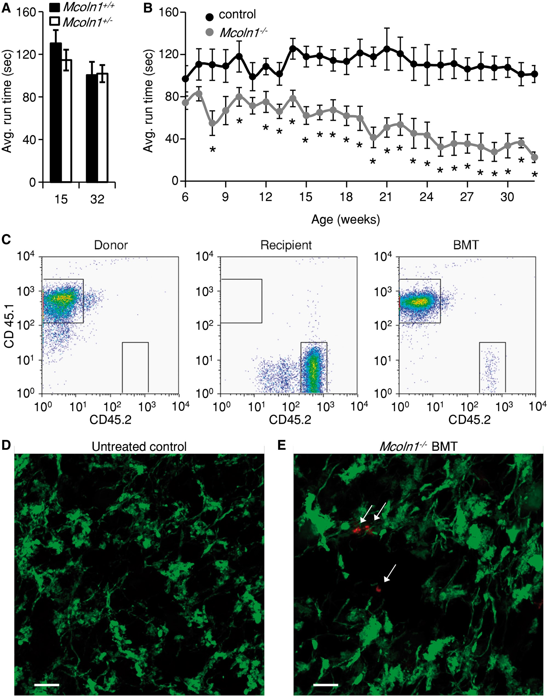
Figure 1. Rotarod locomotor activity assays and BMT efficacy. (A) Rotarod assay activities for Mcoln1<sup>+/+ ...
Notes:
Figure 1. Rotarod locomotor activity assays and BMT efficacy. (A) Rotarod assay activities for Mcoln1+/+ (black bars) and Mcoln1+/− (white bars) animals at 15 and 32 weeks of age. (B) Weekly rotarod assays comparing control and mutant animals. Control (Mcoln1+/−, black) and Mcoln1−/− (grey). We used the unpaired Student t-tests with two-tail analysis. The error bars indicate S.E.M.s and the asterisks indicate P < 0.05. (C) Two-color flow cytometry analyses of peripheral blood monocytes from mice at 12–15 weeks of age. Donor, LY5.2 mouse; Recipient, untreated Mcoln1−/− mice; BMT, bone marrow transplanted recipient mouse. (D) Cross-section of a cerebellum from an untreated Mcoln1−/− mouse expressing a Thy1-YFP transgene. (E) Mcoln−/− mouse at 15 weeks of age expressing a Thy1-YFP transgene transplanted at 8–10 days old with bone marrow from LY5.2 mice congenic mice expressing CD45.1. Thy1-YFP (green) labels neurons and processes. The arrows indicate anti-CD45.1 positive donor cells (red). The scale bars in (D) and E represent 10 μm.
Unless provided in the caption above, the following copyright applies to the content of this slide: © The Author 2016. Published by Oxford University Press. All rights reserved. For permissions, please e-mail: journals.permissions@oup.com

Slide 2
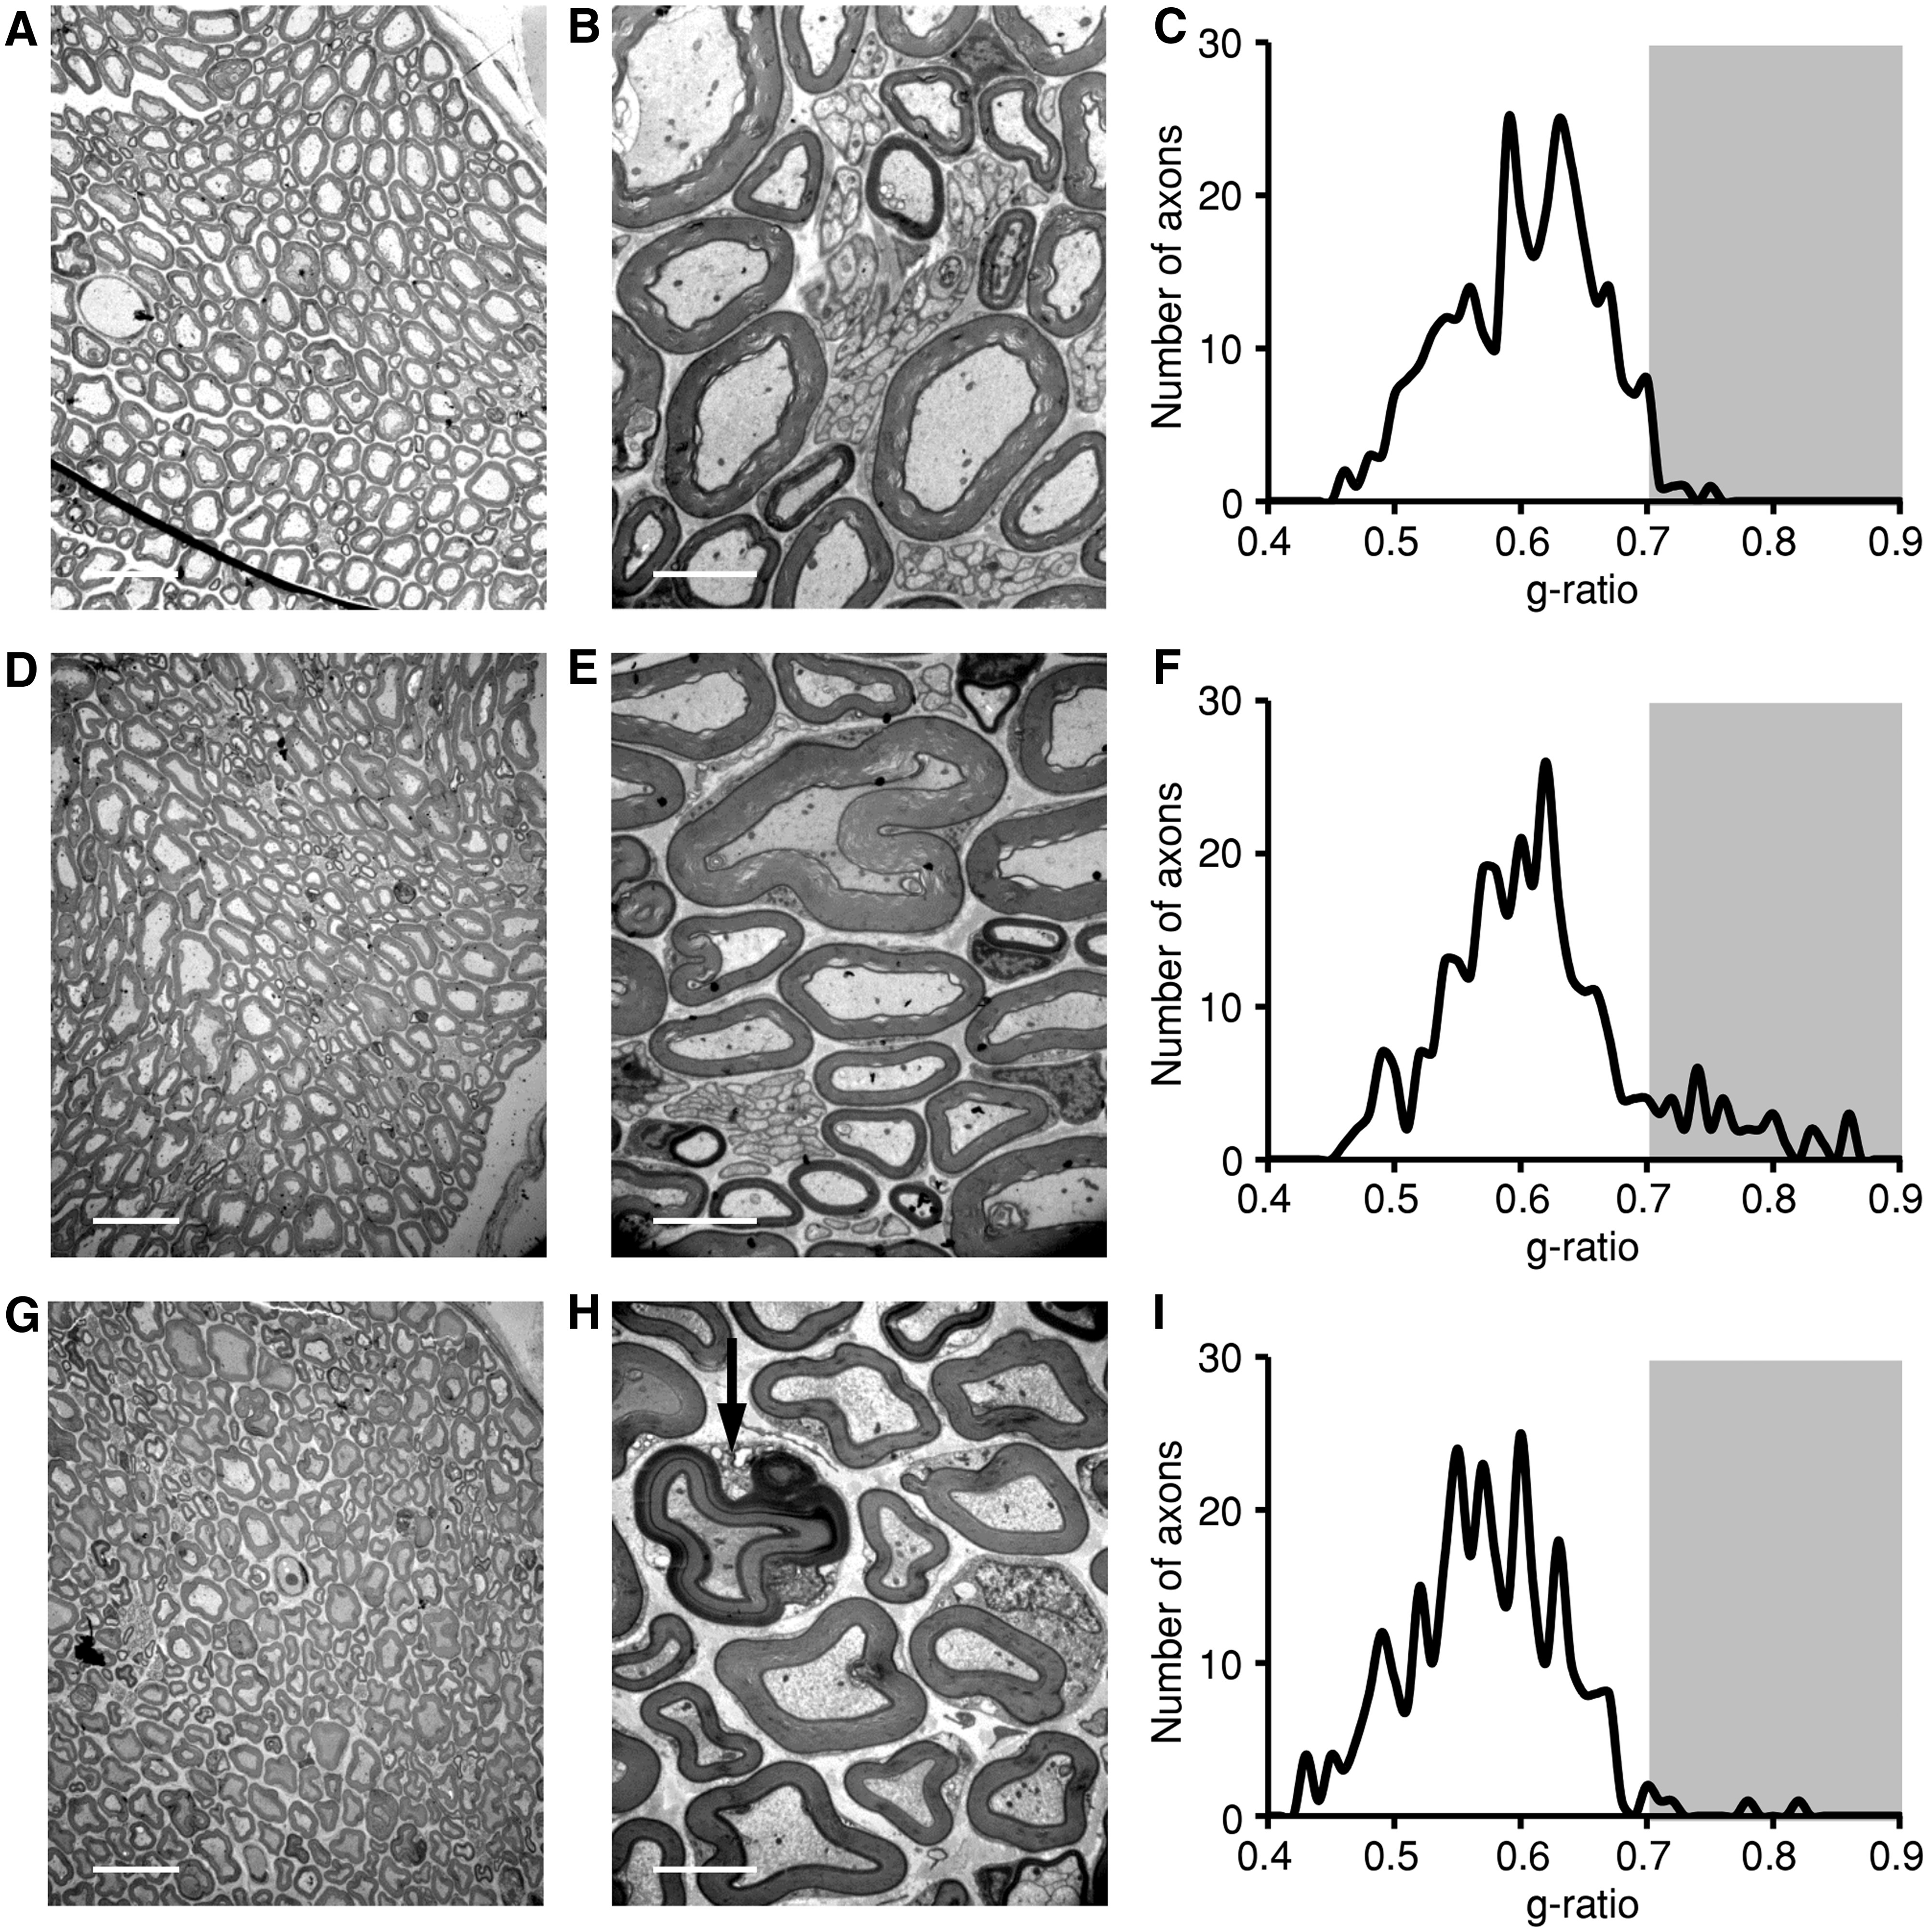
Figure 2. Myelinated axons in the sciatic nerve. (A and B) Electron micrographs of osmium stained sciatic nerve axons ...
Notes:
Figure 2. Myelinated axons in the sciatic nerve. (A and B) Electron micrographs of osmium stained sciatic nerve axons from 15-week-old controls (Mcoln1+/−). (C) Plot of axon myelin g-ratios (√inner area/total area) from control sciatic nerves. The shaded area highlights g-ratios above 0.7. (D and E) Electron micrographs of osmium stained sciatic nerve axons from 15-week-old Mcoln1−/−. (F) Plot of axon myelin g-ratios from Mcoln1−/− sciatic nerves. The shaded area highlights g-ratios above 0.7. (G and H) Electron micrographs of osmium stained sciatic nerve axons from a 15-week-old Mcoln1−/− mouse that underwent BMT at 8–10 days of age. The red arrow indicates a myelinated axon being engulfed by phagocytosis. (I) Plot of axon myelin g-ratio over the axon diameter from sciatic nerves of Mcoln1−/− mice that underwent BMT at 8–10 days of age. The shaded area highlights g-ratios above 0.7. The scale bars in A, D, G and B, E, H indicate 20 μm and 4 μm, respectively.
Unless provided in the caption above, the following copyright applies to the content of this slide: © The Author 2016. Published by Oxford University Press. All rights reserved. For permissions, please e-mail: journals.permissions@oup.com

Slide 3
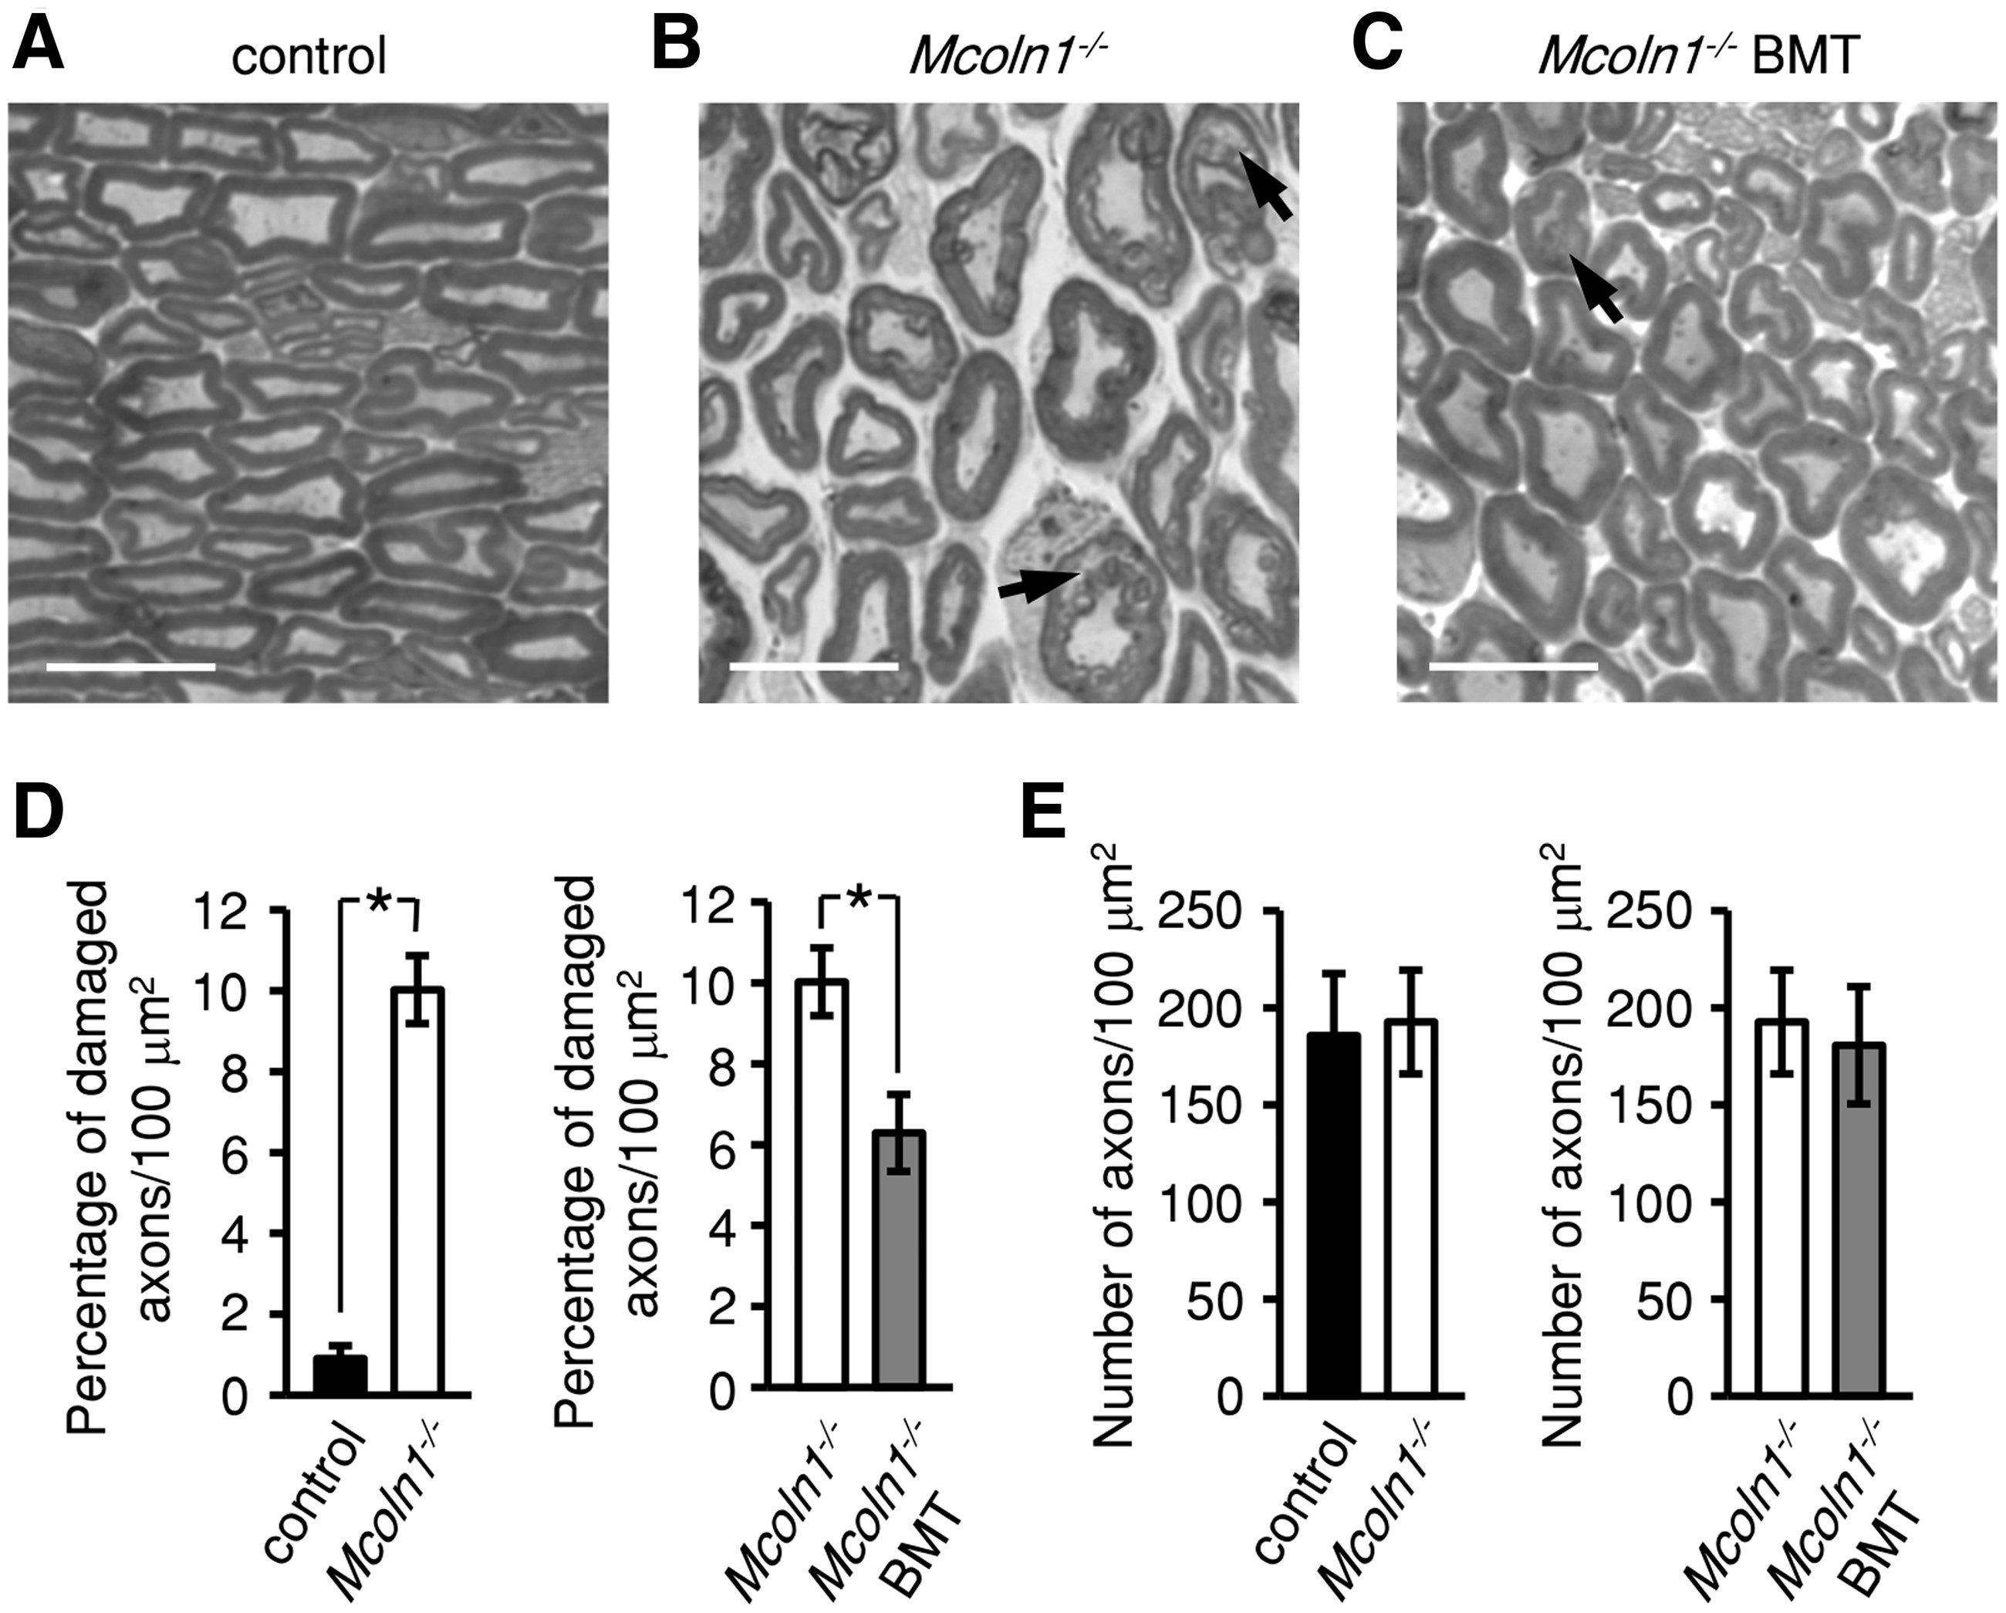
Figure 3. Myelinated axons in the sciatic nerve. (A–C) Light micrographs of methylene blue stained sciatic nerve axons ...
Notes:
Figure 3. Myelinated axons in the sciatic nerve. (A–C) Light micrographs of methylene blue stained sciatic nerve axons from a 15-week-old control (Mcoln1+/−), Mcoln1−/− and Mcoln1−/− that underwent BMT at 8–10 days of age. The arrows indicate buckling and splitting of myelin in damaged axons where the axons are separating from the surrounding myelin sheath. (D) Percentage of damaged axons per 100 μm2. (E) Total number of axons per 100 μm2. The scale bars in A, B, and C indicate 10 μm. Statistical analyses were performed using unpaired Student’s t-tests with two-tail analysis. The asterisks indicate statistically significant differences (P < 0.05).
Unless provided in the caption above, the following copyright applies to the content of this slide: © The Author 2016. Published by Oxford University Press. All rights reserved. For permissions, please e-mail: journals.permissions@oup.com

Slide 4
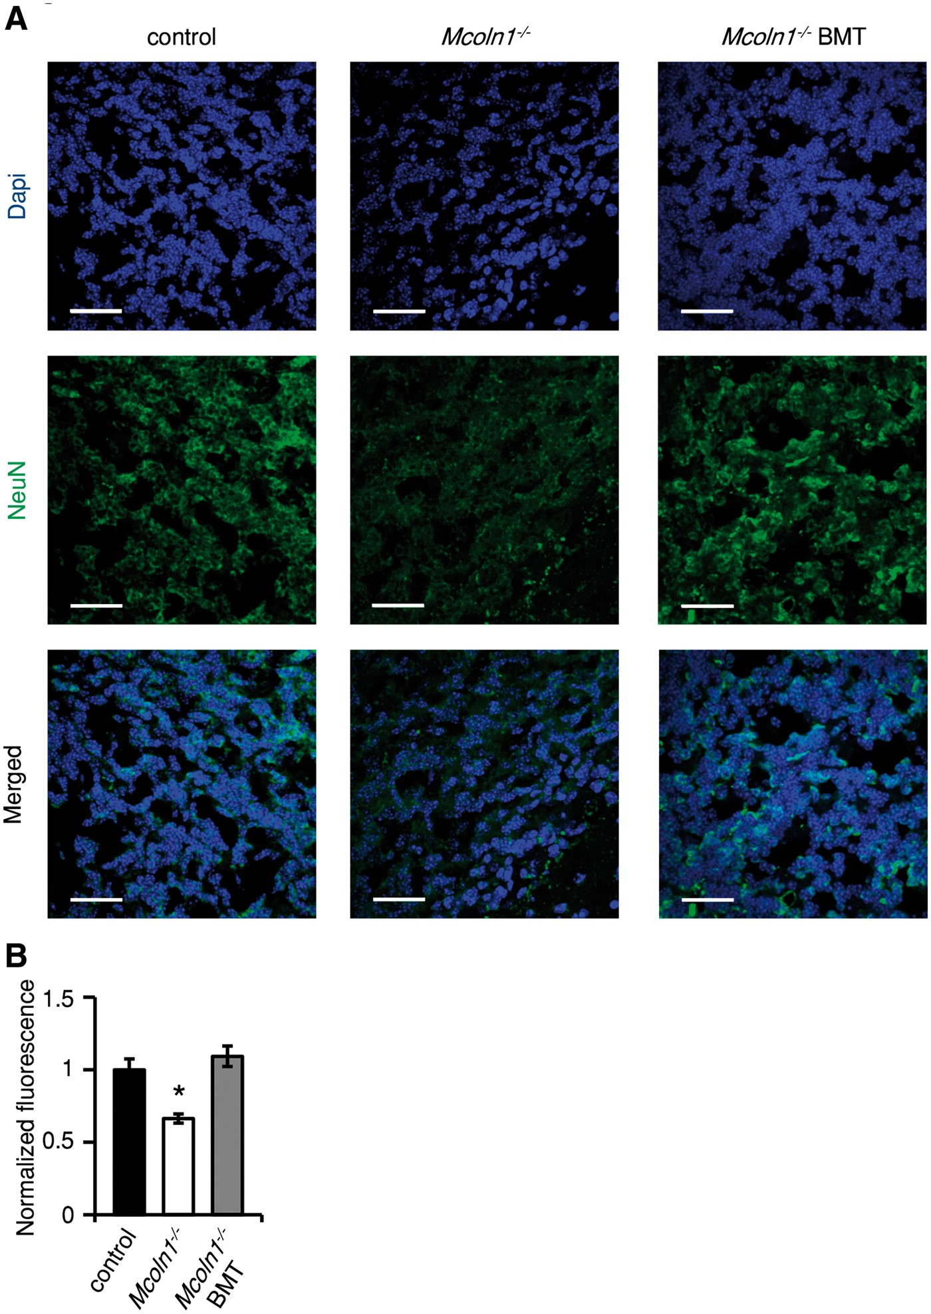
Figure 4. Reduced NeuN staining in 15-week-old Mcoln1^{−/−} cerebellum suppressed by BMT. (A) Cerebellar ...
Notes:
Figure 4. Reduced NeuN staining in 15-week-old Mcoln1−/− cerebellum suppressed by BMT. (A) Cerebellar sections from 15-week-old controls (Mcoln1+/−), Mcoln1−/− and Mcoln1−/− that underwent BMT at 8–10 days of age were stained with anti-NeuN (neuronal nuclei) and DAPI (nuclear stain). The scale bars in each image indicate 30 μm. (B) Relative fluorescence intensities of the anti-NeuN staining. Statistical analyses were performed using a one-way ANOVA test with the Bonferroni–Holm post hoc test. The error bars indicate SEMs and the asterisks indicate statistically significant differences (P < 0.05).
Unless provided in the caption above, the following copyright applies to the content of this slide: © The Author 2016. Published by Oxford University Press. All rights reserved. For permissions, please e-mail: journals.permissions@oup.com

Slide 5
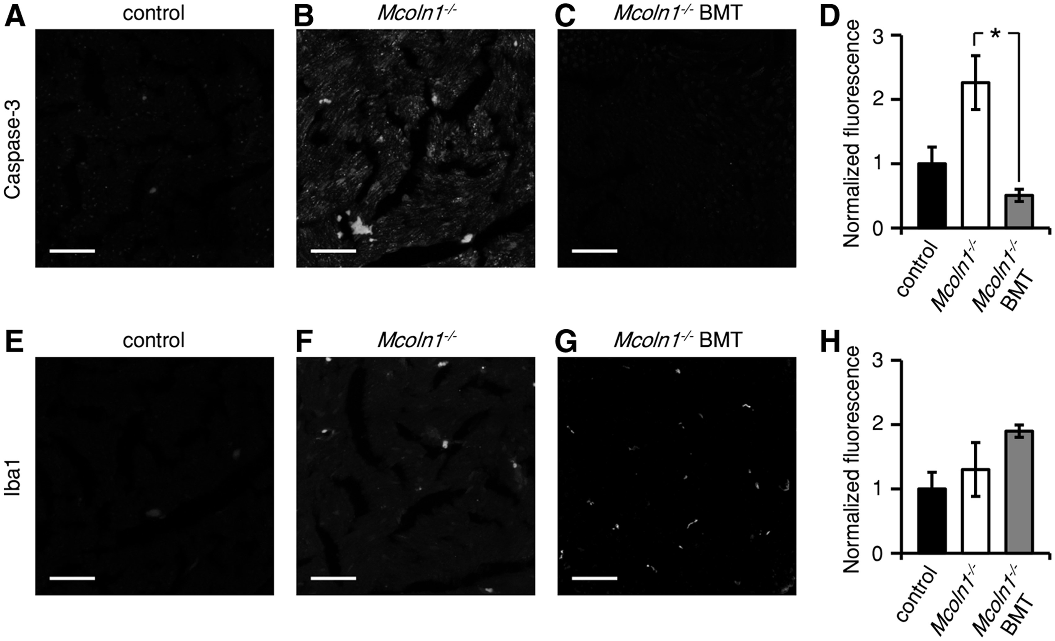
Figure 5. Staining of sections of sciatic nerve with anti-caspase-3 and anti-Iba1. The sections were isolated from ...
Notes:
Figure 5. Staining of sections of sciatic nerve with anti-caspase-3 and anti-Iba1. The sections were isolated from 15-week-old animals. The Mcoln−/− BMT mice underwent BMT at 8–10 days of age. (A–C) Anti-caspase-3 staining of sciatic nerves from control (Mcoln1+/−), Mcoln1−/− and a BMT treated Mcoln−/− mouse. (D) Plot of relative fluorescence intensity of the anti-caspase-3 staining. (E–G) Staining of phagocytic microglia in the sciatic nerve with anti-Iba1. (H) Plot of relative fluorescence intensity of Iba1 staining. The scale bars in A–C and E–G indicate 50 μm. Statistical analyses were performed using a one-way ANOVA test with the Bonferroni–Holm post hoc test. The error bars indicate S.E.M.s and the asterisks indicate statistically significant differences (P < 0.05).
Unless provided in the caption above, the following copyright applies to the content of this slide: © The Author 2016. Published by Oxford University Press. All rights reserved. For permissions, please e-mail: journals.permissions@oup.com

Slide 6
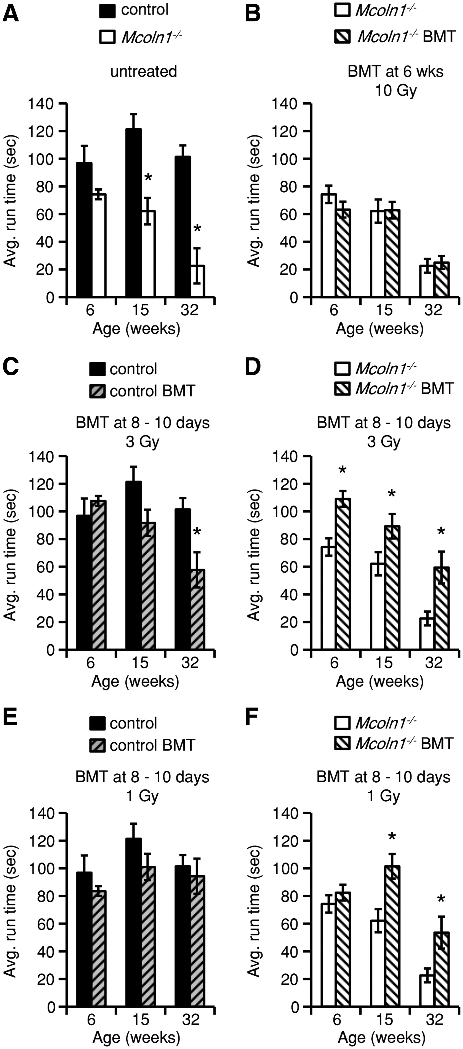
Figure 6. Effects of BMT on performance using rotarod locomotor activity assays. Shown are the average run times of the ...
Notes:
Figure 6. Effects of BMT on performance using rotarod locomotor activity assays. Shown are the average run times of the indicated animals. (A) Untreated control (Mcoln1+/−) and Mcoln1−/−. (B) Untreated Mcoln1−/− and Mcoln1−/−mice that underwent BMT at 6 weeks of age. (C) Untreated control (Mcoln1+/−) and control that were conditioned with 3 Gy irradiation and underwent BMT at 8–10 days of age. (D) Untreated Mcoln1−/− and Mcoln1−/− that were conditioned with 3 Gy irradiation and underwent BMT at 8–10 days of age. (E and F) The same as (C) and (D) except that the mice were conditioned with 1 Gy irradiation. Statistical analysis was performed using an unpaired Student’s t-test with two-tail analysis. The asterisks indicate statistically significant differences (P < 0.05).
Unless provided in the caption above, the following copyright applies to the content of this slide: © The Author 2016. Published by Oxford University Press. All rights reserved. For permissions, please e-mail: journals.permissions@oup.com

