Slide 1
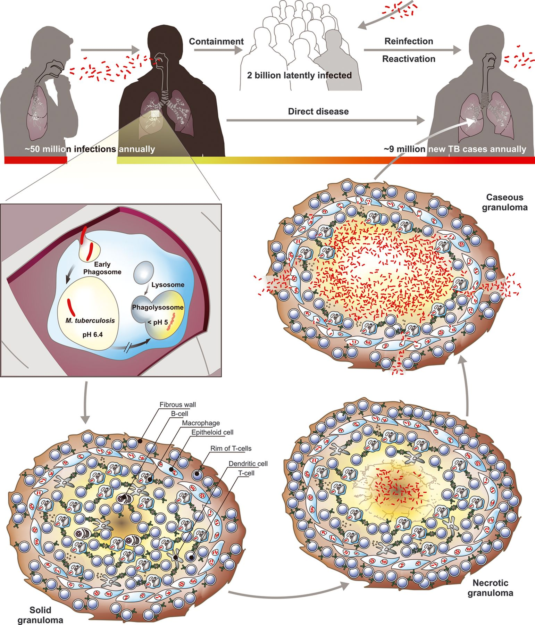
Figure 1 Transmission and pathology of TB. Transmission of TB between individuals occurs via aerosols of infectious ...
Notes:
Figure 1 Transmission and pathology of TB. Transmission of TB between individuals occurs via aerosols of infectious bacilli. An estimated 50 million infections per year maintain a pool of ~ 2 billion latently infected individuals. In a few cases, infection directly transforms to active TB. Together with reactivation and reinfection, this gives rise to approximately 9 million new TB cases annually. Upon inhalation of such droplets, the pathogen reaches lung airways and is phagocytosed by alveolar macrophages. The infected host cell induces a localized proinflamatory response that attracts mononuclear cells and T lymphocytes to build up a granuloma, the hallmark tissue reaction of TB. Healthy individuals can control the pathogen at this stage but remain latently infected and thus at risk of reactivation lifelong. Granuloma maturation (solid, necrotic, and caseous) occurs at different velocities and typically culminates in coexistence of all lesion forms during active TB. The caseating granuloma loses solidity because of decay of its center into a structureless accumulation of host cell debris, the caseum. Mtb grows to high numbers, is released into airways, and coughed out as contagious aerosol.
Unless provided in the caption above, the following copyright applies to the content of this slide: © 2012 Federation of European Microbiological Societies.

Slide 2
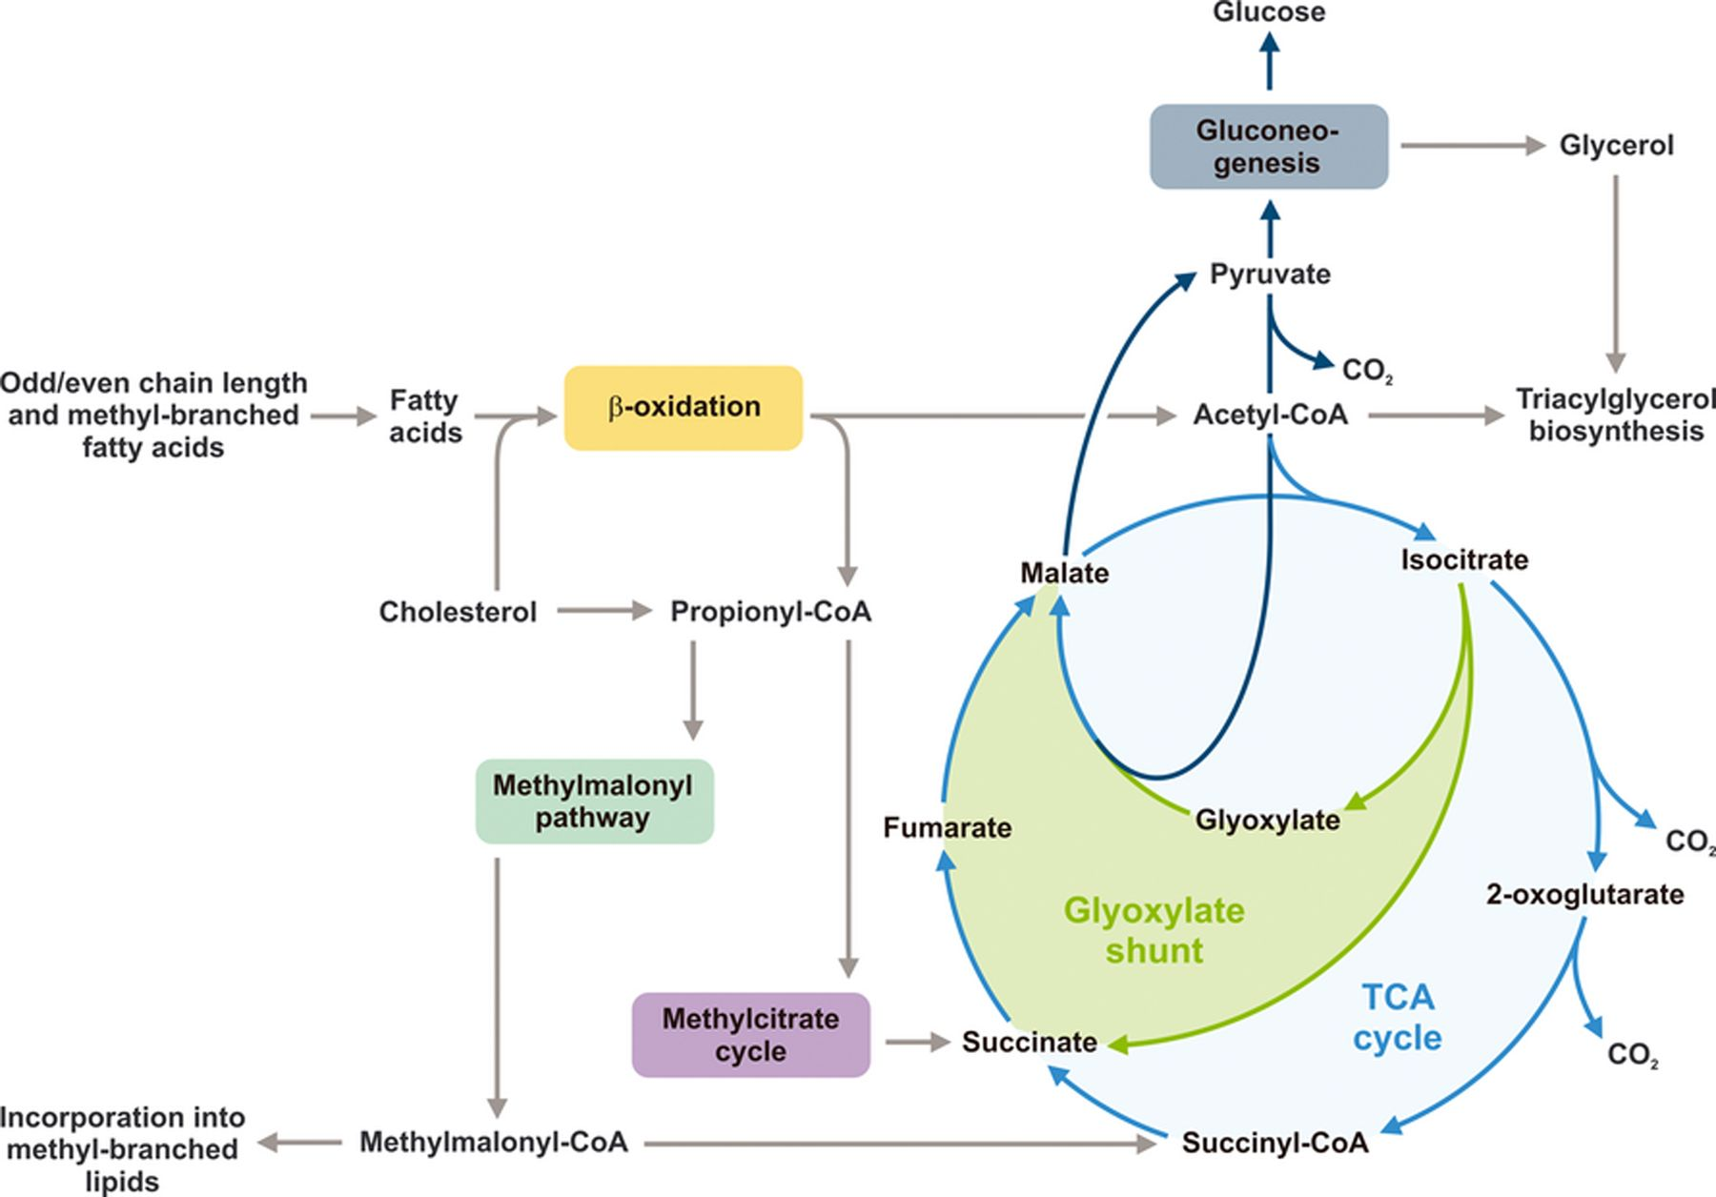
Figure 2 Metabolic pathways of Mtb important during infection. Growing evidence suggests that pathogenic mycobacteria ...
Notes:
Figure 2 Metabolic pathways of Mtb important during infection. Growing evidence suggests that pathogenic mycobacteria rely on lipids in vivo. Degradation of fatty acids by β-oxidation leads to acetyl-CoA (C2) and for uneven chain length or methyl-branched fatty acids additionally to propionyl-CoA (C3). The pathogen can directly metabolize C2 units via the tricarboxcylic acid (TCA) cycle, while excessive accumulation of toxic propionyl-CoA is prevented by two metabolic routes: (1) the methylcitrate cycle and (2) the methylmalonyl pathway. The products of both pathways can enter the TCA cycle, either directly (succinate) or after conversion to succinyl-CoA (methylmalonyl-CoA). Moreover, methylmalonyl-CoA is a building block of methyl-branched lipids. Mycobacterial isocitrate lyase (Icl) plays a key role in the methylcitrate cycle and the glyoxylate shunt. The intermediate glyoxylate can be used terminally to generate pyruvate (via malate), from which glycolytic substrates can be replenished by gluconeogenesis. C3 bodies of the glycolysis/gluconeogenesis and acetyl-CoA are required for the biosynthesis of triacylglycerol, a lipid relevant during dormancy.
Unless provided in the caption above, the following copyright applies to the content of this slide: © 2012 Federation of European Microbiological Societies.

Slide 3
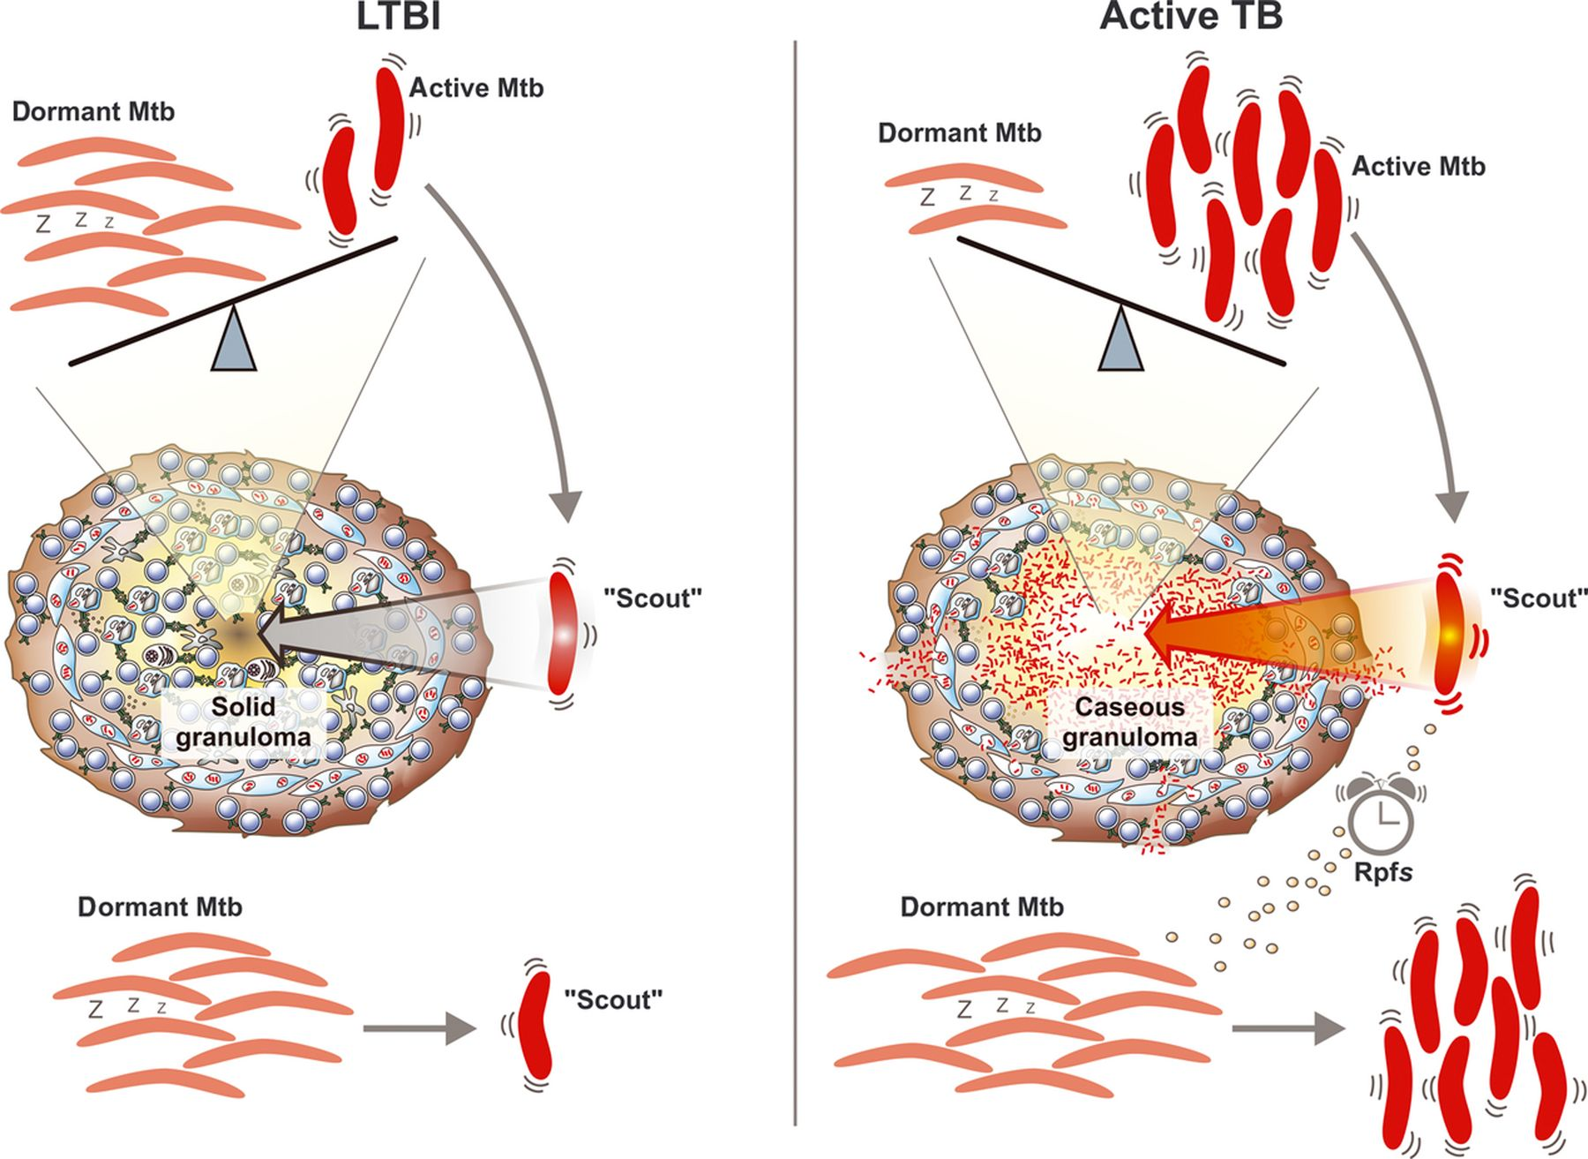
Figure 3 Dynamic model of latent TB infection (LTBI) and active TB. In this model, LTBI is characterized by ...
Notes:
Figure 3 Dynamic model of latent TB infection (LTBI) and active TB. In this model, LTBI is characterized by predominance of dormant bacilli and only very few active scouts capable of sensing the environment for growth attractiveness, which is low inside the solid granuloma. Some Mtb wake-up stochastically to maintain a small pool of scouts (left panel). Once the environment provides more favorable conditions, for example, in a caseating granuloma, scouts resuscitate dormant bacilli to become active probably by secretion of resuscitation-promoting factors (Rpfs) (right panel). A few organisms remain dormant and therefore phenotypically drug resistant, explaining the long treatment time required to cure active TB.
Unless provided in the caption above, the following copyright applies to the content of this slide: © 2012 Federation of European Microbiological Societies.

