Slide 1
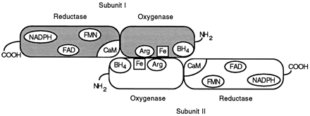
Fig. 1 Scheme of the domain structure of the NOS dimer, showing cofactor and substrate binding sites.
Notes:
Fig. 1 Scheme of the domain structure of the NOS dimer, showing cofactor and substrate binding sites.
Unless provided in the caption above, the following copyright applies to the content of this slide: Copyright © 1999, European Society of Cardiology

Slide 2
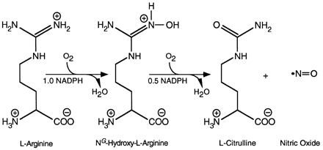
Fig. 2 The NOS-catalysed reaction.
Notes:
Fig. 2 The NOS-catalysed reaction.
Unless provided in the caption above, the following copyright applies to the content of this slide: Copyright © 1999, European Society of Cardiology

Slide 3
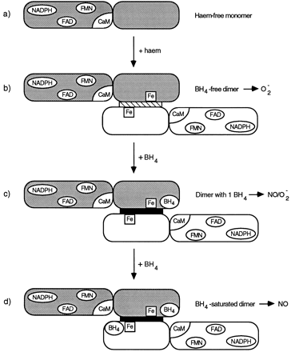
Fig. 3 Stages of NOS dimer assembly. Haem-free monomers (a) associate in the presence of haem to form a dimer with ...
Notes:
Fig. 3 Stages of NOS dimer assembly. Haem-free monomers (a) associate in the presence of haem to form a dimer with NADPH oxidase activity (b). Low levels of BH4 lead to the formation of a stable dimer (indicated by the black bar) which catalyses simultaneous production of NO and O2⋅− (c). At high BH4 levels, the enzyme acts purely as an NO synthase (d).
Unless provided in the caption above, the following copyright applies to the content of this slide: Copyright © 1999, European Society of Cardiology

