Slide 1
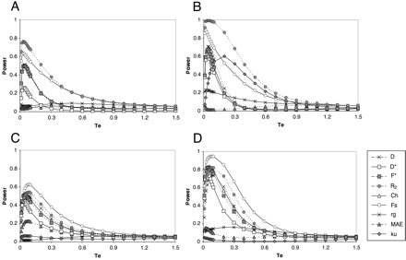
Fig. 1.—Effect of the elapsed time since the expansion event on the power of statistical tests. Results based ...
Notes:
Fig. 1.—Effect of the elapsed time since the expansion event on the power of statistical tests. Results based on 100,000 sample replicates. (A) n = 10, S = 10, and De = 100. (B) n = 10, S = 50, and De = 100. (C) n = 50, S = 10, and De = 10. (D) n = 50, S = 50, and De = 10.
Unless provided in the caption above, the following copyright applies to the content of this slide:

Slide 2
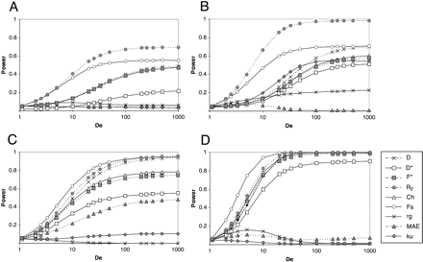
Fig. 2.—Effect of the degree of the expansion on the power of statistical tests. Results based on 100,000 ...
Notes:
Fig. 2.—Effect of the degree of the expansion on the power of statistical tests. Results based on 100,000 sample replicates. (A) n = 10, S = 10, and Te = 0.1. (B) n = 10, S = 50, and Te = 0.1. (C) n = 50, S = 10, and Te = 0.1. (D) n = 50, S = 50, and Te = 0.1
Unless provided in the caption above, the following copyright applies to the content of this slide:

Slide 3
Fig. 3.—Effect of the sample size on the power of statistical tests. Results based on 100,000 sample ...
Notes:
Fig. 3.—Effect of the sample size on the power of statistical tests. Results based on 100,000 sample replicates. (A) S = 10, De = 100, and Te = 0.1. (B) S = 50, De = 10, and Te = 0.1
Unless provided in the caption above, the following copyright applies to the content of this slide:

Slide 4
Fig. 4.—Effect of the number of segregating sites on the power of statistical tests. Results based on 100,000 ...
Notes:
Fig. 4.—Effect of the number of segregating sites on the power of statistical tests. Results based on 100,000 sample replicates. (A) n = 10, De = 100, and Te = 0.1. (B) n = 50, De = 10, and Te = 0.1
Unless provided in the caption above, the following copyright applies to the content of this slide:

Slide 5
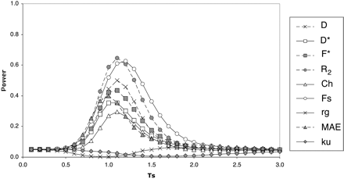
Fig. 5.—Effect of the elapsed time since the expansion event on the power of statistical tests under the ...
Notes:
Fig. 5.—Effect of the elapsed time since the expansion event on the power of statistical tests under the logistic model of population growth. Results based on 100,000 sample replicates, fixing the value of 𝛉 (𝛉 = 10) with n = 50, r = 10, c = 1, Nmax = 20,000 and N0 = 1000
Unless provided in the caption above, the following copyright applies to the content of this slide:

