Slide 1
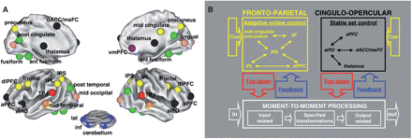
Fig. 1 Thirty-nine putative control regions and proposed dual-network model of task control (Dosenbach et al., 2006, ...
Notes:
Fig. 1 Thirty-nine putative control regions and proposed dual-network model of task control (Dosenbach et al., 2006, 2007, 2008). (A) Thirty-nine putative control regions. The fronto-parietal network is shown in yellow, and the cingulo-opercular network is shown in black. (B) A model of two parallel control networks affecting moment-to-moment processing. The fronto-parietal network is thought to be important for adaptive online control over shorter time scales, while the cingulo-opercular network is thought to support stable set control and to be more resistant to distractions. Part A of figure is from Dosenbach et al., 2007; part B is from Fair et al., 2007a. Abbreviations are explained in Table 3.
Unless provided in the caption above, the following copyright applies to the content of this slide: © 2008 The Author(s)This is an Open Access article distributed under the terms of the Creative Commons Attribution Non-Commercial License (http://creativecommons.org/licenses/by-nc/2.0/uk/) which permits unrestricted non-commercial use, distribution, and reproduction in any medium, provided the original work is properly cited.

Slide 2
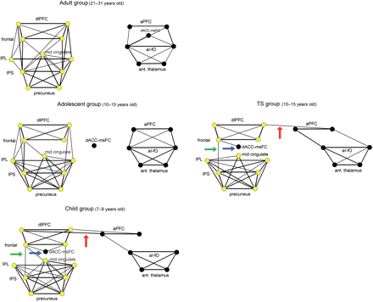
Fig. 2 The development of functional connections within and between the two control networks appears to be disrupted ...
Notes:
Fig. 2 The development of functional connections within and between the two control networks appears to be disrupted or delayed in adolescents with TS. Regions in the fronto-parietal network are shown in yellow, while those in the cingulo-opercular network are shown in black. Eighteen regions at a correlation threshold of r ≥ 0.2 for four groups: unaffected adults, unaffected adolescents, unaffected children and the TS group (see Methods section). The regions in each of the four graphs are arranged pseudoanatomically, such that frontal regions are near the top, parietal regions are near the bottom and left hemisphere regions are on the left of each network, while right hemisphere regions are on the right. For these two networks, it has been shown that three principle connectivity differences exist between childhood and adulthood (Fair et al., 2007a). (i) There are fewer connections between the frontal and parietal regions of the frontal-parietal (yellow) network in typical children versus typical adults and adolescents (green arrow); (ii) the dACC/msFC region is integrated into the frontal-parietal network in typical children compared to typical adults and adolescents (blue arrow); and (iii) the two networks are linked via a connection between the aPFC and dlPFC in typical children versus typical adults and adolescents (red arrow). The adolescents with TS do not appear to undergo this same developmental transition as typically developing subjects. The adolescents with TS appear younger (more similar to the child group) than their age-matched peers (cf. TS group arrows with unaffected child group), suggesting a disruption or delay in the maturation of these networks. Graphs of typical adults, adolescents, and children are derived with a slightly different statistical threshold than Fair et al. (2007a).
Unless provided in the caption above, the following copyright applies to the content of this slide: © 2008 The Author(s)This is an Open Access article distributed under the terms of the Creative Commons Attribution Non-Commercial License (http://creativecommons.org/licenses/by-nc/2.0/uk/) which permits unrestricted non-commercial use, distribution, and reproduction in any medium, provided the original work is properly cited.

Slide 3
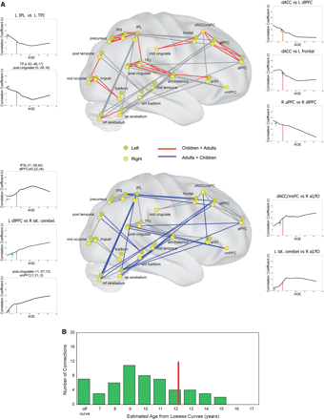
Fig. 3 Significant differences between typically developing children and adults (Fair et al., 2007a), used as COIs ...
Notes:
Fig. 3 Significant differences between typically developing children and adults (Fair et al., 2007a), used as COIs in this analysis. (A) Functional connections that are stronger in children than adults are shown on the top transparent brain (red lines); these connections decrease over age. Functional connections stronger in adults are shown on the lower transparent brain (blue lines); these connections increase over age. LOWESS curves of 210 typically developing people ages 7–31 are shown for 10 connections (figure modified from Fair et al., 2007a). For each curve, the red line indicates the expected LOWESS correlation coefficient for the TS group, given their average age (12.7 years), while the green arrow indicates the actual mean correlation coefficient for the connection in the TS group. The green arrows are often shifted to the left of their expected value, thus representing immaturity in the TS group, independent of whether the connections are growing in strength or diminishing over typical development. Two example ‘off-curve’ connections are highlighted with a horizontal green arrow pointing to the left in the sample LOWESS curves. (B) A histogram of the ages estimated for the TS group based on their actual mean correlation coefficients on the LOWESS curves (green arrows) for all 55 COIs that change significantly from childhood to adulthood. The red line indicates their actual group average age (12.7), and the green bars reveal a significant shift towards ‘younger’ age estimations. For seven connections, TS group average values did not fit the LOWESS curves at all; they were labelled off-curve (left most green bar of B). As with our qualitative observations in Fig. 2, these results suggest an overall immature network profile in adolescents with TS compared to a typically developing population. The semi-transparent brain images were made using Caret and PALS software (Van Essen et al., 2001; Van Essen, 2002, 2005).
Unless provided in the caption above, the following copyright applies to the content of this slide: © 2008 The Author(s)This is an Open Access article distributed under the terms of the Creative Commons Attribution Non-Commercial License (http://creativecommons.org/licenses/by-nc/2.0/uk/) which permits unrestricted non-commercial use, distribution, and reproduction in any medium, provided the original work is properly cited.

Slide 4
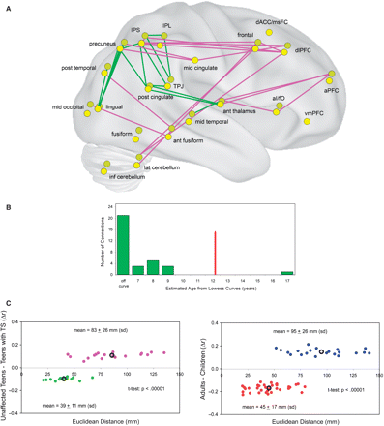
Fig. 4 Connections that are significantly different between the TS group and age-matched adolescents (P < 0.05 ...
Notes:
Fig. 4 Connections that are significantly different between the TS group and age-matched adolescents (P < 0.05 uncorrected). (A) Connections significantly stronger in the TS group (green) are primarily short distance connections between posterior brain regions. Connections significantly stronger in the unaffected group (pink) involve regions more distant in space. (B) Histogram of ‘LOWESS age estimation’ for the connections in A for the TS group. LOWESS curves were extracted for each connection for 210 typically developing subjects. The red line marks the TS group mean actual age. For the majority of these age curves, the TS mean group correlation coefficient did not fit the typical developmental curve at any age point (‘off-curve’ bin), and were most often off the curve in the same direction as the youngest typical subjects. (C) TS adolescents versus unaffected adolescents comparison of Euclidean distances (mm) between the 34 connections of group difference shown in A. Connections stronger in the unaffected group (pink dots) are significantly longer (Euclidian distance between the centres of each ROI) than connections stronger in the TS group (green dots) (Left panel). This finding is similar to a comparison of the typical adults versus children for their developmentally significant COIs, where connections stronger in adults (blue dots) are between regions significantly more distant in space and connections stronger in children are between regions close in space (red dots) (Right panel; from Fair et al., 2007a). Black circles display the mean values for each set of connections.
Unless provided in the caption above, the following copyright applies to the content of this slide: © 2008 The Author(s)This is an Open Access article distributed under the terms of the Creative Commons Attribution Non-Commercial License (http://creativecommons.org/licenses/by-nc/2.0/uk/) which permits unrestricted non-commercial use, distribution, and reproduction in any medium, provided the original work is properly cited.

Slide 5
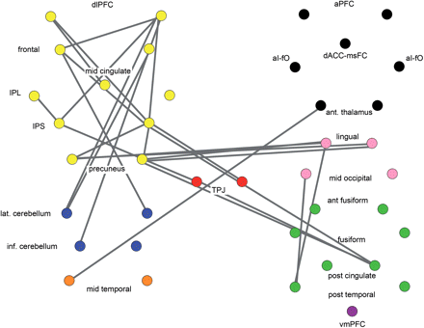
Fig. 5 TS functional connections that do not fit the typical developmental LOWESS curves (i.e. are ‘off-curve’) for ...
Notes:
Fig. 5 TS functional connections that do not fit the typical developmental LOWESS curves (i.e. are ‘off-curve’) for either applied COIs derived from (Fair et al., 2007a) or from the direct comparison between adolescents with and without TS. The 39 putative control regions used in this analysis are coloured by components derived from graph analysis of healthy adult fcMRI data (Dosenbach et al., 2007) (see Table 3, Fig. 1 left panel for abbreviations and locations). Shown in grey are the ‘off-curve’ functional connections in the TS group. These off-curve functional connections are so named because they appear to deviate from the derived developmental trajectories such that the patient group does not intersect the unaffected group at any point of the LOWESS curve (see Methods section for details). Regions in the fronto-parietal, adaptive control network (yellow) are involved in 21 out of the 25 ‘off-curve’ connections. By contrast, only one of the 25 ‘off-curve’ connections involves the cingulo-opercular, task maintenance network (black), suggesting more severe impairment of adaptive control in TS. These may be examples of extreme functional immaturity in the TS group (functionally younger than age 7), or, instead, may be examples of anomalous connectivity in adaptive control in TS (see Discussion section).
Unless provided in the caption above, the following copyright applies to the content of this slide: © 2008 The Author(s)This is an Open Access article distributed under the terms of the Creative Commons Attribution Non-Commercial License (http://creativecommons.org/licenses/by-nc/2.0/uk/) which permits unrestricted non-commercial use, distribution, and reproduction in any medium, provided the original work is properly cited.

Slide 6
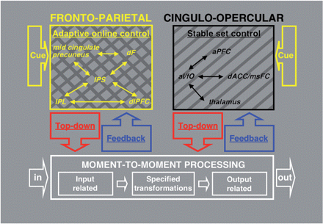
Fig. 6 Proposed task control deficit in Tourette syndrome. While both stable set control and adaptive online control ...
Notes:
Fig. 6 Proposed task control deficit in Tourette syndrome. While both stable set control and adaptive online control networks are compromised in TS, there is more substantial impairment of the brain's adaptive online control network, as indicated by the multiple hash marks.
Unless provided in the caption above, the following copyright applies to the content of this slide: © 2008 The Author(s)This is an Open Access article distributed under the terms of the Creative Commons Attribution Non-Commercial License (http://creativecommons.org/licenses/by-nc/2.0/uk/) which permits unrestricted non-commercial use, distribution, and reproduction in any medium, provided the original work is properly cited.

