Slide 1
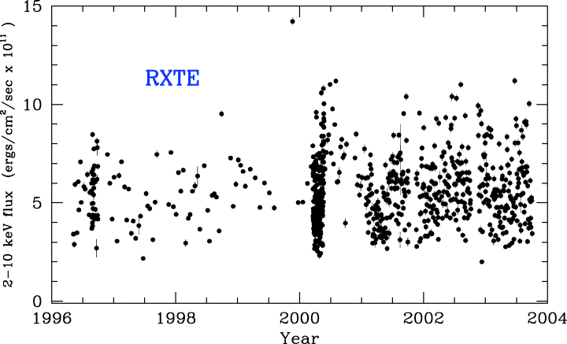
Figure 1 Long-term RXTE 2–10 keV light curve of MCG–6-30-15. Each data point represents an observation of ∼1 ks.
Notes:
Figure 1 Long-term RXTE 2–10 keV light curve of MCG–6-30-15. Each data point represents an observation of ∼1 ks.
Unless provided in the caption above, the following copyright applies to the content of this slide: © 2005 RAS

Slide 2
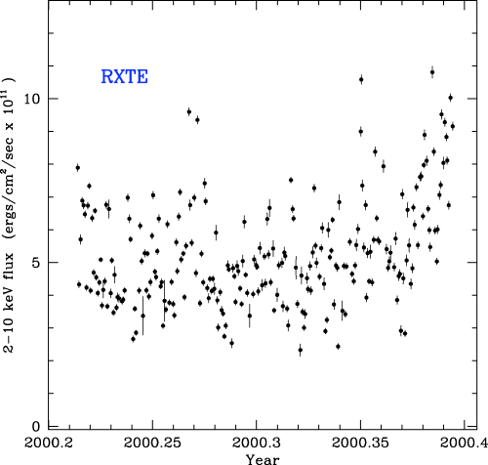
Figure 2 The 2–10 keV RXTE light curve of MCG–6-30-15 covering the 2-month period of four observations per day. Each ...
Notes:
Figure 2 The 2–10 keV RXTE light curve of MCG–6-30-15 covering the 2-month period of four observations per day. Each data point again represents an observation of ∼1 ks.
Unless provided in the caption above, the following copyright applies to the content of this slide: © 2005 RAS

Slide 3
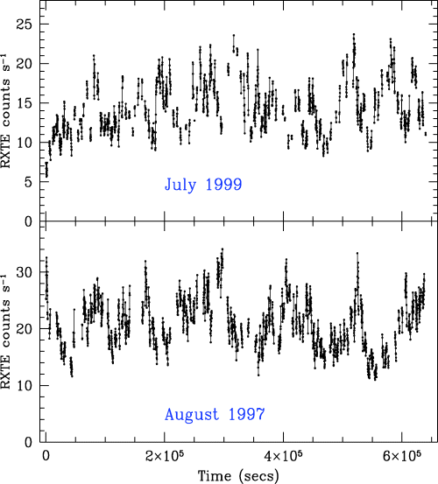
Figure 3 RXTE background-subtracted light curve of MCG–6-30-15 in the 2–10 keV energy band, with 128-s time bins. The ...
Notes:
Figure 3 RXTE background-subtracted light curve of MCG–6-30-15 in the 2–10 keV energy band, with 128-s time bins. The light curves are shown as histogram segments. Gaps are left where there are no data. The bottom panel is the 1997 August observation and the top panel is the 1999 July observation. In both cases the time is measured since the start of the observation.
Unless provided in the caption above, the following copyright applies to the content of this slide: © 2005 RAS

Slide 4
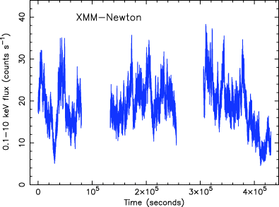
Figure 4 XMM—Newton background-subtracted light curve of MCG–6-30-15 in the 0.1–10 keV energy band, with 20-s time ...
Notes:
Figure 4 XMM—Newton background-subtracted light curve of MCG–6-30-15 in the 0.1–10 keV energy band, with 20-s time bins, using data from the PN CCDs.
Unless provided in the caption above, the following copyright applies to the content of this slide: © 2005 RAS

Slide 5
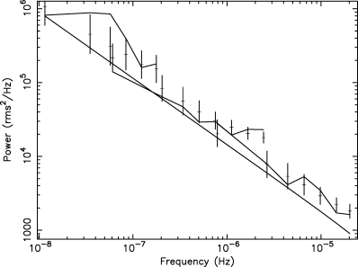
Figure 5 Long time-scale RXTE PSD of MCG–6-30-15. The PSD is well fitted (P = 68 per cent) by a simple power law of ...
Notes:
Figure 5 Long time-scale RXTE PSD of MCG–6-30-15. The PSD is well fitted (P = 68 per cent) by a simple power law of slope 0.9 ± 0.25 over three decades. The underlying undistorted model PSD is shown by the smooth continuous line. The distorted model for each of the three data sets, together with its errors, is shown by the individual points. The observed dirty PSD is given by the jagged lines.
Unless provided in the caption above, the following copyright applies to the content of this slide: © 2005 RAS

Slide 6
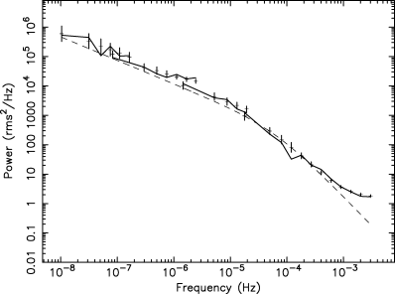
Figure 6 Combined 2–10 keV RXTE and 4–10 keV XMM—Newton PSD of MCG–6-30-15. The lines and data points are as described ...
Notes:
Figure 6 Combined 2–10 keV RXTE and 4–10 keV XMM—Newton PSD of MCG–6-30-15. The lines and data points are as described in Fig. 5.
Unless provided in the caption above, the following copyright applies to the content of this slide: © 2005 RAS

Slide 7
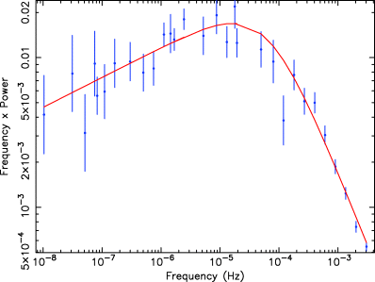
Figure 7 Unfolded combined 2–10 keV RXTE and 4–10 keV XMM—Newton PSD of MCG–6-30-15. Here the errors have been ...
Notes:
Figure 7 Unfolded combined 2–10 keV RXTE and 4–10 keV XMM—Newton PSD of MCG–6-30-15. Here the errors have been translated on to the data points and the continuous line represents the best-fitting underlying PSD. Note that here we plot frequency×power. See the text for details.
Unless provided in the caption above, the following copyright applies to the content of this slide: © 2005 RAS

Slide 8
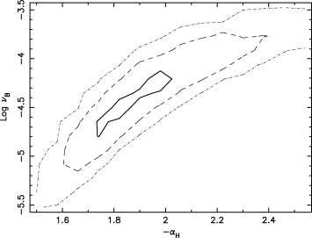
Figure 8 68, 90 and 99 per cent confidence contours for high-frequency slope, α_{H}, and break frequency, ...
Notes:
Figure 8 68, 90 and 99 per cent confidence contours for high-frequency slope, αH, and break frequency, νB, for a bending power-law fit to the combined RXTE and XMM—Newton 4–10 keV PSD shown in Fig. 6. Note we plot –αH.
Unless provided in the caption above, the following copyright applies to the content of this slide: © 2005 RAS

Slide 9
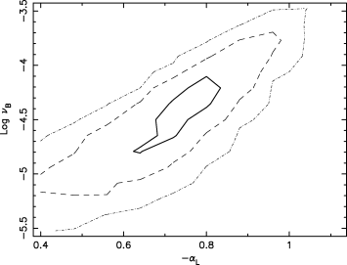
Figure 9 68, 90 and 99 per cent confidence contours for low-frequency slope, α_{L}, and break frequency, ...
Notes:
Figure 9 68, 90 and 99 per cent confidence contours for low-frequency slope, αL, and break frequency, νB, for a bending power-law fit to the combined RXTE and XMM—Newton 4–10 keV PSD shown in Fig. 6. Note we plot –αL.
Unless provided in the caption above, the following copyright applies to the content of this slide: © 2005 RAS

Slide 10
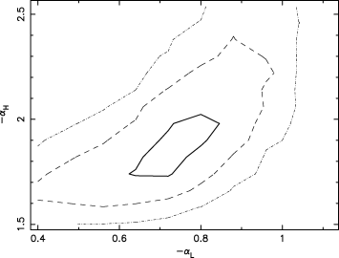
Figure 10 68, 90 and 99 per cent confidence contours for low- and high-frequency slopes, α_{L} and ...
Notes:
Figure 10 68, 90 and 99 per cent confidence contours for low- and high-frequency slopes, αL and αH, respectively, for a bending power-law fit to the combined RXTE and XMM—Newton 4–10 keV PSD shown in Fig. 6. Note we again plot –αL and –αH.
Unless provided in the caption above, the following copyright applies to the content of this slide: © 2005 RAS

Slide 11
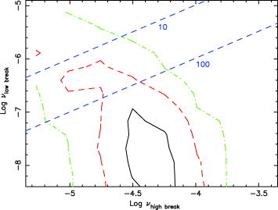
Figure 11 Confidence contours for the high and possible low break frequencies. The 68 per cent contour is solid, the 90 ...
Notes:
Figure 11 Confidence contours for the high and possible low break frequencies. The 68 per cent contour is solid, the 90 per cent contour is dashed and the 99 per cent contour is dot-dashed. The straight dashed lines, with labels of 10 and 100, respectively, indicate those ratios between the high and possible low break frequencies. The fits assume a break below the low-frequency break of 0 and an intermediate slope between the low- and high-frequency breaks of 0.8. Both break frequencies were allowed to vary, as was the slope above the upper break, which was measured at 1.95 ± 0.3.
Unless provided in the caption above, the following copyright applies to the content of this slide: © 2005 RAS

Slide 12
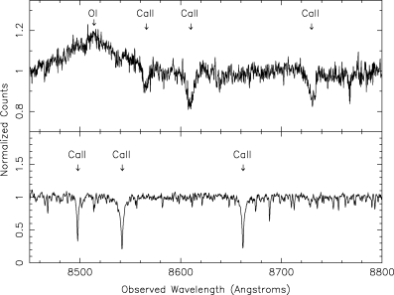
Figure 12 Normalized spectra of MCG–6-30-15 (top panel) and a template star (bottom), with the position of the calcium ...
Notes:
Figure 12 Normalized spectra of MCG–6-30-15 (top panel) and a template star (bottom), with the position of the calcium triplet feature and broad O iλ8446 emission line marked.
Unless provided in the caption above, the following copyright applies to the content of this slide: © 2005 RAS

Slide 13
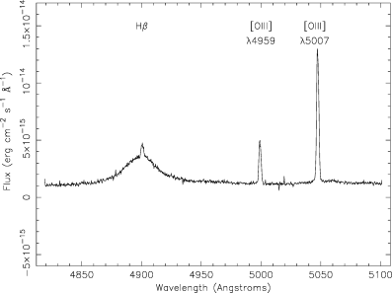
Figure 13 HST/STIS spectrum of MCG–6-30-15, showing broad and narrow Hβ components, and [Oiii]λλ4959, 5007 emission ...
Notes:
Figure 13 HST/STIS spectrum of MCG–6-30-15, showing broad and narrow Hβ components, and [Oiii]λλ4959, 5007 emission lines.
Unless provided in the caption above, the following copyright applies to the content of this slide: © 2005 RAS

Slide 14
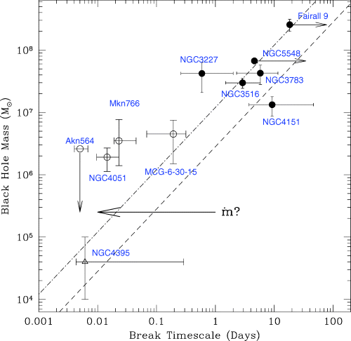
Figure 14 Black hole mass versus PSD break time-scale. Broad-line Seyfert galaxies are shown as filled circles, ...
Notes:
Figure 14 Black hole mass versus PSD break time-scale. Broad-line Seyfert galaxies are shown as filled circles, narrow-line Seyfert galaxies are shown as open circles and NGC 4395 is shown as an open triangle. The dashed line to the right represents linear scaling of the break time-scale with mass from Cyg X-1 in its low state. The dot-dashed line, on the left, represents linear scaling of the break time-scale with mass from Cyg X-1 in its high state. NGC 4395 is plotted as an open triangle (see the text). The arrow labelled with indicates the way in which the relationship of break time-scale versus mass might move with increasing accretion rate.
Unless provided in the caption above, the following copyright applies to the content of this slide: © 2005 RAS

