Slide 1
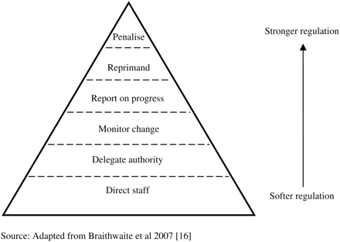
Figure 2 Pyramid of regulatory sanctions. Source: Adapted from Braithwaite et al. [16].
Notes:
Figure 2 Pyramid of regulatory sanctions. Source: Adapted from Braithwaite et al. [16].
Unless provided in the caption above, the following copyright applies to the content of this slide: © The Author 2011. Published by Oxford University Press in association with the International Society for Quality in Health Care; all rights reserved

Slide 2
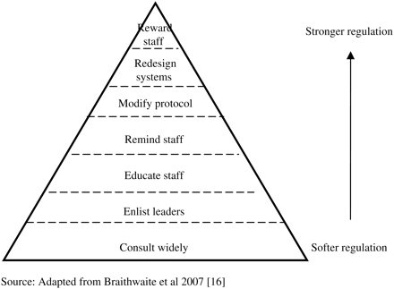
Figure 1 Pyramid of regulatory supports. Source: Adapted from Braithwaite et al. [16].
Notes:
Figure 1 Pyramid of regulatory supports. Source: Adapted from Braithwaite et al. [16].
Unless provided in the caption above, the following copyright applies to the content of this slide: © The Author 2011. Published by Oxford University Press in association with the International Society for Quality in Health Care; all rights reserved

