Slide 1
Figure 1. Location of expression assay ‘ex7–8’ and associated LD block with SNPs rs7903146 and rs12255372 within TCF7L2 ...
Notes:
Figure 1. Location of expression assay ‘ex7–8’ and associated LD block with SNPs rs7903146 and rs12255372 within TCF7L2 gene, exons are marked as black rectangles.
Unless provided in the caption above, the following copyright applies to the content of this slide: Published by Oxford University Press 2009This is an Open Access article distributed under the terms of the Creative Commons Attribution Non-Commercial License (http://creativecommons.org/licenses/by-nc/2.0/uk/) which permits unrestricted non-commercial use, distribution, and reproduction in any medium, provided the original work is properly cited.

Slide 2
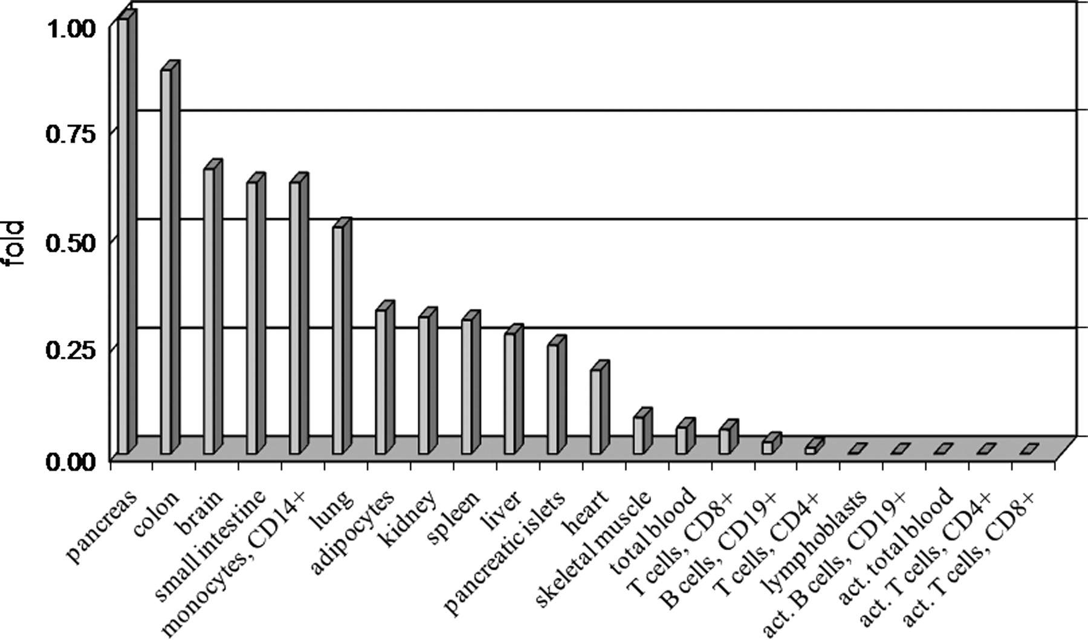
Figure 2. Expression of assay ‘ex7–8’ of TCF7L2 in human tissues as fold difference compared with expression level in ...
Notes:
Figure 2. Expression of assay ‘ex7–8’ of TCF7L2 in human tissues as fold difference compared with expression level in pancreas. TCF7L2 expression is normalized to the levels of endogenous controls B2M and GAPDH (Supplementary Material, Table S1). Each tissue is represented by 1 or 2–3 pooled samples.
Unless provided in the caption above, the following copyright applies to the content of this slide: Published by Oxford University Press 2009This is an Open Access article distributed under the terms of the Creative Commons Attribution Non-Commercial License (http://creativecommons.org/licenses/by-nc/2.0/uk/) which permits unrestricted non-commercial use, distribution, and reproduction in any medium, provided the original work is properly cited.

Slide 3
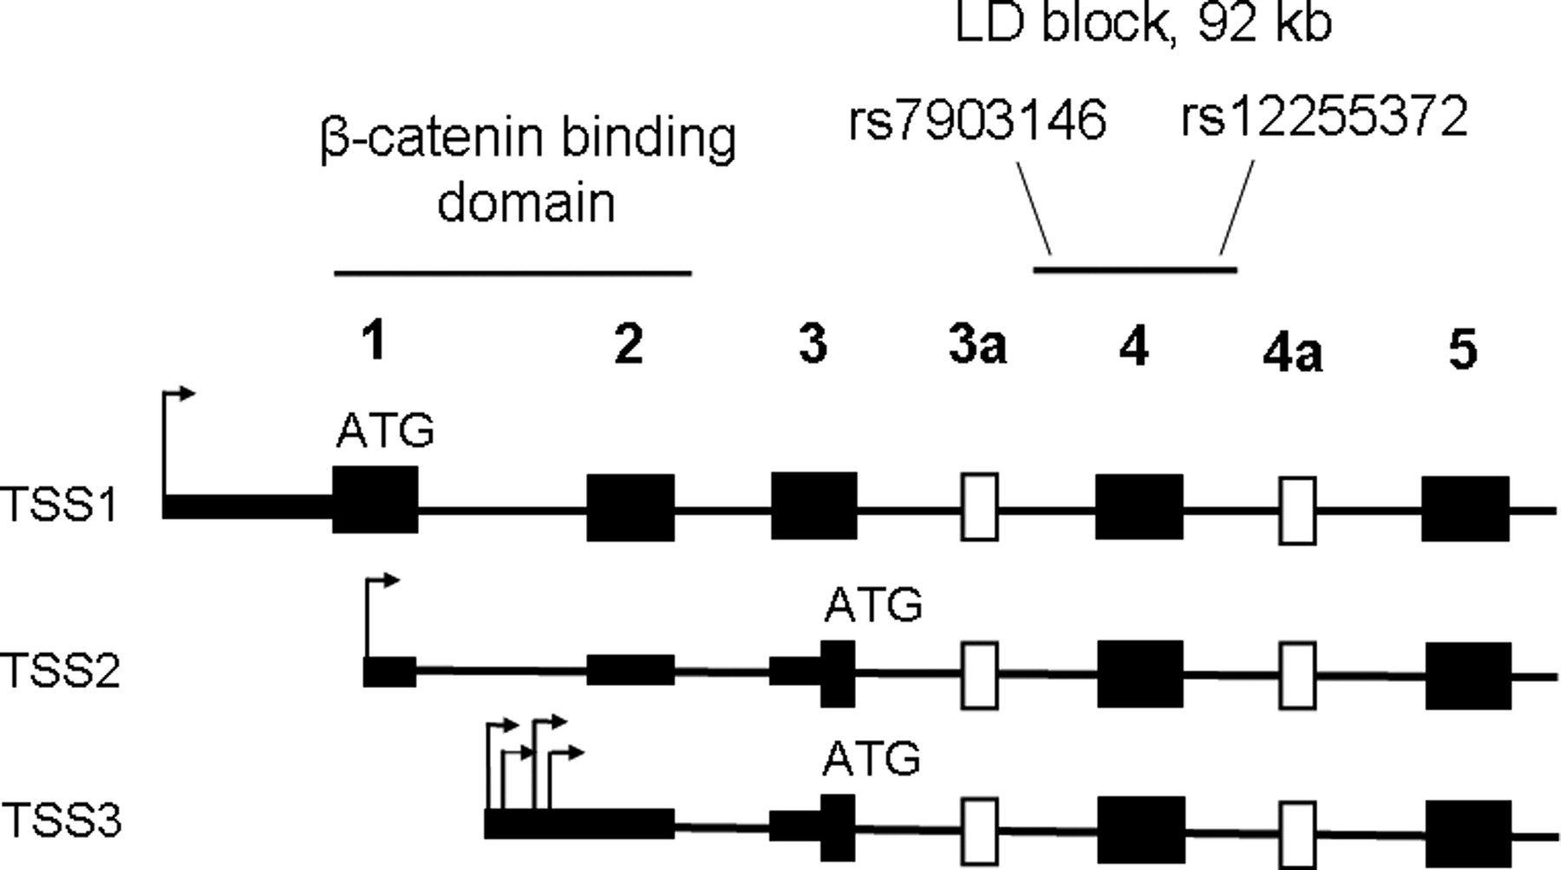
Figure 3. Structure of the N-terminal part of TCF7L2: location of the β-catenin binding domain encoded by exons 1 and ...
Notes:
Figure 3. Structure of the N-terminal part of TCF7L2: location of the β-catenin binding domain encoded by exons 1 and 2, and a T2D-associated LD block with SNPs rs7903146 and rs12255372. Shown: constitutive exons—black rectangles, alternative exons—white rectangles; alternative transcription starts sites TSS1, TSS2 and TSS3—arrows, potential translation starts—‘ATG’.
Unless provided in the caption above, the following copyright applies to the content of this slide: Published by Oxford University Press 2009This is an Open Access article distributed under the terms of the Creative Commons Attribution Non-Commercial License (http://creativecommons.org/licenses/by-nc/2.0/uk/) which permits unrestricted non-commercial use, distribution, and reproduction in any medium, provided the original work is properly cited.

Slide 4
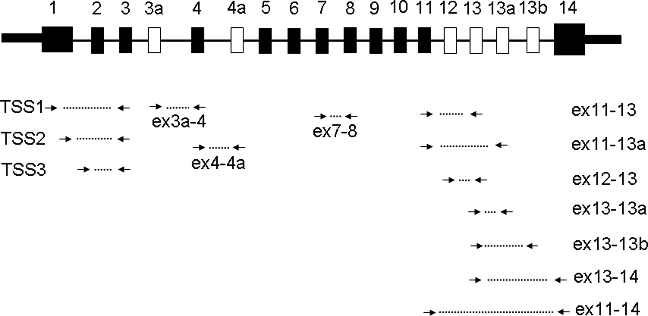
Figure 4. Location of TaqMan expression assays within TCF7L2 gene. Shown: constitutive exons—black rectangles, ...
Notes:
Figure 4. Location of TaqMan expression assays within TCF7L2 gene. Shown: constitutive exons—black rectangles, alternative exons—white rectangles, expression assays—connected arrows.
Unless provided in the caption above, the following copyright applies to the content of this slide: Published by Oxford University Press 2009This is an Open Access article distributed under the terms of the Creative Commons Attribution Non-Commercial License (http://creativecommons.org/licenses/by-nc/2.0/uk/) which permits unrestricted non-commercial use, distribution, and reproduction in any medium, provided the original work is properly cited.

Slide 5
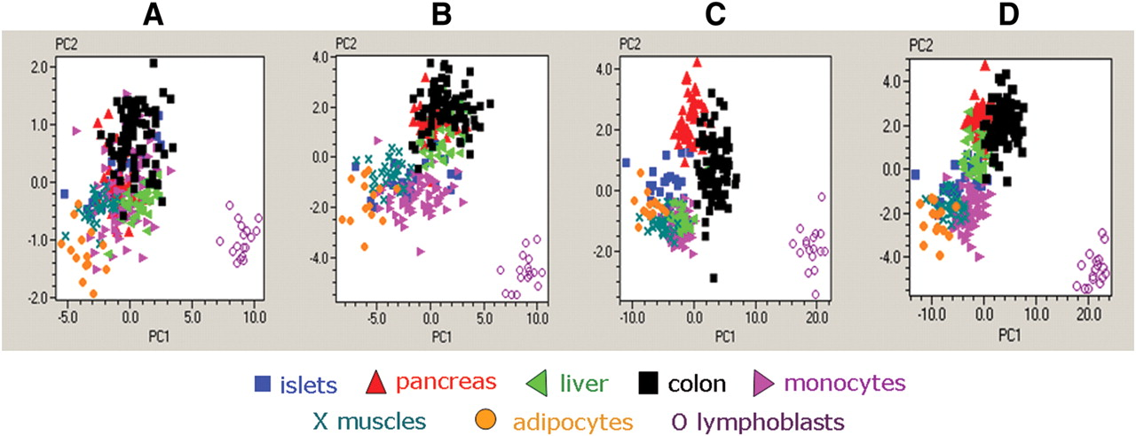
Figure 5. PCA in 289 samples from 8 human tissues. (A) PCA based on three N-terminal expression assays of TCF7L2: ...
Notes:
Figure 5. PCA in 289 samples from 8 human tissues. (A) PCA based on three N-terminal expression assays of TCF7L2: ‘TSS1’, TSS2’ and ‘ex7–8’. (B) PCA based on five N-terminal expression assays for TCF7L2: ‘TSS1’, ‘TSS2’, ‘TSS3’, ‘ex3a’ and ‘ex7–8’. (C) PCA based on six C-terminal expression assays for TCF7L2: ‘ex11–13’, ‘ex11–13a’, ‘ex11–14’, ‘ex12–13’, ‘ex13–13a’ and ‘ex13–14’. (D) PCA based on all eleven expression assays for TCF7L2.
Unless provided in the caption above, the following copyright applies to the content of this slide: Published by Oxford University Press 2009This is an Open Access article distributed under the terms of the Creative Commons Attribution Non-Commercial License (http://creativecommons.org/licenses/by-nc/2.0/uk/) which permits unrestricted non-commercial use, distribution, and reproduction in any medium, provided the original work is properly cited.

Slide 6
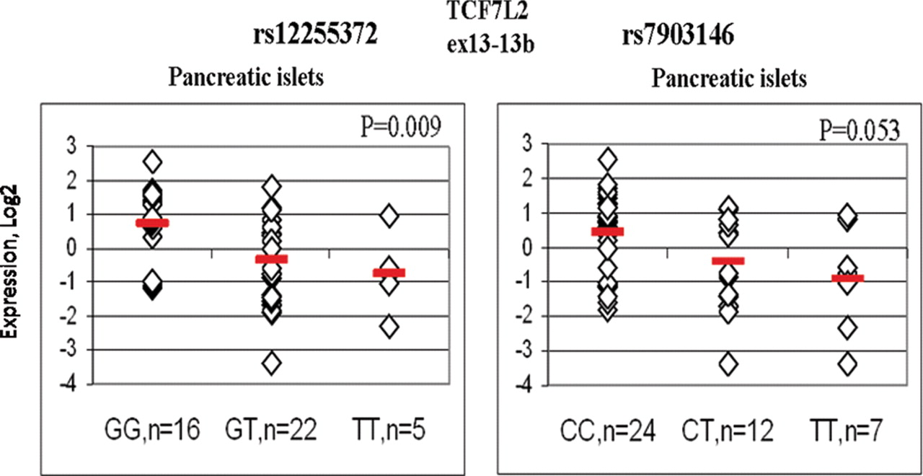
Figure 6. Expression of assay ‘ex13–13b’ in human pancreatic islets by rs12255372 and rs7903146 genotypes. Normalized ...
Notes:
Figure 6. Expression of assay ‘ex13–13b’ in human pancreatic islets by rs12255372 and rs7903146 genotypes. Normalized expression of assay ‘ex13–13b’ is shown in Log 2 scale relative to a mean value of the whole set. Association was tested with univariate linear regression under an additive genetic model for SNPs and with adjustment for two sample sets.
Unless provided in the caption above, the following copyright applies to the content of this slide: Published by Oxford University Press 2009This is an Open Access article distributed under the terms of the Creative Commons Attribution Non-Commercial License (http://creativecommons.org/licenses/by-nc/2.0/uk/) which permits unrestricted non-commercial use, distribution, and reproduction in any medium, provided the original work is properly cited.

