Slide 1
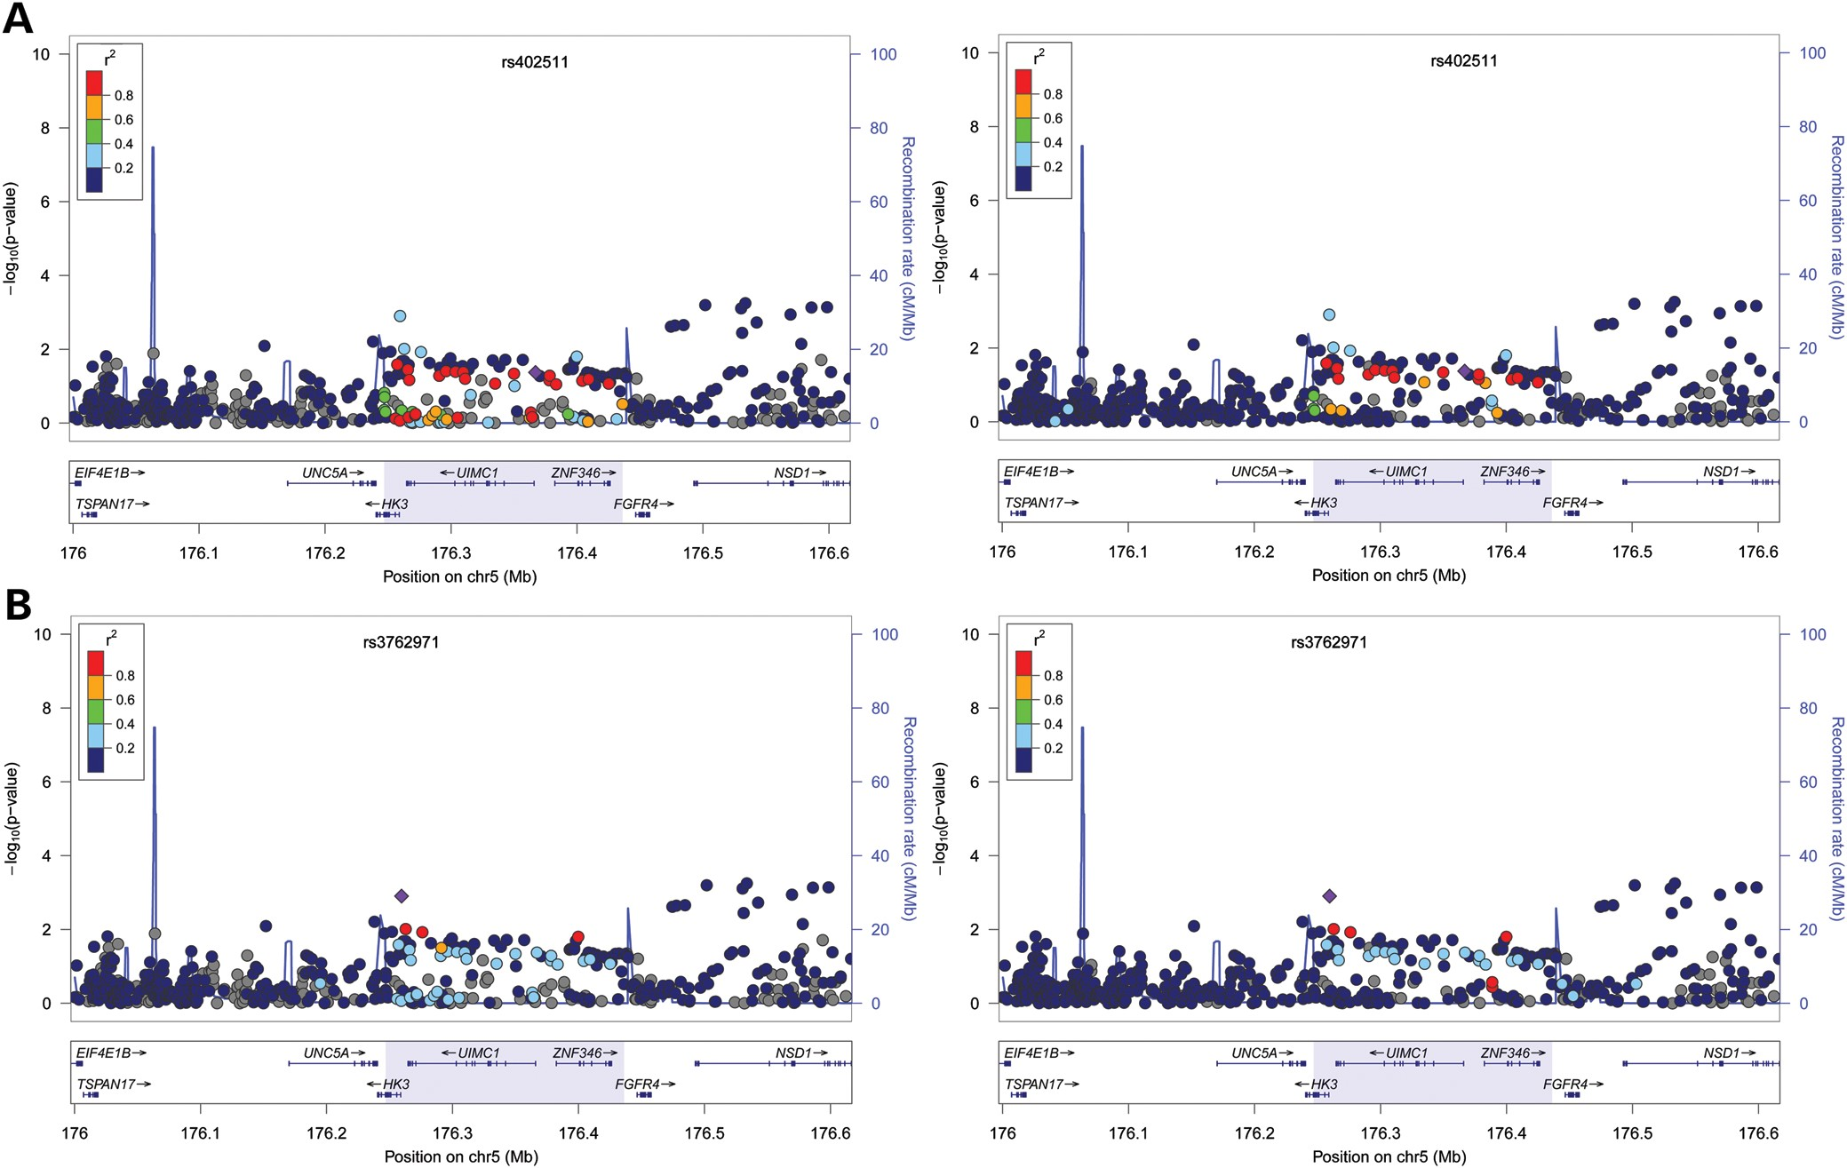
Figure 1. Association between age at menopause and chromosome 5 locus surrounding rs402511. Each panel shows the ...
Notes:
Figure 1. Association between age at menopause and chromosome 5 locus surrounding rs402511. Each panel shows the pairwise disequilibrium between SNPs in this region with rs402511 (A, colored in purple) and rs3762791 (B, colored in purple) estimated from HapMap CEU data (left panels) and HapMap YRI data (right panels). The r2 values are color coded according to the scale on each panel. The y-axis shows the P-values for strength of associations for each SNP in the region. The LD block where the signals reside is highlighted. rs402511 is associated with age at menopause in GWAS of women with European ancestry while a potential secondary signal, rs3762971, is found in women with African ancestry (17). r2 between rs3762971 and rs402511 is low in both HapMap CEU and YRI. The strongest signal in this genomic region reported from meta-analyses of European cohorts (rs365132) is in tight LD with rs402511 in both HapMap CEU (r2 = 0.93) and YRI (r2 = 1) populations, suggesting rs402511 and rs365132 represent the same signal.
Unless provided in the caption above, the following copyright applies to the content of this slide: © The Author 2014. Published by Oxford University Press. All rights reserved. For Permissions, please email: journals.permissions@oup.com

Slide 2
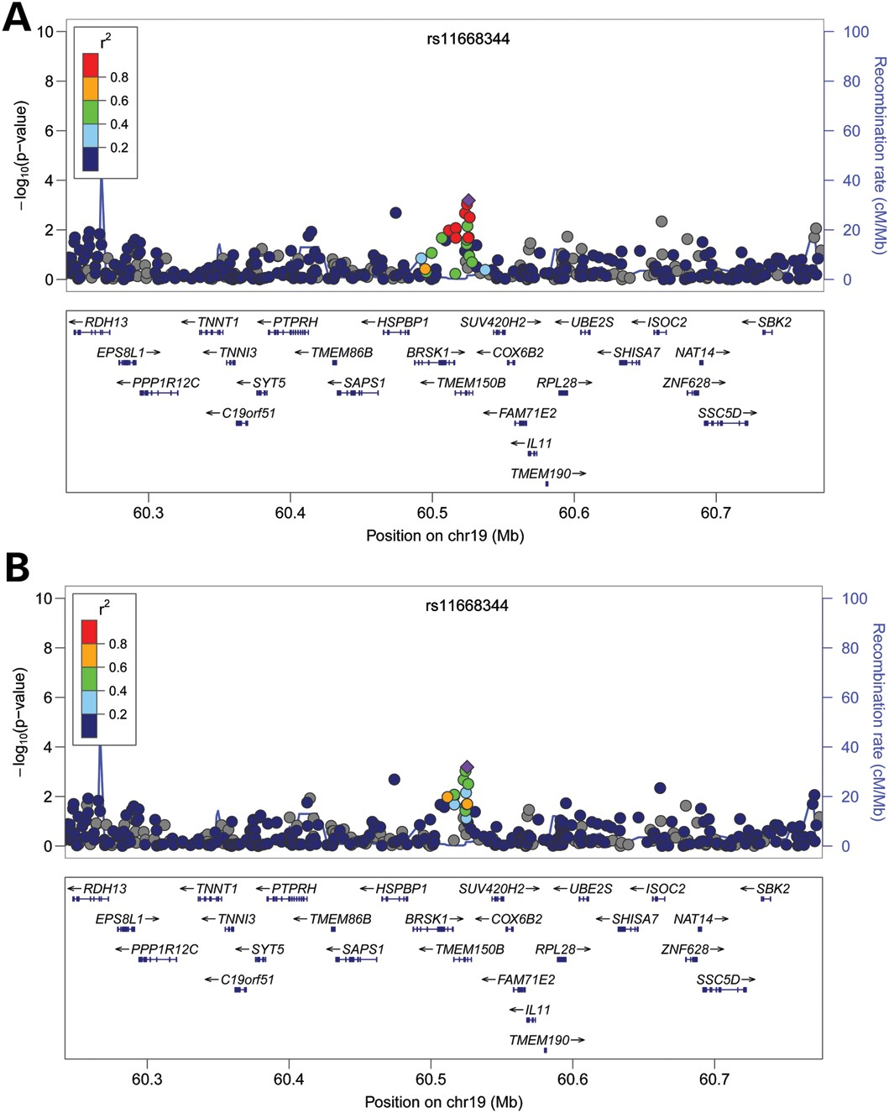
Figure 2. Association between age at menopause and chromosome 19 locus. Each panel shows the pairwise disequilibrium ...
Notes:
Figure 2. Association between age at menopause and chromosome 19 locus. Each panel shows the pairwise disequilibrium between SNPs in this region with rs11668344 (colored in purple) estimated from HapMap CEU data (A) and HapMap YRI data (B). The r2 values are color coded according to the scale on each panel. The y-axis shows the P-values for strength of associations for each SNP in the region. The LD block where the signals reside is highlighted. Five of the eight previously reported signals (rs1551562, rs1172822, rs2384687, rs11668344 and rs897798) in this region replicated in the current study. They likely all represent the same signal as they are in high LD with one another in both HapMap CEU and YRI populations. rs11668344 has the lowest P-value at this locus in our cohorts.
Unless provided in the caption above, the following copyright applies to the content of this slide: © The Author 2014. Published by Oxford University Press. All rights reserved. For Permissions, please email: journals.permissions@oup.com

Slide 3
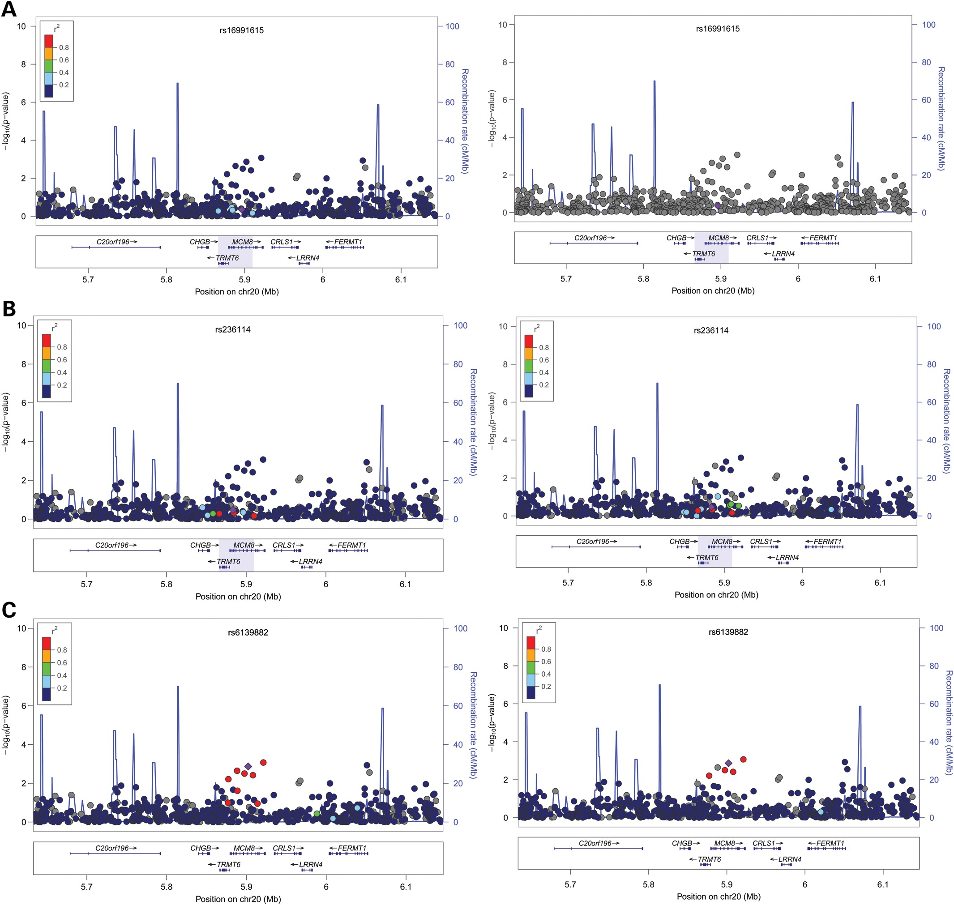
Figure 3. Association between age at menopause and chromosome 20 locus surrounding rs16991615. Each panel shows the ...
Notes:
Figure 3. Association between age at menopause and chromosome 20 locus surrounding rs16991615. Each panel shows the pairwise disequilibrium between SNPs in this region with rs16991615 (A, colored in purple), rs236114 (B, colored in purple), and a likely secondary signal, rs6139882 (C, colored in purple) estimated from HapMap CEU data (left panels) and HapMap YRI data (right panels). The r2 values are color coded according to the scale on each panel. The y-axis shows the P-values for strength of associations for each SNP in the region. The LD block where the signals reside is highlighted. rs16991615 has a low MAF in HapMap YRI population and thus, there is no available LD information with other SNPs at this locus.
Unless provided in the caption above, the following copyright applies to the content of this slide: © The Author 2014. Published by Oxford University Press. All rights reserved. For Permissions, please email: journals.permissions@oup.com

Slide 4
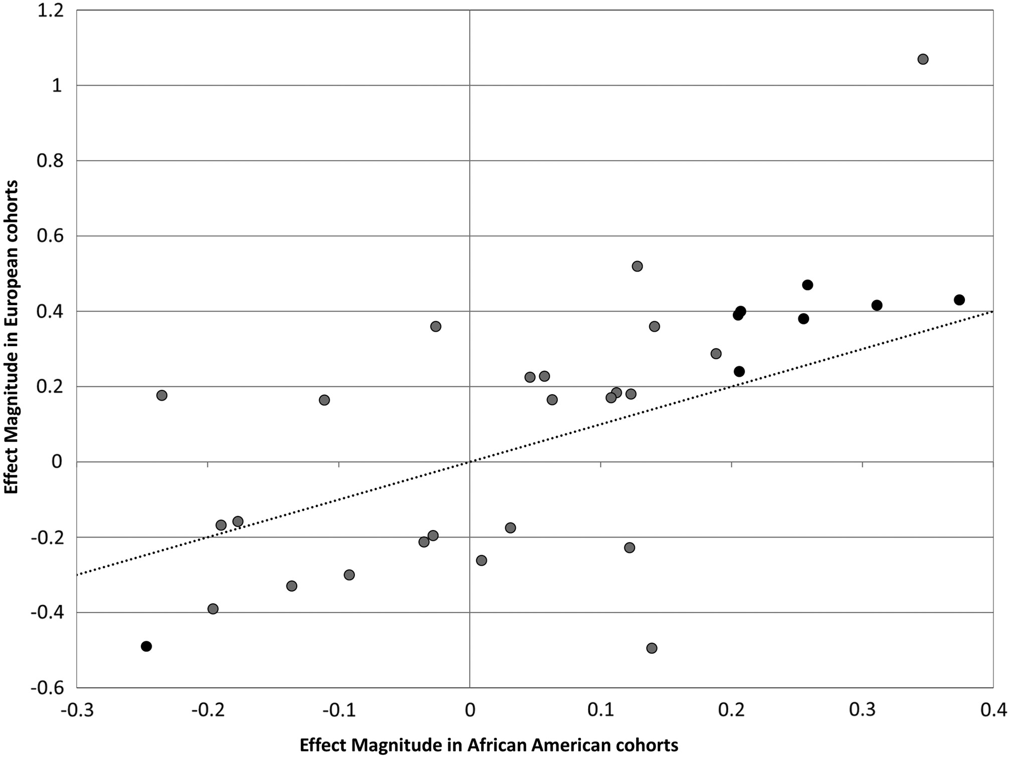
Figure 4. Comparisons of effect magnitude of loci associated with age at menopause between women with European and ...
Notes:
Figure 4. Comparisons of effect magnitude of loci associated with age at menopause between women with European and African ancestry. Each point represents a previously identified locus associated with age at menopause in women with European ancestry. Loci replicated in the current African-American cohorts are colored in black. The dash line indicates the theoretical x = y line.
Unless provided in the caption above, the following copyright applies to the content of this slide: © The Author 2014. Published by Oxford University Press. All rights reserved. For Permissions, please email: journals.permissions@oup.com

