Slide 1
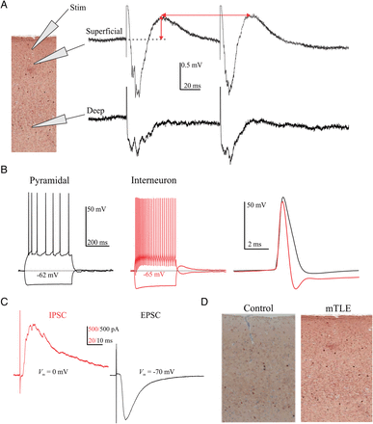
Figure 1. Baseline characterization of the human MTG brain slice preparation. (A) Schematic of the typical recording ...
Notes:
Figure 1. Baseline characterization of the human MTG brain slice preparation. (A) Schematic of the typical recording arrangement with electrodes in the superficial (layers II/III) and deep (V/VI) layers. The stimulating electrode (Stim) was positioned in the superficial layer to generate single or paired evoked potentials. The red arrows represent measures used to quantitate responses to paired-pulse stimuli. (B) Whole-cell recordings from putative pyramidal cells and interneurons, displayed typical spiking (regular spiking vs. fast spiking) and spike features for the respective cell types (see Table 2). (C) Voltage clamp recordings revealed both evoked IPSCs (left, red) and EPSCs (right, black) at their respective holding potentials (Vm). (D) Parvalbumin stained mesial temporal lobe from a control and subject with mTLE.
Unless provided in the caption above, the following copyright applies to the content of this slide: © The Author 2013. Published by Oxford University Press. All rights reserved. For Permissions, please e-mail: journals.permissions@oup.com

Slide 2
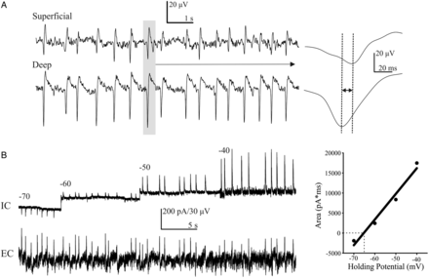
Figure 2. Characterization of spontaneous slow waves. (A) Simultaneous superficial and deep layer extracellular ...
Notes:
Figure 2. Characterization of spontaneous slow waves. (A) Simultaneous superficial and deep layer extracellular recordings demonstrating spontaneous slow waves in the standard recording solution prior to the addition of kainate and carbachol. Right, fast sweep of one spontaneous slow wave demonstrating the time delay between layers. (B) Representative trace of spontaneous slow waves during simultaneous intracellular (IC) voltage clamp of a pyramidal cell and extracellular (EC) recording (n = 6) to demonstrate the reversal potential of the intracellular currents correlated with the sharp wave activity. By holding at various potentials, the reversal potential of the spontaneous outward currents was estimated from the potential at which the fitted (solid line) intersected with zero. In this cell this was estimated to be −65 mV.
Unless provided in the caption above, the following copyright applies to the content of this slide: © The Author 2013. Published by Oxford University Press. All rights reserved. For Permissions, please e-mail: journals.permissions@oup.com

Slide 3
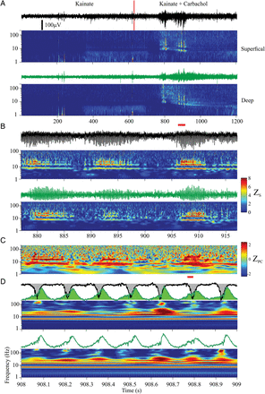
Figure 3. Evanescent oscillatory activity in human cortical slices induced by kainate and carbachol. (A) Extracellular ...
Notes:
Figure 3. Evanescent oscillatory activity in human cortical slices induced by kainate and carbachol. (A) Extracellular traces, high pass filtered at 1 Hz, recorded from superficial (black) and deep (green) layer of a cortical slice. The voltage scale is the same for all the raw data traces. Corresponding spectrograms of varying temporal scales during application of kainate and kainate + carbachol are shown below the traces. The spectrograms are computed from the raw trace, not the high pass filtered data. The first color bar ZS on the right corresponds to the various spectrograms. The vertical red line demarcates the transition between kainate and the addition of carbachol. Horizontal red bars under each spectrogram represent the time range expanded immediately below. (B) Expanded traces and corresponding spectrograms. (C) Wavelet phase coherence with its own color bar shown (ZPC) to the right of it. (D) Further expanded traces and corresponding spectrograms. Top, the superficial and deep layer traces are superimposed and the area under each curve colorized to show the temporal relation between the activities in the 2 layers. Although the peak of the activity in the superficial layer leads the deep layer, buildup of activity in the deep layer precedes the peak in the superficial layer.
Unless provided in the caption above, the following copyright applies to the content of this slide: © The Author 2013. Published by Oxford University Press. All rights reserved. For Permissions, please e-mail: journals.permissions@oup.com

Slide 4
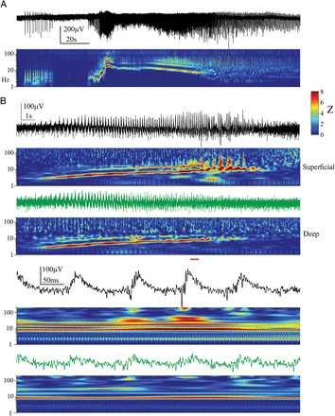
Figure 4. Ictal events display unstable frequency characteristics over time. (A, B) Spectrograms of two types of ictal ...
Notes:
Figure 4. Ictal events display unstable frequency characteristics over time. (A, B) Spectrograms of two types of ictal events observed in human cortical tissue exposed to kainate and carbachol. The event in (A) is recorded from the superficial cortical layer, with no accompanying activity in the deep cortical layer.
Unless provided in the caption above, the following copyright applies to the content of this slide: © The Author 2013. Published by Oxford University Press. All rights reserved. For Permissions, please e-mail: journals.permissions@oup.com

Slide 5
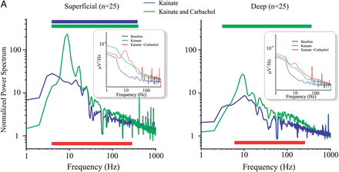
Figure 5. Kainate and carbachol induce broadband and narrowband increases in spectral power in human MTG slices in ...
Notes:
Figure 5. Kainate and carbachol induce broadband and narrowband increases in spectral power in human MTG slices in vitro. (A) Group averaged normalized spectra; the bars above the plots indicate significant power increases during application of kainate (blue), and kainate plus carbachol (green) from the baseline condition. The red bar below indicates the frequency range over which application of kainate + carbachol induced power increases greater than the kainate condition. Insets show non-normalized power spectra for the 3 different conditions: Baseline, Kainate, Kainate + carbachol.
Unless provided in the caption above, the following copyright applies to the content of this slide: © The Author 2013. Published by Oxford University Press. All rights reserved. For Permissions, please e-mail: journals.permissions@oup.com

Slide 6
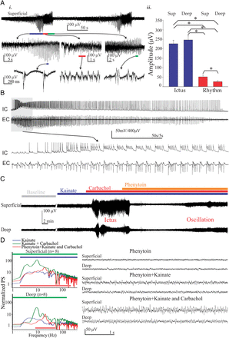
Figure 6. Electrophysiology of ictal events induced by kainate plus carbachol, and distinguishing features from other ...
Notes:
Figure 6. Electrophysiology of ictal events induced by kainate plus carbachol, and distinguishing features from other activated states. (Ai) Top panel shows a representative trace of 2 ictal events induced by kainate plus carbachol in the human MTG. In the middle and bottom, faster sweeps of the electrographic activities observed during 3 distinguishable stages of the ictal events; preictal (blue marker), ictal (red marker), and late-ictal (green marker). (Aii) Bar graphs showing the difference in amplitudes between layers of the activities recorded and classified as ictal events and rhythms. (B) Representative trace showing the intense firing pattern of a putative pyramidal cell during the ictus, and their apparent correlation with the ongoing field potential. (C) Representative trace of an experiment demonstrating the effect of phenytoin on the kainate + carbachol induced ictus. Note that in the presence of phenytoin, physiological oscillations appear under kainate + carbachol, while the ictal events do not recur. (D) Power spectra and representative traces of slices pretreated with phenytoin under kainate + carbachol. The bars above the plots indicate significant power increases during application of kainate (blue), and kainate + carbachol (green) from the baseline condition. The red bar below indicates the frequency range over which application of kainate + carbachol during preapplication of phenytoin-induced power increases above the baseline condition.
Unless provided in the caption above, the following copyright applies to the content of this slide: © The Author 2013. Published by Oxford University Press. All rights reserved. For Permissions, please e-mail: journals.permissions@oup.com

Slide 7
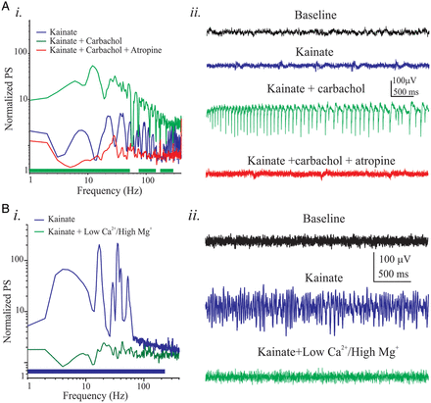
Figure 7. Synaptic transmission and cholinergic activation are essential for rhythm induction in human MTG. (A) Effects ...
Notes:
Figure 7. Synaptic transmission and cholinergic activation are essential for rhythm induction in human MTG. (A) Effects of 10 μM atropine on the rhythms induced by kainate and carbachol. (Ai) Grouped normalized spectral analysis (n = 4) showing significant decrease in the activity induced by kainate and carbachol after the application of the muscarinic receptor antagonist atropine. The only significant power increases were observed during application of kainate and carbachol (green line). (Aii) Representative extracellular recordings under various conditions. (Bi) Grouped normalized spectral analysis (n = 5) showing the effect of synaptic transmission blockade on the activation pattern induced by kainate. Such blockade induced by low calcium (0.5 mM) and high magnesium (3 mM), significantly reduced the broadband power changes induced by kainate (blue bar). (Bii) Representative traces under varying experimental conditions.
Unless provided in the caption above, the following copyright applies to the content of this slide: © The Author 2013. Published by Oxford University Press. All rights reserved. For Permissions, please e-mail: journals.permissions@oup.com

Slide 8
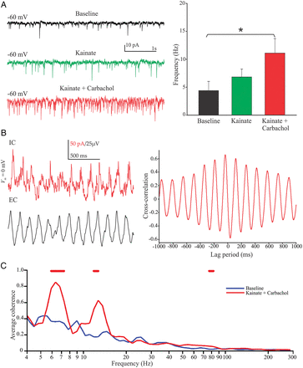
Figure 8. Oscillations in the human MTG are associated with increased rhythmic synaptic activity: (A) Voltage clamp ...
Notes:
Figure 8. Oscillations in the human MTG are associated with increased rhythmic synaptic activity: (A) Voltage clamp recording at holding potential of −60 mV during various stages of activation. Significant increase in the frequency of EPSCs occurred only during the application of kainate + carbachol (n = 14 cells). (B) Representative intracellular voltage clamp recordings (IC) at 0 mV membrane potential, and extracellular (EC) traces displaying rhythmic activity in the theta frequency range during kainate + carbachol application. Cross-correlation (right panel) analysis of a 2-s sweep between IC and EC recordings. (C) Wavelet coherence analysis of IPSCs and EC signal from (B) demonstrating significant effects during kainate + carbachol (red line) when compared with baseline. This was observed in 2 other cells.
Unless provided in the caption above, the following copyright applies to the content of this slide: © The Author 2013. Published by Oxford University Press. All rights reserved. For Permissions, please e-mail: journals.permissions@oup.com

Slide 9
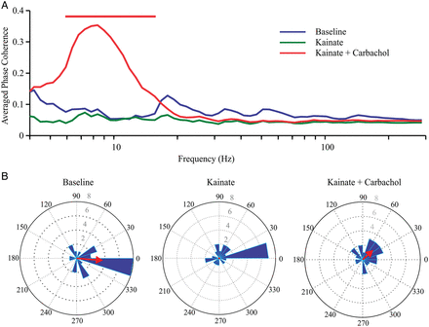
Figure 9. Phase coherence between superficial and deep layers is maximal at theta frequency. (A) Averaged PC both ...
Notes:
Figure 9. Phase coherence between superficial and deep layers is maximal at theta frequency. (A) Averaged PC both across time and across brain slices (n = 25). The red colored bar above the plot indicate statistical significance with respect to baseline conditions, using nonparametric statistical testing. (B) Rose plots for peak PC frequencies (7–10 Hz). Distributions were generated for each trial and condition. Mean phase angle are shown as red arrows. Degrees are shown in black, histogram counts are shown in gray. At theta frequencies (7–10 Hz) on average, the deeper layer leads.
Unless provided in the caption above, the following copyright applies to the content of this slide: © The Author 2013. Published by Oxford University Press. All rights reserved. For Permissions, please e-mail: journals.permissions@oup.com

Slide 10
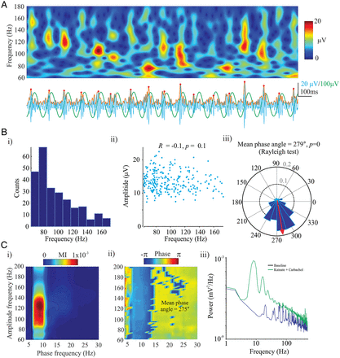
Figure 10. High gamma bursts are of variable frequency and may account for the “broadband” power increases seen during ...
Notes:
Figure 10. High gamma bursts are of variable frequency and may account for the “broadband” power increases seen during kainate and carbachol activation. (A) Time–frequency analysis of high gamma activity. Note the peaks in power are variable in frequency. To quantitate this, peaks in high gamma were detected from the magnitude (orange trace) of the Hilbert transformed band pass filtered signal (60–180 Hz) (light blue trace). Only those peaks ≥ 2 SD were included (red dots) as “bursts.” Superimposed is the theta oscillation (green trace). Using the identified maxima the frequency at which the power was maximal (from the trace above) was extracted for all bursts. (Bi) Histogram of the incidence of the various high gamma bursts. A strong negative correlation was found between the frequency of the burst and number of occurences. (Bii) The amplitude of each high gamma burst as a function of its frequency. No correlation was found between these 2 features. (Biii) Phase at which the bursts occurred was not uniformly distributed and was similar to that obtained from the MI calculation. (Ci) Shown plotted is the MI from the same slices as used in part A. The black contour line represents the region of significance. (Cii) The phase at which CFC was maximal. The mean phase was computed from the circular mean of all points within the significant region obtained from the MI. (Ciii) The power spectrum from the same slice.
Unless provided in the caption above, the following copyright applies to the content of this slide: © The Author 2013. Published by Oxford University Press. All rights reserved. For Permissions, please e-mail: journals.permissions@oup.com

Slide 11
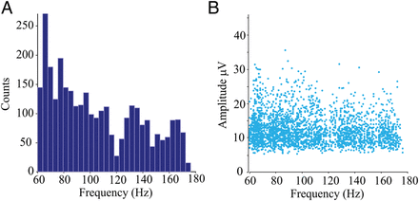
Figure 11. Slow high gamma bursts are more common than fast high gamma bursts, and carry the same amount of power. Group ...
Notes:
Figure 11. Slow high gamma bursts are more common than fast high gamma bursts, and carry the same amount of power. Group analyses of high gamma bursts from the superficial layers of all slices displaying significant theta to high gamma CFC. A total of 3066 bursts were identified across 13 slices. (A) The number of bursts as a function of frequency. The nadir at 120 Hz is due to notch filtering. There was a strong inverse relation between the incidence and frequency of burst events (R = −0.8, P = 3 × 10−8). (B) Amplitude of the burst events as a function of frequency. A weak yet significant inverse relationship was found (R = −0.1, P = 0).
Unless provided in the caption above, the following copyright applies to the content of this slide: © The Author 2013. Published by Oxford University Press. All rights reserved. For Permissions, please e-mail: journals.permissions@oup.com

