Slide 1
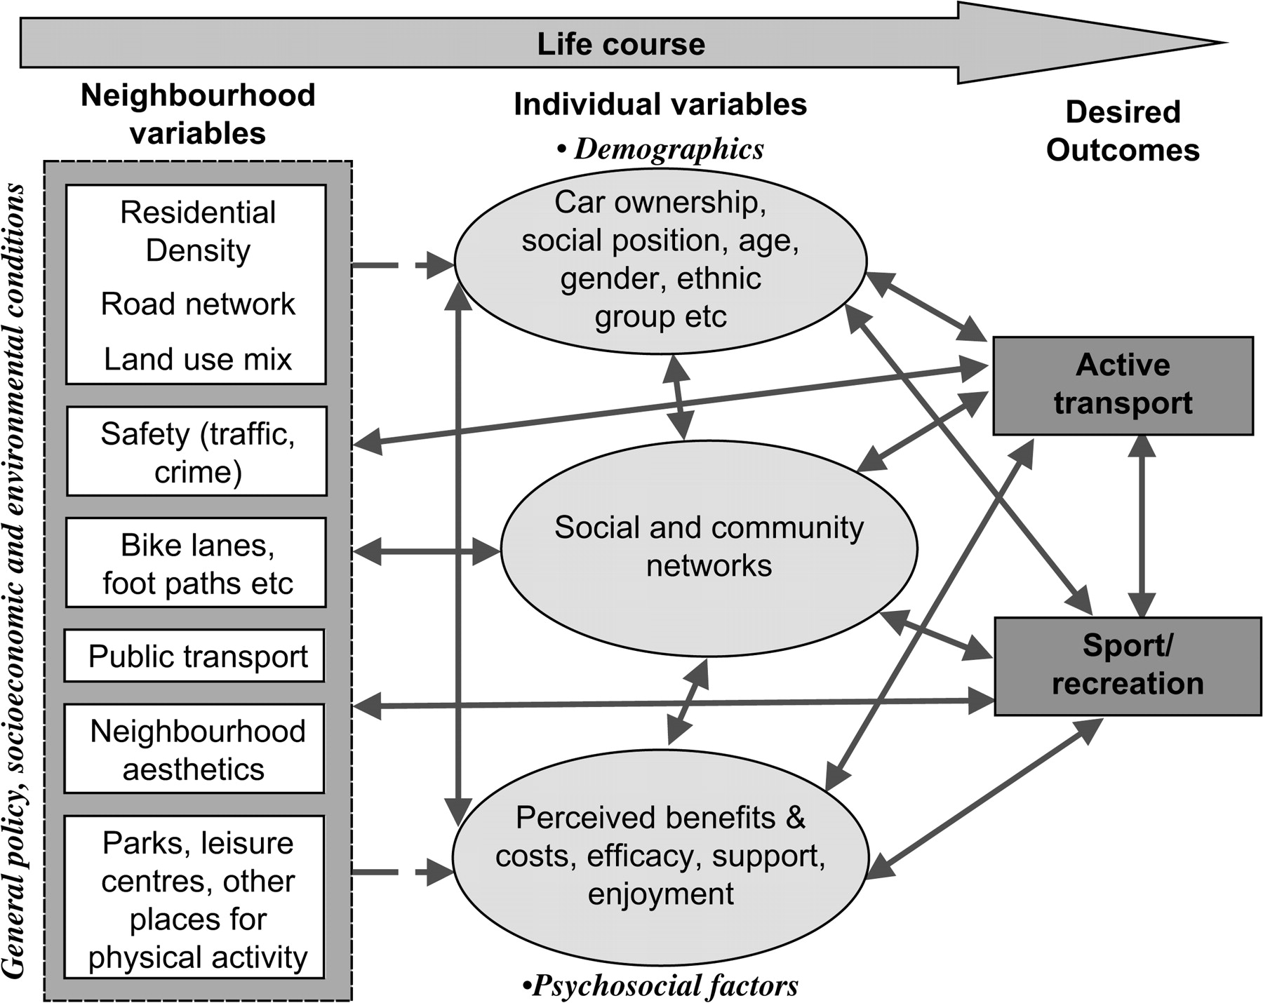
Fig. 1. ‘Oxford’ model of sporting behaviour [30].
Notes:
Fig. 1. ‘Oxford’ model of sporting behaviour [30].
Unless provided in the caption above, the following copyright applies to the content of this slide: © The Author 2007. Published by Oxford University Press. All rights reserved. For permissions, please email: journals.permissions@oxfordjournals.org

