Slide 1
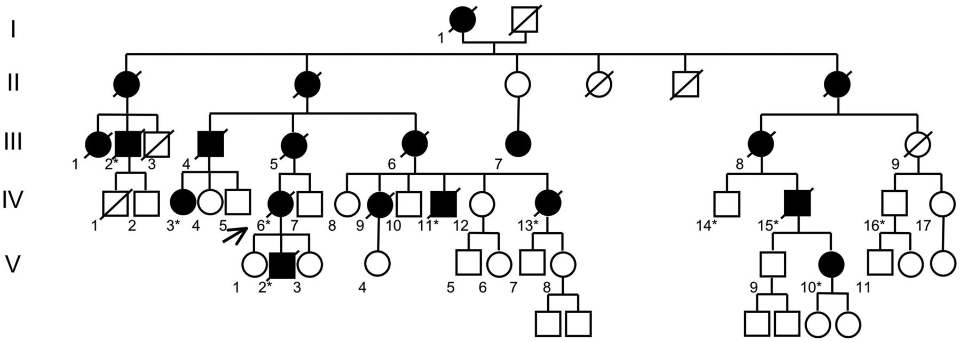
Figure 1 Pedigree of the first family. Solid symbols represent clinically affected individuals. Asterisk corresponds ...
Notes:
Figure 1 Pedigree of the first family. Solid symbols represent clinically affected individuals. Asterisk corresponds to individuals tested for segregation analysis.
Unless provided in the caption above, the following copyright applies to the content of this slide: © The Author (2014). Published by Oxford University Press on behalf of the Guarantors of Brain. All rights reserved. For Permissions, please email: journals.permissions@oup.com

Slide 2
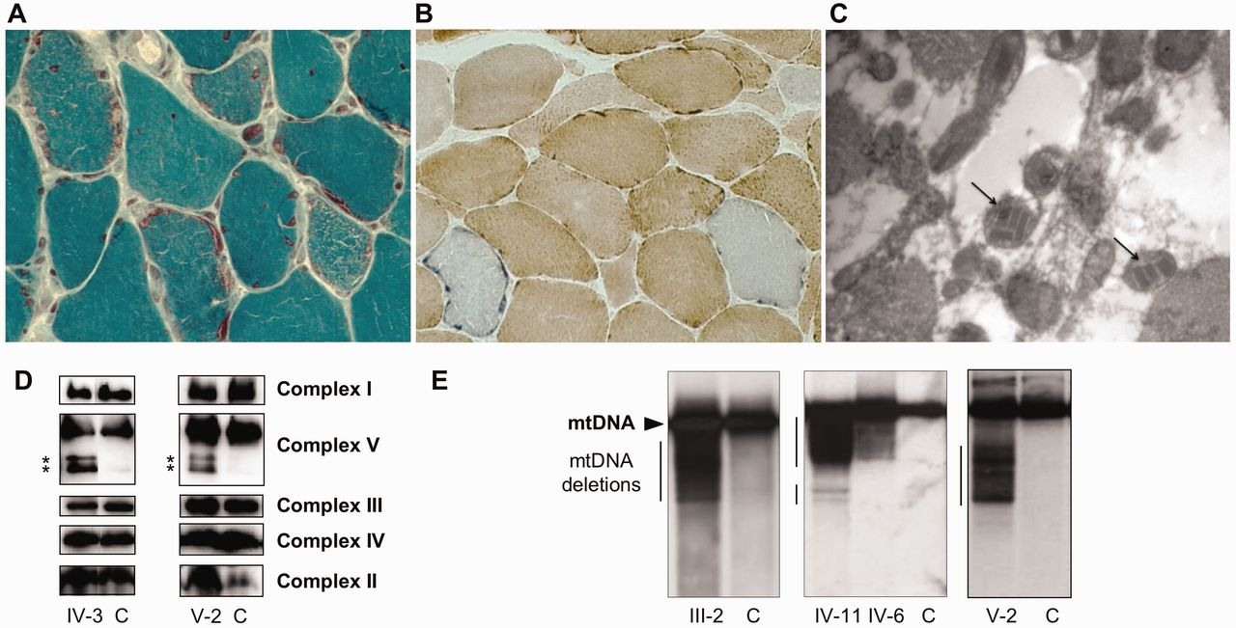
Figure 2 Muscle analysis. (A and B) Histopathology with Gomori modified trichrome (A) showing ragged-red fibres and ...
Notes:
Figure 2 Muscle analysis. (A and B) Histopathology with Gomori modified trichrome (A) showing ragged-red fibres and COX/SDH stain (B) revealing COX-deficient fibres, which are recognized by the prevalent blue stain. (C) Ultrastructure of skeletal muscle showing abnormal mitochondria with crystalloid inclusions (arrows). (D) Blue native electrophoresis of muscle homogenates. Equal amounts (15 µg) of mitochondrial protein from age-matched control subjects (C) and Patients IV-3 and V-2 were subjected to blue native-PAGE, blotted onto a PVDF membrane and then incubated with specific antibodies. Asterisk corresponds to supplementary bands detected by anti-complex V antibody. (E) Southern blot analysis revealing multiple deletion bands in addition to wild-type fragments in muscle of Patients III-2, IV-11, IV-6 and V-2. C = control individual.
Unless provided in the caption above, the following copyright applies to the content of this slide: © The Author (2014). Published by Oxford University Press on behalf of the Guarantors of Brain. All rights reserved. For Permissions, please email: journals.permissions@oup.com

Slide 3
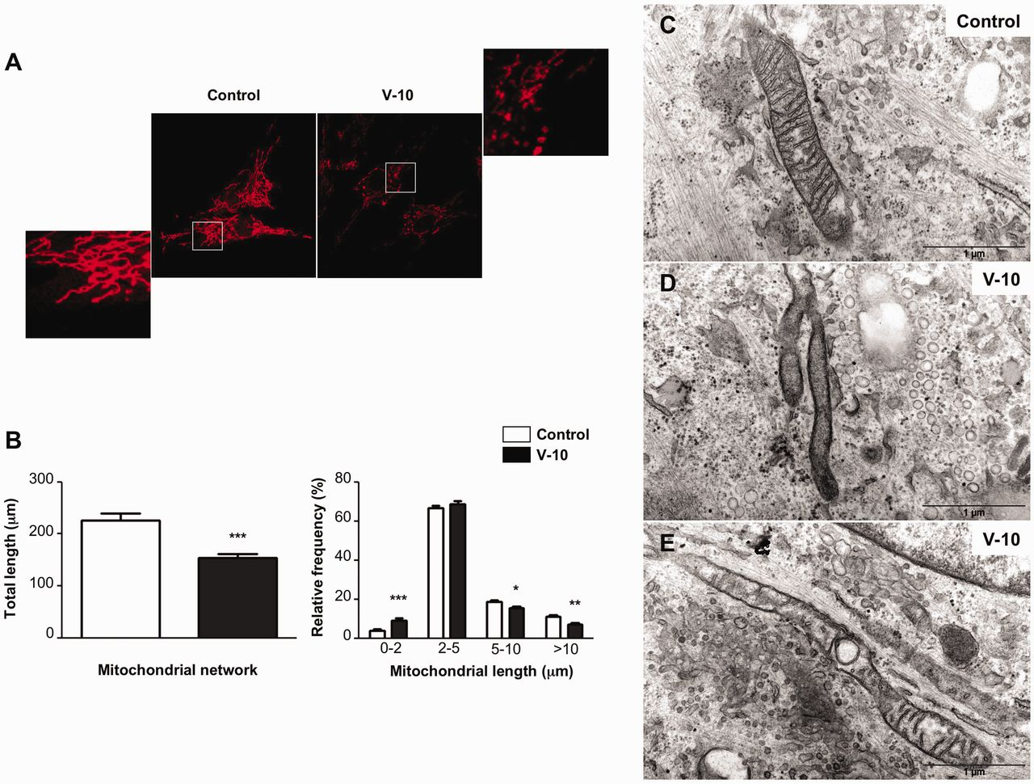
Figure 3 Mitochondrial fragmentation and ultrastructural alterations in skin fibroblasts. (A) Cells obtained from a ...
Notes:
Figure 3 Mitochondrial fragmentation and ultrastructural alterations in skin fibroblasts. (A) Cells obtained from a control (left) and Patient V-10 (right) were analysed by confocal microscopy using MitoTracker® Red. Enlarged details of the areas are indicated. (B) Mitochondrial phenotypes showed in A were quantified for 35 randomly-selected individual cells per each studied fibroblast cell line from two independent experiments. The data obtained were used to calculate the total length of the mitochondrial network per cell (left) and the average mitochondrial fragment length (right). Differences between the two cell lines were analysed by Student’s t-test: significant (*0.05 > P > 0.01), very significant (**0.01 > P > 0.001) or extremely significant (***P < 0.001). (C–E) Ultrastructural analysis of control (C) and Patient V-10 (D and E) fibroblasts. Scale bar = 1 µm (C) Representative image of mitochondria with typical normal aspect found in control cells. (D) Complete mitochondrial disorganization only found in patient cells. (E) Moderate disorganization mainly found in patient cells.
Unless provided in the caption above, the following copyright applies to the content of this slide: © The Author (2014). Published by Oxford University Press on behalf of the Guarantors of Brain. All rights reserved. For Permissions, please email: journals.permissions@oup.com

Slide 4
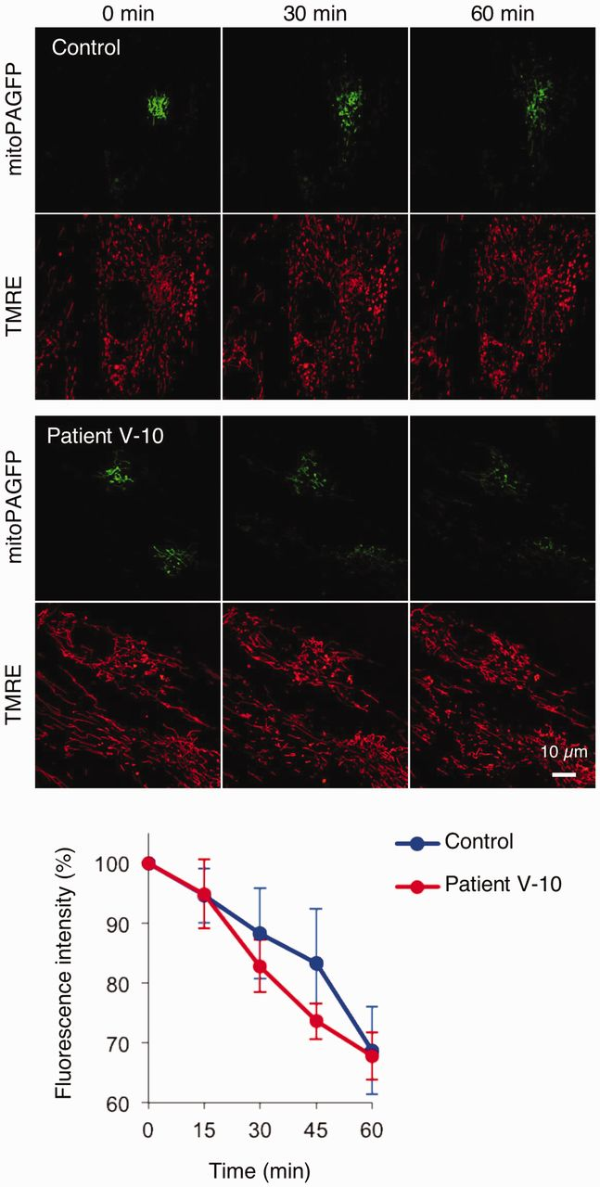
Figure 4 Fusion analysis in patient fibroblasts. Control and patient fibroblasts expressing mitochondria-targeted ...
Notes:
Figure 4 Fusion analysis in patient fibroblasts. Control and patient fibroblasts expressing mitochondria-targeted photoactivatable GFP (mitoPAGFP) were stained with 7 nM tetramethylrhodamine ethyl ester (TMRE). mitoPAGFP was photoactivated with a 405-nm laser in a small region of cells (30 × 30 pixels) at 0 min. Fibroblasts were observed with 15-min intervals for 60 min. Fluorescence intensity of mitoPAGFP was quantified using NIH ImageJ. Values represent the mean ± SEM (n = 7 for controls and n = 9 for patients).
Unless provided in the caption above, the following copyright applies to the content of this slide: © The Author (2014). Published by Oxford University Press on behalf of the Guarantors of Brain. All rights reserved. For Permissions, please email: journals.permissions@oup.com

Slide 5
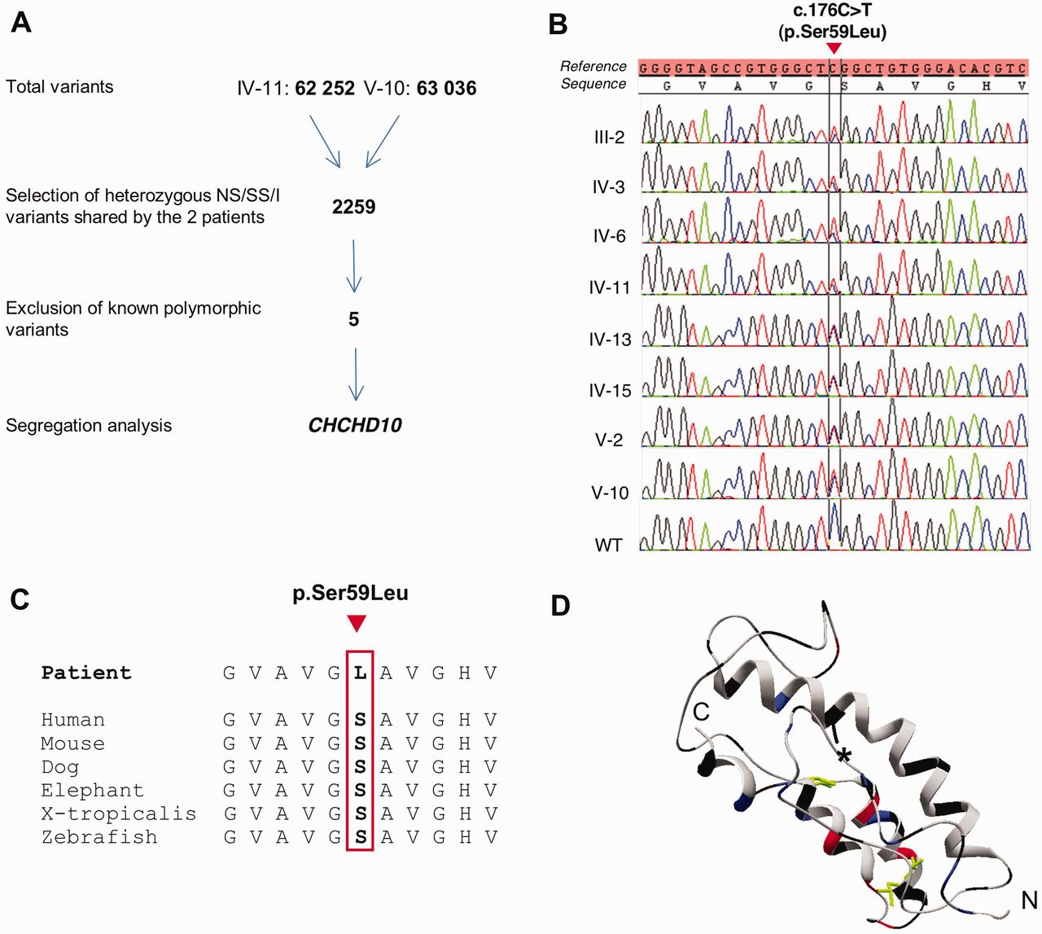
Figure 5 Identification of the p.Ser59Leu mutation in CHCHD10. (A) Schematic representation of the exome data analysis ...
Notes:
Figure 5 Identification of the p.Ser59Leu mutation in CHCHD10. (A) Schematic representation of the exome data analysis and data filtering. NS = non-synonymous variants; SS = splice site disrupting single nucleotide variants; I = exonic indels. Known variants correspond to single nucleotide polymorphisms and Indels already reported in dbSNP132, EVS (Exome Variant Server), HapMap, 1000 Genome databases and in-house control exomes. (B) CHCHD10 mutation sequences in Patients III-2, IV-3, IV-6, IV-11, IV-13, IV-15, V-2, V-10 and a control (WT). (C) Cross-species protein conservation of CHCHD10, flanking the altered amino acid p.Ser59. (D) Model of CHCHD10 based on the CHCHD5 structure (PDB ID: 2LQL). Aliphatic, polar, basic and acidic residues are respectively in grey, black, blue and red. Disulphide bonds are in green. The polar residue Ser59 is indicated with an asterisk.
Unless provided in the caption above, the following copyright applies to the content of this slide: © The Author (2014). Published by Oxford University Press on behalf of the Guarantors of Brain. All rights reserved. For Permissions, please email: journals.permissions@oup.com

Slide 6
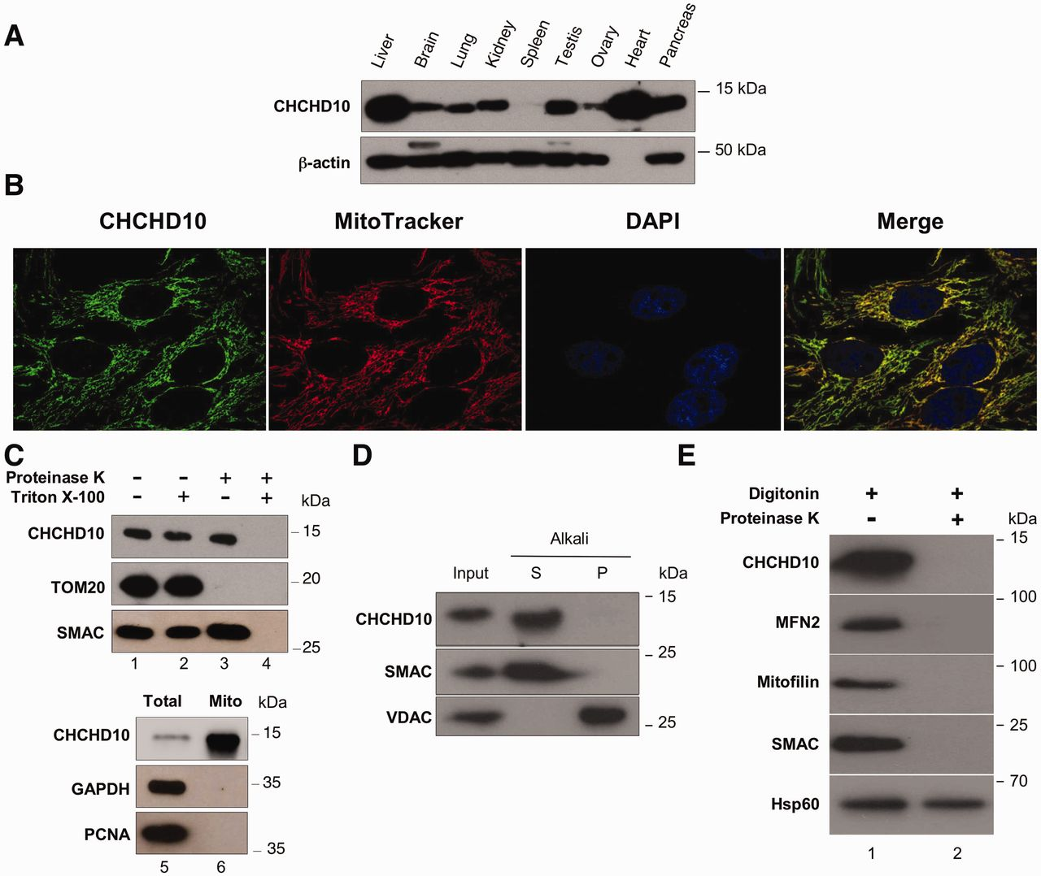
Figure 6 Mitochondrial localization of CHCHD10. (A) Expression of CHCHD10 protein in human tissues analysed by western ...
Notes:
Figure 6 Mitochondrial localization of CHCHD10. (A) Expression of CHCHD10 protein in human tissues analysed by western blotting using human multiple tissue blot. (B) Co-localization of endogenous CHCHD10 protein with MitoTracker® Red indicating mitochondrial localization for CHCHD10 in HeLa cells (overlay in yellow). (C) Intact isolated mitochondria from HeLa cells (lanes 1–4) were incubated in presence (+) or in absence (-) of proteinase K or Triton™ X-100 before analysis by immunoblotting using antibodies against CHCHD10, TOMM20 (mitochondrial outer membrane protein) or SMAC (mitochondrial intermembrane space protein). To verify the purity of isolated mitochondria, total lysates (lane 5) and mitochondrial isolates (lane 6) were analysed by immunoblotting using antibodies against CHCHD10, GAPDH (cytosolic protein) or PCNA (nuclear protein). (D) Intact mitochondria were prepared and subjected to Na2CO3 extraction. A soluble protein fraction (S) and an integral membrane protein fraction (P) were prepared. Samples of an extract from intact mitochondria (input), and the fraction of each extraction were subjected to western blot analysis. VDAC1 and SMAC were used to identify behaviours of well-defined mitochondrial proteins that are integral membrane protein and soluble, respectively. (E) Isolated mitochondria from HeLa cells (lanes 1 and 2) were incubated in presence (+) or in absence (-) of digitonin or proteinase K before analysis by immunoblotting using antibodies against CHCHD10, MFN2 (outer membrane protein), mitofilin (inner membrane protein mainly facing the intermembrane space, now known as IMMT), SMAC (intermembrane space protein) or Hsp60 (mitochondrial matrix protein, HSPD1).
Unless provided in the caption above, the following copyright applies to the content of this slide: © The Author (2014). Published by Oxford University Press on behalf of the Guarantors of Brain. All rights reserved. For Permissions, please email: journals.permissions@oup.com

Slide 7
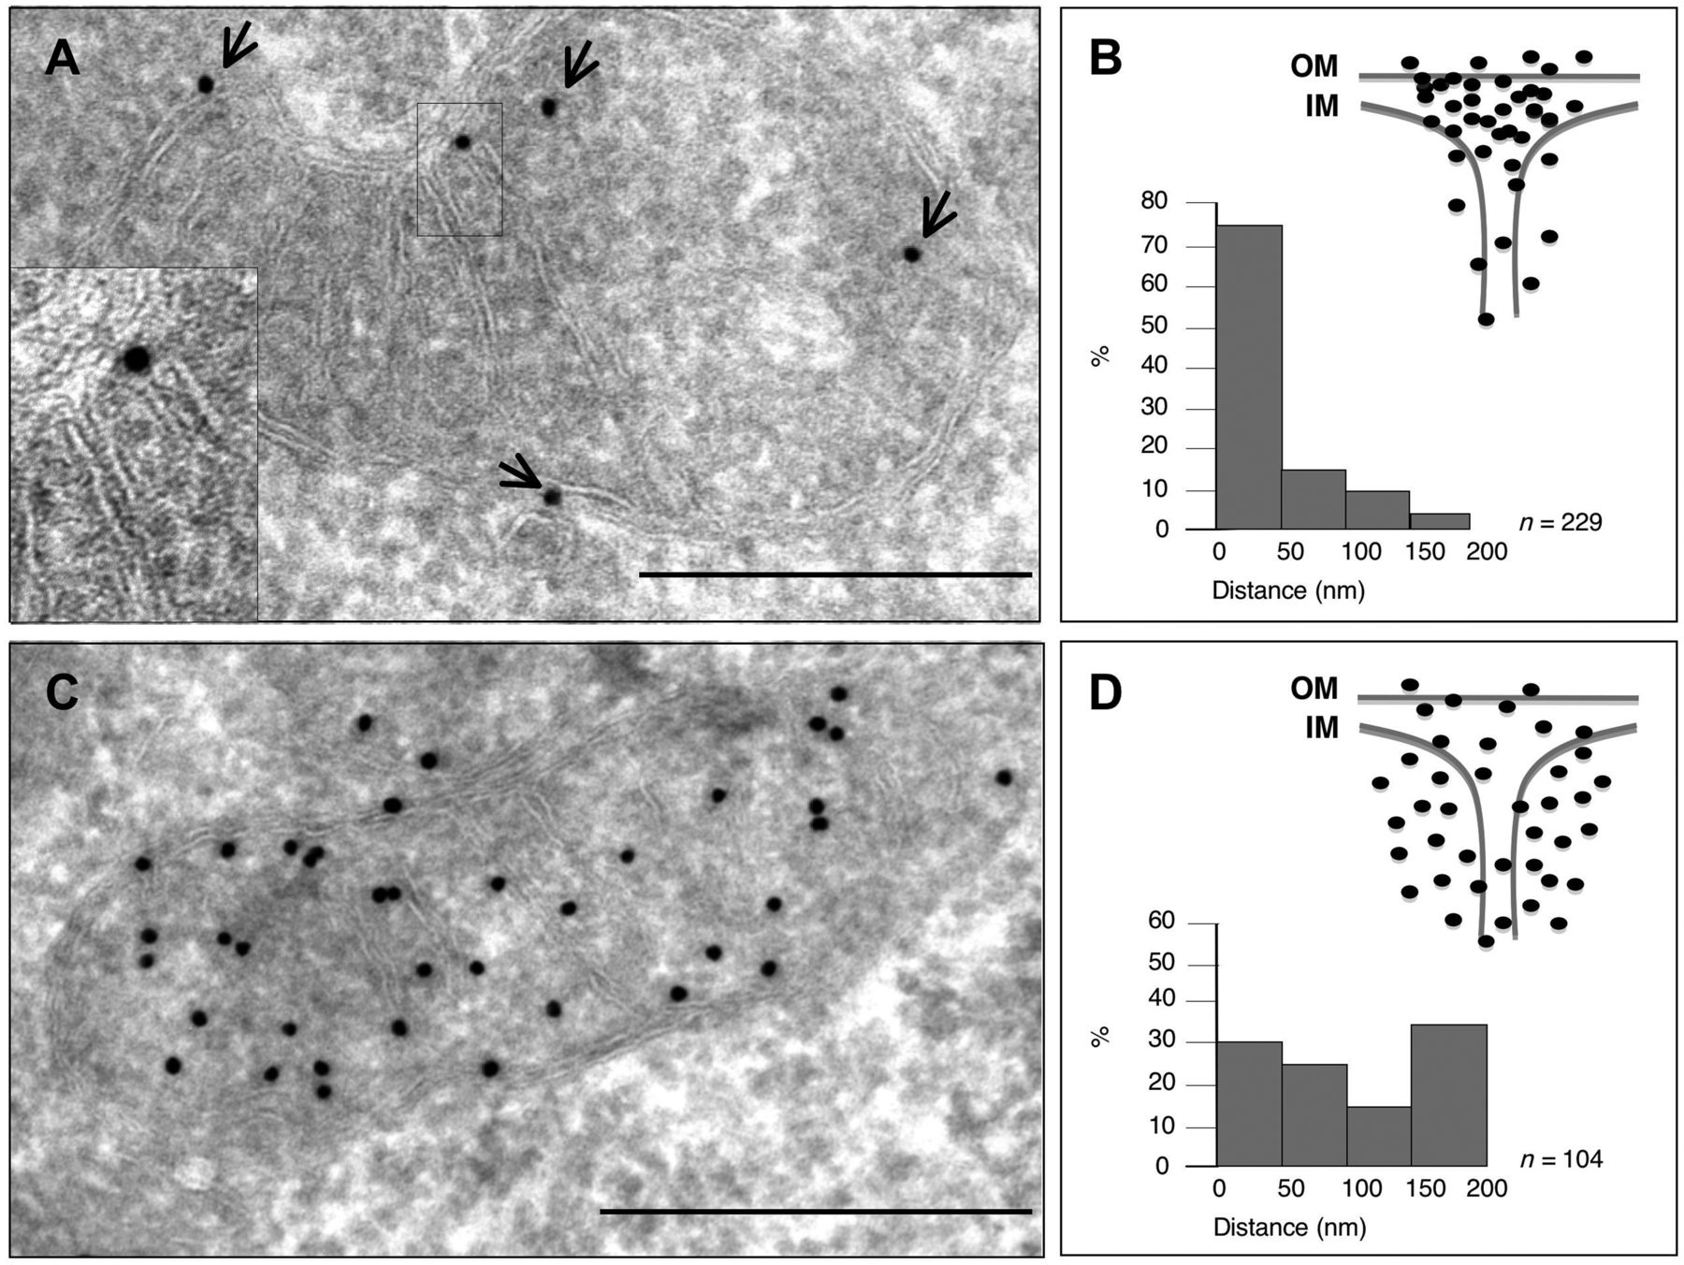
Figure 7 Submitochondrial localization of CHCHD10 using immunoelectron microscopy. (A) Immunogold labelling of CHCHD10 ...
Notes:
Figure 7 Submitochondrial localization of CHCHD10 using immunoelectron microscopy. (A) Immunogold labelling of CHCHD10 in HeLa cells. Arrows point to the position of gold particles. Enlarged details of the areas are indicated by black boxes. Scale bar = 500 nm. (B) Localization of the gold particles as determined by immunogold labelling of CHCHD10 plotted on a scheme representing a part of a mitochondrion. OM = outer membrane; IM = inner membrane. The histogram shows the fraction of gold particules within the indicated distance to the cristae junction. The histogram and the graphical representation are based on the same measured gold particle localizations. (C) Control immunogold labelling of Hsp60 in HeLa cells. Scale bar = 500 nm. (D) Localization of the gold particles as determined by immunogold labelling of Hsp60 plotted on a scheme representing a part of a mitochondrion. The histogram shows the fraction of gold particles within the indicated distance to the cristae junction. The histogram and the graphical representation are based on the same measured gold particle localizations.
Unless provided in the caption above, the following copyright applies to the content of this slide: © The Author (2014). Published by Oxford University Press on behalf of the Guarantors of Brain. All rights reserved. For Permissions, please email: journals.permissions@oup.com

Slide 8
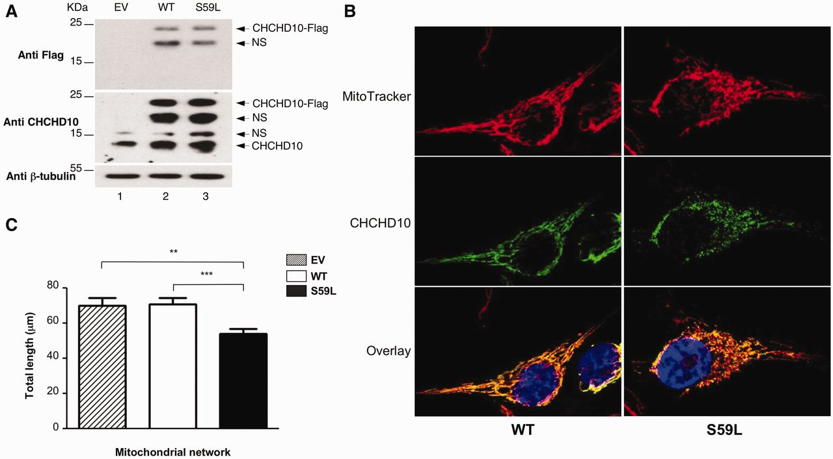
Figure 8 Effects of overexpression of wild-type and pathogenic CHCHD10 alleles on mitochondrial network in HeLa cells. ...
Notes:
Figure 8 Effects of overexpression of wild-type and pathogenic CHCHD10 alleles on mitochondrial network in HeLa cells. Transfections were performed with empty vector (EV) or vectors encoding either wild-type CHCHD10-Flag (WT) or mutant CHCHD10-Flag (S59L). (A) Western blot of HeLa cell extracts using antibodies against Flag, CHCHD10 or β-tubulin. NS = non-specific. (B) Analysis of DAPI (blue), MitoTracker® (red) staining and CHCHD10 (green) immunolabelling by fluorescence microscopy in HeLa cells transfected with either wild-type CHCHD10-Flag (WT) or mutant CHCHD10-Flag (S59L). (C) Quantification of mitochondrial phenotypes of cells transfected with empty vector (EV) or vectors encoding either wild-type CHCHD10-Flag (WT) or mutant CHCHD10-Flag (S59L). Thirty-five randomly-selected individual cells per each transfection were analysed from two independent experiments. The data obtained were used to calculate the total length of the mitochondrial network per cell. Differences between the two cell lines were analysed by Student’s t-test: very significant (**: 0.01 > P > 0.001) or extremely significant (***: P < 0.001).
Unless provided in the caption above, the following copyright applies to the content of this slide: © The Author (2014). Published by Oxford University Press on behalf of the Guarantors of Brain. All rights reserved. For Permissions, please email: journals.permissions@oup.com

Slide 9
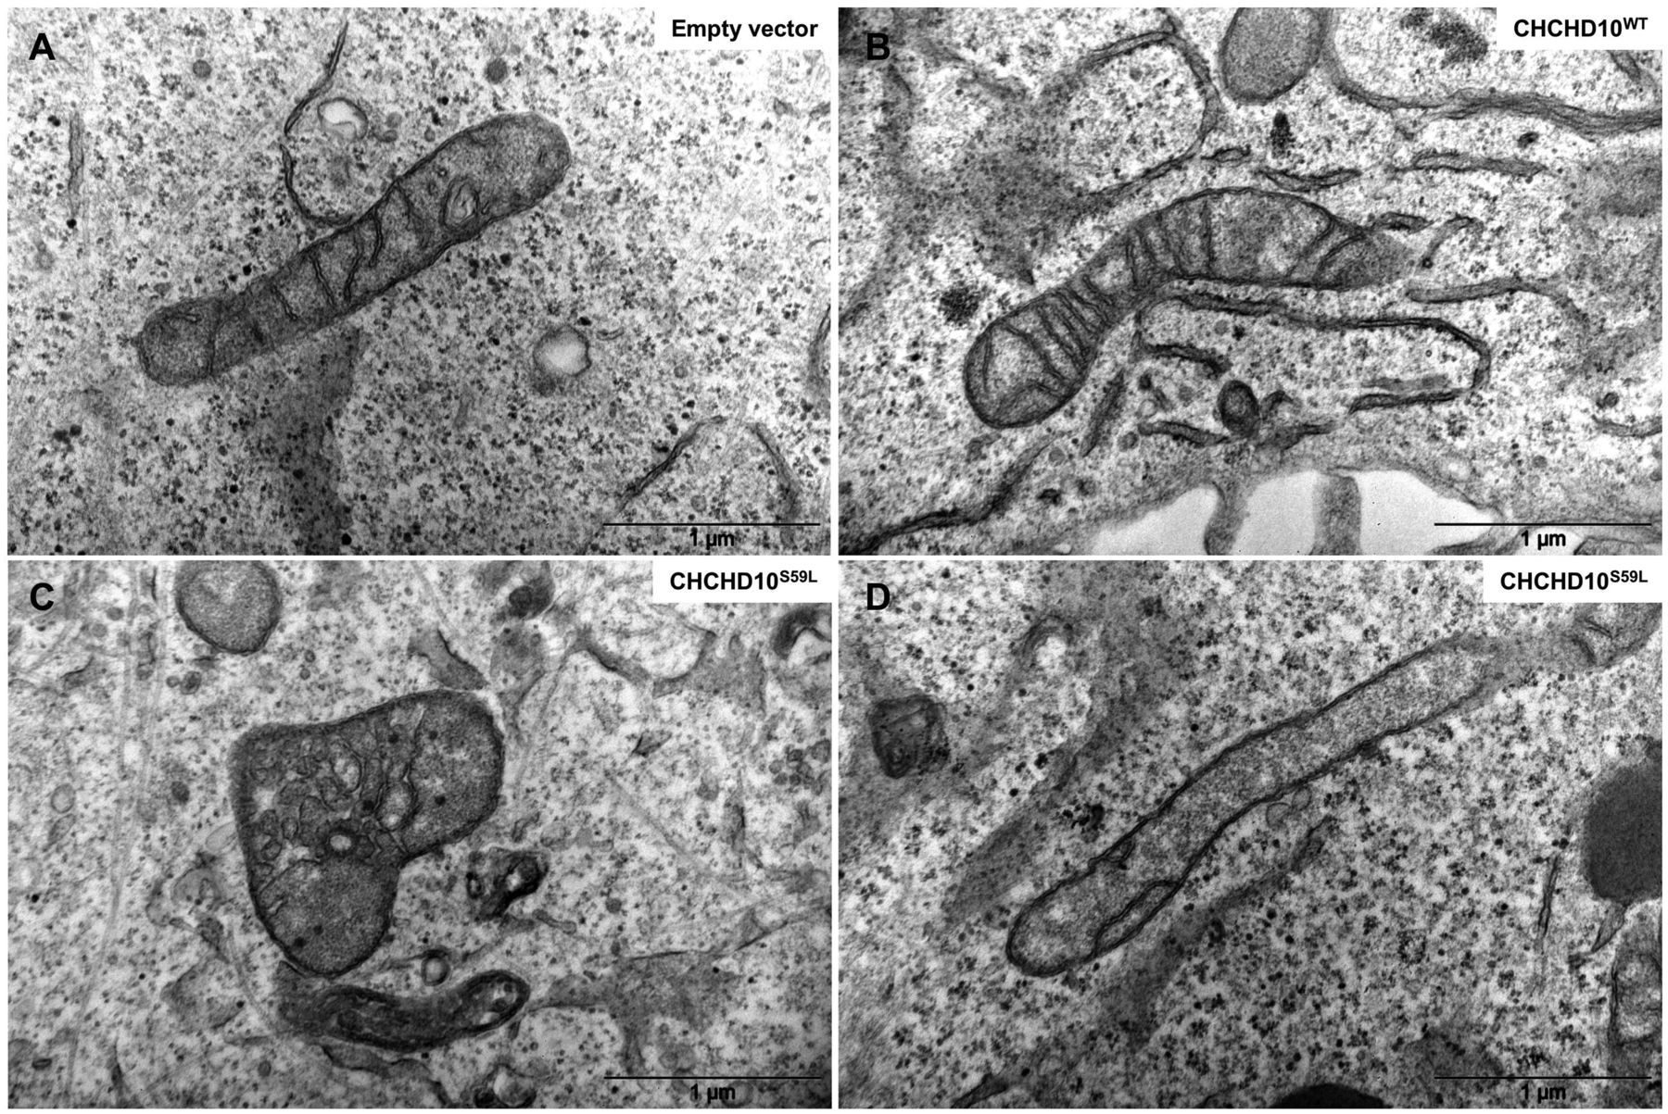
Figure 9 Effects of overexpression of wild-type and pathogenic CHCHD10 alleles on cristae morphology in HeLa cells. ...
Notes:
Figure 9 Effects of overexpression of wild-type and pathogenic CHCHD10 alleles on cristae morphology in HeLa cells. (A) Representative image of mitochondria after transfection with the empty vector. (B) Representative image of mitochondria in cells overexpressing the wild-type CHCHD10 allele. (C and D) Representative images of mitochondria in cells overexpressing the mutant CHCHD10 allele (S59L).
Unless provided in the caption above, the following copyright applies to the content of this slide: © The Author (2014). Published by Oxford University Press on behalf of the Guarantors of Brain. All rights reserved. For Permissions, please email: journals.permissions@oup.com

