Slide 1
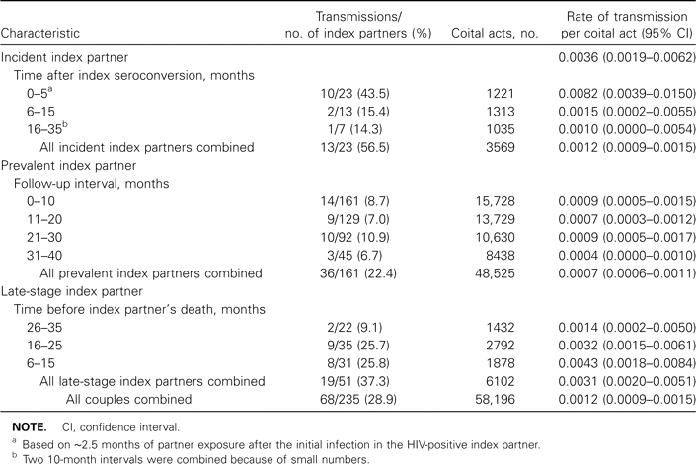
Table 1 The proportion of HIV transmissions and HIV transmission rates per coital act by, stage of infection and by ...
Notes:
Table 1 The proportion of HIV transmissions and HIV transmission rates per coital act by, stage of infection and by interval of follow-up, Rakai, Uganda, 1994–1999
Unless provided in the caption above, the following copyright applies to the content of this slide: © 2005 by the Infectious Diseases Society of America

Slide 2
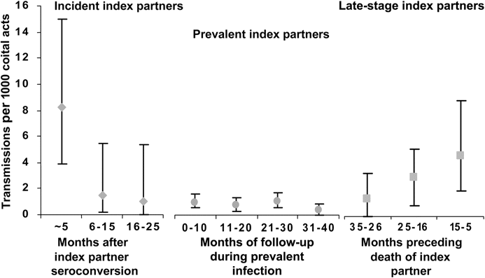
Figure 1 HIV transmission per coital act, and 95% confidence intervals, by follow-up interval
Notes:
Figure 1 HIV transmission per coital act, and 95% confidence intervals, by follow-up interval
Unless provided in the caption above, the following copyright applies to the content of this slide: © 2005 by the Infectious Diseases Society of America

Slide 3
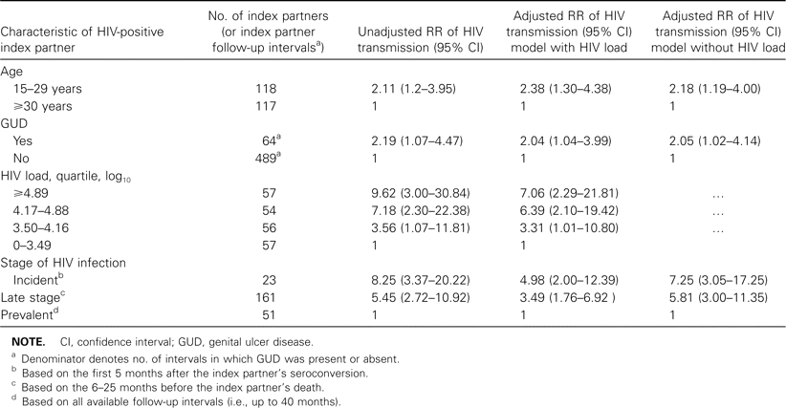
Table 2 Unadjusted and Poisson-adjusted rate ratios (RRs) of HIV transmission per coital act, Rakai, Uganda, ...
Notes:
Table 2 Unadjusted and Poisson-adjusted rate ratios (RRs) of HIV transmission per coital act, Rakai, Uganda, 1994–1999
Unless provided in the caption above, the following copyright applies to the content of this slide: © 2005 by the Infectious Diseases Society of America

