Slide 1
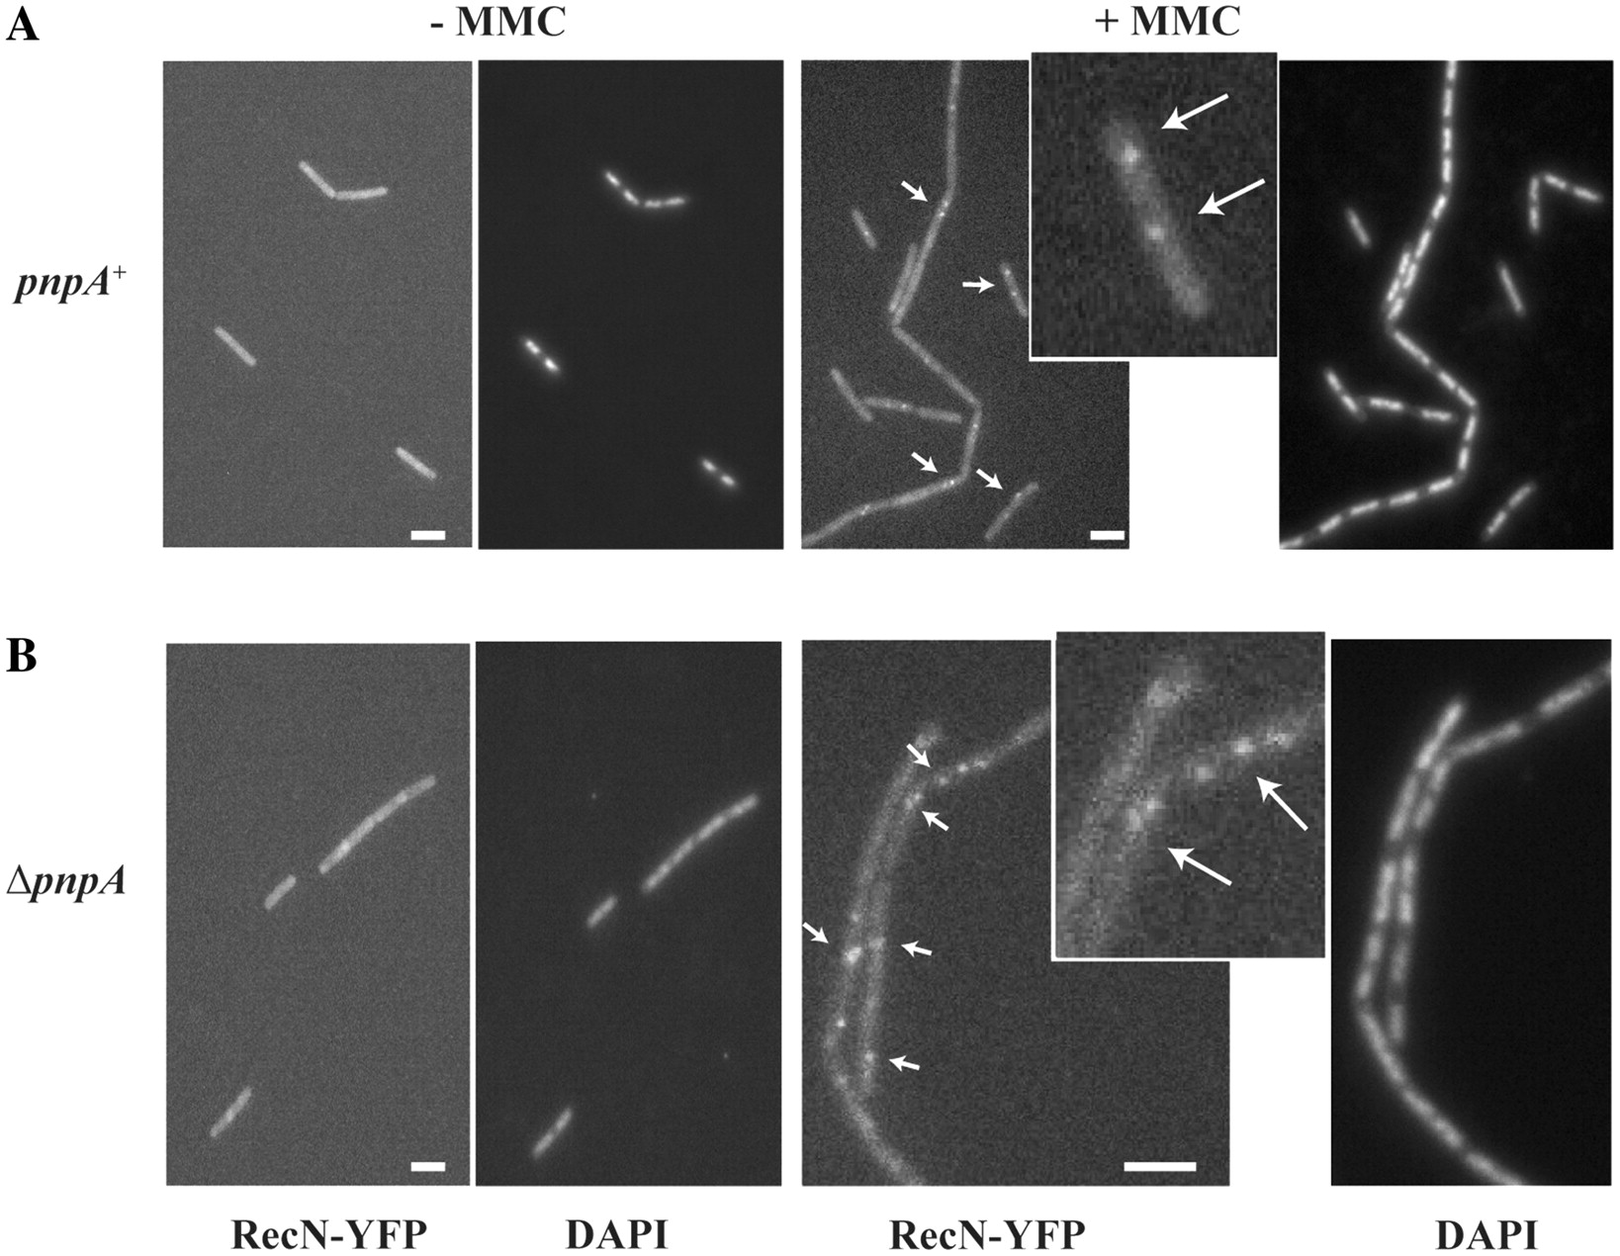
Figure 1. PNPase promotes assembly of a discrete RecN focus per nucleoid. Bacillus subtilis BG1089 ...
Notes:
Figure 1. PNPase promotes assembly of a discrete RecN focus per nucleoid. Bacillus subtilis BG1089 (pnpA+recN:yfp) (A) and BG1091 (ΔpnpA recN:yfp) (B) exponentially growing cells were treated (+MMC, 50 ng/ml) or not (−MMC) for 30 min. The nucleoids were stained with DAPI and the intracellular distribution of RecN:YFP and DAPI was observed by fluorescence microscopy. The arrows indicate some MMC-induced foci. White bars 2 µm.
Unless provided in the caption above, the following copyright applies to the content of this slide: © The Author(s) 2011. Published by Oxford University Press.This is an Open Access article distributed under the terms of the Creative Commons Attribution Non-Commercial License (http://creativecommons.org/licenses/by-nc/3.0), which permits unrestricted non-commercial use, distribution, and reproduction in any medium, provided the original work is properly cited.

Slide 2
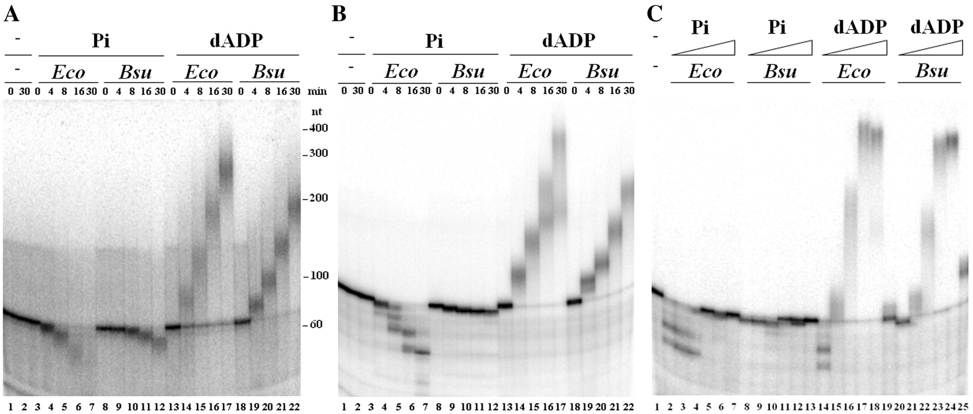
Figure 2. Mn²⁺-dependent phosphorolysis, template-independent synthesis of ssDNA catalyzed by PNPase, and ...
Notes:
Figure 2. Mn2+-dependent phosphorolysis, template-independent synthesis of ssDNA catalyzed by PNPase, and inhibition of phosphorolysis and polymerization by high concentrations of Pi and dADP, respectively. (A) [32P]-oligo-A56 or (B) [32P]-oligo-A (0.25 nM each) was incubated with PNPaseEco (Eco) or PNPaseBsu (Bsu) (10 nM) in buffer A containing either Pi (10 µM) or dADP (100 µM) for the time indicated (min) at 26°C. (C) The 5′-end labeled [32P]-oligo-A (0.25 nM) was incubated with PNPaseEco or PNPaseBsu (10 nM each) in buffer A containing increasing Pi (0, 0.001, 0.01, 0.1, 1 and 10 mM) or dADP (0, 0.001, 0.01, 0.1, 1 and 10 mM) concentrations for 30 min at 26°C. The reaction products were fractionated by 6% dPAGE.
Unless provided in the caption above, the following copyright applies to the content of this slide: © The Author(s) 2011. Published by Oxford University Press.This is an Open Access article distributed under the terms of the Creative Commons Attribution Non-Commercial License (http://creativecommons.org/licenses/by-nc/3.0), which permits unrestricted non-commercial use, distribution, and reproduction in any medium, provided the original work is properly cited.

Slide 3
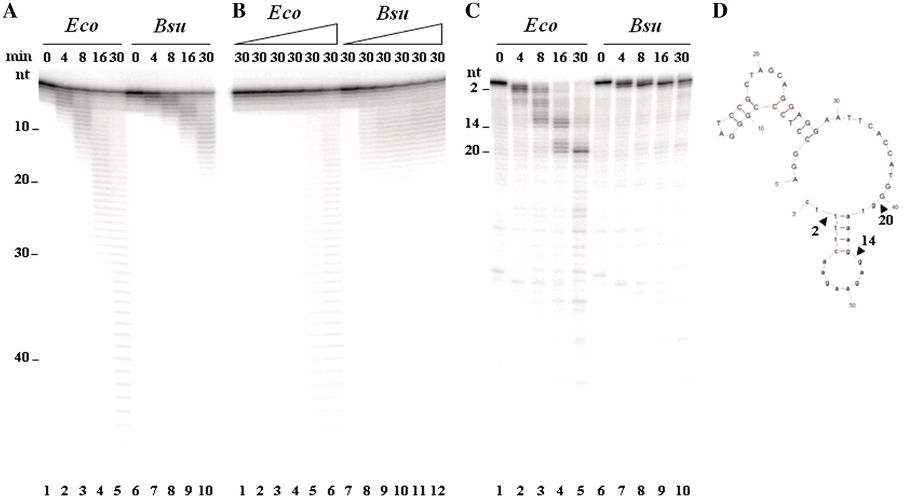
Figure 3. Phosphorolysis of different ssDNA probes by PNPase_{Eco} (Eco) and PNPase_{Bsu} (Bsu). The ...
Notes:
Figure 3. Phosphorolysis of different ssDNA probes by PNPaseEco (Eco) and PNPaseBsu (Bsu). The 5′-end labeled [32P]-oligo-A56 (panels A and B) or [32P]-oligo-A (C) (0.25 nM each) was incubated with PNPaseEco or PNPase in buffer A with 10 µM Pi for the times indicated at 26°C. PNPase was 10 nM (panels A and C) or at increasing concentrations (0, 0.5, 1, 2.5, 5 and 10 nM) (B). The reaction products were fractionated by 12% dPAGE. (D) M-FOLD-predicted secondary structure of oligo-A. The arrowheads denote the pausing sites.
Unless provided in the caption above, the following copyright applies to the content of this slide: © The Author(s) 2011. Published by Oxford University Press.This is an Open Access article distributed under the terms of the Creative Commons Attribution Non-Commercial License (http://creativecommons.org/licenses/by-nc/3.0), which permits unrestricted non-commercial use, distribution, and reproduction in any medium, provided the original work is properly cited.

Slide 4
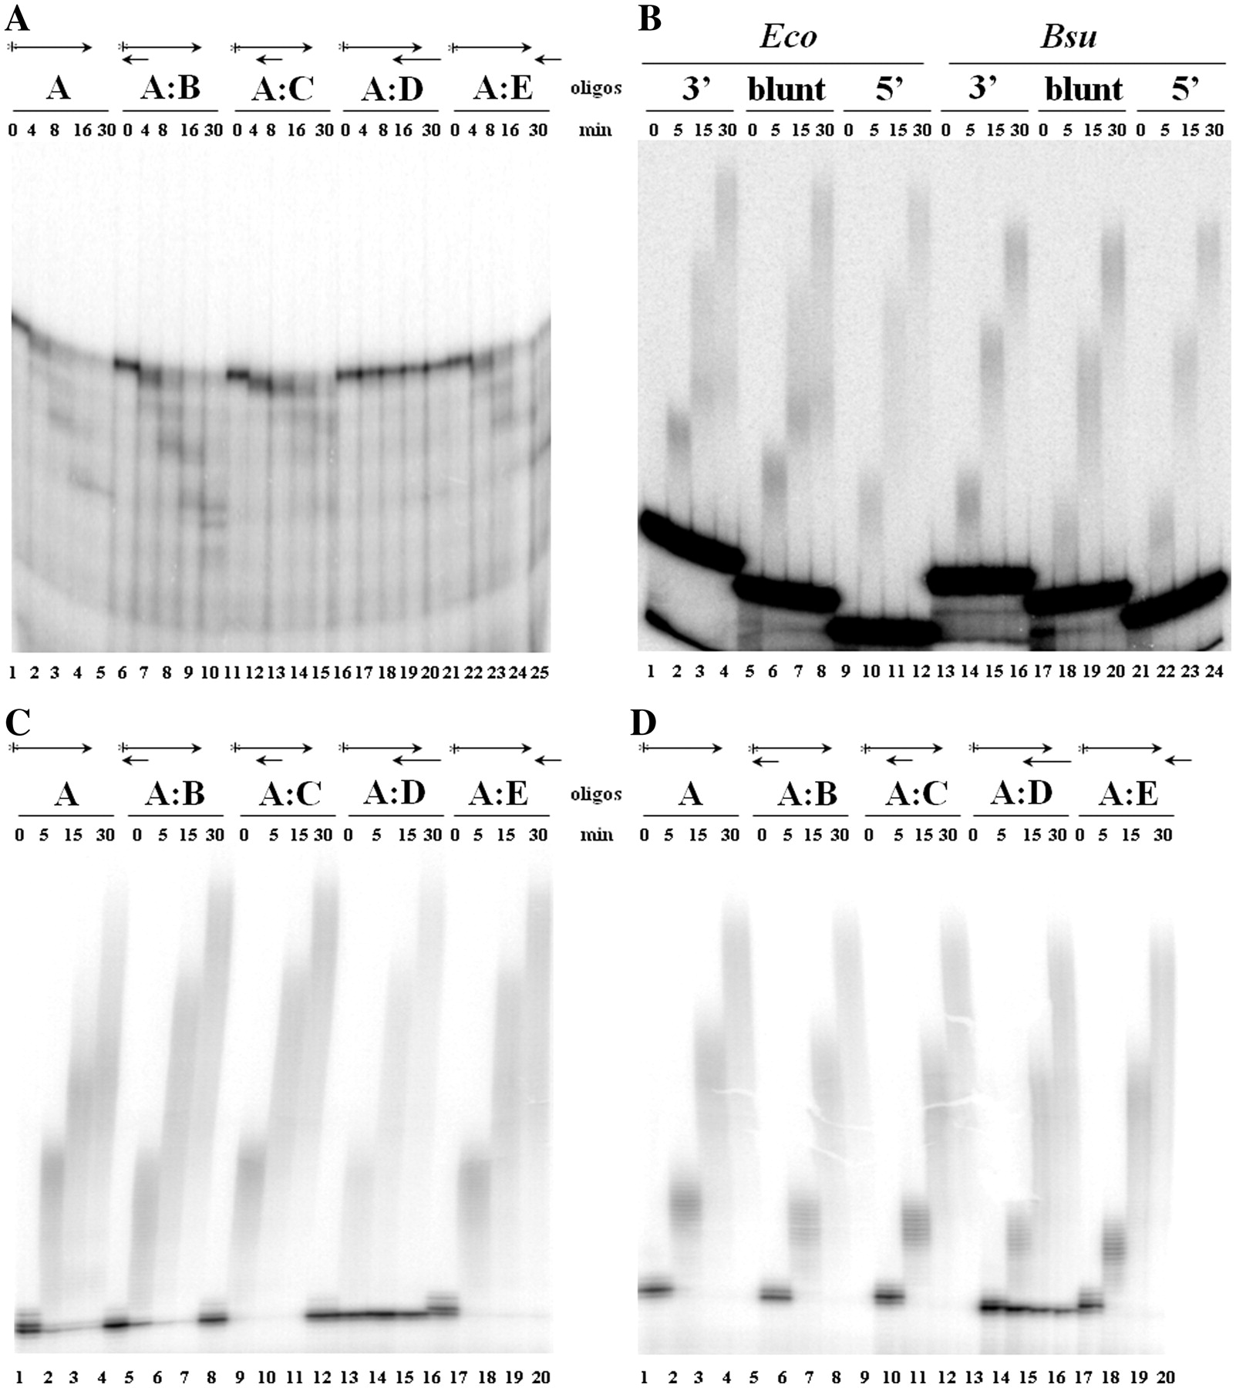
Figure 4. PNPase catalyzed phosphorolysis of and template-independent polymerization on duplex DNA with different ...
Notes:
Figure 4. PNPase catalyzed phosphorolysis of and template-independent polymerization on duplex DNA with different 3′-ends. The 5′-end labeled [32P]-oligo-A (0.25 nM) alone, annealed with non-labeled complementary oligo-B (A:B), -C (A:C) or -D (A:D) (0.50 nM each), or together with oligo-E as depicted on top of panels A, C and D were incubated with 10 nM PNPaseEco in buffer A containing 10 µM Pi (A) with 10 nM PNPaseEco (C) or PNPaseBsu (D) in buffer A containing dADP (100 µM) for the time indicated at 26°C. (B) 5′-end labeled [32P]-dsDNA with either 3′-protruding, blunt or 5′-protruding end was incubated with 10 nM PNPaseEco (Eco) or PNPaseBsu (Bsu) in buffer A containing 100 µM dADP for the time indicated at 26°C. Samples were separated as in Figure 2.
Unless provided in the caption above, the following copyright applies to the content of this slide: © The Author(s) 2011. Published by Oxford University Press.This is an Open Access article distributed under the terms of the Creative Commons Attribution Non-Commercial License (http://creativecommons.org/licenses/by-nc/3.0), which permits unrestricted non-commercial use, distribution, and reproduction in any medium, provided the original work is properly cited.

Slide 5
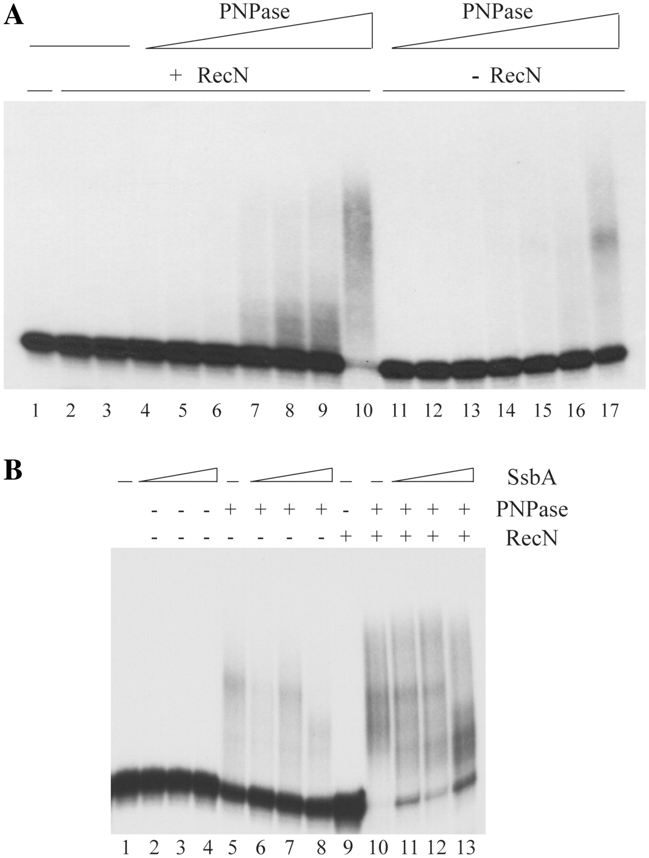
Figure 5. PNPase activities are modulated by RecN and SsbA. (A) The 5′-end labeled [³²P]-oligo-F ssDNA ...
Notes:
Figure 5. PNPase activities are modulated by RecN and SsbA. (A) The 5′-end labeled [32P]-oligo-F ssDNA (0.25 nM) was pre-incubated with or without RecN (10 nM), as indicated, in buffer A containing 1 mM dATP and 100 µM dADP for 5 min. Then increasing concentrations of PNPaseBsu (7, 12, 25, 50, 100, 200 500, 750 or 1000 pM) were added and the reaction incubated for 30 min at 26°C. In lane 2, dADP was omitted. (B) The 5′-end labeled [32P]-oligo-F (0.25 nM) was pre-incubated with or without RecN (10 nM) for 5 min in buffer A containing 1 mM dATP at 26°C. PNPaseBsu (0.5 nM) and 100 µM dADP was added, 5 min later different SsbA concentrations (0.75, 1.5 and 3 nM) were added and the reaction incubated for 20 min at 26°C. + and −, denote the presence or absence of the indicated protein. Samples were separated as in Figure 2.
Unless provided in the caption above, the following copyright applies to the content of this slide: © The Author(s) 2011. Published by Oxford University Press.This is an Open Access article distributed under the terms of the Creative Commons Attribution Non-Commercial License (http://creativecommons.org/licenses/by-nc/3.0), which permits unrestricted non-commercial use, distribution, and reproduction in any medium, provided the original work is properly cited.

Slide 6
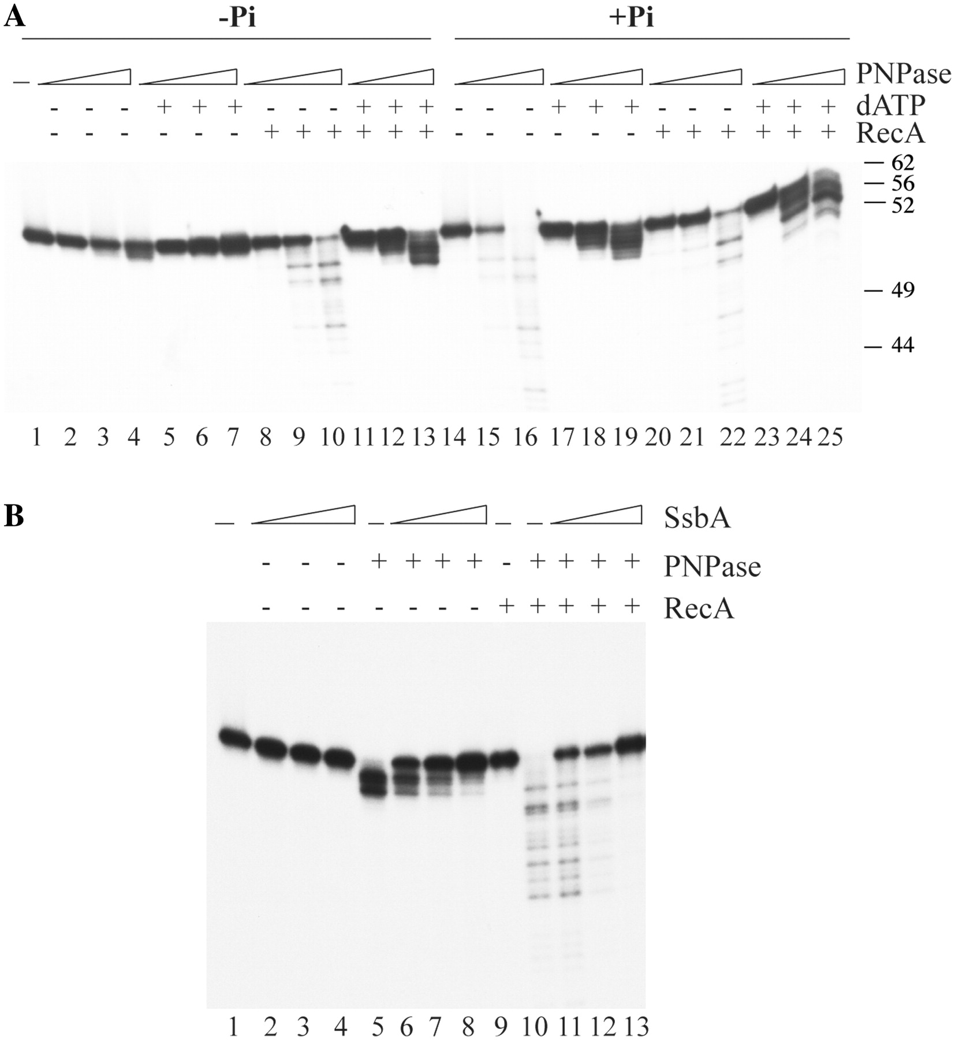
Figure 6. PNPase activities are modulated by RecA and SsbA. (A) The 5′-end labeled [³²P]-oligo-F ssDNA ...
Notes:
Figure 6. PNPase activities are modulated by RecA and SsbA. (A) The 5′-end labeled [32P]-oligo-F ssDNA (0.25 nM) was pre-incubated with or without RecA (20 nM) in buffer A containing or not Pi (10 µM) and/or dATP (1 mM), as indicated, for 5 min at 26°C. Then increasing concentrations of PNPaseBsu (0.1, 0.5 and 1 nM) were added and the reaction incubated for 30 min. + and −, denote the presence or absence of the indicated protein. (B) The 5′-end labeled [32P]-oligo-F (0.25 nM) was pre-incubated with different SsbA concentrations (0.75, 1.5 and 3 nM) in buffer A for 5 min. Then RecA (20 nM) was added and 5 min later PNPaseBsu (10 nM) and the reaction incubated for 30 min at 26°C. + and −, denote the presence or absence of the indicated protein. Samples were separated as in Figure 2.
Unless provided in the caption above, the following copyright applies to the content of this slide: © The Author(s) 2011. Published by Oxford University Press.This is an Open Access article distributed under the terms of the Creative Commons Attribution Non-Commercial License (http://creativecommons.org/licenses/by-nc/3.0), which permits unrestricted non-commercial use, distribution, and reproduction in any medium, provided the original work is properly cited.

Slide 7
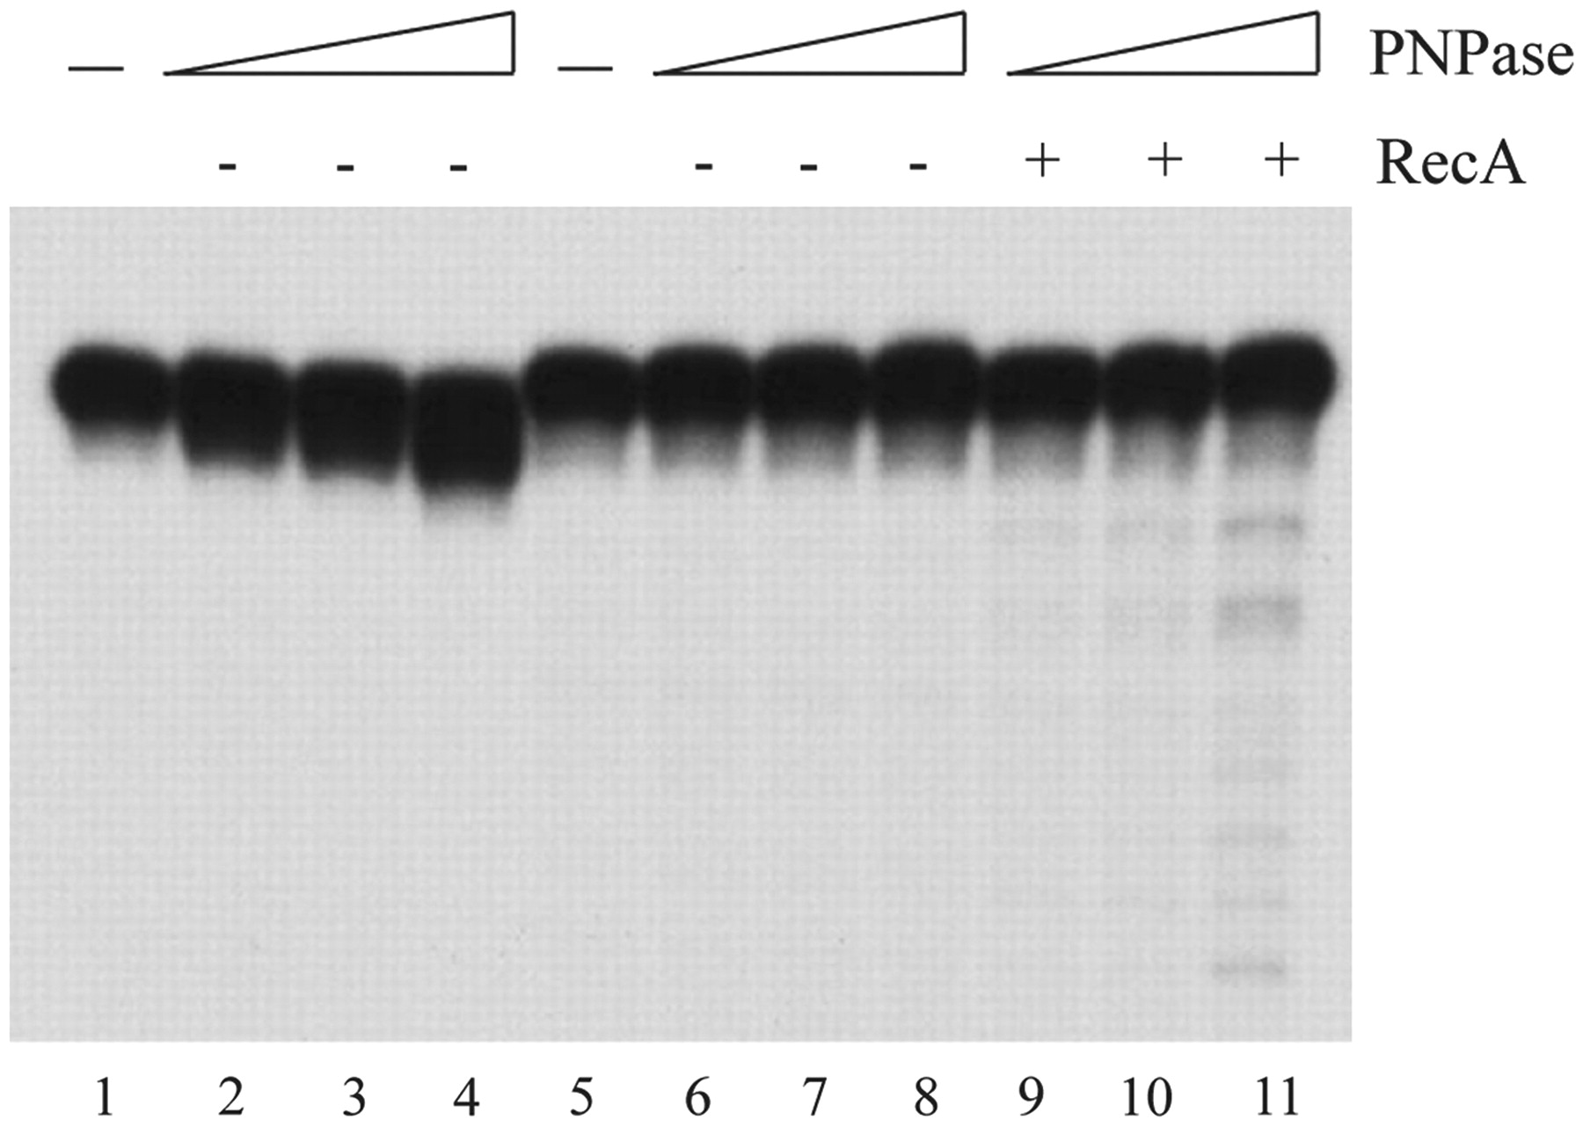
Figure 7. RecA stimulates phosphorolysis of ssDNA with a 3′-ddTMP. The 60-nt long 5′-end labeled ...
Notes:
Figure 7. RecA stimulates phosphorolysis of ssDNA with a 3′-ddTMP. The 60-nt long 5′-end labeled [32P]-oligo-F (0.25 nM, lanes 1–4) or the 61-nt long 5′-end labeled [32P]-oligo-F’ with a ddTMP at the 3′-end (0.25 nM, lanes 5–11) was pre-incubated with PNPaseBsu (0.5, 1 and 5 nM) for 5 min in buffer A. Then RecA (20 nM) was added and the reaction incubated for 30 min. The samples were separated as in Figure 2.
Unless provided in the caption above, the following copyright applies to the content of this slide: © The Author(s) 2011. Published by Oxford University Press.This is an Open Access article distributed under the terms of the Creative Commons Attribution Non-Commercial License (http://creativecommons.org/licenses/by-nc/3.0), which permits unrestricted non-commercial use, distribution, and reproduction in any medium, provided the original work is properly cited.

