Slide 1
Fig. 1. Representative fruit types in the Solanaceae. (A) Drupe of Duckeodendron cestroides Kuhlm. (base of ...
Notes:
Fig. 1. Representative fruit types in the Solanaceae. (A) Drupe of Duckeodendron cestroides Kuhlm. (base of fruit in upper right corner). (B) Capsules of Schizanthus pinnatus Ruiz and Pav. (C) Capsules of Sessea corymbiflora Taylor and Phillips. Scale bars=1 cm.
Unless provided in the caption above, the following copyright applies to the content of this slide:

Slide 2
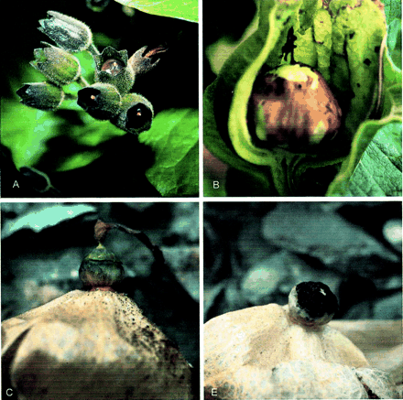
Fig. 2. Representative fruit types in the Solanaceae: dehiscent non‐capsular fruit (pyxidia). (A) ...
Notes:
Fig. 2. Representative fruit types in the Solanaceae: dehiscent non‐capsular fruit (pyxidia). (A) Physochlaina orientalis, unripe fruit. (B) Anisodus luridus, unripe fruit with the calyx cut away. (C) Przewalskia tangutica Maxim., ripe fruit showing line of dehiscence. (D) Fruit after dehiscence showing seeds (photographs courtesy of M Gilbert).
Unless provided in the caption above, the following copyright applies to the content of this slide:

Slide 3
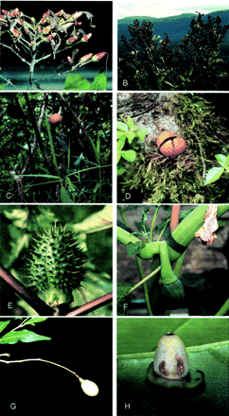
Fig. 3. Representative fruit types in the Solanaceae. (A) Nicotiana tomentosa Ruiz and Pav., unripe capsules. ...
Notes:
Fig. 3. Representative fruit types in the Solanaceae. (A) Nicotiana tomentosa Ruiz and Pav., unripe capsules. (B) Nicotiana tabacum L., ripe and opened capsules. (C) Brunfelsia lactea, bright orange ripe fruit on plant. (D) Brunfelsia lactea, fruit showing dehiscence and dry seeds. (E) Datura stramonium L., unripe spiny capsule. (F) Datura ceratocaula Ortega, unripe green capsule. (G) Cestrum fragile Francey, white ripe berry. (H) Markea panamense Standl., ripe juicy berry.
Unless provided in the caption above, the following copyright applies to the content of this slide:

Slide 4
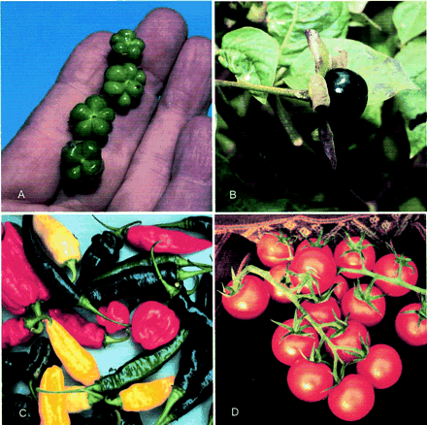
Fig. 4. Representative fruit types in the Solanaceae. (A) Immature mericarps of Nolana carnosa (Lindl.) Miers ...
Notes:
Fig. 4. Representative fruit types in the Solanaceae. (A) Immature mericarps of Nolana carnosa (Lindl.) Miers ex Dunal (photograph courtesy of MO Dillon). (B) Atropa belladonna L., ripe fleshy berry. (C) Capsicum fruits. (D) Solanum lycopersicum L., ripe berries.
Unless provided in the caption above, the following copyright applies to the content of this slide:

Slide 5
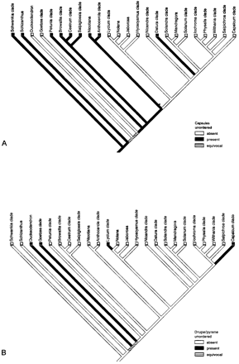
Fig. 5. (A) Distribution of capsular fruits on the framework molecular phylogeny. (B) Distribution of drupes ...
Notes:
Fig. 5. (A) Distribution of capsular fruits on the framework molecular phylogeny. (B) Distribution of drupes and pyrenes on the framework molecular phylogeny.
Unless provided in the caption above, the following copyright applies to the content of this slide:

Slide 6
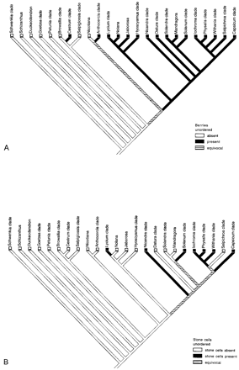
Fig. 6. (A) Distribution of berries on the framework molecular phylogeny. (B) Distribution of berries with ...
Notes:
Fig. 6. (A) Distribution of berries on the framework molecular phylogeny. (B) Distribution of berries with stone cells on the framework molecular phylogeny.
Unless provided in the caption above, the following copyright applies to the content of this slide:

Slide 7
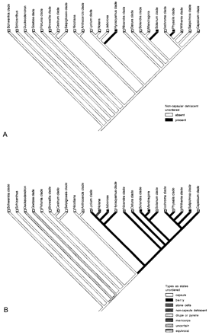
Fig. 7. (A) Distribution of non‐capsular dehiscent fruit on the framework molecular phylogeny. (B) Fruit ...
Notes:
Fig. 7. (A) Distribution of non‐capsular dehiscent fruit on the framework molecular phylogeny. (B) Fruit types coded as states (see legend in figure) and mapped onto the framework molecular phylogeny.
Unless provided in the caption above, the following copyright applies to the content of this slide:

Slide 8
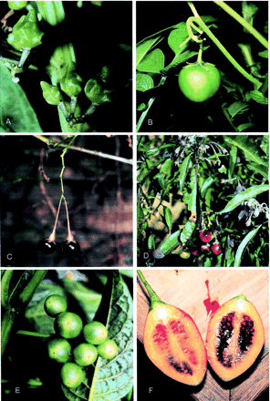
Fig. 8. Fruit types in Solanum. (A) S. angustialatum Bitter (potato clade) green berry with unusual verrucose ...
Notes:
Fig. 8. Fruit types in Solanum. (A) S. angustialatum Bitter (potato clade) green berry with unusual verrucose pericarp. (B) S. tuberosum L. (potato clade), green relatively hard berry. (C) S. jasminoides Paxt. (Dulcamaroid clade), shiny black juicy berry. (D) S. nitidum Ruiz and Pav. (Dulcamaroid clade), berries turing from green to bright red at maturity. (E) Solanum sp. (Morelloid clade), green unripe fruits showing darker lines at locule margins. (F) S. betaceum Cav. (Cyphomandra clade) brightly colored berry with juicy pulp.
Unless provided in the caption above, the following copyright applies to the content of this slide:

Slide 9
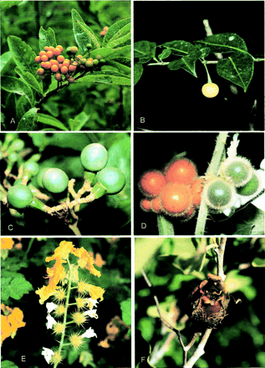
Fig. 9. Fruit types in Solanum. (A) S. argentinum Bitter and Lillo (Geminata clade), bright orange berry (B) ...
Notes:
Fig. 9. Fruit types in Solanum. (A) S. argentinum Bitter and Lillo (Geminata clade), bright orange berry (B) S. falconense S. Knapp (Geminata clade) yellow soft berry. (C) S. oblongifolium Dunal (Geminata clade) woody, hard green berry. (D) S. candidum Dunal (spiny solanum clade) bright orange densely pubescent berries. (E) S. rostratum Dunal (spiny solanum clade), spiny accrescent calyces holding dry berries. (F) S. tridynamum Dunal (spiny solanum clade), splash cup or censer fruit (dry berry).
Unless provided in the caption above, the following copyright applies to the content of this slide:

