Slide 1
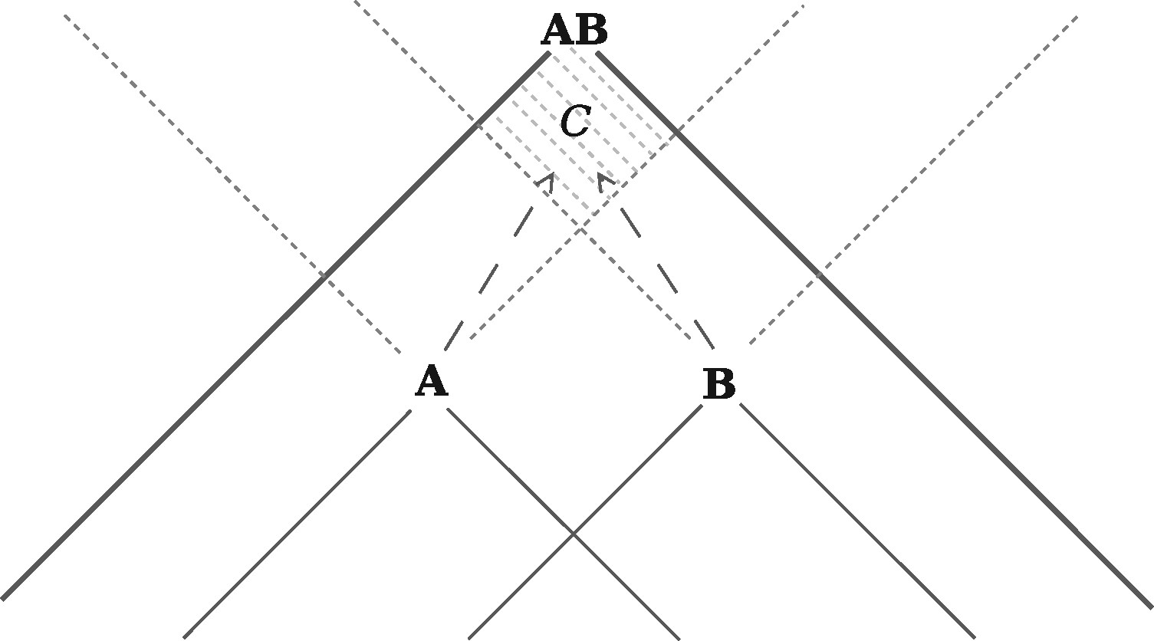
Figure 1. A conceivable explanation of the observation of the result of a joint experimental outcome, AB, that posits ...
Notes:
Figure 1. A conceivable explanation of the observation of the result of a joint experimental outcome, AB, that posits local (conspiratorial) influences interacting within region C. This figure is adapted from (Cuffaro [2017]).
Unless provided in the caption above, the following copyright applies to the content of this slide: © The Author 2017. Published by Oxford University Press on behalf of British Society for the Philosophy of Science. All rights reserved. For Permissions, please email: journals.permissions@oup.comThis article is published and distributed under the terms of the Oxford University Press, Standard Journals Publication Model (https://academic.oup.com/journals/pages/about_us/legal/notices)

