Slide 1
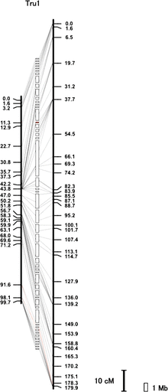
FIG. 1.— Fugu chromosome 1. Vertical black bars represent the male (left) or female (right) genetic map. Distances in ...
Notes:
FIG. 1.— Fugu chromosome 1. Vertical black bars represent the male (left) or female (right) genetic map. Distances in centimorgans (cM) are indicated below (Kosambi mapping function). White boxes sandwiched between the male and female maps represent scaffolds. Scaffolds containing centromeric repeat sequences are labeled in red (see supplementary fig. S2 and Supplementary Data, Supplementary Material online). Transverse lines link the location of each marker on the genetic maps with its corresponding anchored scaffolds. Red transverse lines indicate disagreement between the position of marker on the genetic map and that of physical map. Such differences could be due to a misassembly in the reference sequence or an actual polymorphism between the mapping population and the sequenced individual. Gap between scaffolds is arbitrary because the actual distance between scaffolds is unknown. Scale bars represent 10 cM and 1 Mb. Details of all chromosomes and anchored scaffolds are shown in supplementary figure S2 and Supplementary Data, Supplementary Material online.
Unless provided in the caption above, the following copyright applies to the content of this slide: © The Author(s) 2011. Published by Oxford University Press on behalf of the Society for Molecular Biology and Evolution.This is an Open Access article distributed under the terms of the Creative Commons Attribution Non-Commercial License (http://creativecommons.org/licenses/by-nc/2.5), which permits unrestricted non-commercial use, distribution, and reproduction in any medium, provided the original work is properly cited.

Slide 2
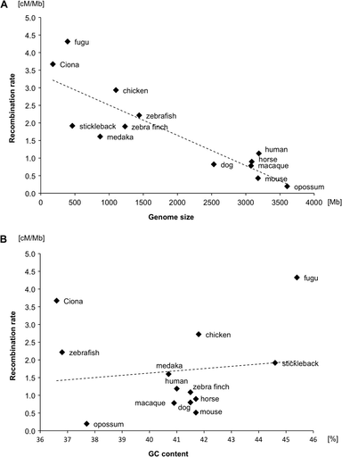
FIG. 2.— Scatter plots of genome sizes and GC contents versus recombination rates of chordates. (A) Genome sizes ...
Notes:
FIG. 2.— Scatter plots of genome sizes and GC contents versus recombination rates of chordates. (A) Genome sizes versus recombination rates. The golden path length for each species in Ensembl was regarded as their genome size (http://www.fugu-sg.org/ and http://www.ensembl.org/). (B) GC contents versus recombination rates. Details of genome sizes, genetic map sizes, and GC contents are listed in supplementary table S7, Supplementary Material online. The correlation between genome size and recombination rate was tested using Pearson’s product moment correlation coefficient as implemented in the “cor.test” function in R (http://www.r-project.org/).
Unless provided in the caption above, the following copyright applies to the content of this slide: © The Author(s) 2011. Published by Oxford University Press on behalf of the Society for Molecular Biology and Evolution.This is an Open Access article distributed under the terms of the Creative Commons Attribution Non-Commercial License (http://creativecommons.org/licenses/by-nc/2.5), which permits unrestricted non-commercial use, distribution, and reproduction in any medium, provided the original work is properly cited.

Slide 3
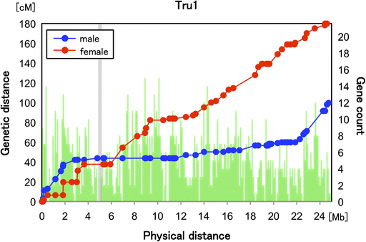
FIG. 3.— Genetic distance and physical distance in chromosome 1 for fugu. The positions in cM for female (red) and ...
Notes:
FIG. 3.— Genetic distance and physical distance in chromosome 1 for fugu. The positions in cM for female (red) and male (blue) are plotted against the physical position on Tru1. The number of predicted genes within bins of 10 kb is shown as green bars. A shadow box indicates the centromeric region where centromeric repeats were mapped (supplementary table S11, Supplementary Material online).
Unless provided in the caption above, the following copyright applies to the content of this slide: © The Author(s) 2011. Published by Oxford University Press on behalf of the Society for Molecular Biology and Evolution.This is an Open Access article distributed under the terms of the Creative Commons Attribution Non-Commercial License (http://creativecommons.org/licenses/by-nc/2.5), which permits unrestricted non-commercial use, distribution, and reproduction in any medium, provided the original work is properly cited.

Slide 4
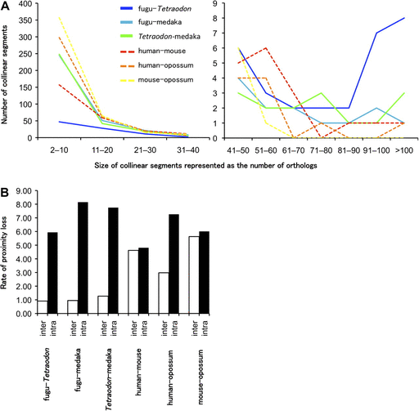
FIG. 6.— Retention of gene collinearity and loss of gene proximity in teleosts and mammals. (A) Number of collinear ...
Notes:
FIG. 6.— Retention of gene collinearity and loss of gene proximity in teleosts and mammals. (A) Number of collinear segments between the species pairs. Lines indicate the number of collinear segments observed in each segment size: solid blue lines represent fugu and Tetraodon; solid cyan line fugu and medaka; solid green line Tetraodon and medaka; dashed red line human and mouse; dashed orange line human and opossum; dashed yellow line mouse and opossum. (B) Rate of proximity loss between pairs of species after normalization with divergence times estimated by the fossil record. The rates of proximity loss caused by interchromosomal and intrachromosomal rearrangements are shown as white and black bars, respectively.
Unless provided in the caption above, the following copyright applies to the content of this slide: © The Author(s) 2011. Published by Oxford University Press on behalf of the Society for Molecular Biology and Evolution.This is an Open Access article distributed under the terms of the Creative Commons Attribution Non-Commercial License (http://creativecommons.org/licenses/by-nc/2.5), which permits unrestricted non-commercial use, distribution, and reproduction in any medium, provided the original work is properly cited.

Slide 5
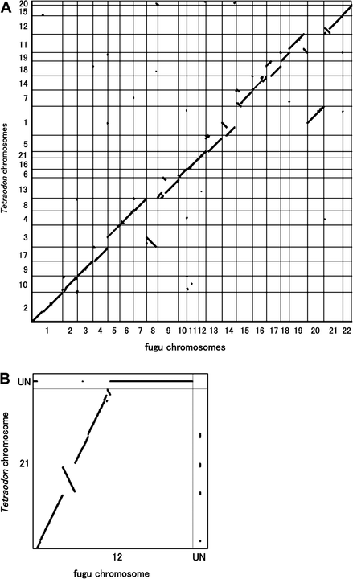
FIG. 5.— Retention of synteny and gene order between fugu and Tetraodon chromosomes. The gene order of orthologs on ...
Notes:
FIG. 5.— Retention of synteny and gene order between fugu and Tetraodon chromosomes. The gene order of orthologs on fugu chromosomes and Tetraodon chromosomes are plotted. Orthologs with unknown gene order in the two species were excluded from the plot. (A) Genome-wide comparison of fugu with Tetraodon. The orthologs on all fugu chromosomes and all Tetraodon chromosomes are plotted. The greater length of the axis reflects the greater number of mapped genes. (B) Comparison of Tru12 with Tni21. The figures for other syntenic chromosome pairs are shown in supplementary figure S8, Supplementary Material online. Orthologs whose orders are not known in one of the two species are plotted in the row and column labeled as UN.
Unless provided in the caption above, the following copyright applies to the content of this slide: © The Author(s) 2011. Published by Oxford University Press on behalf of the Society for Molecular Biology and Evolution.This is an Open Access article distributed under the terms of the Creative Commons Attribution Non-Commercial License (http://creativecommons.org/licenses/by-nc/2.5), which permits unrestricted non-commercial use, distribution, and reproduction in any medium, provided the original work is properly cited.

Slide 6
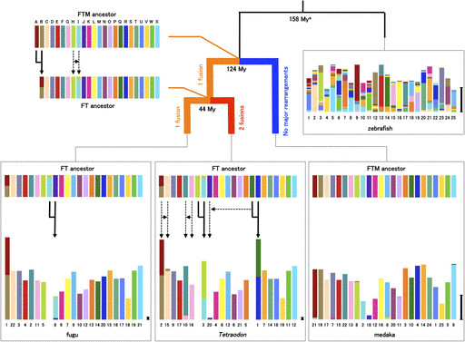
FIG. 4.— Reconstruction of the ancestral karyotypes of fugu–Tetraodon and pufferfishes–medaka. The proto-chromosomes ...
Notes:
FIG. 4.— Reconstruction of the ancestral karyotypes of fugu–Tetraodon and pufferfishes–medaka. The proto-chromosomes of the pufferfishes–medaka (FTM ancestor) are labeled from A to X. Genome segments in each species are color coded according to the chromosome of the FTM ancestor. The length of chromosomes of extant species indicates the number of orthologs. Scale bar represents 20 orthologs. Gene order within chromosomes of each species has been reallocated to highlight orthologous relationships with gene on the FTM ancestral chromosomes. Major chromosomal fusions are indicated as solid arrows. Major translocations of the genome segments containing at least four orthologs are displayed as dotted arrows. FT ancestor means the common ancestor of fugu and Tetraodon. Details of orthologs are shown in supplementary table S3, Supplementary Material onine. aData of divergence times in phylogram are from Benton and Donoghue (2007).
Unless provided in the caption above, the following copyright applies to the content of this slide: © The Author(s) 2011. Published by Oxford University Press on behalf of the Society for Molecular Biology and Evolution.This is an Open Access article distributed under the terms of the Creative Commons Attribution Non-Commercial License (http://creativecommons.org/licenses/by-nc/2.5), which permits unrestricted non-commercial use, distribution, and reproduction in any medium, provided the original work is properly cited.

Slide 7
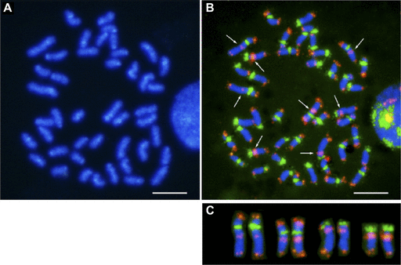
FIG. 7.— Fluorescence in situ hybridization of centromeric and telomeric repeats. (A) DAPI banding of metaphase ...
Notes:
FIG. 7.— Fluorescence in situ hybridization of centromeric and telomeric repeats. (A) DAPI banding of metaphase chromosomes. Chromosome preparation was obtained from peripheral blood leucocytes of fugu. (B) Two-color FISH using the 118-mer centromeric and the telomeric (TTAGGG)n repeats probes. The centromeric and telomeric probes are labeled in green and red, respectively. Arrows indicate interstitial telomere-like sequence (ITS). (C) Confirmation of the ITS localization. These signals are shown on four chromosome pairs of fugu. Scale bar represents 5 μm.
Unless provided in the caption above, the following copyright applies to the content of this slide: © The Author(s) 2011. Published by Oxford University Press on behalf of the Society for Molecular Biology and Evolution.This is an Open Access article distributed under the terms of the Creative Commons Attribution Non-Commercial License (http://creativecommons.org/licenses/by-nc/2.5), which permits unrestricted non-commercial use, distribution, and reproduction in any medium, provided the original work is properly cited.

