Slide 1
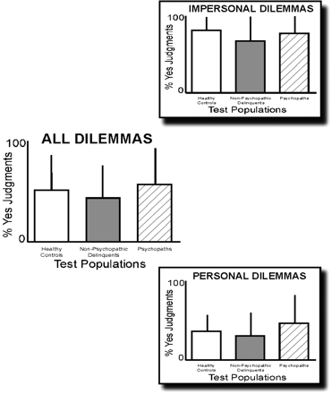
Fig. 1 The left column presents the results for subjects’ judgments of all 21 dilemmas. There were no differences ...
Notes:
Fig. 1 The left column presents the results for subjects’ judgments of all 21 dilemmas. There were no differences between healthy controls (white bar, n = 35), non-psychopathic delinquents (gray bar, n = 23), and psychopaths (hashed bar, n = 14) for the mean proportion (+s.d.) of Yes judgments. The right column presents the results for subjects’ judgments on impersonal (top) and personal dilemmas. Again, there were no differences between groups. However, all three groups judged impersonal dilemmas as more permissible (i.e. a higher proportion of Yes judgments) than personal dilemmas.
Unless provided in the caption above, the following copyright applies to the content of this slide: © The Author(s) (2010). Published by Oxford University Press.This is an Open Access article distributed under the terms of the Creative Commons Attribution Non-Commercial License (http://creativecommons.org/licenses/by-nc/4.0/), which permits non-commercial re-use, distribution, and reproduction in any medium, provided the original work is properly cited. For commercial re-use, please contact journals.permissions@oup.com

Slide 2
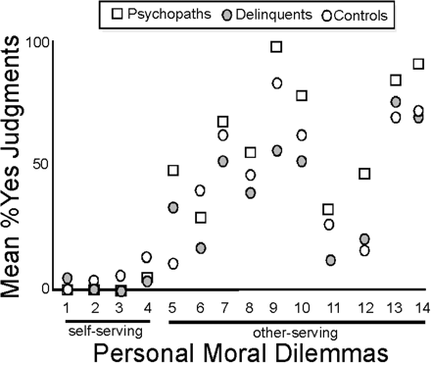
Fig. 2 Scatterplot of subjects’ judgments (mean proportion of Yes responses) for all personal moral dilemmas, ...
Notes:
Fig. 2 Scatterplot of subjects’ judgments (mean proportion of Yes responses) for all personal moral dilemmas, divided into self-serving (far left, first three cases) and other-serving (right, 11 cases) vignettes. Healthy controls are indicated by white circles, non-psychopathic delinquents by gray circles, and psychopaths by hashed squares.
Unless provided in the caption above, the following copyright applies to the content of this slide: © The Author(s) (2010). Published by Oxford University Press.This is an Open Access article distributed under the terms of the Creative Commons Attribution Non-Commercial License (http://creativecommons.org/licenses/by-nc/4.0/), which permits non-commercial re-use, distribution, and reproduction in any medium, provided the original work is properly cited. For commercial re-use, please contact journals.permissions@oup.com

Slide 3
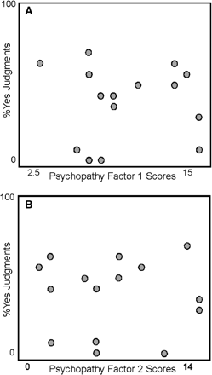
Fig. 3 (A) Scatterplot of psychopathy factor 1 scores for offenders [psychopaths and non-psychopathic delinquents[ ...
Notes:
Fig. 3 (A) Scatterplot of psychopathy factor 1 scores for offenders [psychopaths and non-psychopathic delinquents[ [N = 15*] grouped by the proportion of yes judgments for all personal moral dilemmas. (B) Scatterplot of psychopathy factor 2 scores for offenders [N = 15*] grouped by the proportion of yes judgments for the personal moral dilemmas. *: For 20 individuals, crime files documented the administration of a PCL-R interview. However, these juridical file records only described PCL-R total score without mentioning both factor scores.
Unless provided in the caption above, the following copyright applies to the content of this slide: © The Author(s) (2010). Published by Oxford University Press.This is an Open Access article distributed under the terms of the Creative Commons Attribution Non-Commercial License (http://creativecommons.org/licenses/by-nc/4.0/), which permits non-commercial re-use, distribution, and reproduction in any medium, provided the original work is properly cited. For commercial re-use, please contact journals.permissions@oup.com

Slide 4
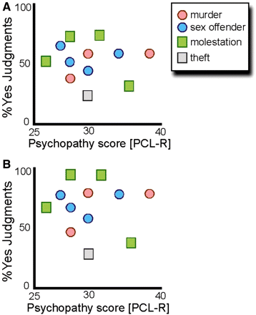
Fig. 4 (A) Scatterplot of psychopathy scores (PCL-R; N = 12*) grouped by type of crime, against the proportion of ...
Notes:
Fig. 4 (A) Scatterplot of psychopathy scores (PCL-R; N = 12*) grouped by type of crime, against the proportion of yes judgments for all personal moral dilemmas. (B) Scatterplot of psychopathy scores (PCL-R; N = 12*) grouped by type of crime, against the proportion of yes judgments for the high conflict, other-serving personal moral dilemmas. *: For two individuals, crime files documented the administration of a PCL-R interview. However, these juridical file records only described these subjects as being a psychopath without mentioning the exact PCL-R score.
Unless provided in the caption above, the following copyright applies to the content of this slide: © The Author(s) (2010). Published by Oxford University Press.This is an Open Access article distributed under the terms of the Creative Commons Attribution Non-Commercial License (http://creativecommons.org/licenses/by-nc/4.0/), which permits non-commercial re-use, distribution, and reproduction in any medium, provided the original work is properly cited. For commercial re-use, please contact journals.permissions@oup.com

