Slide 1
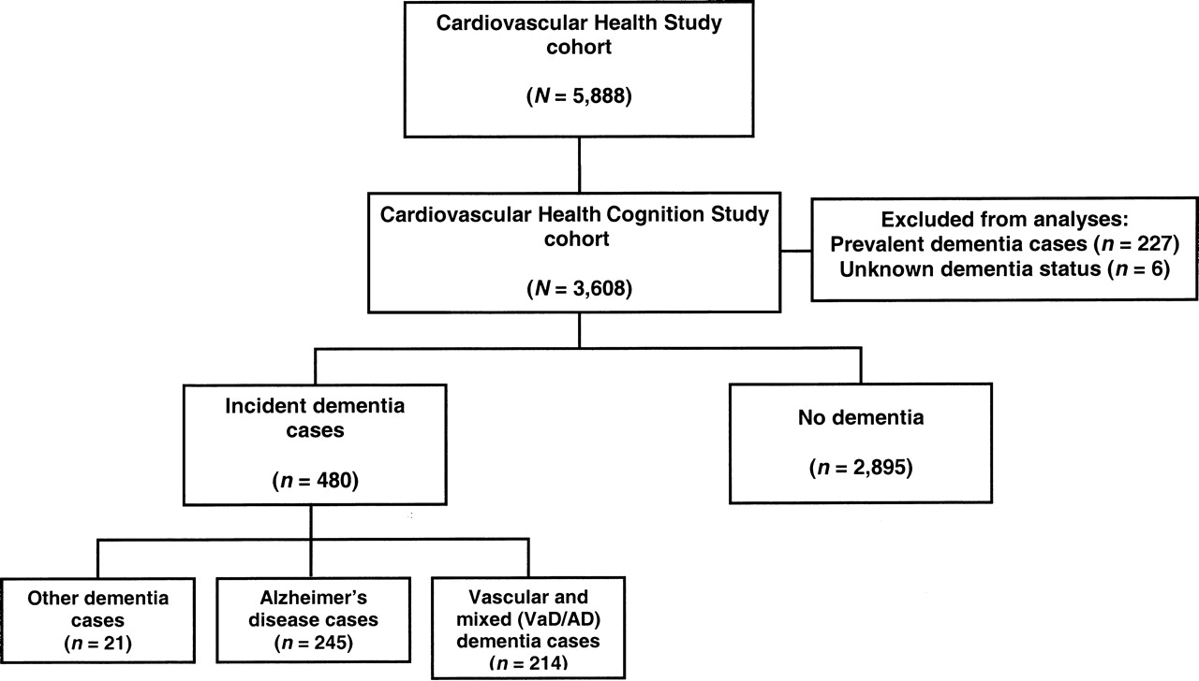
FIGURE 1. Cardiovascular Health Cognition Study sample selection (1992–1993) and follow-up (1999–2000), United States. ...
Notes:
FIGURE 1. Cardiovascular Health Cognition Study sample selection (1992–1993) and follow-up (1999–2000), United States. VaD, vascular dementia; AD, Alzheimer's disease.
Unless provided in the caption above, the following copyright applies to the content of this slide: American Journal of Epidemiology Copyright © 2005 by the Johns Hopkins Bloomberg School of Public Health All rights reserved

Slide 2
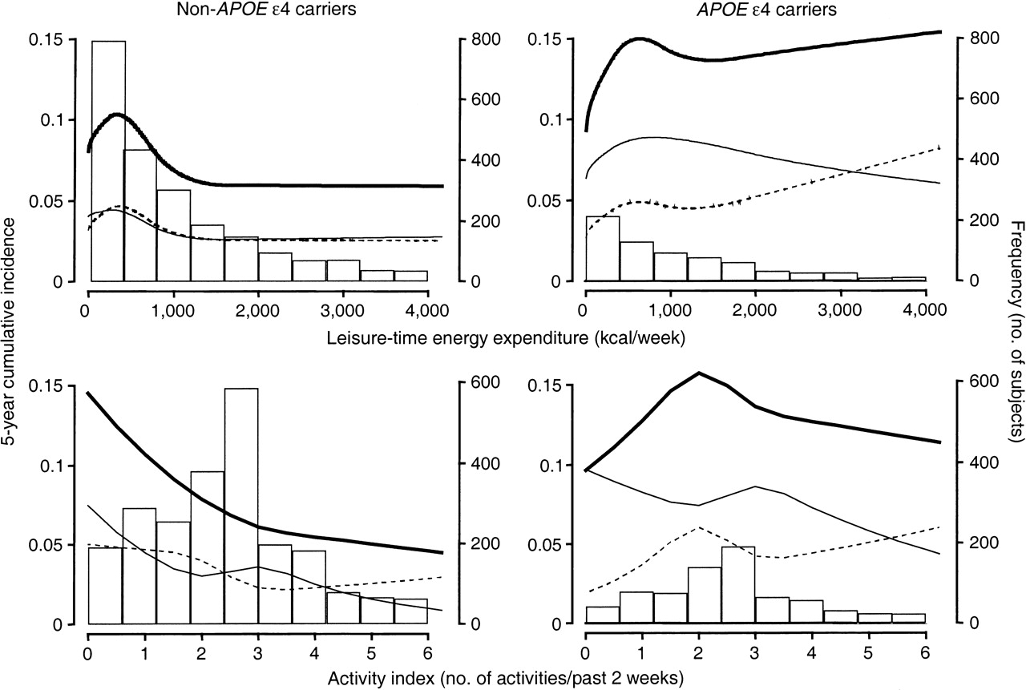
FIGURE 2. Five-year cumulative incidence of dementia as a function of leisure-time energy expenditure or activity index ...
Notes:
FIGURE 2. Five-year cumulative incidence of dementia as a function of leisure-time energy expenditure or activity index among apolipoprotein E genotype (APOE) ε4 carriers and noncarriers, United States, Cardiovascular Health Cognition Study, 1992–2000. Bold curves, all-cause dementia; thin solid curves, Alzheimer's disease; dashed curves, vascular dementia; bars, frequency distribution of physical activity within each APOE genotype stratum.
Unless provided in the caption above, the following copyright applies to the content of this slide: American Journal of Epidemiology Copyright © 2005 by the Johns Hopkins Bloomberg School of Public Health All rights reserved

